Slide 1
Angular 1.6.1 Introduction Lot4 Team
Mustaq Hussain
24th January 2017

Slide 2
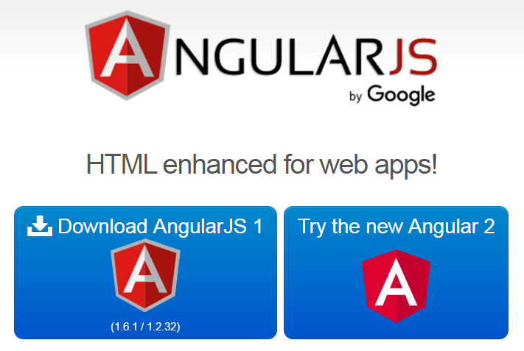
What is Angular 1.6.1?
Angular 1.6.1 JavaScript library
Complete front-end web application framework
Extends HTML DOM with additional attributes
Used in developing single-page applications (SPA)
http://www.w3schools.com/angular/
https://angularjs.org/
https://angular.io/
Angular 2 TypeScript
(future sessions)

Slide 3
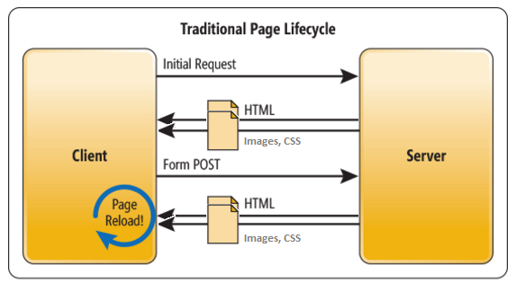
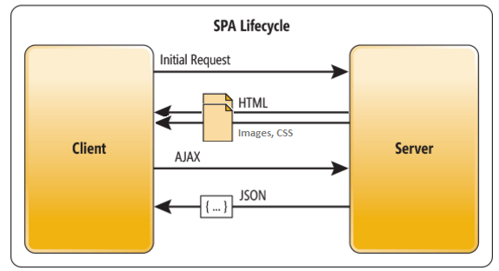
Single Page Application (SPA)
A traditional Web Page typically:
Loads & re-loads whole pages (images, css, js) on every request
Not very efficient on the bandwidth, especially for mobiles
In a SPA:
Load the initial content/main layout
On the fly load a ‘mini-view/page’ & embed in main layout

Slide 4
Angular Full featured SPA Framework
Notes:
Does not require other libraries such as sammyJS, jQuery and historyJS and requires or Ajax

Slide 5
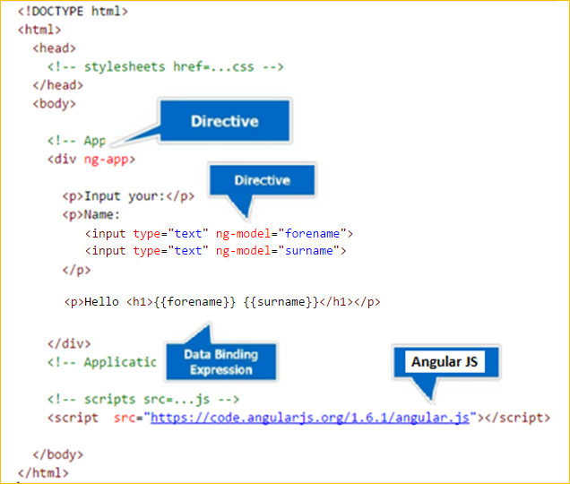
Example 1.html

Slide 6
Directives
ng-prefix – Angular directive are special attributes that extend HTML
Common directives:
ng-app - Starts an Angular application
ng-init - Initializes application data
ng-model - Defines a variable to be used in Angular’s ‘$scope’
ng-repeat - Repeats HTML elements for each item in a collection
ng-view – Include template/view location into main layout

Slide 7
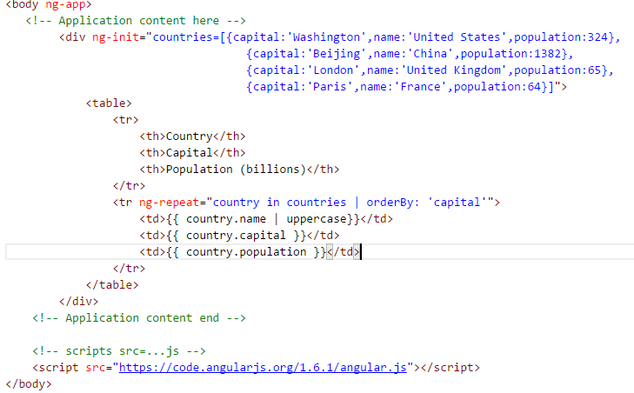
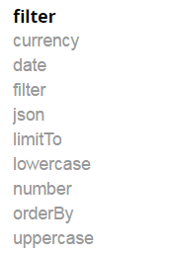
Filters – Example 2.html
Apply a filter to the data model
by using a pipe [|]
separator between
the data binding
statement and
built in filter

Slide 8
Modules are JavaScript Containers

Slide 9
Controller
Angular was using HTML with Directives, Filters and Data Binding.
Should not put business logic into the View because of maintainable and not testable
Controllers are
JavaScript objects
Contain attributes/properties, and functions
Should contain business logic – should drive things
Controls what data gets bound to the View via the $scope object

Slide 10
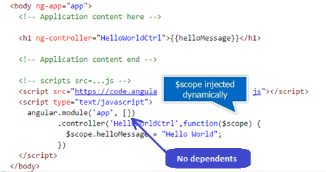
Controller cont.. Example 3.html (left out 4.html)
View does not have to know about the Controller
Controller should not know about the View
(bind to different views - a mobile view, desktop view, .. see routing later)

Slide 11
Routes (e.g. http paths)
A module can have config function which can be used to associate different routes (http paths) with different
views/templates & controllers (SPA)
ng-view directive position where
new view to be added in main layout
From Angular 1.2.0 route
moved to a ‘dependent’
module
Need Express running
to handle http request

Slide 12
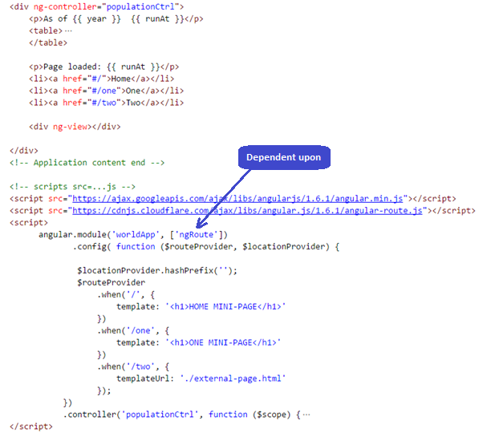
Route Example 5.html

Slide 13
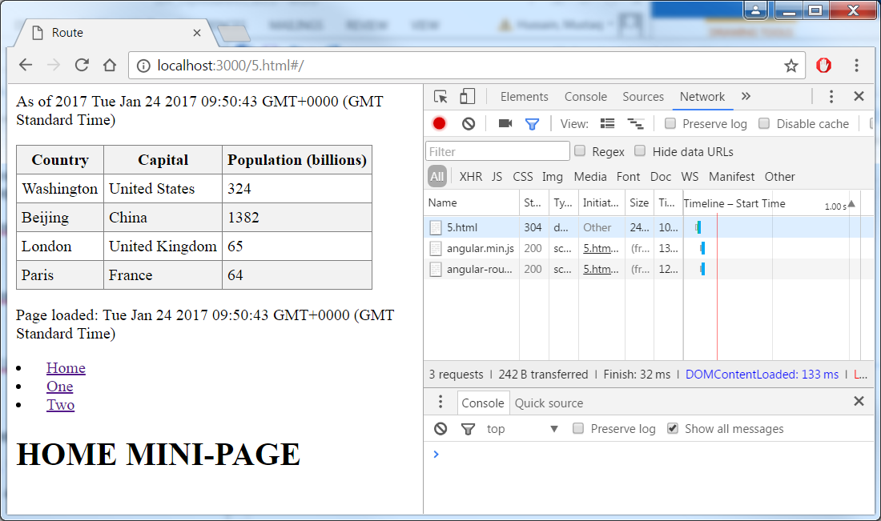
Initial Page Load Traffic

Slide 14
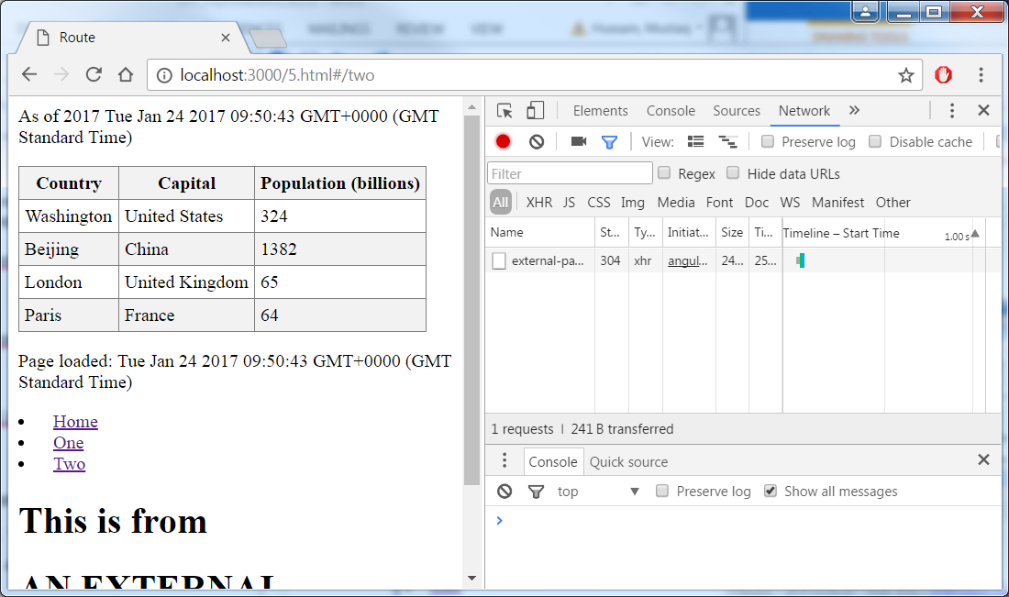
Page load of external-page only

