Slide 1
SQL Express Angular & Node Lot4 Team
Mustaq Hussain
5th April 2017

Slide 2
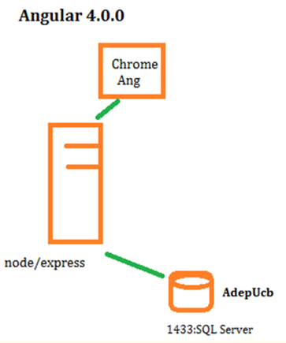
Add Angular to UCB App
Todays session:
Add Angular to UCB
SQL Server
Express
Angular
Node
Use GitHub to clone Quickstart
template

Slide 3
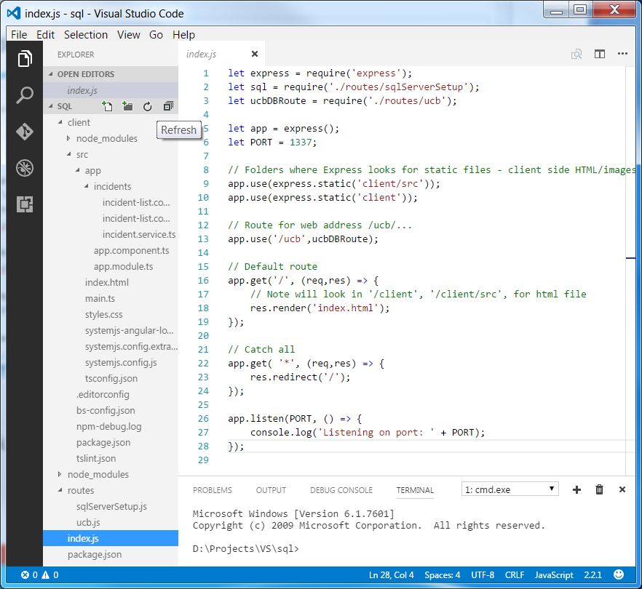
Index.js
index.js
let – local/block scope
var – global/func scope
// Where Server/Express can
// find ‘static’ files –
// html/js/node_modules/pic
app.use(express.static(..));
// Route hander
app.use(‘/bla’, blaModule);
Integrated Terminal – 1.cmd
EXPLORER pane – create/refresh
nodemon

Slide 4
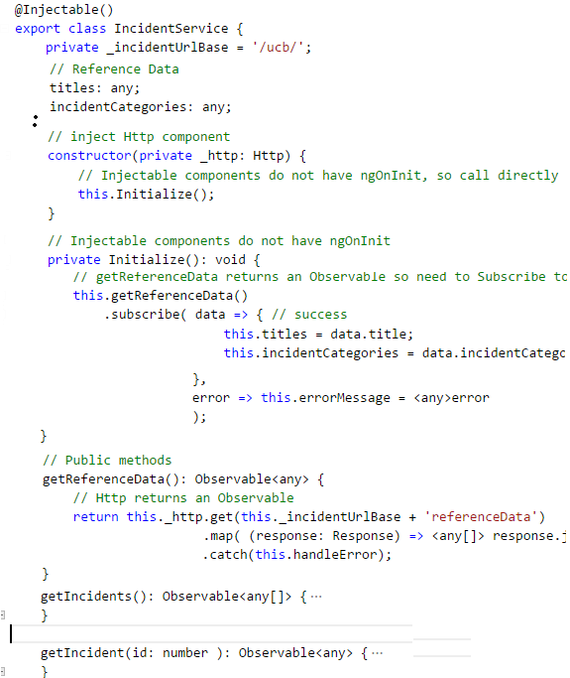
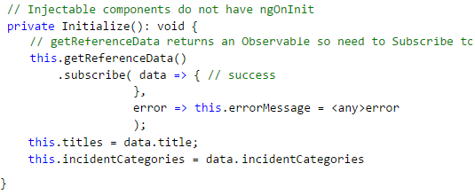
Injectable Incident Srv
IncidentService – one instance
– Common/shared ref data public available to caller
- Public methods to
- No ngOnInit (only for @Component)
What is wrong with below code?

Slide 5
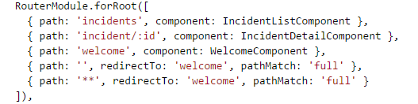


Angular Routing – on the Browser
Define route paths:
Which Component are serviced by particular paths
RouteLinks

Slide 6
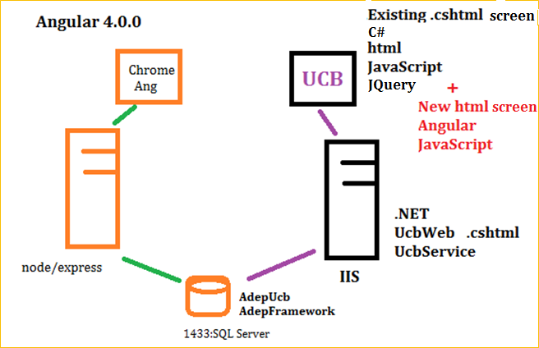
Coming up… Angular 4.0.0 with .NET
UCB and Angular 4.0.0
.NET version of UCB with Angular screens

