Slide 1
Azure Load Balancer VM Scale Set Autoscaling
Mustaq Hussain
7th August 2017

Slide 2
Managed Image of VM (S18 correction)
Capture image of VM including
OS, installed software
NOT sku: cores, memory…
Steps:
Deprovision (remove account info)
Stop (deallocate)
Create image
Use image to create new VMs
Cannot do in Portal (maybe in future)
Must use either
PowerShell cmdlets
Command Line Interface (CLI)

Slide 3
Session 19 Outline
Linux
Gold Image
Load Balancer
VM Scale Set
Autoscaling

Slide 4
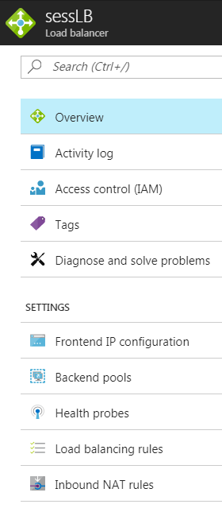
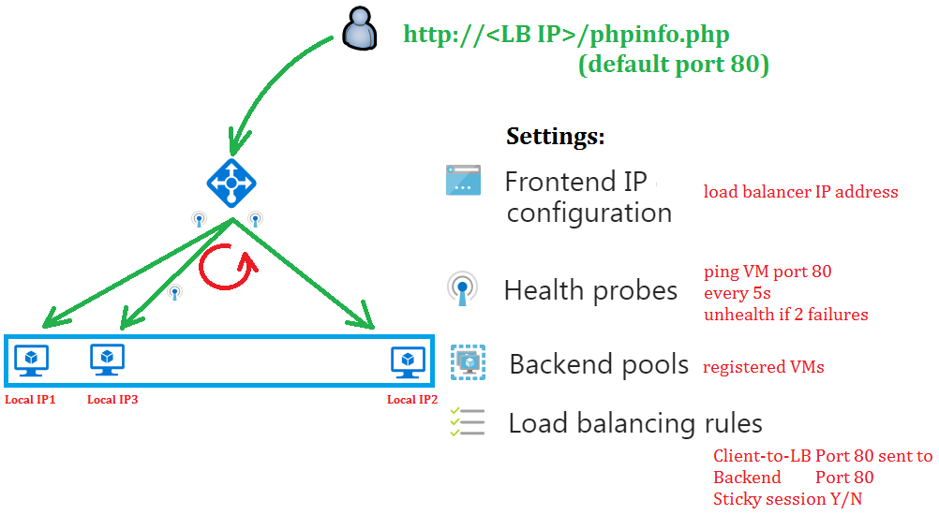
Azure Load Balancer
Kkkk

Slide 5
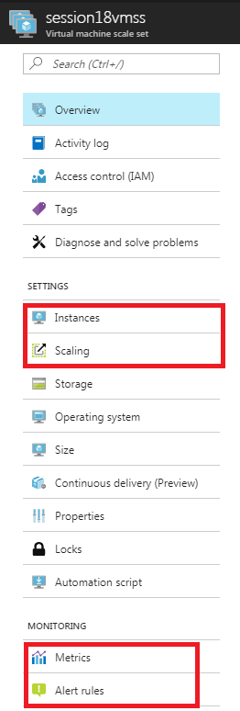
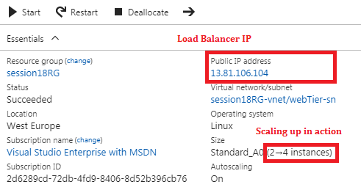
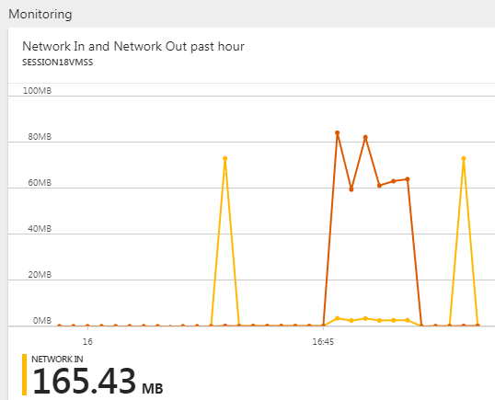
Virtual Machine Scale Set (VMSS)
Virtual machine scale set: Azure resource used to
Deploy & manage set of identical VMs (instances)
VMs provisioned from an image
Supports autoscaling (in/out)
Create/attach a Load Balancer

Slide 6
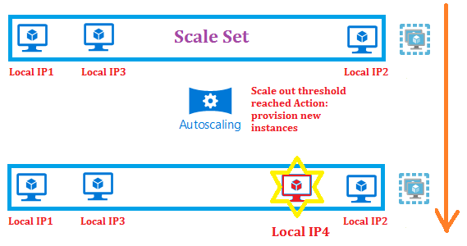
Auto Scaling
Create/delete
VMs depending on
CPU
Network traffic
Day/Time of day
Manually
For high availability deployed across fault domains
Set limits
0 -> 1000 VMs

Slide 7
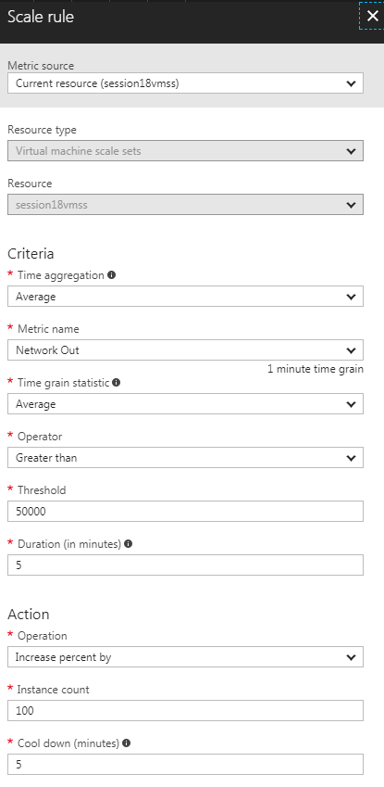
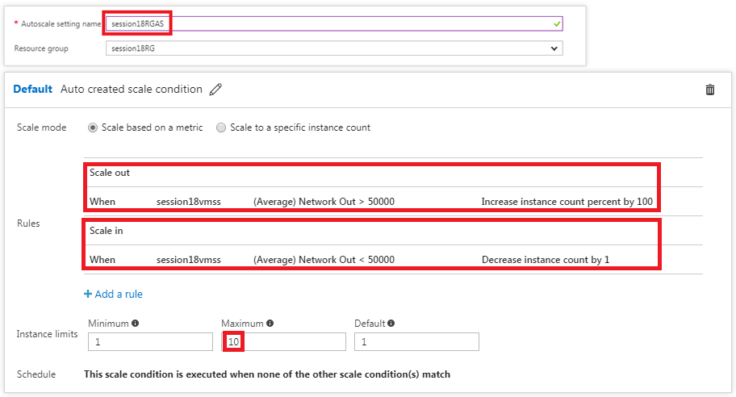
Auto Scaling in Azure
Scale out: if Traffic > 50,000 by 100%
Scale in: if Traffic < 50,000 by 1 instance
Scale out quickly, Scale in slowly

Slide 8
Command Line Interface (CLI2)
az login
az vm create
az vm deallocate
az vm generalize
az create vmss

