Slide 1
.Net 4.5.2 & Angular 4.0.0 Lot4 Team
Mustaq Hussain
13th April 2017

Slide 2
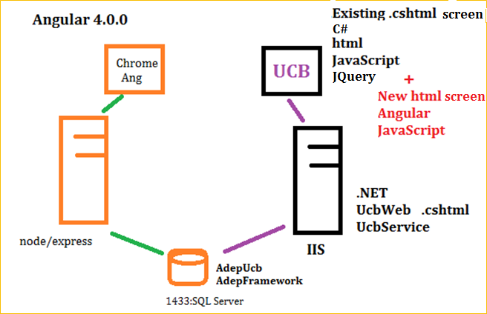
Angular 4.0.0 with .NET 4.5.2
UCB and Angular 4.0.0
.NET version of UCB with Angular screens

Slide 3
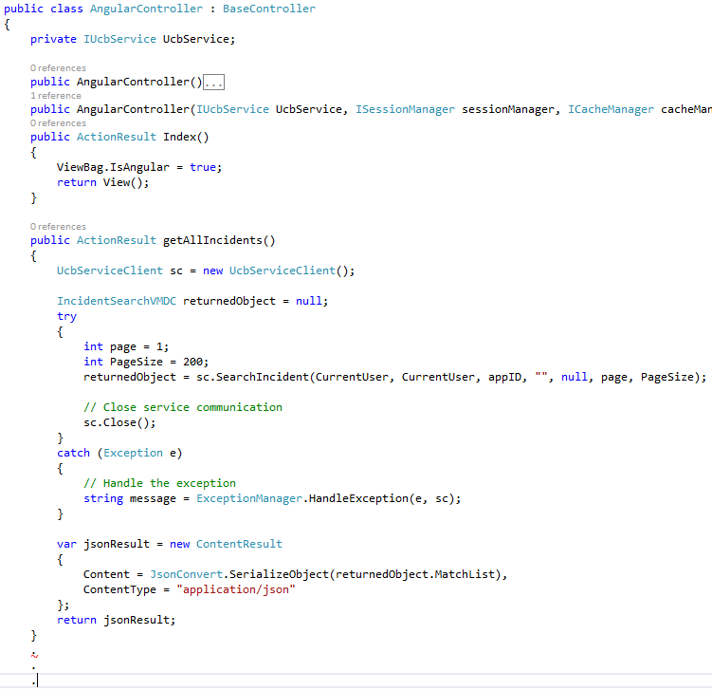
.Net Controller
Inherits from BaseController
Should be familar
Mapping actions/methods:
http://ucb/Angular
Index() -- default
http://ucb/Angular/getAllIncidents
getAllIncidents
Call service layer/ DB using
UcbServiceClient
sc.SearchIncident
Angular expects JSON
jsonResult

Slide 4
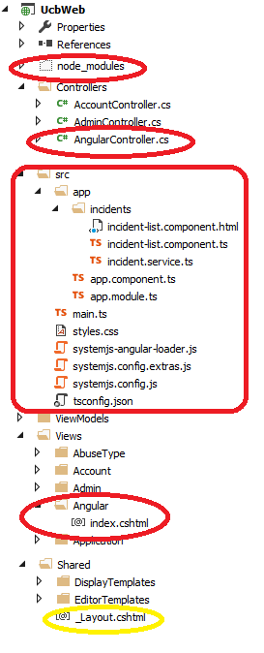
UCBWeb Changes
Some of the file changes
New Controller
New View
Updated _Layout.cshtml
(all pages inherit this)
New src Angular components
New node_moudules

Slide 5
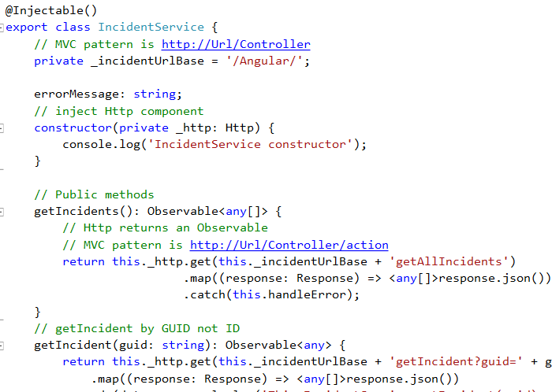
Angular Incident Srv calls .Net Controller Actions
IncidentService IncidentService
– Url Base – Which controller
- Url Action – Which methods of controller
Sev
.NET Controller/Actions

