Slide 1
Angular 1.6.1 pt3 Lot4 Team
Mustaq Hussain
8th February 2017

Slide 2
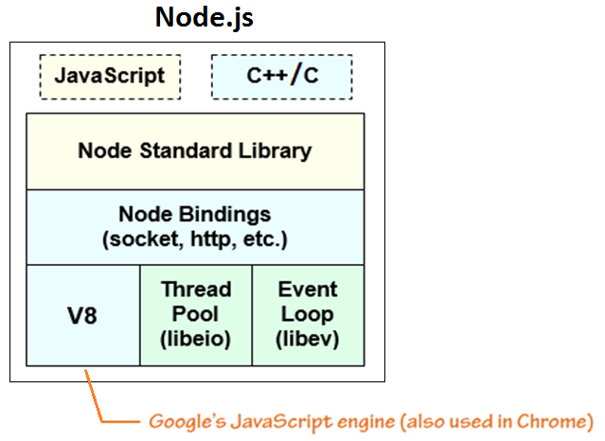
Recap Node.js - V8 (JavaScript Engine)
Browser | JavaScript Engine
Mozilla | Spidermonkey
Chrome | V8
Safari | JavaScriptCore
IE and Edge | Chakra
Node.js | V8

Slide 3
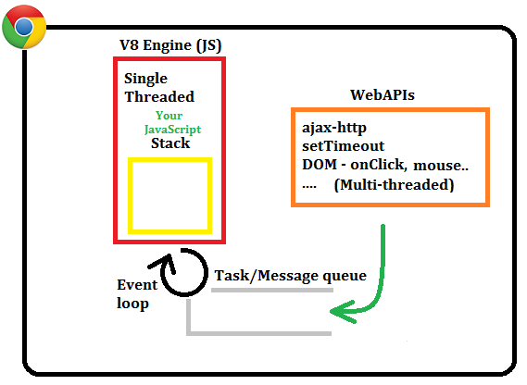
Google’s Browser Chrome - V8 (JavaScript Engine)
V8 JavaScript Engine
WebAPIs
Event Loop
Poles (every ‘tick’) ‘Stack’ - if empty
Move Task from ‘Task queue’ to ‘Stack’
Task/Message queue
Task/Message callbacks
Example: partial script
...
foo();
http(url,callback(rec){
console.log(rec);
});
bar();
baz();

Slide 4
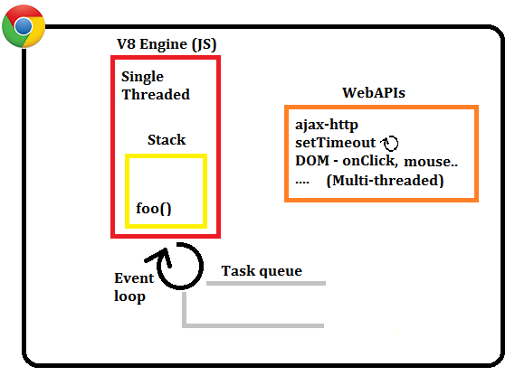
Chrome – 1st function pushed onto stack
foo(); -- push onto Stack
http(url,callback(rec){
console.log(rec);
});
bar();
baz(); note: previous
setTimeout
still running
Notes:
Foo on stack
Note setTimeout set previously still running

Slide 5
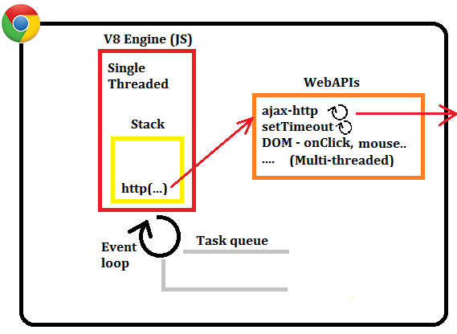
Chrome – http on stack – invokes WebAPI
foo();
http(url,callback(rec){ -- push onto Stack, which invokes WebAPI
console.log(rec);
});
bar();
baz(); e.g. call to
external site
Notes:
http on stack
Invokes WEBAPI
WEBAPI uses url to call external website url and registers callback

Slide 6
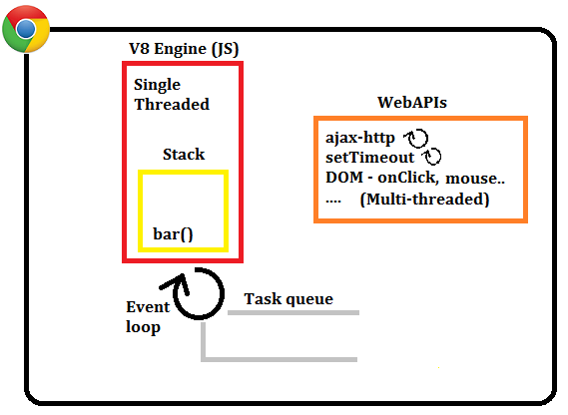
Chrome – bar() on stack, http request running
foo();
http(url,callback(rec){ -- WebAPI http still processing
console.log(rec);
});
bar();
baz();
Notes:
Bar on stack
WebAPI still waiting for results

Slide 7
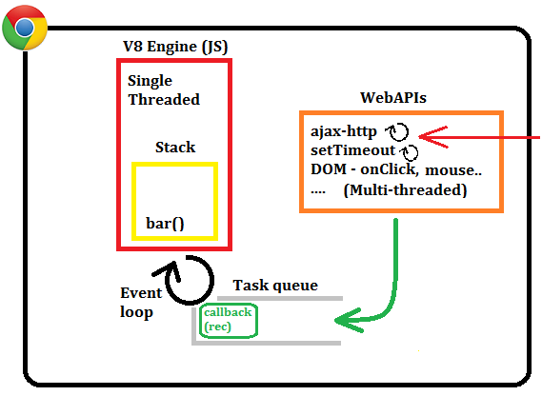
Chrome – http results returned add callback to queue
foo();
http(url,callback(rec){
console.log(rec);
});
bar();
baz(); http results returned
and
callback pushed onto
Task queue
Notes:
While bar executing
http results come back
WebAPI pushes callback onto Task/Message queue

Slide 8
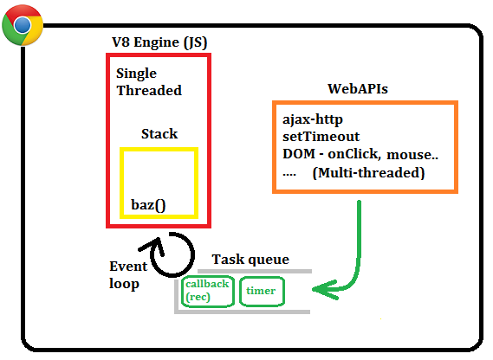
Chrome – setTimer callback added to queue
foo();
http(url,callback(rec){
console.log(rec);
});
bar();
baz();
Different WebAPI
callback added to queue
Notes:
Bar added to stack
Same time setTimer callback completed and add to Task Queue

Slide 9
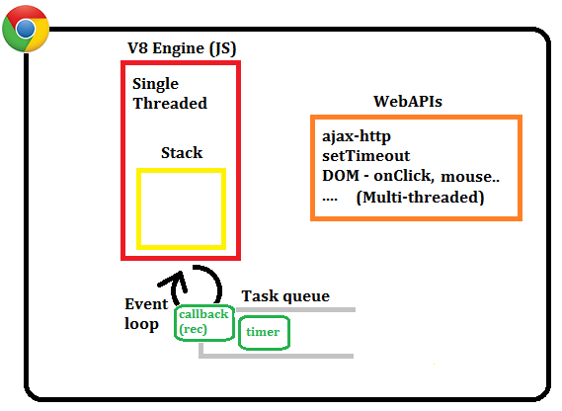
Chrome – Stack empty Event loop moves callback
foo();
http(url,callback(rec){
console.log(rec);
});
bar();
baz();
Finally Stack empty
Event loop moves
1st Task onto Stack
Notes:
User script complete. Stack empty
Event loop pops 1st task off queue and move to stack

Slide 10
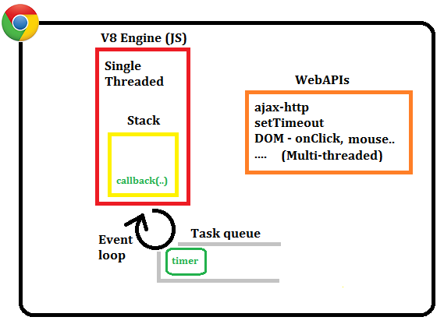
Chrome – http callback(…) on stack
foo();
http(url,callback(rec){
console.log(rec);
});
bar();
baz();
Notes:
Callback fires

Slide 11

Chrome – console.log added to stack
foo();
http(url,callback(rec){
console.log(rec);
});
bar();
baz();
Notes:
Console log put onto stack - pulled off
Callback pulled off
Timer then put on stack

Slide 12
WebAPI Events
In user’s JS can register events/callbacks associated with a DOM element (i.e. button, text, image...):
Click (onClick(…))
Focus
Blur
Hover
callback get moved to task queue when user interacts with browser (DOM)
Other events (also in Node.js)
http request
databaseConnect
databaseQuery
readFile
User defined events

Slide 13
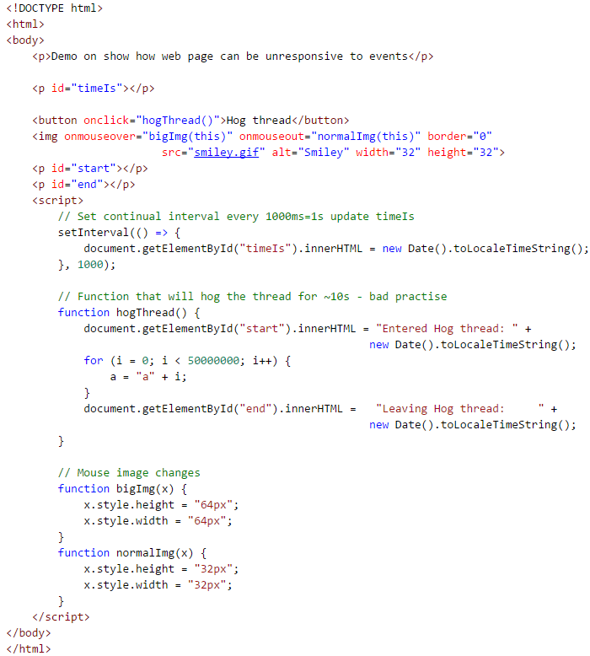
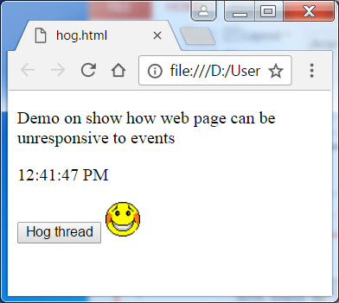
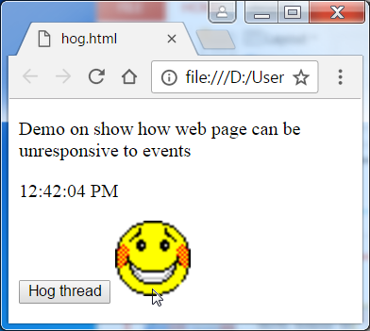
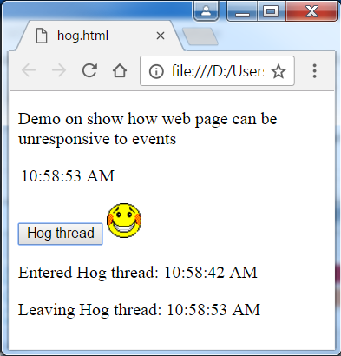
Hog.html - demo
Time updated ever 1s
Face expanded onmouseover event
But has a hasty function
hogThread(), which will render page
Unresponsive for 10s

Slide 14
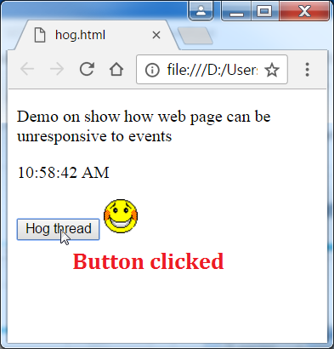
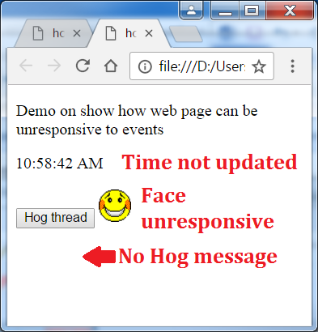
Unresponsive Page
Hog button clicked………………….5s later (still no visual change)….....11s later
hogThread() on stack hogThread() still on stack page unresponsive for 11s!
timer callback on queue (not acceptable for users)
DOM ‘Entered’ message queued ‘Entered’ & ‘Leaving’ mess seen (almost) simultaneously – even though times 11s apart

Slide 15
Promise - asynchronous functions
A Promise is associated with asynchronous functions
The asynchronous function returns immediately but ‘promises’ that a
successful result value or
reason for failure
will be available at some point in the future
A Promise can be in one of 3 states depending on asyn operation:
Pending - outcome hasn’t yet been determined yet.
Fulfilled - operation has completed and the promise has a value.
Rejected - operation failed with a reason for failure.
(Callbacks are good for simplified Promises, without states)
Promises make it easier to handle multiple asynchronous calls

Slide 16
Promise - call
A Promise’s ‘then’ method registers callback to receive either the eventual value or the reason why the promise cannot be fulfilled
asyncCall(args).then( successCallback,
[errorCallback optional],
[notifyCallback optional]
);
For example the $http Angular service is a function which takes a single argument is used to generate a HTTP request and returns a promise.
$http.get('/someUrl').then(successCallback, errorCallback);

Slide 17
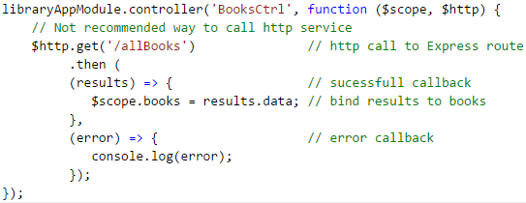
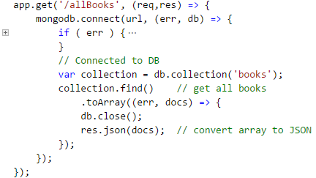
allBooks - $http Promise 1st approach
$http Promise from Controller (not recommended approach)
Better design: Defer logic in Controller
to Service (Business) Layer. Why?
Code re-use, common functions can used by different Controllers
Service Layer logic easier to isolate in a unit test
Removes dependencies & hides implementation details (file/http//mock data)
Keeps Controller slim and focused

Slide 18
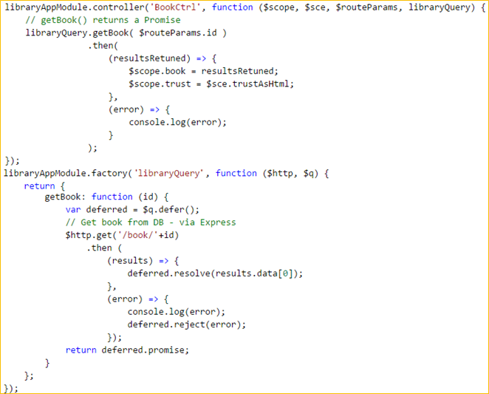
getBook(id) – Recommended design approach Delegate to Service Layer (user Promise)
Controller calls
Service Layer function
getBook() returns a user
defined Promise funct.
(Controller not aware
where/initial structure of results;
$sce.trustAsHtml (No XSS)
Service Layer
calls $http Promise
Angular’s $q service
allows you to write
your own custom Promises –
getBook() returns user Promise
Notes:
Controller needs to know returned results structure – dependency
Results contains html tags – tell Angular we trust it

