Slide 1
Angular 2.4.0 pt23 Lot4 Team
Mustaq Hussain
16th March 2017

Slide 2
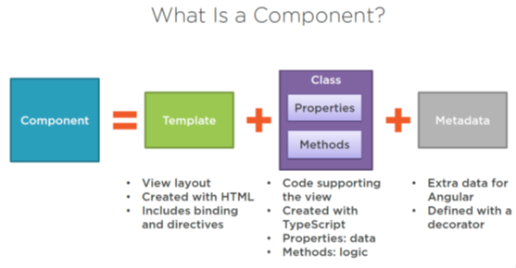
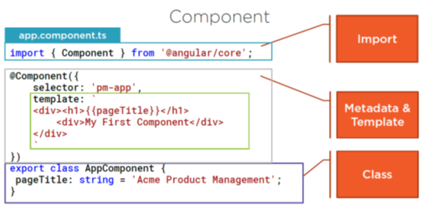
Recap - Component (default AppComponent)
A component contains application
Logic that controls a region of the
View (user interface)

Slide 3
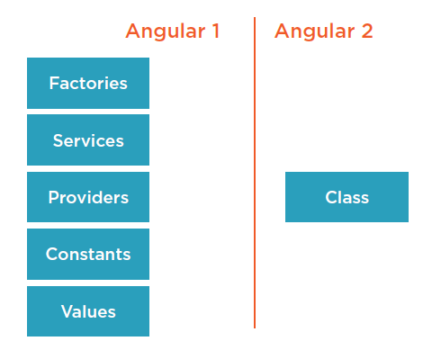
Recap - Services
A Service is a class that has a focused purpose
Shares functions or data
Eg Data layer, Logger, Message Service, Library Service
Angular 2 simplified services
compared to Angular 1
Dependency Injection
Register with a provider
Inject into constructor

Slide 4
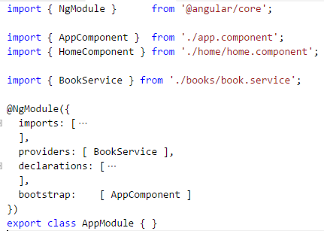
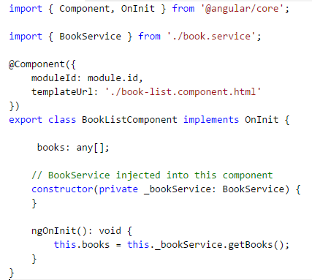
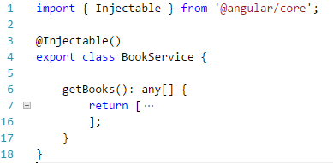
Example
Register – BookService Inject BookService into constructor
BookService - Injectable

Slide 5
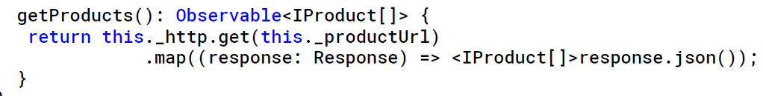

Retrieving Data with Http – Observable, RxJs
ServiceLayer
Make Http call
Angular 2 returns either a Promise or Observable
Promise – gets a single (complex) value
Observable – emits multiple values over time – map results
Calling Component
Subscribe to the Observable, success failures
Reactive Js (RxJs)
Implements asynchronous Observable pattern (not part of Angular 2 – yet)

Slide 6
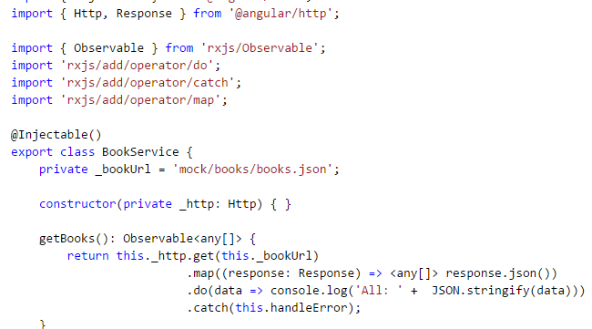
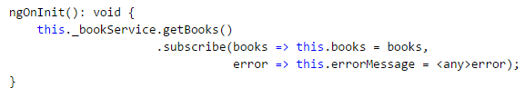
Example
BookService – rxjs imports, returns Observable (map results)
BookListComponent - subscribe to
Observable
Note Http injected into BookService

Slide 7
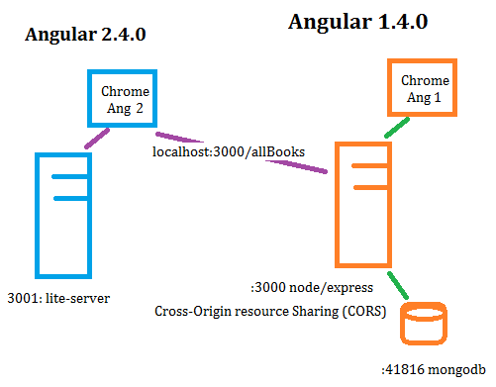
Connect to DB

