Slide 1
Node & SQL Server Lot4 Team
Mustaq Hussain
30th March 2017

Slide 2
Recap – Anon Functions => (fat arrow)
// 1. function definition - has keyword 'function'
function double(x) { double(20)---> 40
return 2*x;
}
// 2. function expression - variable assigned the function named ‘double’
var d = function double(x) { d(5) ----> 10
return 2*x;
};
// 3. function expression
// anonymous function - no name after 'function'
var m = function (x) { return 2*x; }; m(6) ---> 12
// 4. New syntax ES6 for anonymous functions, arrow syntax/lamda syntax
var e = x => { return 2*x; } e(10) ---> 20
var e = x => return 2*x;

Slide 3
Anon Function example
Subscribe to Observables (alternatives to Promises) pattern, for example getAllBooks() ‘gets’ all books via a Http call.
Calls are asynchronous – invoke the call then do next statement (DOES NOT WAIT for results)
function successCallbackA (s) { ....}
function errorCallbackB (e) { ....}
bookService.getAllBooks()
.subscribe( successCallbackA(s),
errorCallbackB (e)
);
bookService.getAllBooks()
.subscribe( function success(s) {….},
function error(e) {….}
);

Slide 4
Anon Function example conti
Anon functions as ES6
products: IProducts[]
productService.getProducts()
.subscribe( function success (products) {
this.products = products;
},
function error ( e ) {..}
);
productService.getProducts() // Anon functions
.subscribe( function ( products ) {
this.products = products;
},
function ( e ) {..}
);
productService.getProducts() // ES6 fat arrow
.subscribe( ( products ) => {
this.products = products;
},
( e ) => {..}
);
// Single line remove productService.getProducts() // brackets
.subscribe( ( products ) => this.products = products,
( e ) => {..}
);
productService.getProducts() // Remove param brackets
.subscribe( products => this.products = products,
e => {..}
);

Slide 5
MS Hot Keys – Use and Remember These!!!
Word/Excel/…Notepad/SQL Server/Visual Studio
Ctrl + C Copy
Ctrl + V Paste
Ctrl + A Select all
Ctrl + F Find
Developer hot keys
F5 Run/Execute (SQL execute highlighted text or all)
F10 Step over
F11 Step into
Ctrl+K Ctrl+C Comment out code
Ctrl+K Ctrl+U Un-comment out commented code
http://www.tech-recipes.com/rx/47195/11-keyboard-shortcuts-every-sql-server-geek-should-know/

Slide 6
Microsoft SQL Server Client for Node.js - mssql
https://www.npmjs.com/package/mssql
Supports
Query – SELECT/UPDATE
Stored Procedures
Transactions
Azure

Slide 7
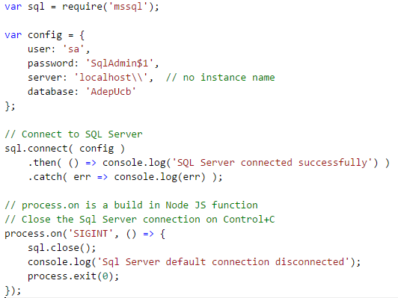
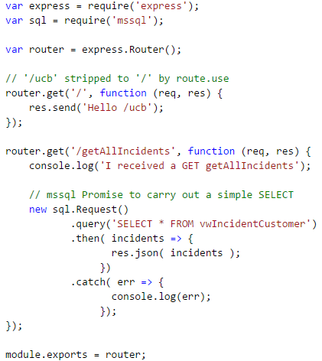
Simple example
1. Connect to DB 2. Simple Query

Slide 8
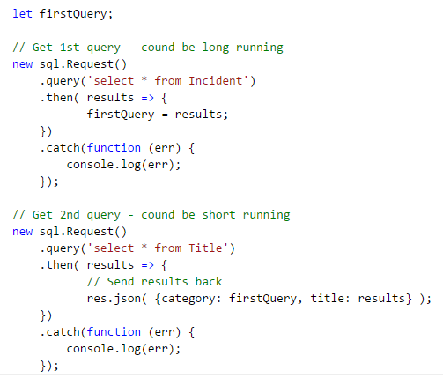
Multiple queries
What are the problems with this?
2nd query could complete
before 1st query
Incomplete information could
be returned
Results treated as though
synchronous
Repeated ‘query’ pattern

Slide 9
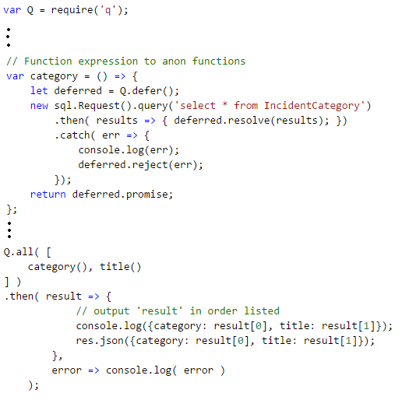
Promises (q module) to collate results
Use Promises to collate results
Install q (via npm)
Function exp. category() & title()
both return Promise
Q.all function:
[ list of promises ]
then – when ALL promises have been
fulfilled, carry out actions
(results is an array in order
of list)

Slide 10
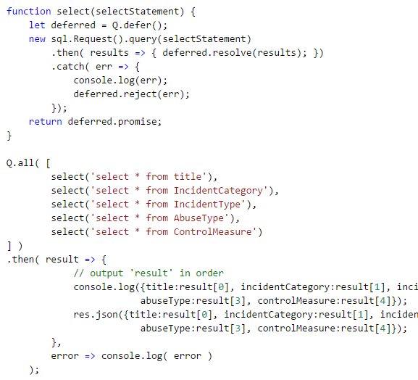
Improve design
Turn repeated
function expression
(category() & title()) queries
into a common function
and pass query in as a
parameter

Slide 11
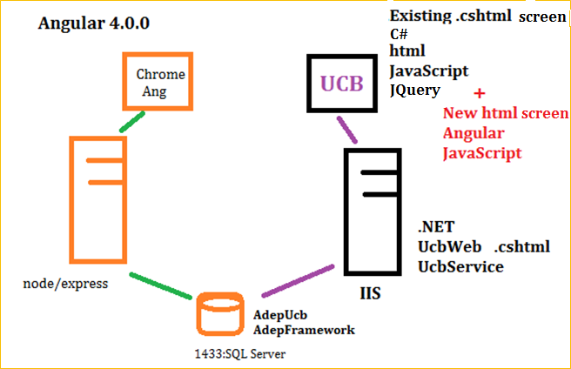
Coming up… Angular 4.0.0 with .NET
UCB and Angular 4.0.0
.NET version of UCB with Angular screens

