Slide 1

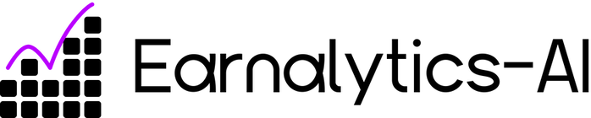
TRUSTED PARTNER IN COMPENSATION PREDICITION
AI-Powered Salary Prediction
Enhancing fairness in salary prediction and budgeting through AI technology

Slide 2

Accenture's Business Background
Accenture is a leading provider of IT services.
Founded in 1989, its headquarters are in Dublin.
It operates in more than 200 cities and 120 countries
The company provides services in various sectors
Accenture is currently facing financial challenges
The report shows that some workers are undercompensated while others are overcompensated
This has affected project management and employee satisfaction
Accenture's main objective is to address this issue

Slide 3
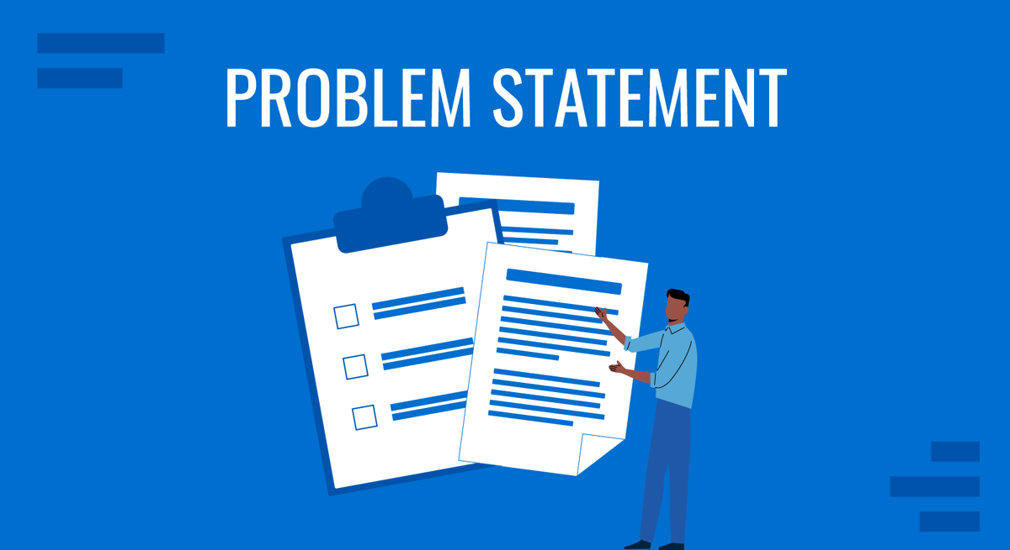
Accenture’s
Problem Statement
Setting fair salaries is crucial for stability and morale
Current methods rely on outdated systems and human judgment
Leads to unfairness and inefficiency
Budget planning struggles by HR
Employees lack transparency and fairness
Low trust from employees

Slide 4

Solution
Utilizing AI to ensure fair and accurate salary assessments
Earnalytics is a salary prediction AI designed to support financial planning and equitable compensation. It estimates salaries using age, gender, years of experience, and education. For managing company budgets, this AI enables accurate payroll forecasting while advancing fairness and transparency. This not only guards against underpayment but also improves financial stability and strengthens trust between management and staff.

Slide 5

Community Impact of Fair Income
Promoting equality through fair pay distribution
Beyond individual companies, fair and transparent salary allocation reduces income inequality, promotes workforce stability, and strengthens economic growth in the wider community. It empowers employees, increases local spending, and fosters sustainable industry practices. The company will be able to give back to the community in terms of hiring more people and also offering subsidized services for them.

Slide 6
Business Objectives Overview
Accuracy target
Achieve 65% accuracy in salary predictions for better budgeting.
Equity reduction
Aim for a 15–20% reduction in salary inequities across demographics.
Focus on key targets for success and equity in salary predictions.
Salary range match
Ensure 5% salary range match for fair compensation practices.

Slide 7
Employee Data
Data Requirements Overview
Accurate records of employee demographics and salaries are essential.
Finance Records
Historical financial data aids in predictive salary modeling and budgeting.
Essential resources needed for Earnalytics implementation and functionality
HR Experts
Skilled HR professionals ensure ethical data handling and compliance.

Slide 8

Constraints and Risks
Understanding POPIA and bias concerns in AI
The Protection of Personal Information Act (POPIA) ensures data privacy while using AI tools. Addressing potential bias replication in AI models is crucial for maintaining fairness in salary predictions and ensuring equitable treatment across all demographics.

Slide 9
Tools
• Programming
• Python libraries
Sk-learn | Matplotlib | joblib
Numpy | Pandas | Random
CustomKinter | NLTK
GitHub Developer Platform
Git | Python IDE | AI programs
Word | Canva | Excel | PowerPoint
Photoshop | Grammarly

Slide 10
TECHNIQUES
Data Cleaning
Converting blank values to NaN.
Model training
Train-test split
One hot encoding
Removing instances with blank values
55% for training
45% for testing
Linear Regression
Simple
Data is numerical and not categorical
Fast and efficient

Slide 11
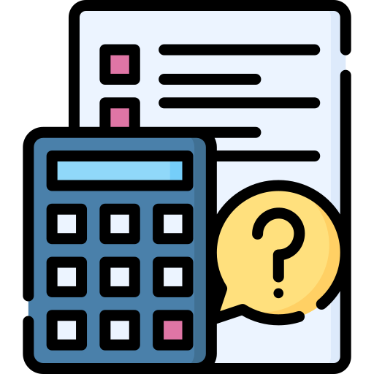
EVALUATION METRICS
• Prediction Score
NUMERICAL ACCURACY OF THE MODEL
•Mean absolute error
AVARAGE DIFFERENCE BETWEEN DATASET AND MODEL
• Mean square error
MEASURES ERRORS
•Median absolute error
MEASURES THE AVARAGE OF ERRORS
• Explain variance score
EVALUATES THE PERFORMANCE
• R2Score
MEASURES HOW WELL MODEL PREDICTS APPROXIMATE DATA

Slide 12
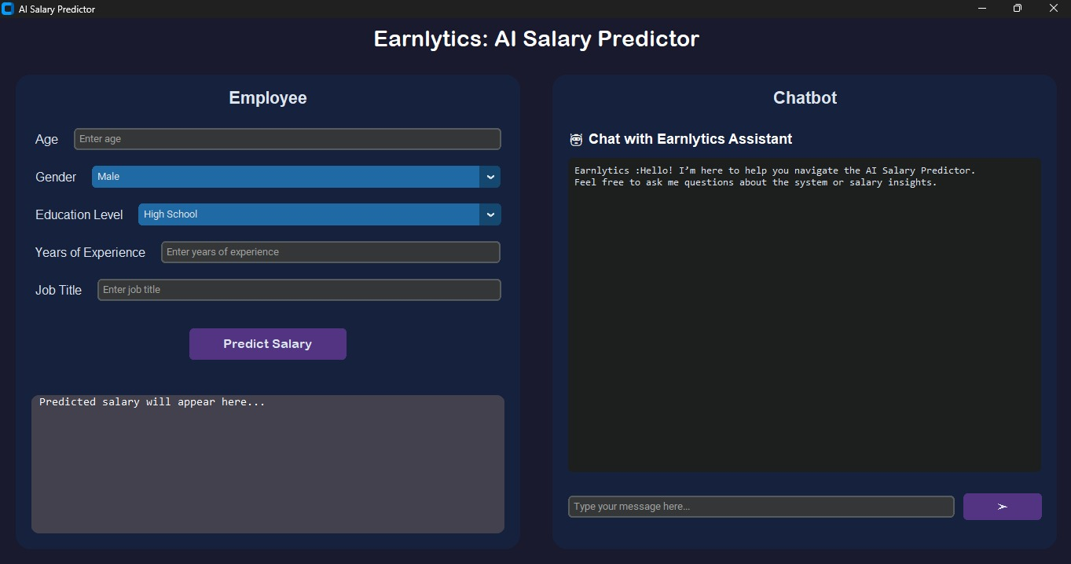
Graphic user interface(GUI)

Slide 13

Any questions about Earnalytics?
We’d love to hear your thoughts and insights!

