Slide 1
Blind Stick
CSE 3216
Microcontroller Based System Design Lab
Instructors
Farzad Ahmed
Lecturer, CSE , AUST
Ashna Nawar Ahmed
Lecturer, CSE, AUST Department Name: Computer Science & Engineering

Slide 2
Presented By
Mustavi Ibne Masum
-180204040
Abdullah Al Noman
-180204042
Yumna Islam
-180204046
Farhana Azad
-180204068

Slide 3
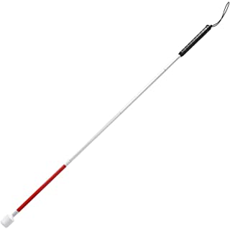
What is a blind stick?
A device for the visually impaired to guide the user to respective destination and avoiding to collide with the obstacle.

Slide 4
Objective
A device for the visually impaired.
Need to update traditional stick using today’s technology.
Provides sound based assistance to blind people.
Focuses on designing a device that helps to travel independently and comfortable to use.

Slide 5
Social Values
Blind stick decreases dependency of blind people on others
Proposes a low-cost smart blind stick which will be economical for many blind people
Makes it easy and safe for them to move outside

Slide 6
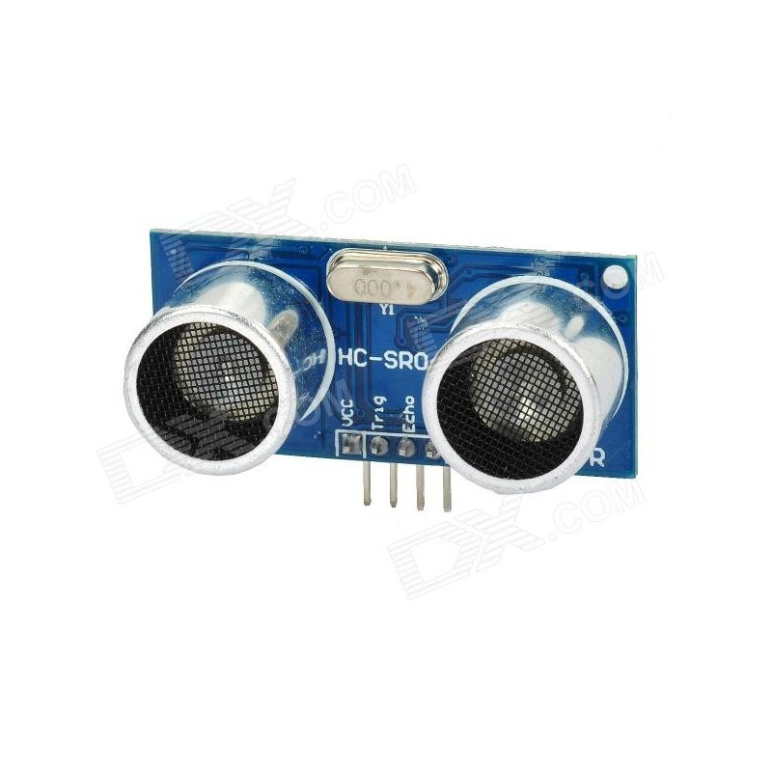
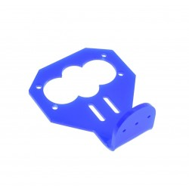
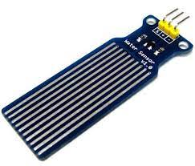
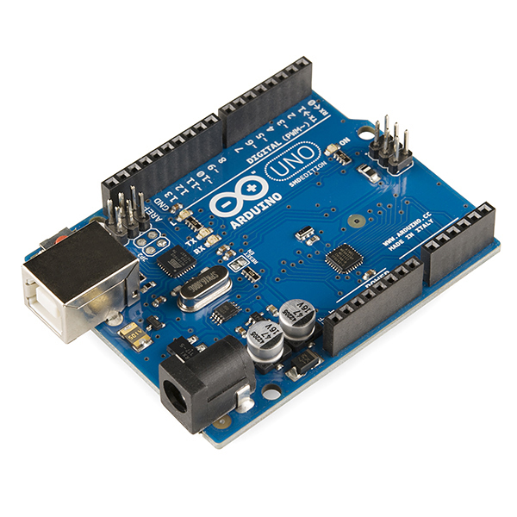
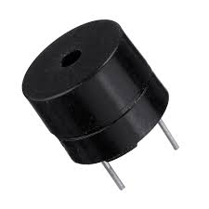
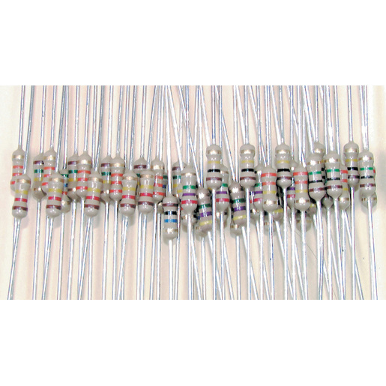
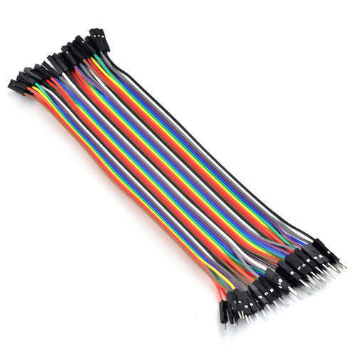
Components
HC-SR04 Ultrasonic Sensor
Ultrasonic Sensor Mount
Water Sensor
Arduino Uno R3
Resistors
(100ohm,300ohm)
Jumper Wires
(M-M,M-F)
Buzzer

Slide 7
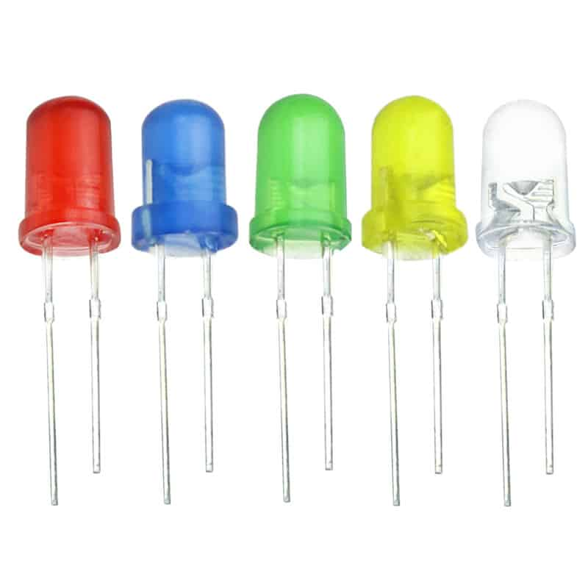
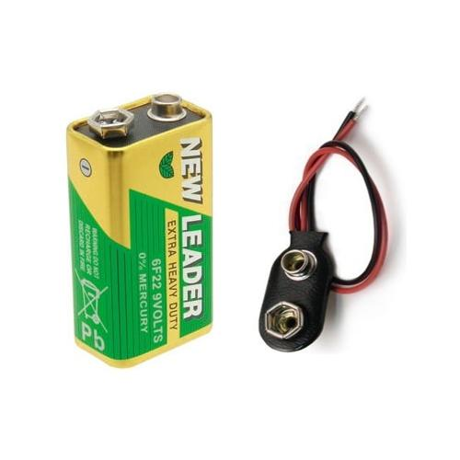
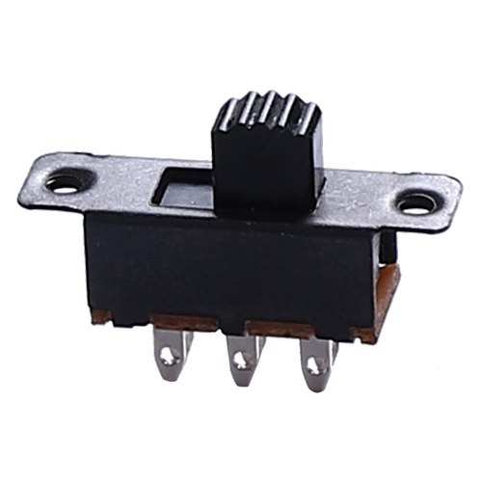
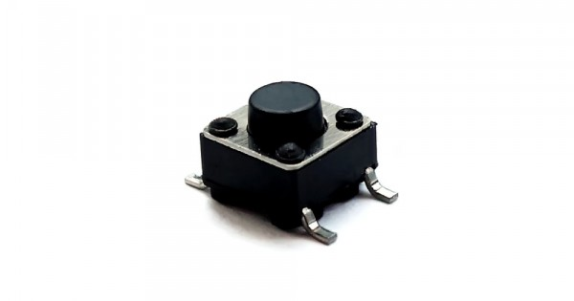
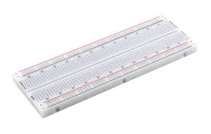
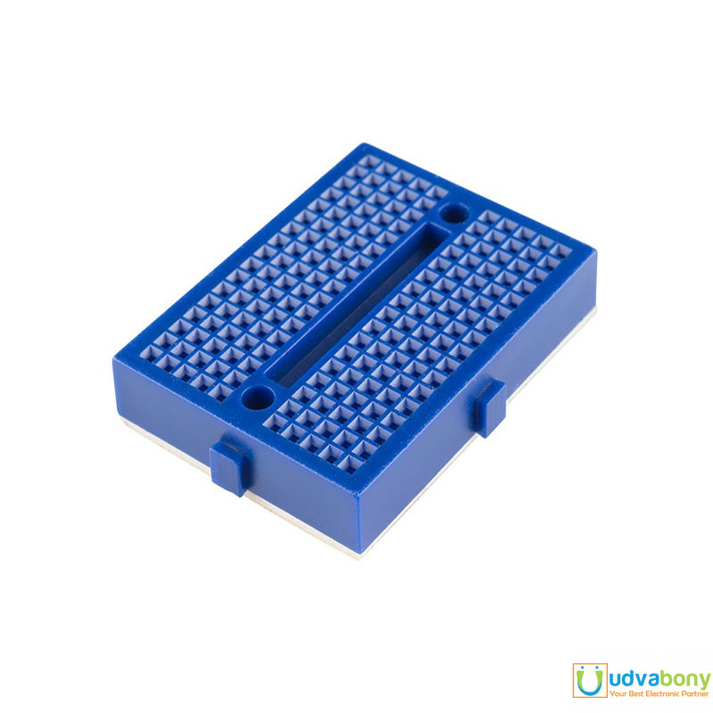
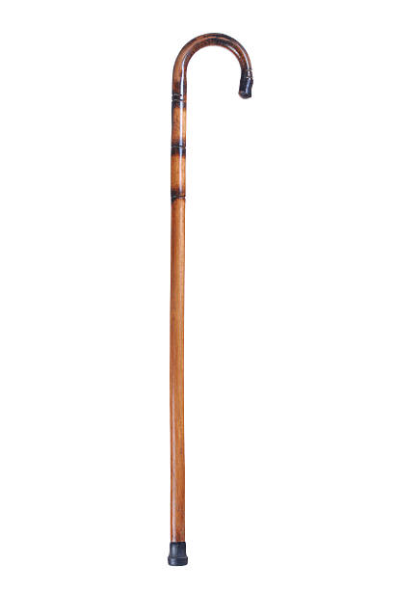
Components
Push Switch
LED
9V Battery
Slide Switch
Breadboard
Mini Breadboard
Wooden Cane

Slide 8
Previously Estimated Budget
Equipment | Quantity | Budget (Tk)
Arduino Mega 2560 | 1 | 1150
HC-SR04 Ultrasonic Sensor | 2 | 210
Water Sensor | 1 | 150
Buzzer | 3 | 60
Breadboard | 2 | 230
Resistors(100ohm,300ohm,1kohm) | As required | 35
Jumper Wires(M-M,M-F) | As required | 75
LED | 5 | 15
9V Battery | 1 | 95
9V Battery Cap | 1 | 9
Slide Switch | 1 | 8
Push Switch | 1 | 7
Wooden Cane | 1 | 600
Total- |  | 2644

Slide 9
Final Expenditure
Equipment | Quantity | Budget (Tk)
Arduino Uno R3 | 1 | 795
HC-SR04 Ultrasonic Sensor | 2 | 210
HC-SR04 Ultrasonic Sensor Mount | 2 | 138
Water Sensor | 1 | 150
Buzzer | 2 | 48
Breadboard | 2 | 230
Mini Breadboard | 1 | 47
Resistors(100ohm,300ohm) | As required | 20
Jumper Wires(M-M,M-F) | As required | 150
LED | 5 | 15
9V Battery | 2 | 190
9V Battery Cap | 2 | 20
Slide Switch | 2 | 16
Large Push Switch | 1 | 15
Wooden Cane | 1 | 200
Total- |  | 2244

Slide 10
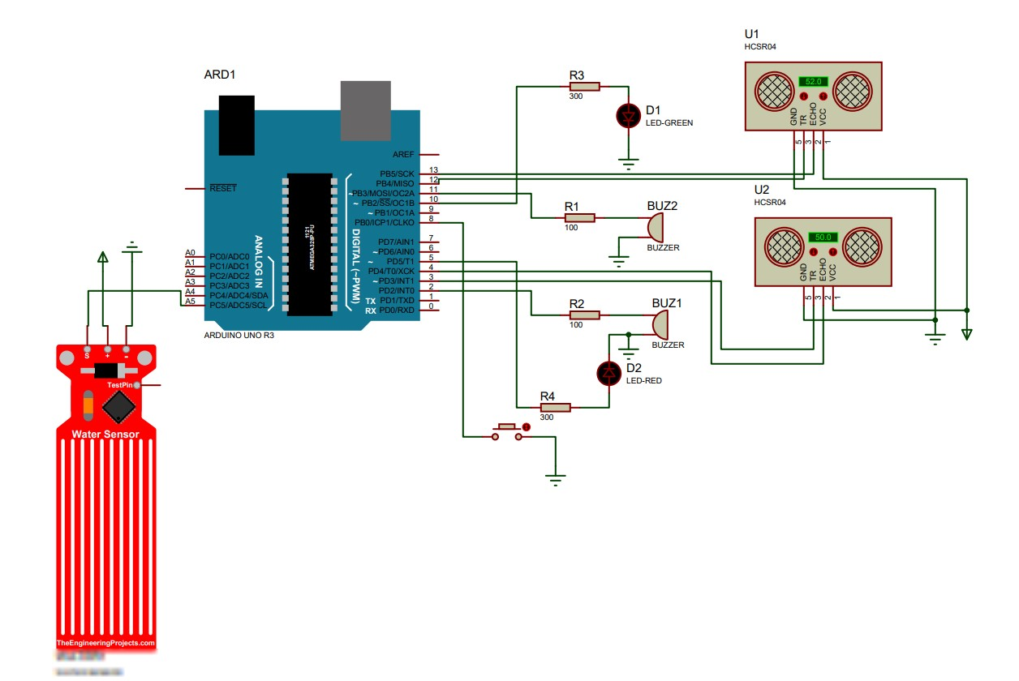
Proteus Model

Slide 11
Working Procedure
Slide switch : We will use the slide switch to turn On and Off the whole system.
Push switch : The push switch will be used to turn off the buzzer momentarily.
LED : The LED will blink as a signal to the person in front of the user who is not aware of his/her surroundings.

Slide 12
Working Procedure
Buzzer : The Buzzer will sound when there is an obstacle or person in front of the user.
Resistor : We will use resistors to make a proper electrical flow through the entire system.
Sensors : Sensors will detect the obstacles in front of user, high places and water surrounding the user.
Arduino Uno: We will use Arduino Uno as the main driver device because it has low power consumption with fast start up, easier to use. It has a clock speed of 16 MHz and a flash memory of 32 kB.

Slide 13
Challenges Of The Project
Ultrasonic sensor read latency:
Solved this problem with three different noise levels.
Noise levels distinguished by frequency and delay.
Conflict created by buzzers:
Solved this problem with a flag value.
While flag value is set, bottom buzzer is deactivated.
Water sensor misreading:
Solved this problem by conducting minimum value experiment.
The minimum value is the relative value which can be ignored.

Slide 14
Conclusion
Blind Stick is an easily implementable project. The developed smart blind stick that is incorporated with multiple sensors will help in navigating the way while walking and keep alarming the person if any sign of danger or obstacle is detected.

Slide 15
Thanks!
Any questions?

