Slide 1

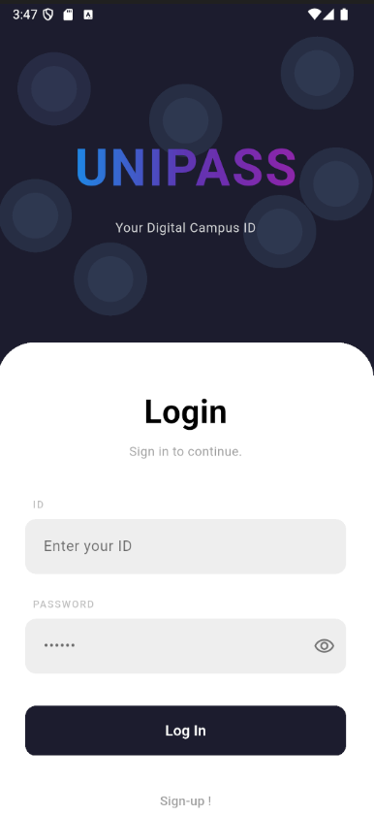

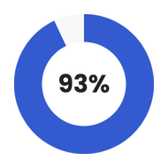
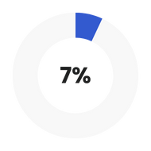
UNI
PASS
UniPass is a smart digital student ID and code-based attendance system. Students use a mobile ID and enter a time-limited lecturer code to record attendance. Lecturers create codes, manage courses, and export reports—making attendance fast, accurate, and paperless.
Dart
JavaScript

Slide 2
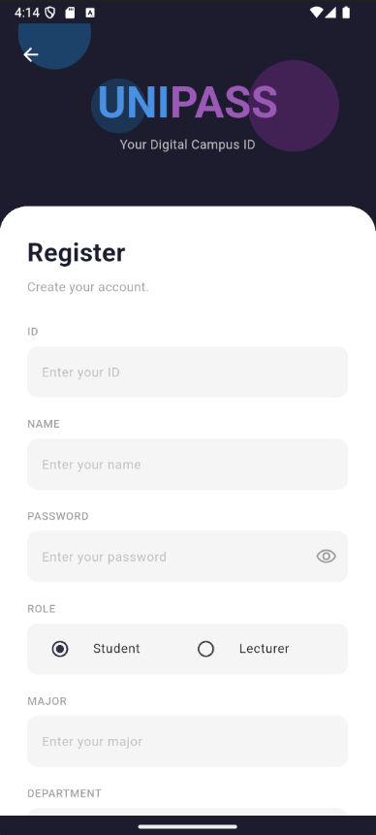
Register
Page
The Registration Page allows users to create their own accounts by choosing either Student or Lecturer. Students fill in all required details, while lecturers can skip the major field. Uploading a profile photo is optional for both.

Slide 3
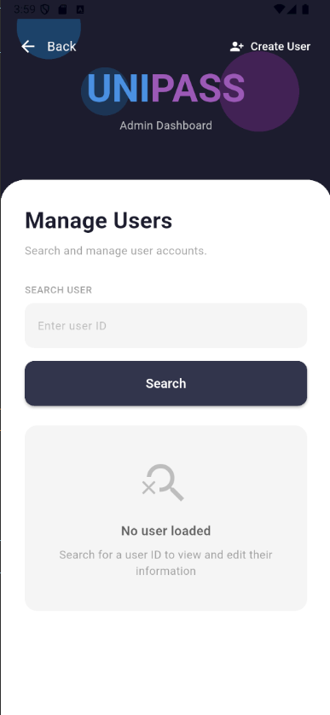
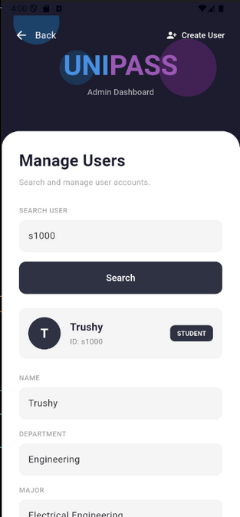
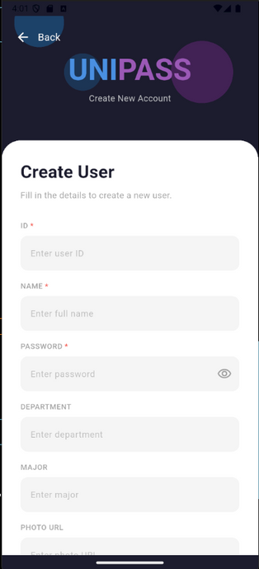
This is our Admin’s Dashboard
The Admin Dashboard allows administrators to search users by ID, update their name, major, and department, change passwords, delete profiles, and create new student or lecturer accounts—all in one place for easy management.

Slide 4
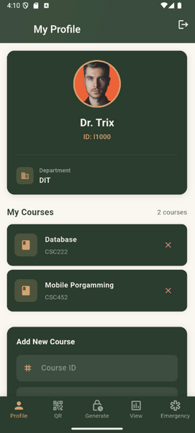
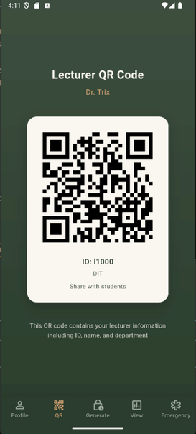
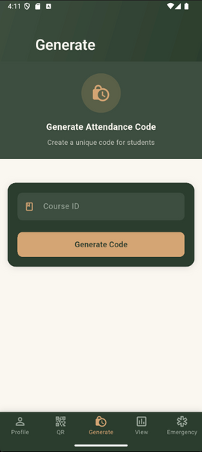
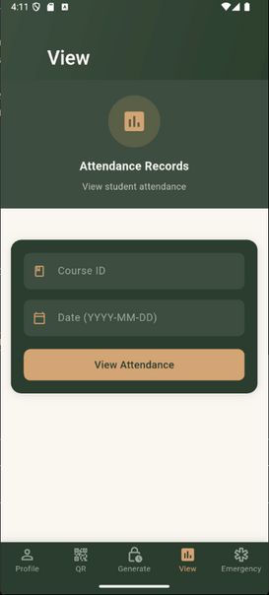
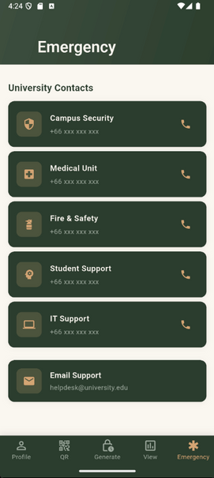
Lecturer Sections
The Lecturer Tab includes five sections:
  Profile for personal details,
  QR for viewing the lecturer’s unique ID QR code
  Generate for creating attendance codes
  View for checking student attendance records
  Emergency for accessing important campus contacts.

Slide 5
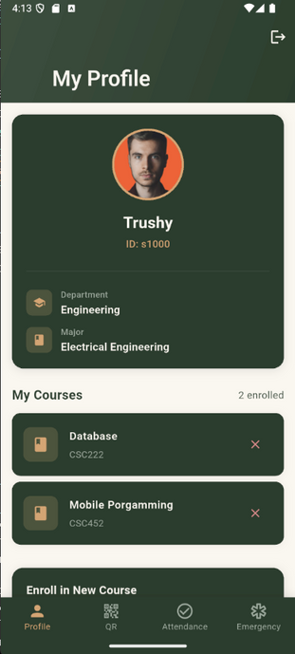
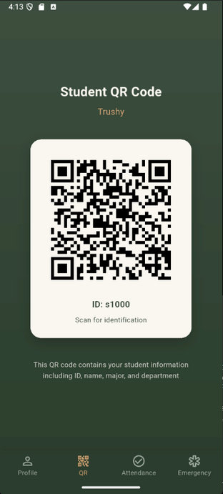
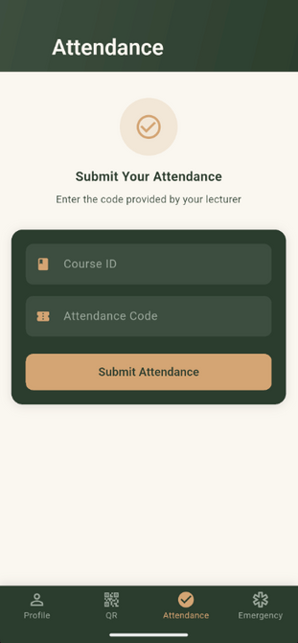
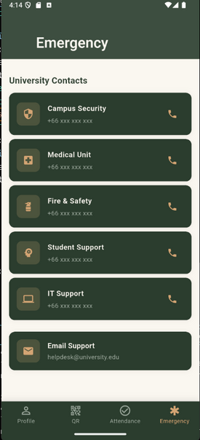
Student
Sections
The Student Tab has four sections
  Profile for personal details
  QR for the student’s unique ID QR code
  Attendance for submitting the lecturer’s attendance code
  Emergency for quick access to important campus contacts.

Slide 6
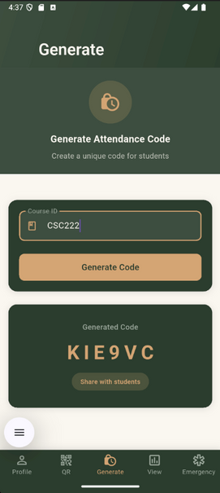
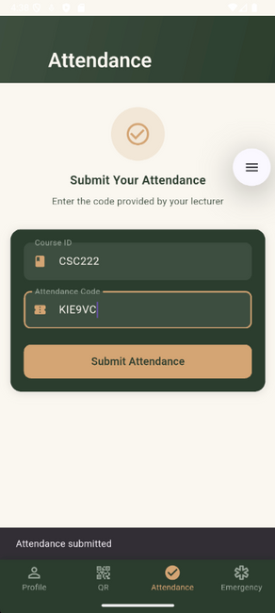
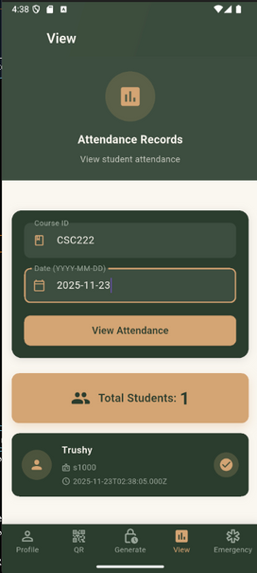
Step 1 - Generate Code (Lecturer): The lecturer enters the course code and taps Generate. The system creates a unique, time-limited attendance code
Step 2 – Submit Code (Student): Students enter the code in the Attendance section to mark their attendance for that class
Step 3 – View Attendance (Lecturer): The lecturer checks the View section to see how many students submitted the code, filtered by course code and date.

Slide 7

Thank You

