Slide 1
To Prevent and Detect Address Resolution Protocol Poisoning in Open WiFi
Submitted by
MohamedMusthafa M 812418104026
DhatshanaMoorthy V 812418104010
Manikandan K 812418104021
Project Guide
Mrs.A.GETSYAL.M.E
Assistant Professor

Slide 2
OBJECTIVE
To stop the MITM of ARP(Address Resolution Protocol) poisoning in open WiFi and to establishing secure local infra structure.

Slide 3
INTRODUCTION
Vulnerabilities eavesdrop on communications LAN
network.
link layer address.
Internet plays a vital role in our daily life.
Using Debian based system.
Ettercap and wireshark tool.

Slide 4
EXISTING SYSTEM
Firewall IDS(Intrusion Detection System) and IPS(Intrusion Prevention System).
Threats act could use MITM(Man-in-the-Middle) attack to harvest personal information or login credentials
Telnet, Session Hijacking, packet filtering, DNS spoofing, port stealing.

Slide 5
DEMERITS
If attacker do it again, it can’t able to detect or prevent ARP poisoning attack.
Cant able to update the tool.

Slide 6
PROPOSED SYSTEM
To implement the bash(shell) scripting algorithm to stop ARP poisoning.

Slide 7
MERITS
To prevent the ARP Request from the router in very less interval.
If it is sent continuously it has conclude that our network has been affected by ARP poisoning.

Slide 8
LITERATURE SURVEY
S.NO | Title | Author | Journals name and year | Technology used | Merits | Demerits
1 | Comparative Study on Network Monitoring Tools | Vudipi Manohar | International Research Journal of Engineering and Technology, 2020 | Using Zenmap to scannning network. | Show all the Local area network ip. | It doesn’t do anything in network.
2 | Performance Analytics of Network Monitoring Tools | Deepak Chahal, Lat ika Kharb, Deepanshu Choudhary | International Journal of Innovative Technology and Exploring Engineering (IJITEE) , 2019 | Wireshark to sniff network packets | smart network monitoring system. | Cant able to sniff https packet
3 | Network Monitoring Tools and Technologies | Bhavya Jani, Kajal Jain, Narendra Vishwakarma | International Journal of Creative Research Thoughts, 2018 | Nmap used to sniff total LAN with MAC address. | It can able to sniff to MAC address of user | Not able to retrieve packets
4 | Capability of Wireshark as Intrusion Detection System | Sakshi Singh | International Journal of Recent Technology and Engineering, 2020 | Kiwi Monitor network traficc analysis | Easy to sniff the packet of FTP SMTP | Not updated tools

Slide 9
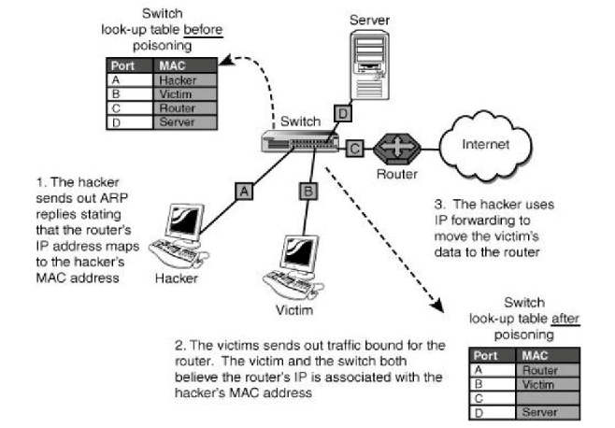
Flow Chart

Slide 10
Modules
● ARP (Address Resolution Protocol) . ● Working Of ARP. ● ARP Spoofing. ● Man in the middle attack (MITM) ● MAC flooding

Slide 11
ARP (Address Resolution Protocol)
Address Resolution Protocol (ARP) is a protocol or procedure that connects an ever-changing Internet Protocol (IP) address to a fixed physical machine address, also known as a media access control (MAC) address, in a local-area network (LAN).
This mapping procedure is important because the lengths of the IP and MAC addresses differ, and a translation is needed so that the systems can recognize one another.
The most used IP today is IP version 4 (IPv4). An IP address is 32 bits long. However, MAC addresses are 48 bits long. ARP translates the 32-bit address to 48 and vice versa.

Slide 12
ARP Spoofing
ARP does not authenticate whether the reply is from the desired device or not.
if the reply is not sent by the desired user, but instead by a malicious user then the network becomes prone to ARP spoofing.
Many detection and prevention techniques exist to detect and prevent such false mappings.
This survey conducts a deep comparative analysis of those strategies bringing out their advantages and disadvantages.

Slide 13
Man in the middle attack (MITM)
In this attack, the hacker intercepts the communication of two genuine devices.
It receives the data from the transmitter and then forwards it to the target device to remain undetected.
With this, they can steal the crucial data and can then use it for various purposes without distorting the communication. Keeping the hosts unaware, the hacker becomes a part of their communication and sniffs passwords or hijacks the secured internet sessions.

Slide 14
MAC flooding
MAC Flooding is one of the most common network attacks.
MAC Flooding is not a method of attacking any host machine in the network, but it is the method of attacking the network switches.
The intention of the attacker is consuming the memory of the switch that is used to store the MAC address table

Slide 15
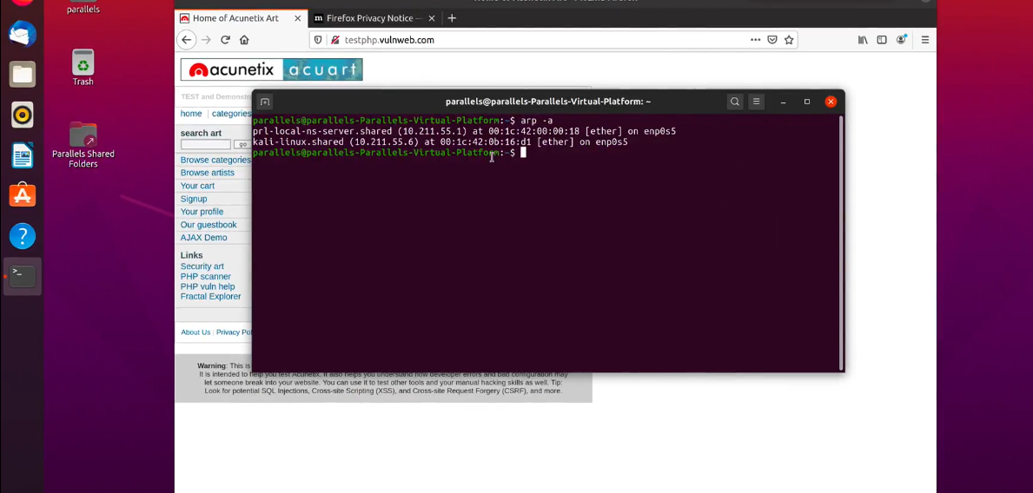
Screenshots
ARP Sniffer

Slide 16
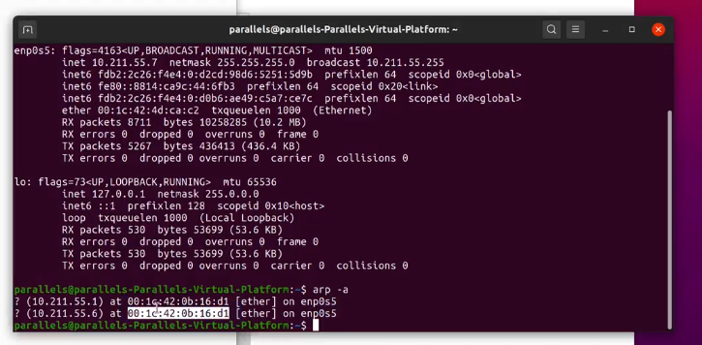
IP Spoofing

Slide 17
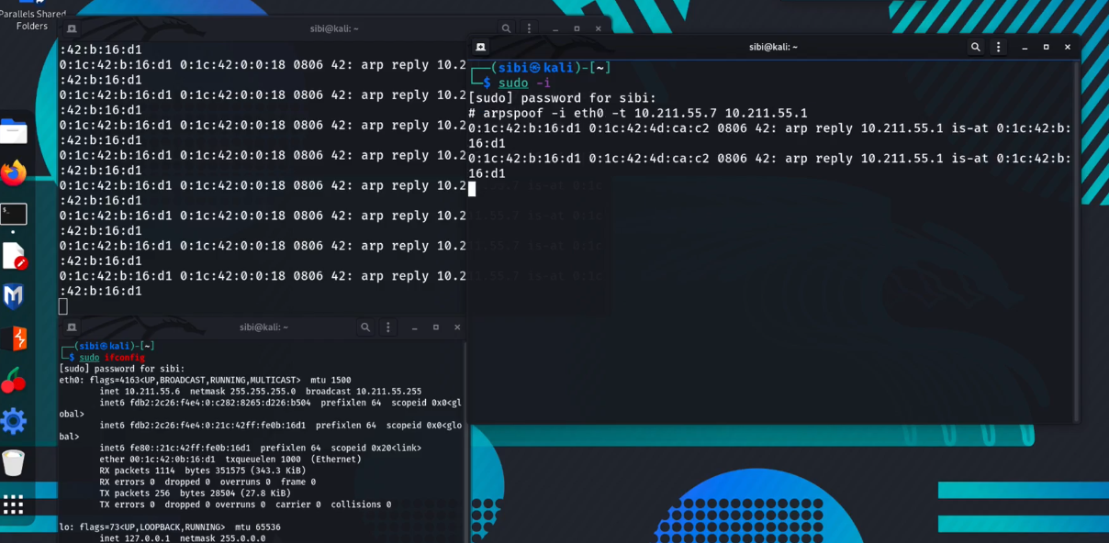
Analysis the packet to sniffing

Slide 18
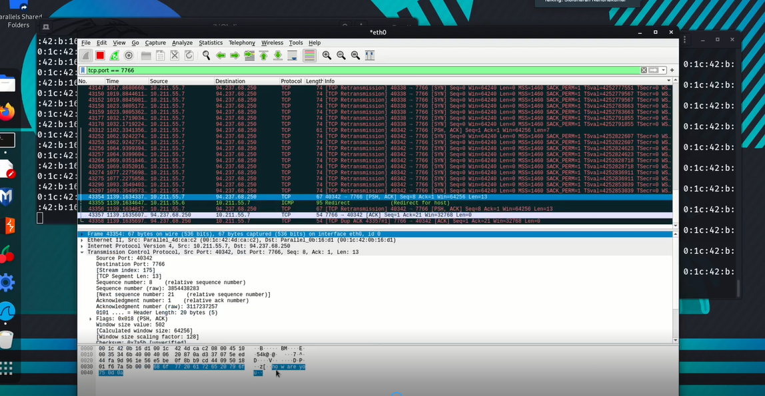
Analysis the packet to sniffing

Slide 19
Conclusion
Cyber security is growing in its importance.
It is a requirement for every individual to be knowledgeable of attacks and follow certain safety measures when on the internet. Privacy and data protection have become the needs of the hour.
The sensitive data like the username and password can easily be sniffed if the user does not follow the security principle when on the internet.
We have seen that the user credentials are easily sniffed using the ARP tool. The user can observe some safety precautions which might prevent his data from getting stolen. To train the next generation of workers in this area, it is necessary for students to learn cyber security and related attacks/concepts using actual real world attack and protection implementation.
Additionally, the user needs to be aware of best practices in safeguarding them self against popular cyber-attacks.

Slide 20
FUTURE ENHANCEMENT
This study is carried out to check the economic impact that the system will have on the organization.
The amount of fund that the company can pour into the research anddevelopment of the system is limited. The expenditures must be justified.
Thus the developed system as well within the budget and this was achieved because most of the technologies used are freely available. Only the customized products had to be purchased.

Slide 21
Thank You

