Slide 1
To stop MITM attack in Open wifi using bash scripting.
Submitted by
MohamedMusthafa M 812418104026
DhatshanaMoorthy V 812418104010
Manikandan K 812418104021
Project Guide
Ms.A.GETSYAL.M.E
Assistant Professor

Slide 2
OBJECTIVE
To stop the MITM of ARP poisoning in open wifi and to establishing secure local infra structure.

Slide 3
INTRODUCTION
Vulnerabilities eavesdrop on communications LAN
network.
link layer address.
Internet plays a vital role in our daily life.
Using Debian based system.
Ettercap and wireshark tool.

Slide 4
EXISTING SYSTEM
In Existing system, It prevent the attack only once at a time.
Threats act could use MITM attack to harvest personal information or login credentials
FTP ,Telnet, Session Hijacking, packet filtering, DNS spoofing, port stealing.

Slide 5
DEMERITS
If attacker do again, it can’t able to detect or prevent ARP poisoning attack.
Cant able to update the tool.

Slide 6
PROPOSED SYSTEM
To implement the bash scripting algorithm to stop ARP poisoning.

Slide 7
MERITS
To prevent the ARP Request from the router in very less interval.
If it is sent continuously it has conclude that our network has been affected by ARP poisoning.

Slide 8
LITERATURE SURVEY
S.NO | Title | Author | Journals name and year | Technology used | Merits | Demerits
1 | Comparative Study on Network Monitoring Tools | Vudipi Manohar | International Research Journal of Engineering and Technology, 2020 | Using Zenmap to scannning network. | Show all the Local area network ip. | It doesn’t do anything in network.
2 | Performance Analytics of Network Monitoring Tools | Deepak Chahal, Lat ika Kharb, Deepanshu Choudhary | International Journal of Innovative Technology and Exploring Engineering (IJITEE) , 2019 | Wireshark to sniff network packets | smart network monitoring system. | Cant able to sniff https packet
3 | Network Monitoring Tools and Technologies | Bhavya Jani, Kajal Jain, Narendra Vishwakarma | International Journal of Creative Research Thoughts, 2018 | Nmap used to sniff total LAN with MAC address. | It can able to sniff to MAC address of user | Not able to retrieve packets
4 | Capability of Wireshark as Intrusion Detection System | Sakshi Singh | International Journal of Recent Technology and Engineering, 2020 | Kiwi Monitor network traficc analysis | Easy to sniff the packet of FTP SMTP | Not updated tools

Slide 9
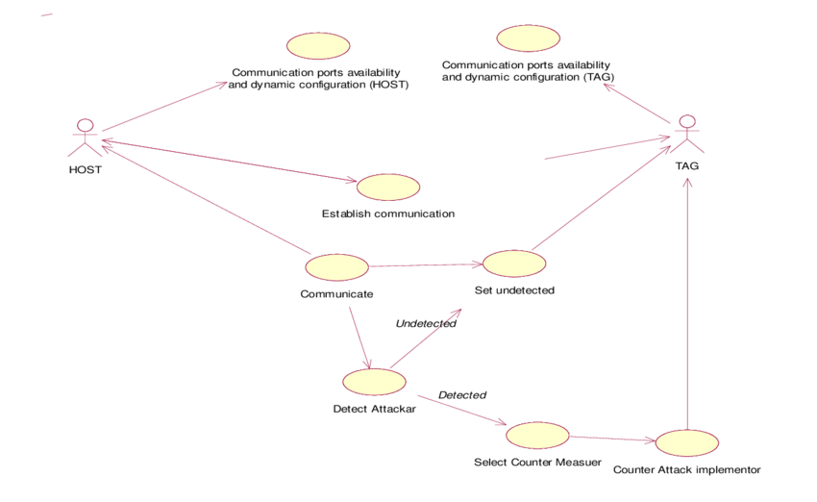
Flow chart

