Slide 1

Student Management System

Slide 2

Team Members
Documented By:-
Piyush Kumar
Musthakhdhim
Shiny Zebalda
Shashi Kant
Jadi Sidharth
Pragati Chaubey

Slide 3
Introduction
Student Management System (SMS) is a solution tool that is designed to track and maintain the details of students.
It manage all the data generated by a school, including the grades of a student, their attendance, etc.
The student management system is an automated version of manual management system.

Slide 4
Objective:
The main objective of student management system is to manage the details of Profiles, Fees, Marks, Attendance.
It manages all the information about Profiles, Students, Fees.
The project is totally built at administrative end and thus only the administrator is guaranteed the access.
It helps the admission department track perspective students during the application and enrollment process.

Slide 5
Purpose:
To develop an online system to help the admin.
To manage the details of students.
To track the records and to modify.

Slide 6
Project Scope:
Our project aims to safe and easy handling of students data. i.e. we have made a computerized process to store data and distribution.
It satisfies the admin.
It is easy and safe to store data.
It is easy to operator.
Have a good user interface.
It saves time and function faster.
It helps the admin to handle the students data .
We have tried to develop safe and secure software with above mentioned specifications.
Scope of change: barcoding reading.

Slide 7


Used Tools and Technology:
Frontend: Angular
Back end: Spring tool suite
Oracle Database.
Online tools:
Word pad
Notepad

Slide 8
Module:
We have admin module along with that we have some other modules:
Student info.
Login/Registration
Fee
Attendance
Marks

Slide 9


Frontend Tool :
We used :-
Angular
CSS
HTML
Java Script
Typescript

Slide 10


Backend [language used]:
JAVA
SPRING BOOT
SPRING DATA JPA

Slide 11

DATABASE:
Oracle SQL

Slide 12
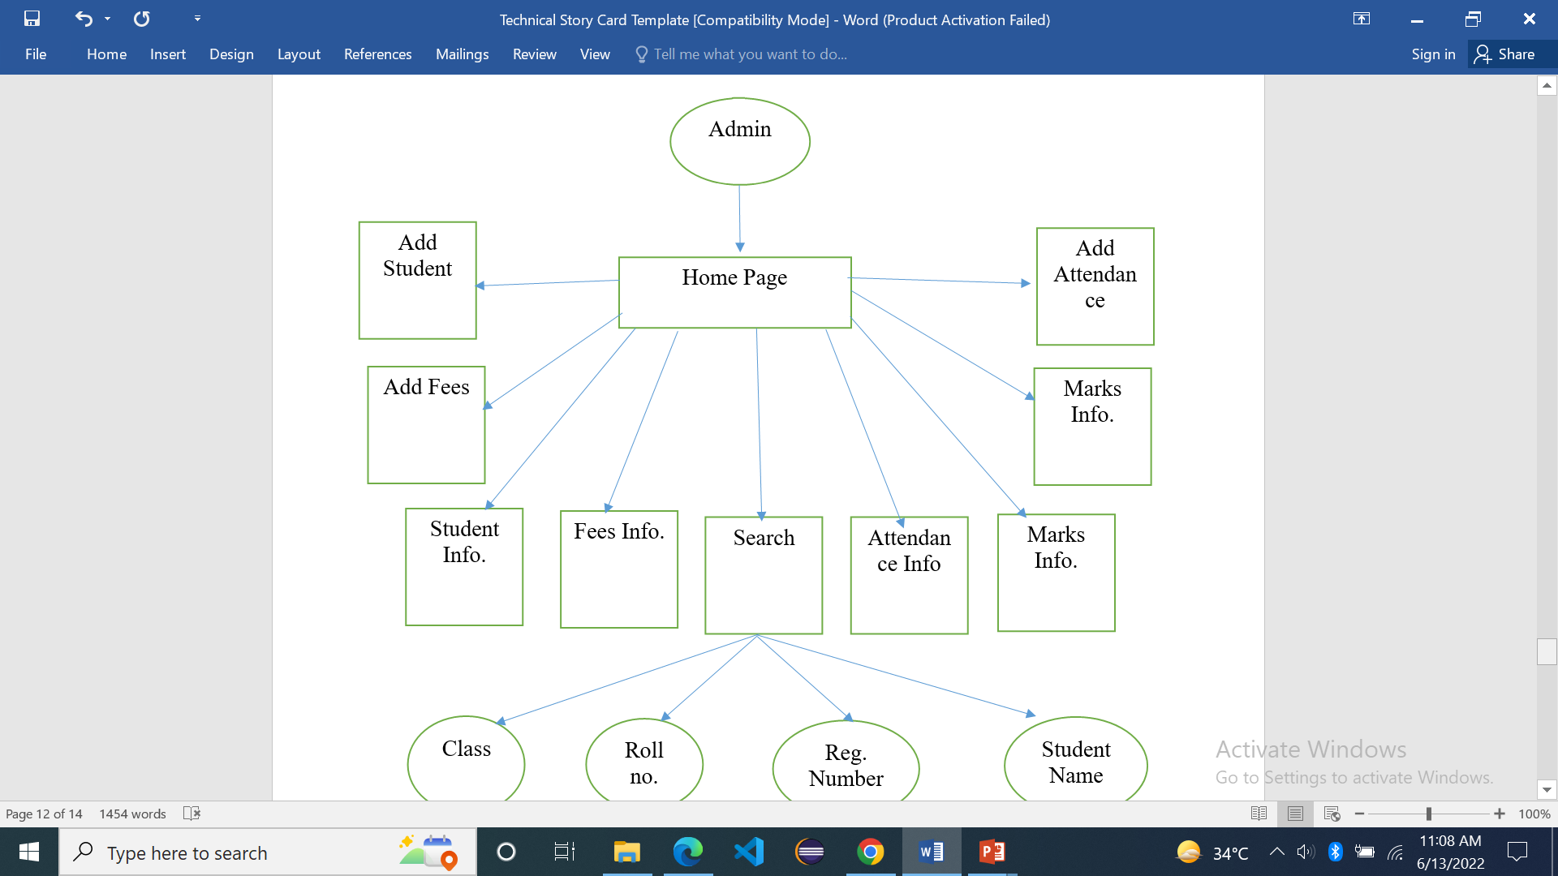
Data flow diagram:

Slide 13
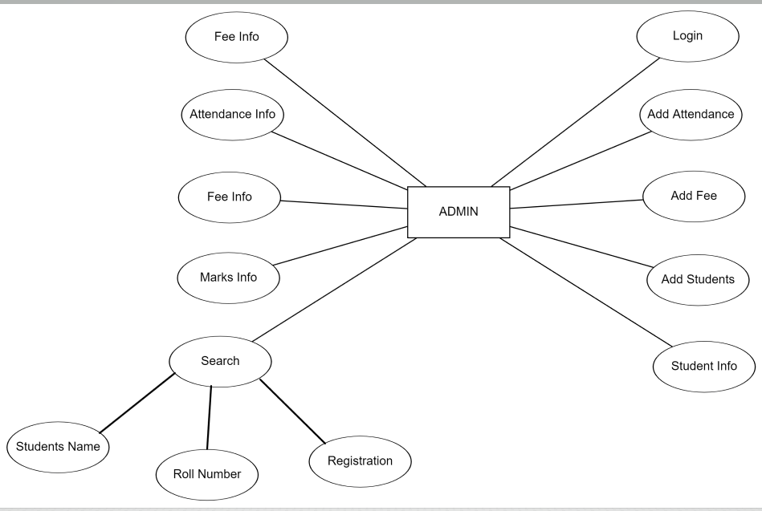
Use case diagram

Slide 14
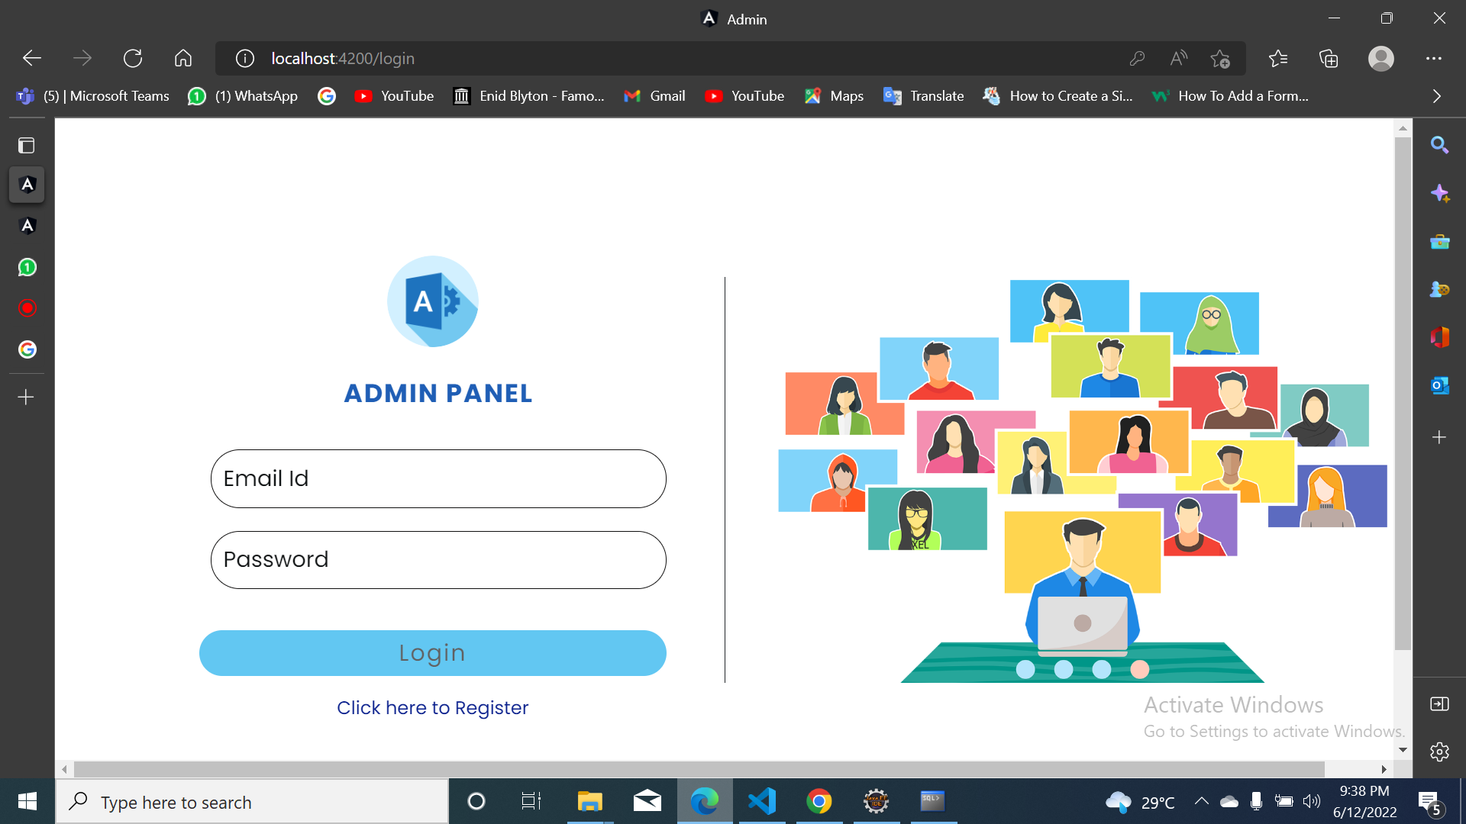
Login page:

Slide 15
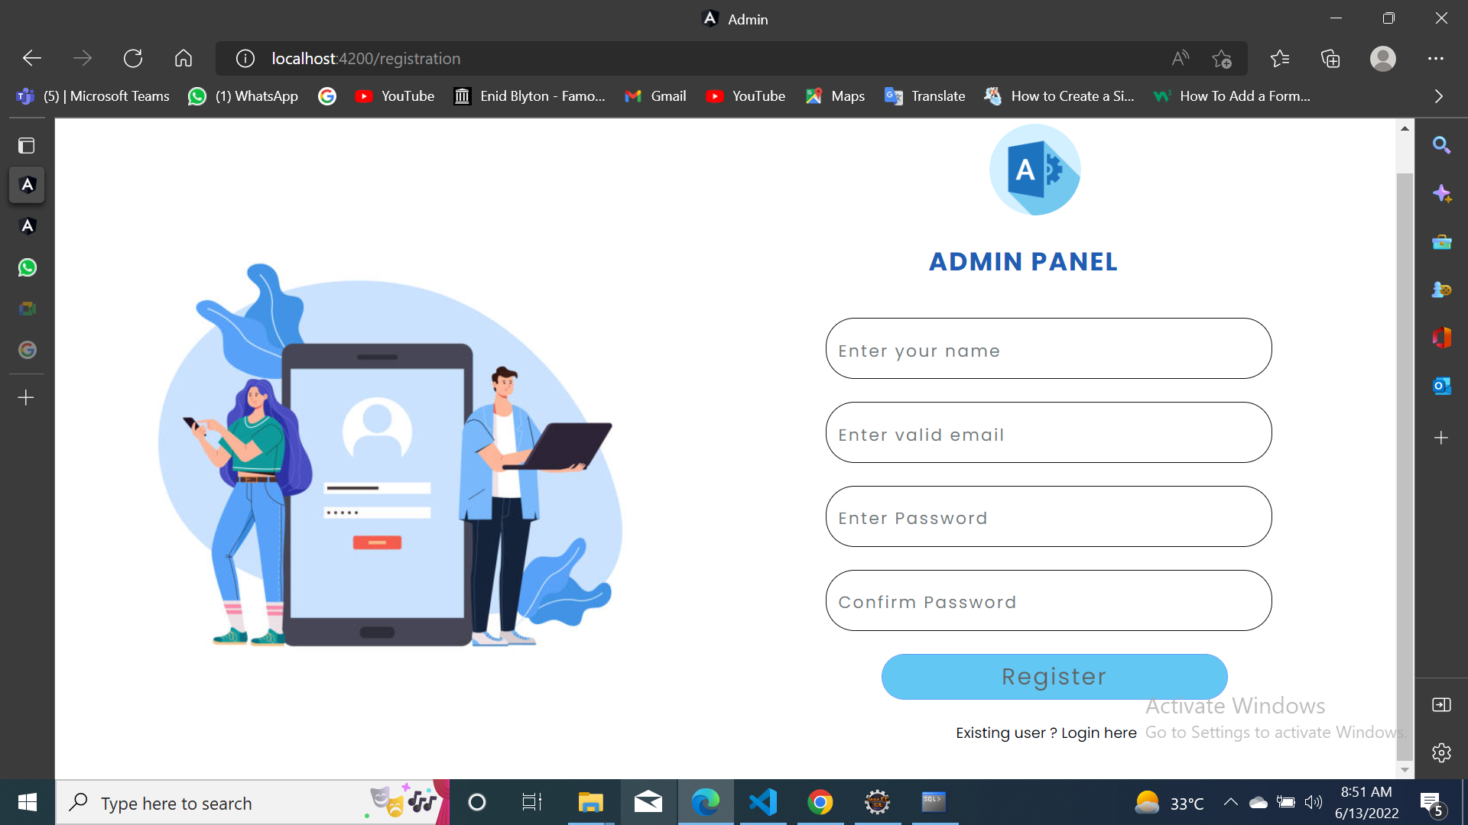
Registration page:

Slide 16
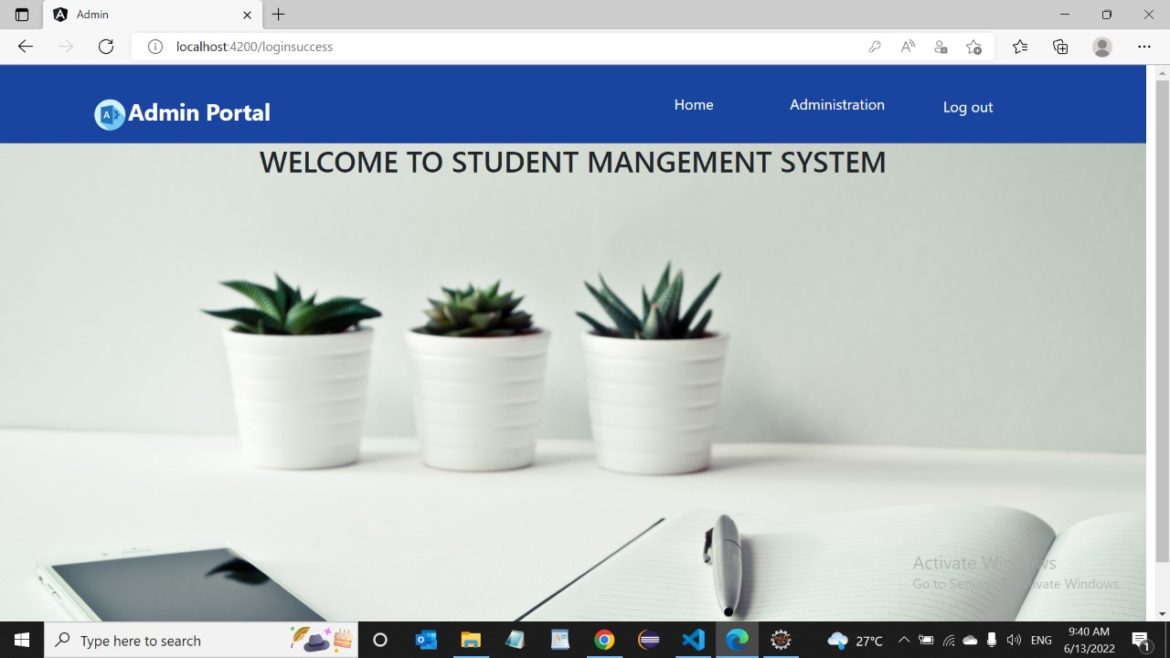
Home page:

Slide 17
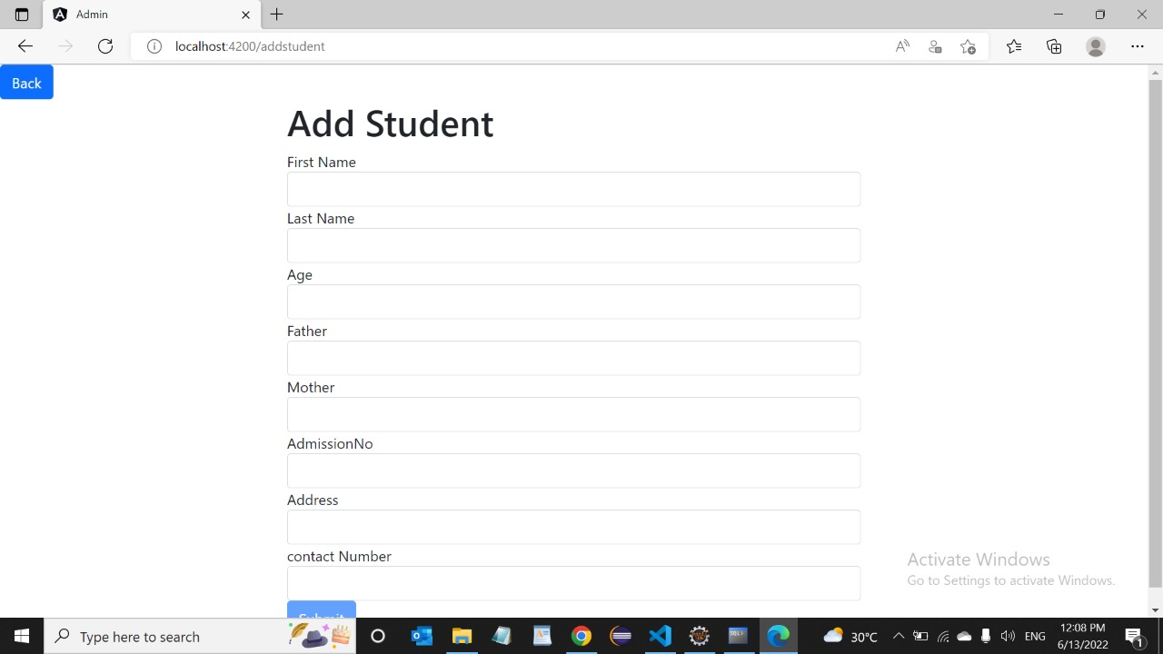
Student info

Slide 18
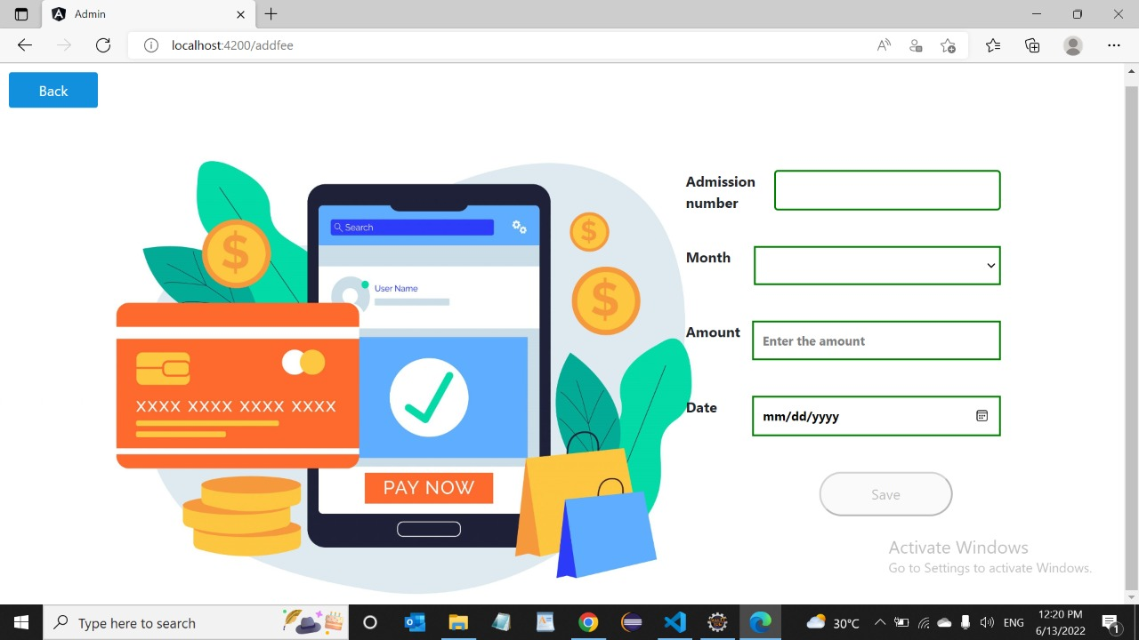
Fee Info

Slide 19
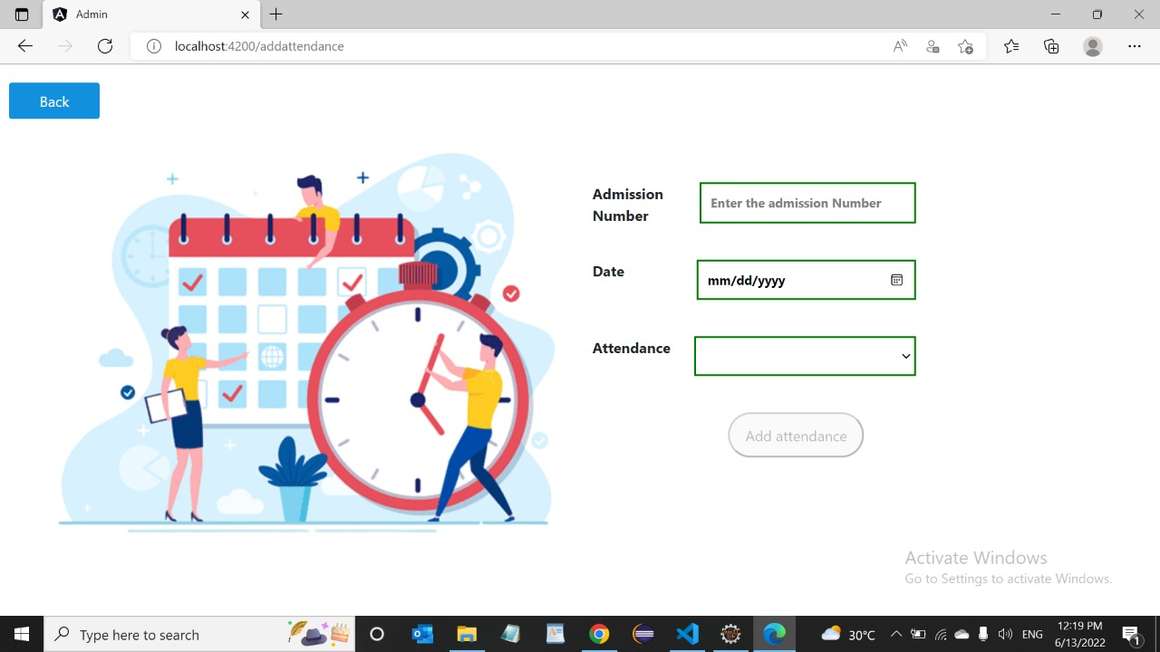
Attendance Info

Slide 20
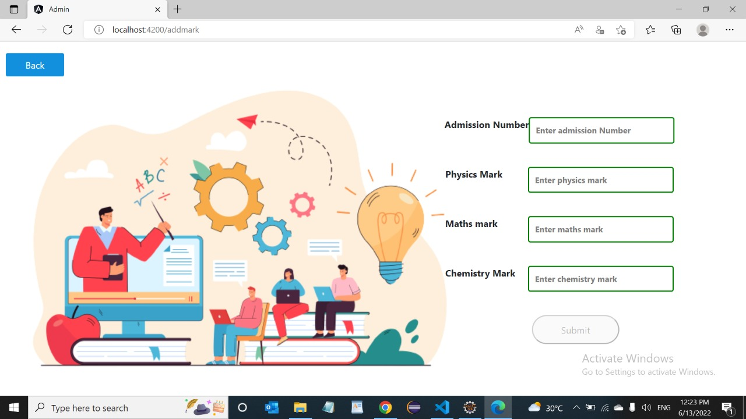
Marks Info

Slide 21
Conclusion and future scope:
Future scope:
This application involves almost all the basic features of
Student management system.
The future implementation will be help for the Management of schools.
Conclusion:
The project entitled “Student management system” is developed using Angular, Html and CSS as frontend and Oracle database, Java, Spring Boot,
in backend to computerize the process of online management of students. This projects covers only the basic features required.

