Slide 1
SIGN LANGUAGE TRANSLATOR
PRESENTED BY-
ANANYO BANERJEE 16BEE0148
MUSKAN AGGARWAL 16BEE0143
AASHI KAPOOR 16BEE0130
RISHU RANJAN CHOUBEY 16BEE0090

Slide 2
ABSTRACT
Differently abled and mute people use gestures for communicating with others.
In this project we propose a sign language TRANSLATOR which will assist such people.
This will help bridge the communication barrier a mute or deaf person faces.

Slide 3
Thank You

Slide 4
PURPOSED IDEA
We here create a device which will convert the gestures to the corresponding word.
This will be processed by the microcontroller to readable statement.
After processing the data will be displayed on the LCD screen.
Also a audio synthesizer will speak out the sentence expressed by the user.

Slide 5
COMPONENTS REQUIRED
Glove
Arduino
Flex Sensor
LCD Display
TTS & Speak Jet (Audio Synthesizer)
Speaker

Slide 6
SKILLS REQUIRED
Arduino Programming
Connection Debugging
Data Processing
Sensor calibration and troubleshooting

Slide 7
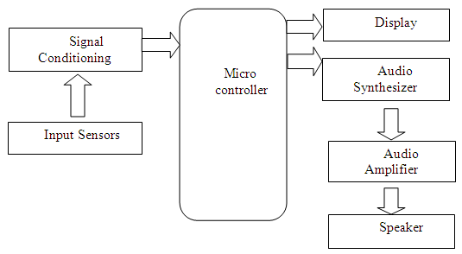
BLOCK DIAGRAM

Slide 8
TIMELINE
Review 1- Making of Circuitry. Assembling the components . Attaching the sensors and audio synthesizer to Arduino. Review 2- Programming the code for conversion . Code for displaying the data and Audio Synthesis. Debugging the code as well as Circuitry. Review 3- Fabricate the device for real-time use. Further advancements if required.

