Slide 1

INCIDENT HANDLING LAB
Security Monitoring, Attack Simulation and Incident Detection
Built on the Elastic Stack and Fleet Architecture
TEAM MEMBERS
Aashish Shrestha · Antonio Musumeci · Sujan Thapa
April 2026
Notes:
“Good Afternoon everyone, My Name is Sujan Thapa. Before we begin the presentation, I’d like to start with a quick idea. In today’s world, cyberattacks are not rare events -they are constant. Every year, organizations face millions of brute force attacks. That breaks down to thousands every month… hundreds every day… and in many cases, attacks happening every minute. Now here’s the important part — every single one of those attempts leaves a trace. And that trace is stored in logs. There’s a well-known idea in incident response: ‘No logs, no evidence. No evidence, no investigation.’ The challenge is not whether data exists - the challenge is how we collect it, analyze it, and respond to it in time. In real-world environments, organizations often rely on SIEM platforms to do this. But many of those solutions are expensive and not always accessible to everyone. So today, together with my teammates Aashish and Antonio, we are presenting a complete, working SIEM solution built using open-source tools. Before we continue, I’d also like to thank our professor for his guidance and for creating such an engaging learning environment, and for giving us the opportunity to work on and present this project. Our goal is simple: to show you what a SIEM actually is, how it works, and how it helps detect real attacks in real time. Now, let’s get started.”
What we built is a complete, working security monitoring environment from scratch, and then we used it to detect three different real attacks that we launched ourselves against our own machines.
The whole project runs on the Elastic Stack, which is one of the most widely used platforms in real Security Operations Centres around the world. Over the next 27 slides I am going to walk you through what we built, how we built it, what attacks we ran, and how we detected them end to end.

Slide 2







Presentation Roadmap
What we'll cover in the next 27 slides
01
Project Overview
02
Project Relevance
Goals and the four-VM lab
Why SIEM matters in incident response
03
Methodology
04
Task 1 — SSH Brute Force
Architecture, data pipeline, build phases
Hydra against the ELK server
05
Task 2 — RDP Brute Force
06
Task 3 — File Integrity Monitoring
Hydra against Windows Server
Auditd on the Fleet Server
07
Detection Rule & Teams Alert
08
Findings, Lessons & Conclusion
Automated detection pipeline
What we learned
Incident Handling Lab | Elastic SIEM
2 / 29
Notes:
The presentation has eight parts. We will begin with a quick overview of what the project is and why it matters. Then we will move into the methodology, which covers the architecture, the data pipeline, and the build phases. After that we get to the core of the presentation, which is the three attack tasks. Task 1 is an SSH brute force attack. Task 2 is an RDP brute force attack. And Task 3 is file integrity monitoring using Auditd.
Once we have covered all three attacks, We will show you the custom detection rule we built in Kibana and how it delivers alerts to Microsoft Teams in real time. Finally we will close with the key findings, the lessons we learned along the way, and some ideas for how this lab could be extended further.

Slide 3



Project Overview
End-to-end SIEM lab built on the Elastic Stack
A fully operational Security Operations Centre
environment was built from the ground up using
open-source tools.
Four virtual machines on a private host-only network,
three of them instrumented with Elastic Agents
shipping telemetry through Fleet into Elasticsearch
and visualized in Kibana.
Three distinct attack scenarios were simulated
end-to-end and automatically detected, culminating
in a real-time Microsoft Teams alert.
4
3
Virtual Machines
Attack Scenarios
Ubuntu ELK, Ubuntu Fleet, Windows Server, Kali Linux
SSH brute force, RDP brute force, FIM tamper
5
1
Stack Components
Teams Webhook
Elasticsearch, Kibana, Logstash, Fleet, Agent
End-to-end automated alert delivery
OBJECTIVE
Deploy a SIEM that detects real attacks in real time and turns raw events into actionable analyst alerts
Incident Handling Lab | Elastic SIEM
3 / 29
Notes:
This project is a full end to end build of a Security Operations Centre environment using open source tools. Everything you see on this slide was built from nothing. We started with empty virtual machines and ended up with a fully monitored network that could detect real attacks in real time.
The four numbers on screen
On the right side we have four key numbers that summarize the whole lab.
The number four is our virtual machines. We have an Ubuntu machine running the full Elastic Stack. A second Ubuntu machine running the Fleet Server. A Windows Server acting as an enterprise endpoint. And a Kali Linux machine that plays the role of the attacker.
The number three is our attack scenarios. SSH brute force, RDP brute force, and file integrity monitoring for when an attacker tries to change files on the system.
The number five is the components of the Elastic Stack that we deployed. Elasticsearch is the search engine and database. Kibana is the web interface. Logstash is the data processing pipeline. Fleet is the central agent manager. And Elastic Agent is the software that runs on each monitored machine to collect and ship logs.
The number one is the Microsoft Teams webhook. This is the final piece that turns a technical detection into a real world alert that a SOC analyst actually sees on their screen.
Before I get into the technical details let me explain why SIEM matters so much in incident response.

Slide 4


Why SIEM Matters in Incident Response
Log data is the evidence — a SIEM makes it searchable
"Without log data, an investigation has no evidence.
With it, an analyst can reconstruct exactly what an attacker did, when, and how."
The SIEM value proposition
Volume
Visibility
Speed
PROBLEM
PROBLEM
PROBLEM
A single Windows server produces tens of thousands of events per hour.
Log data scattered across hundreds of machines is impossible to review.
Manual investigation of failed logins requires logging into each host.
SIEM ANSWER
SIEM ANSWER
SIEM ANSWER
Elasticsearch indexes everything and returns results in milliseconds.
Fleet-managed agents centralize telemetry from every host.
One KQL query surfaces every matching event across the whole fleet.
Incident Handling Lab | Elastic SIEM
4 / 29
Notes:
The quote at the top is the core argument for why SIEM platforms exist. Without log data, an investigation has no evidence. With log data, an analyst can reconstruct exactly what an attacker did, when they did it, and how they did it.
Every security incident investigation starts with log data. The logs are the written record of everything that happened on every machine. If we do not have them, we cannot investigate. If we have them but cannot search them efficiently, we still cannot investigate fast enough to matter.
As we have limited time for our presentation, I wont like to pause here before going deeper and move on into next slide.

Slide 5




Elastic Stack Across the IR Lifecycle
NIST SP 800-61 phases and where our stack fits
01
02
03
Preparation
Detection & Analysis
Containment
Agents deployed on every endpoint; detection rules written and tuned; dashboards built for baseline visibility.
Rules fire on suspicious activity; analysts pivot in Kibana Discover; timeline built from ECS-normalized events.
One KQL query over Elasticsearch surfaces every host, user, and IP touched by the adversary.
04
05
06
Eradication
Recovery
Post-Incident
FIM logs expose persistence mechanisms — modified files, startup scripts, new cron jobs — with full metadata.
Baseline patterns from before the incident compared against restored hosts to validate clean operation.
Events retained in Elasticsearch for forensic review, detection gap analysis, and legal evidence.
Source: NIST Special Publication 800-61 Revision 2 — Computer Security Incident Handling Guide
Incident Handling Lab | Elastic SIEM
5 / 29
Notes:
This framework comes from the NIST Special Publication 800-61 Revision 2, which is the Computer Security Incident Handling Guide. It is the industry standard for how incident response teams organize their work. It breaks the process into six phases, and our SIEM platform plays a meaningful role in every single one of them.
Walk through each phase
Phase one is preparation. This happens before any incident occurs. Agents are deployed on every endpoint, detection rules are written and tuned to the environment, and dashboards are built so the team can see what normal activity looks like.
Phase two is detection and analysis. This is where the rules fire automatically when something suspicious happens. Analysts then use the Kibana Discover tab to pivot through the data and build a timeline of what occurred.
Phase three is containment. Once a threat is found, analysts query Elasticsearch for every event associated with that suspicious IP or user account. This tells them exactly which machines were affected so they can decide what to isolate.
Phase four is eradication. This is where file integrity monitoring really proves its value. The logs show exactly which files were modified, when, and by whom. That is critical for finding the persistence mechanisms an attacker may have installed.
Phase five is recovery. The baseline log patterns from before the incident can be compared against the current activity to confirm that a restored machine is actually behaving normally before it goes back into production.
Phase six is post incident activity. All the log data stays in Elasticsearch for forensic review. This is used to build the final incident report, identify any detection gaps, and provide legal evidence if needed.

Slide 6
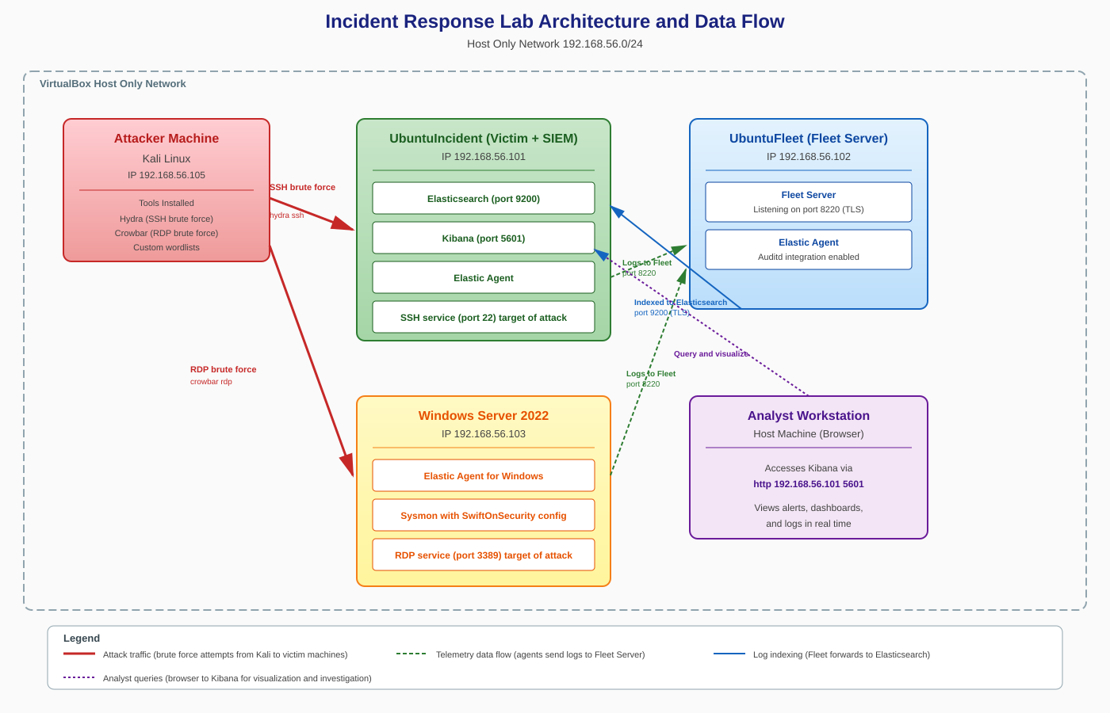
Lab Architecture — The Big Picture
Four virtual machines on a private host-only network
Incident Handling Lab | Elastic SIEM
6 / 29
Notes:
This is the analytical core of the SIEM. All log data from every agent in the environment is ultimately stored in Elasticsearch on this machine. Kibana provides the web interface for all analysis and management. It Also runs an Elastic Agent to monitor its own OS activity.
This machine acts as the centralized hub through which all Elastic Agents in the environment are managed. Every agent connects to this machine to receive its configuration policy and to ship its log data. It also runs its own Elastic Agent and has Auditd installed for file integrity monitoring.
Windows server has the Elastic Agent for Windows and Sysmon running. Sysmon gives us very rich telemetry about what is happening on the Windows side.

Slide 7
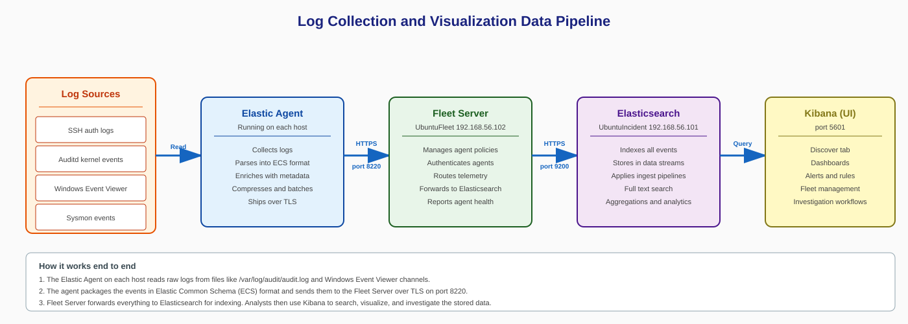
Data Pipeline — Source to Analyst
How a single endpoint event becomes a searchable alert
Complete data pipeline from OS event generation through Elastic Agent, Fleet Server, Elasticsearch, and into Kibana with alerting to Microsoft Teams
1
OS generates
2
Agent collects
3
Fleet routes
4
Elasticsearch indexes
5
Analyst acts
Failed SSH / Failed RDP / File modified
Reads local logs; formats to ECS; ships over HTTPS
Receives from all enrolled agents; forwards to ES
Stores every field; searchable in milliseconds
KQL queries, dashboards, detection rules, alerts
Incident Handling Lab | Elastic SIEM
7 / 29
Notes:
Elastic Agent: The Elastic Agent running on that machine watches the log files continuously. When a new entry appears, it reads it, formats it according to the Elastic Common Schema (which is a standardized field naming system), and then ships it over encrypted HTTPS to the Fleet Server.
Fleet server: The Fleet Server receives events from every enrolled agent across the environment and forwards everything on to Elasticsearch. It also handles agent policies and health reporting.
Elastic search: Elasticsearch parses each event, creates an inverted index entry for every field, and stores the event in its database. From this moment, the event is instantly searchable.

Slide 8


Virtual Machine Inventory
Four VMs on host-only network 192.168.56.0/24
Ubuntu ELK Server
Ubuntu Fleet Server
192.168.56.101 · Ubuntu 22.04
192.168.56.102 · Ubuntu 22.04
Elasticsearch · Kibana · Logstash — analytical core of the SIEM. Target of Task 1.
Fleet Server on port 8220 — centralized agent management. Auditd host for Task 3.
Windows Server 2022
Kali Linux
192.168.56.103 · Windows Server 2022
192.168.56.105 · Kali Rolling
Enterprise Windows endpoint with Elastic Agent + Sysmon. Target of Task 2.
Attacker machine running Hydra for brute force against all other VMs.
Incident Handling Lab | Elastic SIEM
8 / 29
Notes:
So, this slide gives an overview of the four virtual machines we set up for this lab. All of them are running on a private host-only network using the subnet 192.168.56.0/24, so they can communicate with each other but are isolated from the outside.
The first machine is the Ubuntu ELK Server at 192.168.56.101 — this is the core of our SIEM. It runs Elasticsearch, Kibana, and Logstash. It's also the target of Task 1, which is the SSH brute force attack.
The second one is the Ubuntu Fleet Server at 192.168.56.102. This machine manages all the Elastic Agents across the network through Fleet on port 8220. It's also the host where we ran the File Integrity Monitoring in Task 3.
The third machine is the Windows Server 2022 at 192.168.56.103. This is a typical enterprise Windows endpoint. We installed Elastic Agent and Sysmon on it, and it was the target of the RDP brute force in Task 2.
And finally, we have Kali Linux at 192.168.56.105 — this is our attacker machine. We used it to run Hydra for both the SSH and RDP brute force attacks."

Slide 9

Build Phases — The Four-Step Deployment
How the lab was assembled, in order
01
02
03
04
PHASE
PHASE
PHASE
PHASE
Install the ELK Stack
Set up the Fleet Server
Deploy Elastic Agents
Add the Windows Integration
Elasticsearch on port 9200, Kibana on port 5601 accessed via URL, Logstash as the processing layer. All from the official Elastic APT repository.
Dedicated Ubuntu VM running Fleet on port 8220. Generates installation commands and authenticates every agent that enrolls.
One on Windows Server (PowerShell), one on the ELK server, one on the Fleet host. Each agent receives a unique enrollment token from Kibana.
Enables Security events, Sysmon telemetry, and PowerShell logs. Pushed automatically from Kibana to every enrolled agent.
Outcome: all agents registered as Healthy in Kibana Fleet, ready for attack simulation
Incident Handling Lab | Elastic SIEM
9 / 29
Notes:
This slide walks through how we actually built the lab, step by step.
Phase 1 was installing the ELK Stack on the Ubuntu server — so Elasticsearch on port 9200, Kibana on port 5601, and Logstash as the processing layer. We pulled everything from the official Elastic APT repository.
Phase 2 was setting up the Fleet Server on a separate Ubuntu VM. Fleet runs on port 8220 and is responsible for generating enrollment commands and authenticating every agent that connects.
Phase 3 was deploying the Elastic Agents — one on the Windows Server using PowerShell, one on the ELK server itself, and one on the Fleet host. Each agent gets a unique enrollment token from Kibana.
Phase 4 was adding the Windows Integration from Kibana, which enables Security events, Sysmon telemetry, and PowerShell logs. This configuration gets pushed automatically to all enrolled agents.
The end result was all three agents showing as Healthy in the Kibana Fleet dashboard — ready for the attack simulations.

Slide 10

PART II
Attack Simulations
Real attacks, from a real Kali box, detected with real telemetry
TASK 1
TASK 2
TASK 3
SSH Brute Force
RDP Brute Force
File Integrity
Hydra → port 22 → Ubuntu ELK
Hydra → port 3389 → Windows
Auditd on Ubuntu Fleet
Notes:
Now we move into the core of the project — the actual attack simulations. We ran three distinct scenarios, all from the Kali machine.
Task 1 is an SSH Brute Force — Hydra targeting port 22 on the Ubuntu ELK Server.
Task 2 is an RDP Brute Force — Hydra targeting port 3389 on the Windows Server.
Task 3 is File Integrity Monitoring — using Auditd on the Ubuntu Fleet Server to detect file changes.
All three were designed to generate real telemetry that we could then detect and alert on using the SIEM we built.

Slide 11
Task 1 — SSH Brute Force Attack
Rapid-fire credential guessing against port 22
WHAT IS IT?
ATTACK FLOW
SSH Brute Force
Kali Linux
SSH :22
Ubuntu ELK
SSH (Secure Shell) is the standard protocol for remote Linux access on port 22. Because nearly every Linux server exposes it, SSH is one of the most frequently targeted services on the internet.
Brute force tools like Hydra try thousands of username-password combinations per minute using common password wordlists, hoping to find one valid combination before defenses detect the attempt.
192.168.56.105
192.168.56.101
Hydra + wordlist
Brute force
sshd + Elastic Agent
EVIDENCE CAPTURED
Every failed attempt → /var/log/auth.log entry
Elastic Agent ships to Fleet Server
DEFENDER'S ADVANTAGE
Fleet forwards to Elasticsearch (port 9200)
Dozens of failure events from one source IP in seconds — a distinctive, easy-to-detect pattern
Event visible in Kibana Discover in seconds
Incident Handling Lab | Elastic SIEM
11 / 29
Notes:
SSH stands for Secure Shell. It is the standard protocol for remotely accessing Linux servers over the command line on port 22. Almost every Linux server in the world exposes SSH, which is why it is one of the most frequently targeted services on the internet.
A brute force attack is simple in concept. The attacker uses an automated tool to try thousands of username and password combinations per minute, usually pulled from lists of common passwords. The goal is to find just one combination that works before the defender notices and blocks the attempt. Hydra is the tool we used, and it is highly optimized for exactly this kind of attack. It can try hundreds of combinations per minute and can run multiple threads in parallel.
an SSH brute force attack is actually one of the easiest attacks to detect. The reason is in the green box on the slide. The attack produces dozens of failure events from a single source IP in just a few seconds, and that pattern is extremely distinctive. No legitimate user fails to log in thirty times in thirty seconds. So once the logs are being collected, brute force stands out immediately

Slide 12
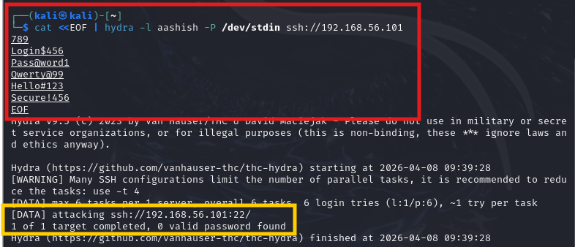

Task 1 — Launching the Attack with Hydra
Kali Linux → SSH service on 192.168.56.101
KEY FLAGS
-l aashish
single username
-P /dev/stdin
piped password list
ssh://...:101
target protocol + IP
RESULT
1 of 1 target completed, 0 valid password found
Every guess failed — by design. The lab's value is not whether the attack succeeded but whether the telemetry captured every attempt with enough forensic detail for an analyst to reconstruct the sequence.
Incident Handling Lab | Elastic SIEM
12 / 29
Notes:
“What you’re seeing here is the actual SSH brute force attack launched from our Kali Linux machine.
At the top, we used the Hydra tool to target the Ubuntu server on port 22, which is the default port for SSH.
We specified a single username using the dash L flag — in this case, aashish — and we piped a list of common weak passwords into Hydra using standard input. These include passwords like Password123, Welcome123, and Secure456 -which are commonly used in real-world attacks.
Hydra then automatically tries each password against the target system at high speed.
On the right side, you can see the key flags:
dash L specifies the username
dash P slash dev slash stdin allows us to pass the password list
and ssh with the IP defines the target protocol and machine
At the bottom, we see the result: 1 target completed, 0 valid passwords found.
So the attack failed — which is expected for a secure system.
But the important point is not whether the attack succeeded — it’s that every single attempt was logged and captured, which allows us to detect and investigate the attack in the next steps.”
In a real SOC, even a failed attack like this is valuable -because it tells us someone is actively trying to break in.

Slide 13
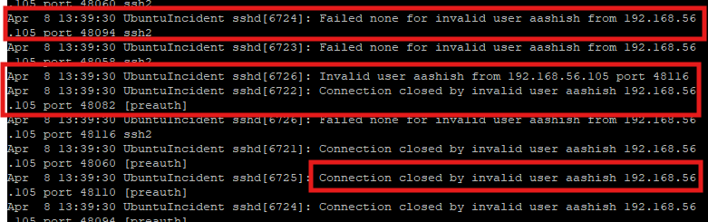


Task 1 — Evidence in /var/log/auth.log
Every failed SSH attempt is logged at the OS level
Timestamp
All attempts within the same second
Invalid User
User 'aashish' does not exist on host
Source IP
192.168.56.105 — the Kali attacker
Process
sshd[6724] — the SSH daemon itself
The OS captures everything — and the Elastic Agent reads this file continuously, shipping every new line to Fleet within seconds.
Incident Handling Lab | Elastic SIEM
13 / 29
Notes:
This is the raw content of slash var slash log slash auth.log on the target Ubuntu machine, taken while the Hydra attack was running. Every one of those repeated lines is a failed SSH authentication attempt. You can see the pattern immediately: many attempts within the same second, all from the same source IP, all with the same username that does not exist on the server.
On the right, the key fields are highlighted:
Timestamp shows all attempts happening almost instantly, which is not human behavior.
Invalid user tells us the username does not exist.
Source IP identifies the attacker machine.
And process confirms the activity is coming from the SSH service.
So even at the operating system level, we can clearly detect suspicious activity before it even reaches the SIEM.

Slide 14
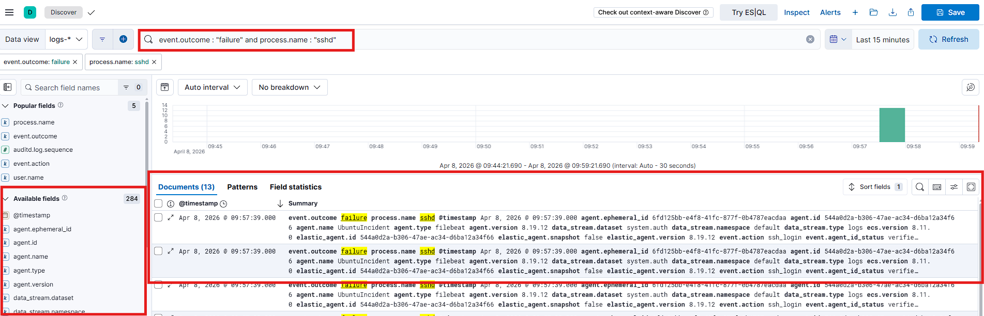
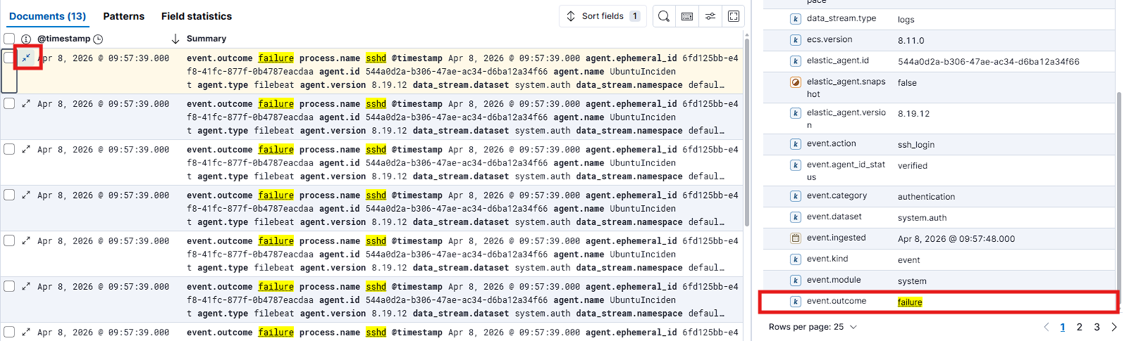
Task 1 — Detection in Kibana
From raw log to pivot-ready evidence
KQL:
event.outcome : "failure" and process.name : "sshd"
13
sshd
failure
ssh_login
documents matched
process.name
event.outcome
event.action
Incident Handling Lab | Elastic SIEM
14 / 29
Notes:
“At the top, you can see the KQL query we used to find the attack in Kibana.
In simple terms, this query is saying: show me all events where the login failed and the process is SSH.
Below that, on the left, is the Discover view. We can see 13 matching events, all happening within a very short time. This tight grouping is a clear sign of an automated brute force attack, because a normal user would not fail login attempts this quickly.
On the right side, when we expand an event, we get full details like the timestamp, source IP, username, and process. This gives us complete visibility into what happened.
At the bottom, the key points are summarized: 13 events, all from the SSH process, all failed logins, and all related to SSH login attempts.
So from this, we can clearly confirm that a brute force attack occurred, even though it was unsuccessful.
In a real SOC, this type of activity would trigger an alert automatically within seconds.

Slide 15
Task 2 — RDP Brute Force Attack
Interactive desktop access as the attacker's prize
WHAT IS IT?
ATTACK FLOW
RDP Brute Force
Kali Linux
RDP :3389
Windows
Remote Desktop Protocol (RDP) provides full graphical desktop access to a Windows machine over TCP port 3389. It is enabled by default on Windows Server.
A successful RDP brute force gives the attacker the same level of access as a legitimate administrator — complete control of the machine.
192.168.56.105
192.168.56.103
Hydra → Administrator
Sysmon + Elastic Agent
DEFENCE IN DEPTH
Security Event 4625 → failed logon
TWO LAYERS OF EVIDENCE
Sysmon Event 3 → network connection to :3389
Windows Security Event ID 4625
Both sources indexed in Elasticsearch
Native failed-logon event recorded by Windows itself
Sysmon Event Code 3
Overlapping evidence = harder to tamper with
Network connection detected, logged by Sysinternals Sysmon
Incident Handling Lab | Elastic SIEM
15 / 29
Notes:
This slide introduces the RDP brute force attack. RDP stands for Remote Desktop Protocol — it's the service that gives you full graphical desktop access to a Windows machine, running on TCP port 3389. It's enabled by default on Windows Server, which makes it a very common attack target.
What makes RDP interesting from a defender's perspective is that a successful brute force here gives the attacker complete control of the machine — same level of access as a legitimate administrator.
For this task we have two layers of evidence. First, Windows Security Event ID 4625, which is the native failed-logon event recorded by Windows itself. Second, Sysmon Event Code 3, which logs every network connection, detected by the Sysinternals Sysmon tool we installed.
Having overlapping evidence from two independent sources makes it much harder for an attacker to cover their tracks.

Slide 16
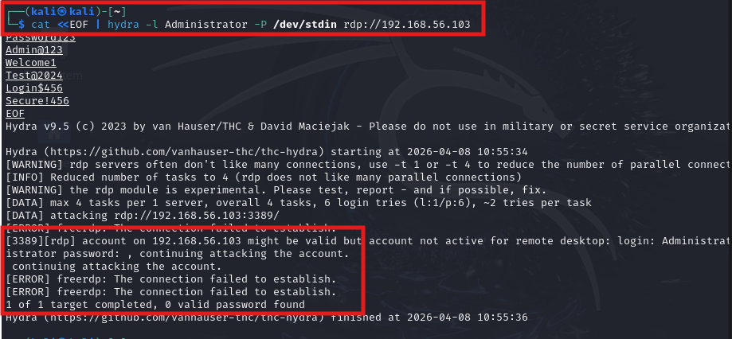

Task 2 — Launching the RDP Attack
Kali Linux → Windows Server on 192.168.56.103
ATTACK BREAKDOWN
TARGET
192.168.56.103:3389
ACCOUNT
Administrator
TOOL
hydra v9.5 (Kali)
MODULE
rdp (experimental)
TASKS PER TARGET
4 (RDP limited)
RESULT
0 valid password found
Every attempt produced a Security 4625 event on the target AND a Sysmon Event 3 for the network connection — the kind of overlapping evidence an analyst relies on.
Incident Handling Lab | Elastic SIEM
16 / 29
Notes:
Here we can see the actual Hydra command we ran from Kali Linux. The target was 192.168.56.103 on port 3389, the account we were attacking was Administrator, and we used the experimental RDP module in Hydra version 9.5.
One thing to note — Hydra limits RDP to 4 concurrent tasks because the protocol doesn't handle parallelism well.
The result was 0 valid passwords found, which was expected. The point of the exercise wasn't to actually break in — it was to generate the telemetry. And every single attempt produced a Security Event 4625 on the Windows machine AND a Sysmon Event 3 for the network connection. That's exactly the kind of overlapping evidence an analyst would look for in a real investigation.

Slide 17
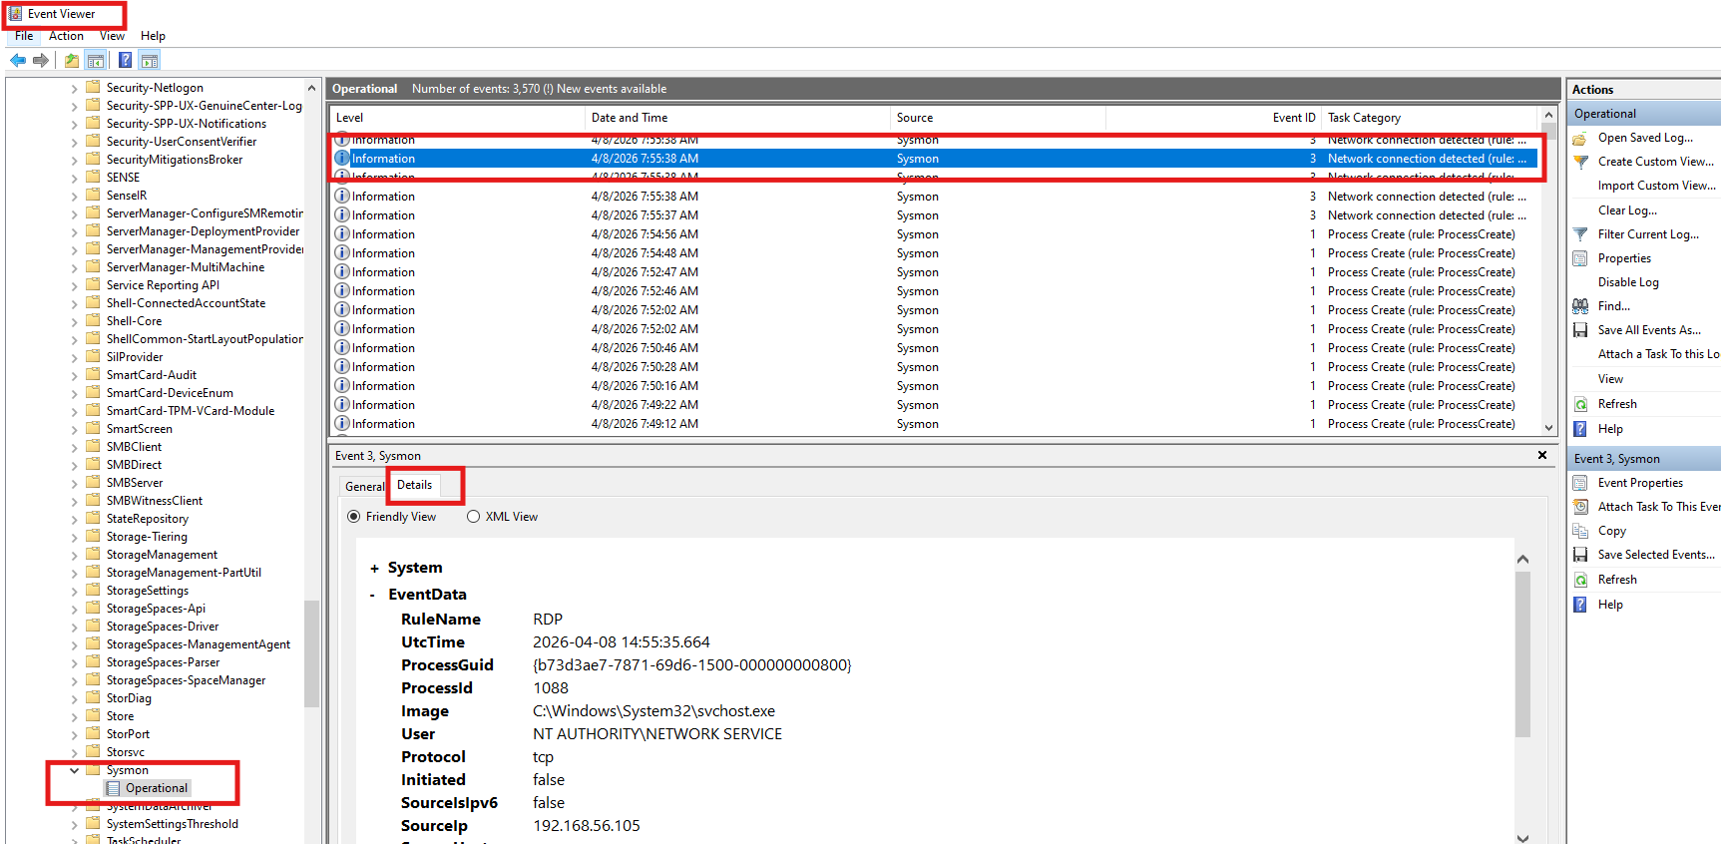



Task 2 — Evidence in Windows Event Viewer
Sysmon Operational channel capturing every connection
Source
Sysmon (SwiftOnSecurity config)
Event ID
3 — Network connection detected
Image
svchost.exe — RDP listener
Source IP
192.168.56.105 (Kali)
Rule
RDP (matched SysmonConfig rule)
Incident Handling Lab | Elastic SIEM
17 / 29
Notes:
This slide shows the evidence captured in Windows Event Viewer, specifically from the Sysmon Operational channel.
We can see Event ID 3, which is the network connection detection event. The key fields here are: the source is Sysmon configured with the SwiftOnSecurity ruleset; the Image is svchost.exe, which is the RDP listener process on Windows; the Source IP is 192.168.56.105, confirming it came from our Kali machine; and the Rule name matched 'RDP' from the Sysmon config.
This is real forensic evidence — it tells you exactly who connected, from where, and what process handled the connection.

Slide 18
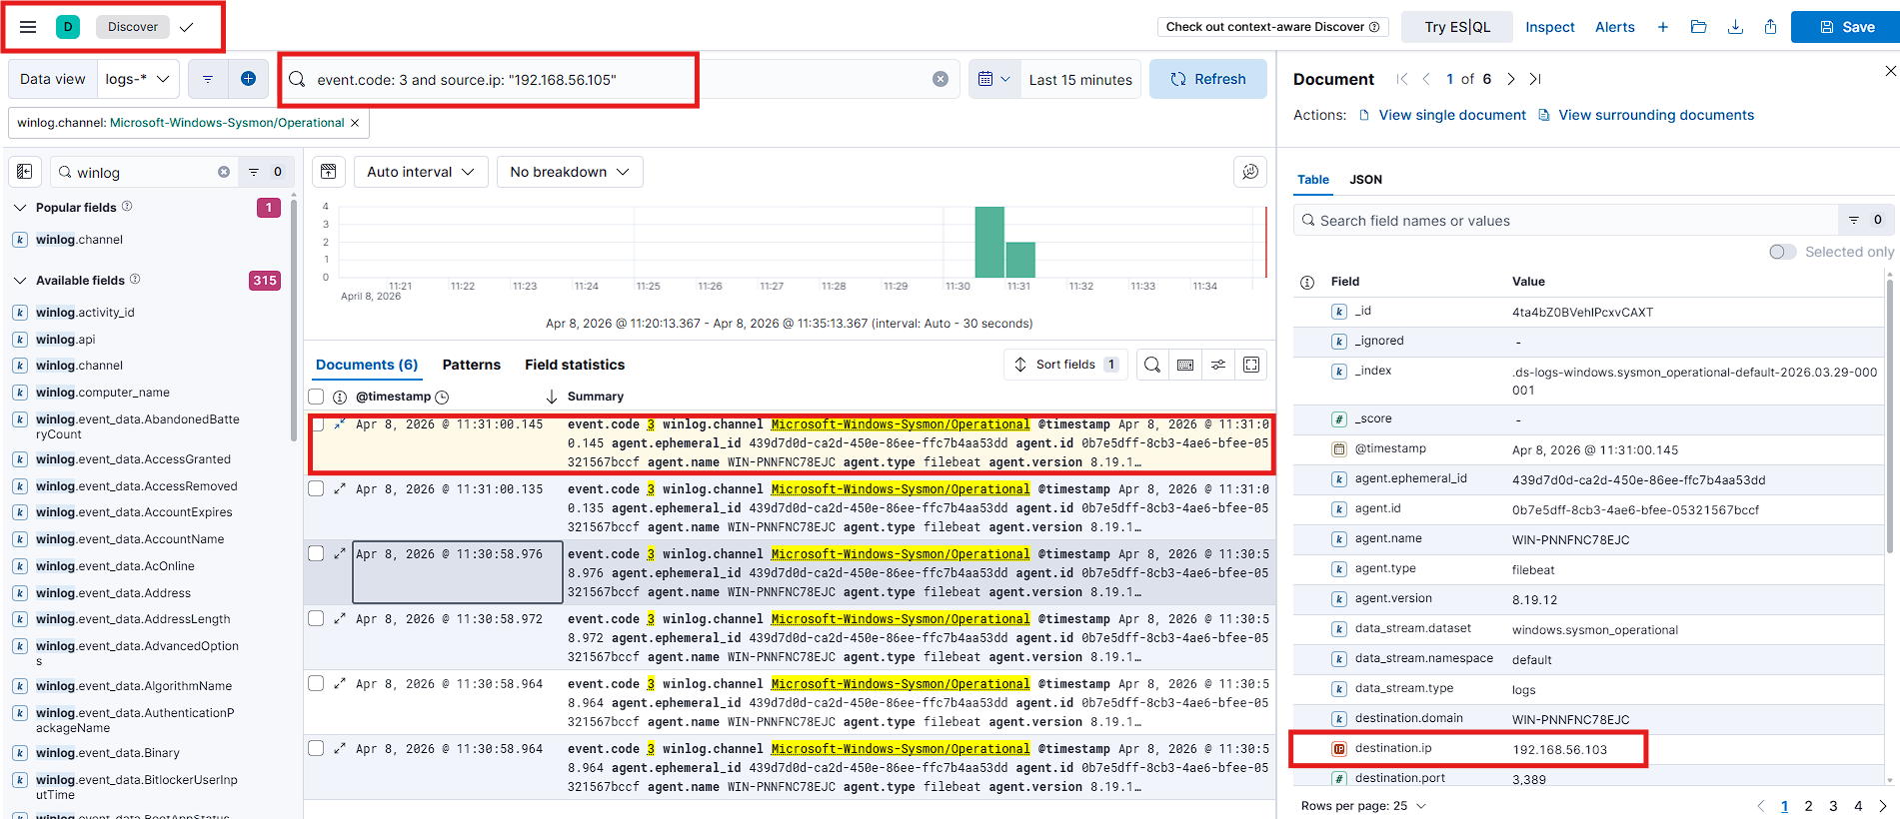
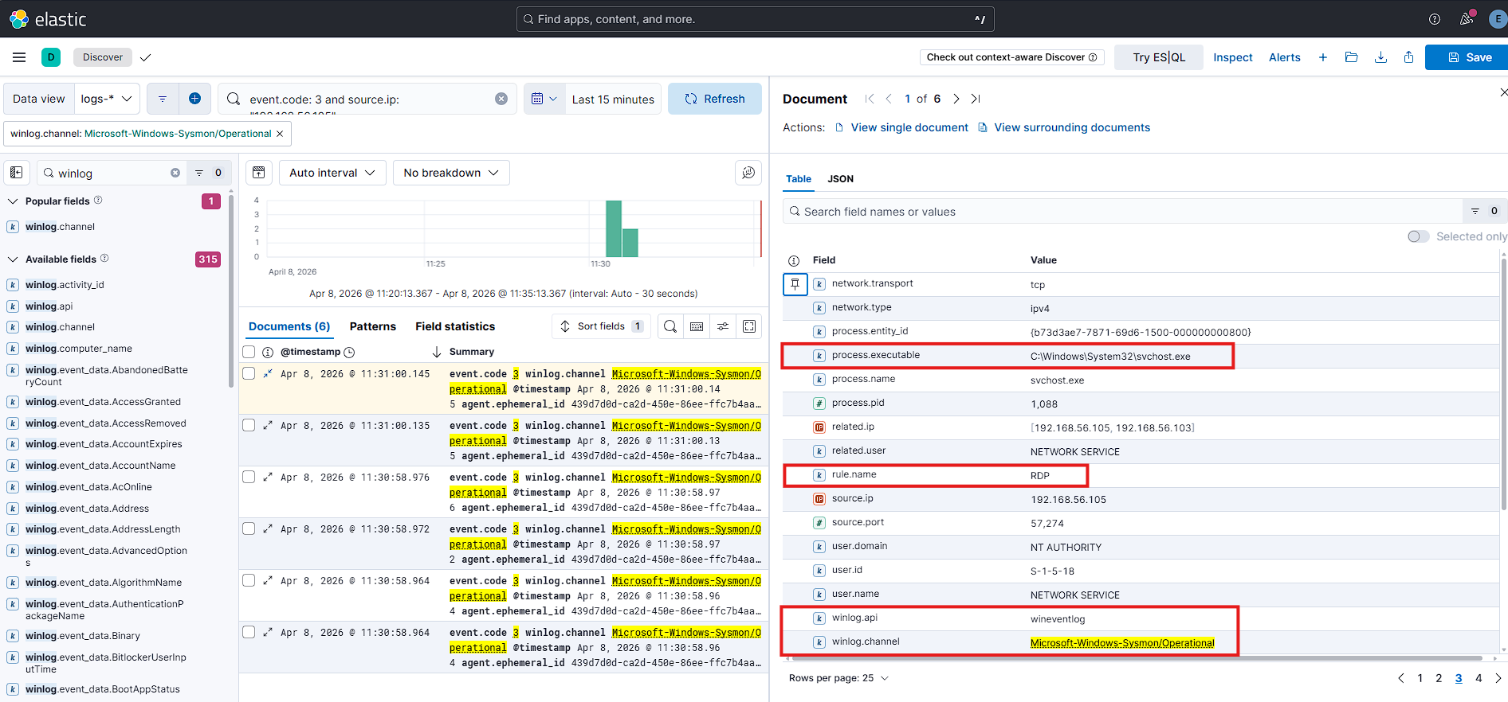
Task 2 — RDP Attack Surfaced in Kibana
Sysmon Event Code 3 with full process metadata
KQL:
event.code : 3 and source.ip : "192.168.56.105"
KEY FIELDS IN THE EXPANDED EVENT
rule.name: RDP
process.executable: C:\Windows\System32\svchost.exe
user.name: NETWORK SERVICE
winlog.channel: Microsoft-Windows-Sysmon/Operational
Incident Handling Lab | Elastic SIEM
18 / 29
Notes:
And here's what it looks like when we search for this in Kibana. The KQL query we used was: event.code : 3 and source.ip : 192.168.56.105 — filtering for Sysmon network connection events from our Kali attacker.
When we expand one of the events, we can see all the key fields: the rule name is RDP, the process executable is svchost.exe in System32, the user is NETWORK SERVICE, and the Winlog channel confirms it came from the Sysmon Operational log.
This is the power of having Sysmon integrated with the SIEM — raw Windows events become fully searchable, pivotable records in seconds.

Slide 19


Task 3 — File Integrity Monitoring
Catching what every other detection layer misses
WHAT IS IT?
PERSISTENCE MECHANISMS FIM CATCHES
File Integrity Monitoring
Startup script modification
FIM is a is a security control that watches specific files or directories and fires an alert whenever any of them is created, modified, renamed, or deleted.
On Linux, FIM is implemented through Auditd. Auditd intercepts kernel-level system calls directly. An attacker cannot change a file on an auditd-monitored system without generating a record.
FIM is also mandated by PCI DSS, HIPAA, and the CIS Controls.
Adding a line to /etc/rc.local or systemd unit files so malware runs at boot
New cron job
A scheduled task that re-establishes the attacker's foothold every N minutes
SSH authorized_keys
Adding an attacker-controlled public key for later passwordless access
Configuration backdoor
Modifying sshd_config or sudoers to create an invisible administrator
Incident Handling Lab | Elastic SIEM
19 / 29
Notes:
It is important because It helps to detect what an attackers do after breaking into a system. One of the first things attackers usually do is set up persistence so they can keep access even if the original entry point is blocked.

Slide 20
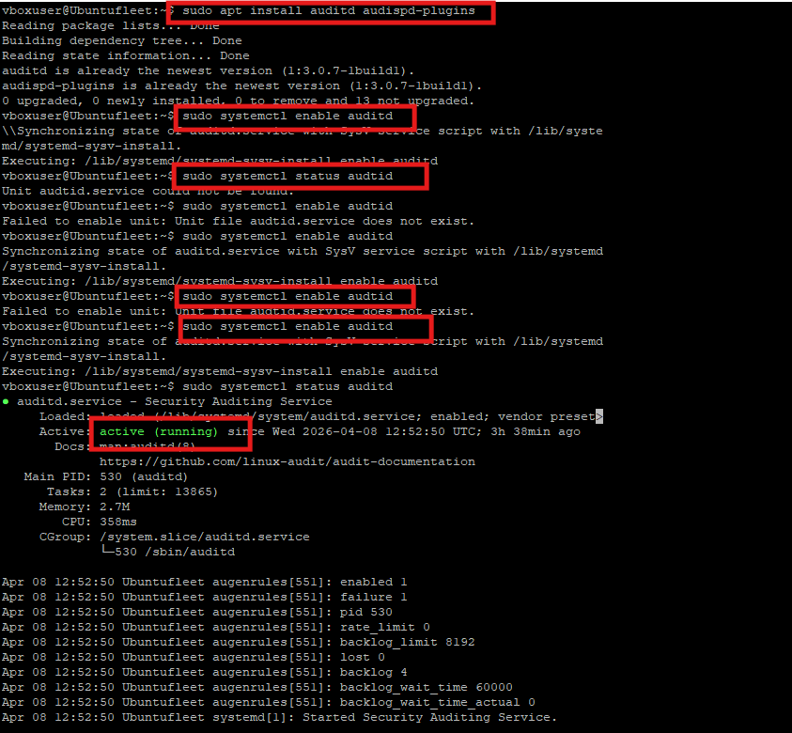

Task 3 — Auditd on the Ubuntu Fleet Server/Set Audit Rule
Custom rules targeting high-value files
The exact Auditd rule syntax showing the file path being monitored and the key identifier assigned to the rule for filtering in log searches
CUSTOM AUDIT RULE SET
/etc/audit/rules.d/audit.rules
-w /etc/passwd -p wa -k passwd_changes
this watches if any user account information changes
-w /etc/shadow -p wa -k shadow_changes
this watches if password/security-related changes
-w /etc/ssh/sshd_config -p wa -k sshd
SSH daemon configuration tampering
-w /usr/bin/sudo -p x -k sudo_commands
Every sudo invocation
-a always,exit -F arch=b64 -S execve -F euid=0
Any command executed as root
Incident Handling Lab | Elastic SIEM
20 / 29

Slide 21
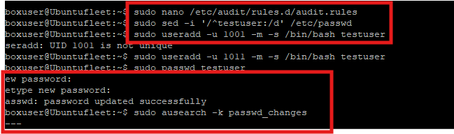
Task 3 — Creating the Auditd Watch Rule
Editing, defining and loading the rule set on the Fleet Server
Rule applied and triggered
The rule is loaded into the active rule set. Running useradd and passwd generates events, and ausearch -k passwd_changes confirms the rule is capturing them.
The Elastic Agent running on the Fleet Server picked up this new audit log entry and shipped it to Elasticsearch within seconds.
Open the rule file, write the watch rules with keys, reload auditd and confirm the rules fire when the watched files change
Incident Handling Lab | Elastic SIEM
21 / 29

Slide 22
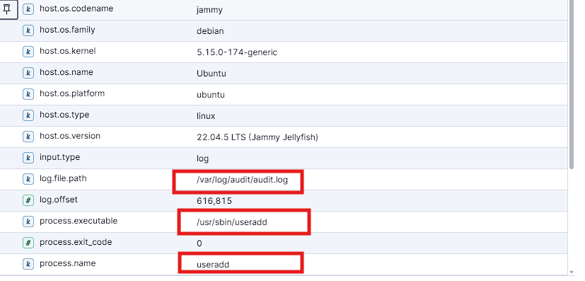
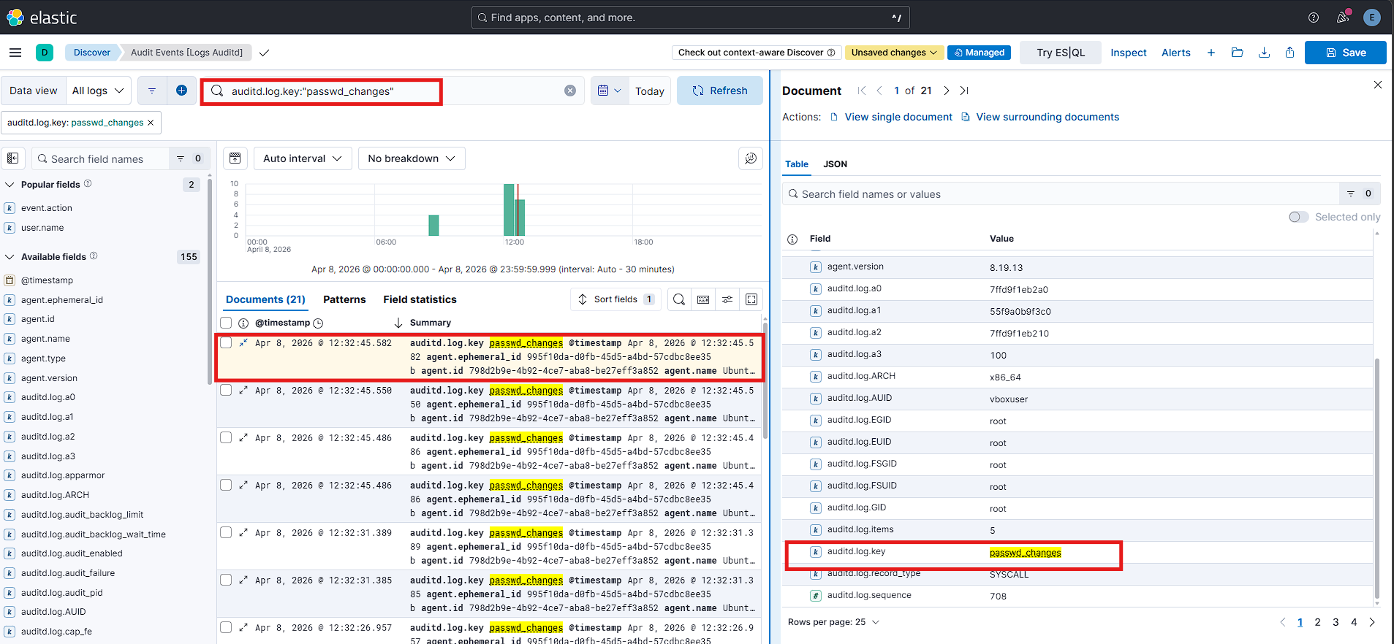
Task 3 — File Integrity Event in Kibana
21 audit records captured for the passwd_changes key
Kibana showing the Auditd file integrity event appearing in the log data after the monitored file was modified, confirming the pipeline from Auditd on the Fleet Server to Elasticsearch is working
The event fields visible in Kibana provide a complete picture of what happened. The data includes the exact file path that was changed, the precise timestamp, the user account that made the change, the process name and process ID that carried out the modification, and the system call that was used. This level of detail is exactly what an incident responder needs to determine whether a file change was authorised and expected, or suspicious and worth investigating further.
:
C
auditd.log.key: passwd_changes
process.name: useradd
process.executable: /usr/sbin/useradd
auditd.log.EUID: root
Incident Handling Lab | Elastic SIEM
22 / 29
Notes:
Everything demonstrated so far has relied on an analyst actively opening Kibana and running a search query to find attack evidence. In a real SOC environment that approach is not sufficient. An analyst cannot be manually running searches all day long looking for attacks. The system needs to do that work automatically and alert the analyst only when something worth their attention is found. This is the role of detection rules.

Slide 23
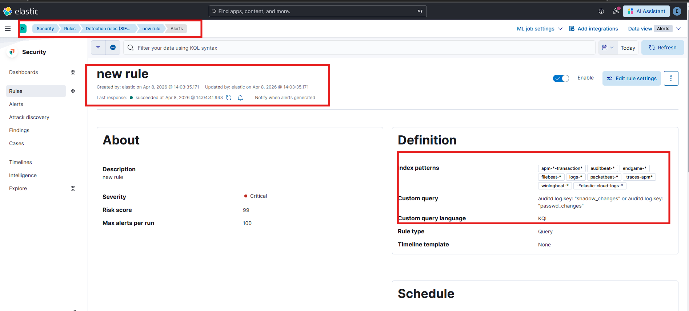
From Passive Search to Active Detection
A Kibana custom rule that fires automatically when it detects specific log key such as passwd_change,shadow_change
RULE CONFIGURATION
NAME
passwd_changes detection
SEVERITY
Critical
RISK SCORE
99 / 100
RULE TYPE
Custom Query (KQL)
INDEX PATTERNS
logs-*, auditbeat-*
DETECTION QUERY (KQL)
auditd.log.key : "shadow_changes" or auditd.log.key : "passwd_changes" fire an alert whenever any event has an audit key of shadow_changes or passwd_changes. So any change to the password files, or any change to the shadow password hashes, will automatically trigger this rule without anyone having to do anything
Incident Handling Lab | Elastic SIEM
23 / 29
Notes:
Log * means Search all Elasticsearch indexes whose names start with log-
Auditbeat means Search all indexes whose names start with auditbeat-

Slide 24
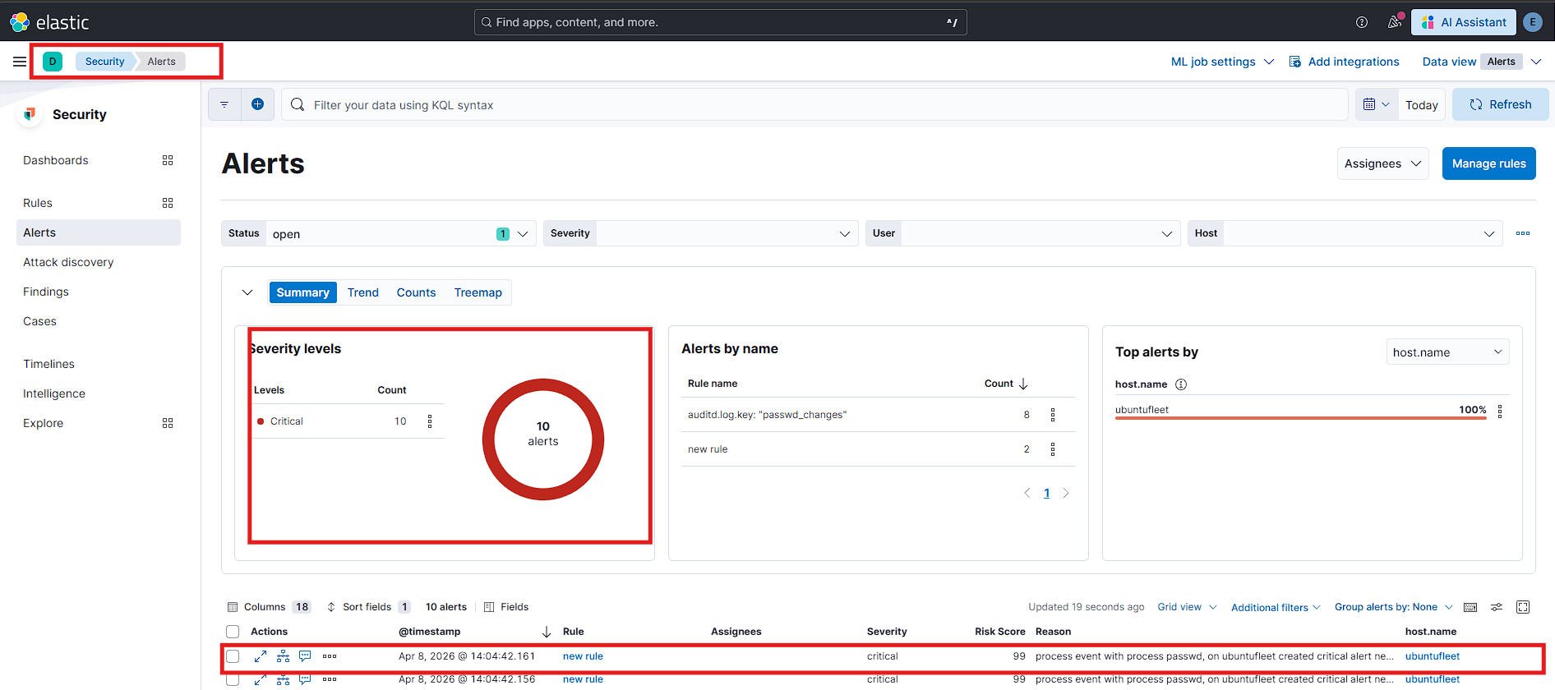
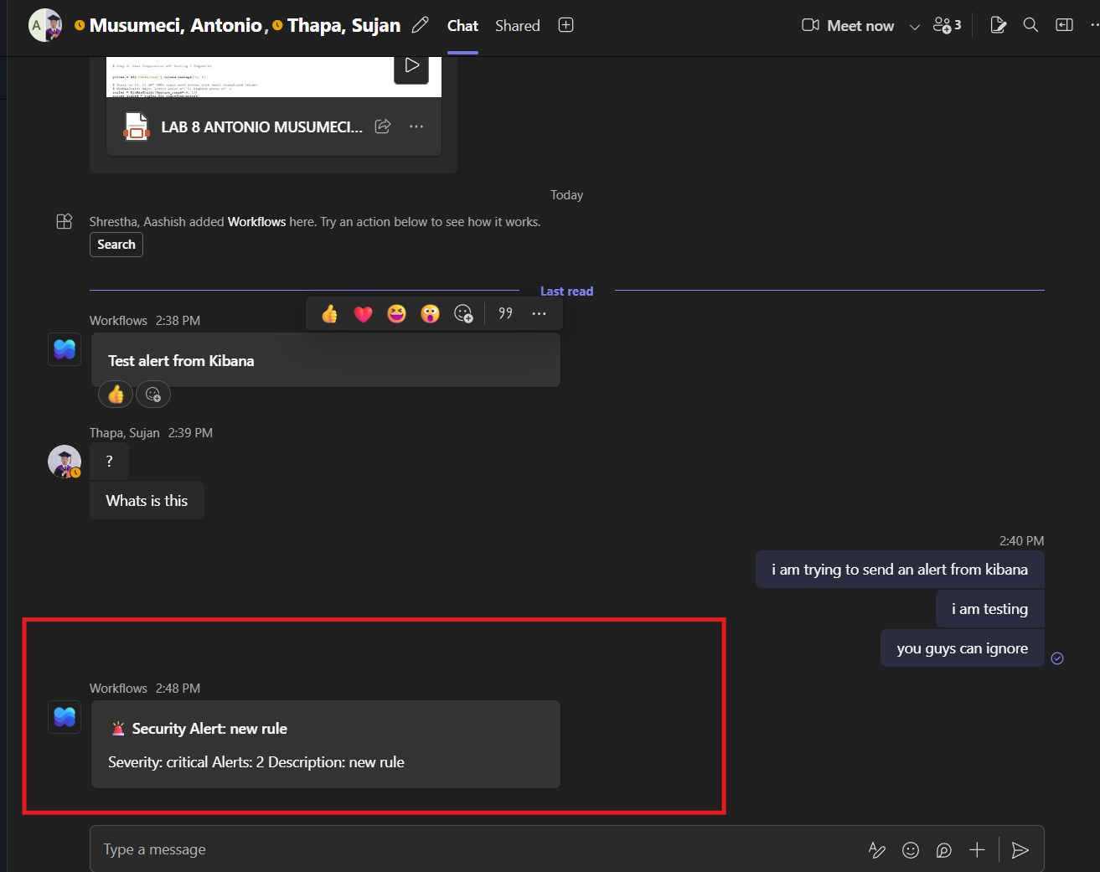
Alert Delivery to Microsoft Teams
Closing the loop from event to SOC analyst
Microsoft Teams channel showing the alert notification delivered by Kibana via the webhook integration, confirming the complete end-to-end pipeline from Auditd event on the Fleet Server through to a real-time notification in the SOC communication channel
Kibana Security Alerts view
Microsoft Teams incoming webhook alert
END-TO-END PIPELINE — 4 STEPS, UNDER 60 SECONDS
1
→
2
→
3
→
4
File changed
Auditd logs event
Rule fires in Kibana
Teams notification
Incident Handling Lab | Elastic SIEM
24 / 29

Slide 25

Key Findings & Insights
What the end-to-end build taught us
Centralised log collection is transformative
Before the SIEM, investigating a failed login meant SSHing into the target to read files. After, one KQL query covers every monitored machine in seconds.
Brute force attacks have a loud, consistent signature
Many failure events from one source IP in a narrow time window — distinctive and well understood, yet still the top breach vector for many organizations.
The failure/success distinction matters enormously
Finding one successful login hidden among thousands of failures is the single most important skill in this kind of data.
Kernel-level FIM catches what nothing else can
An attacker can hide process activity, mask network traffic, or clear syslog — but changing a file on a machine running Auditd always leaves a record.
Alerting pipelines turn forensic tools into operational ones
A SIEM that only shows you what happened yesterday is valuable. One that alerts in real time lets you respond before the attacker achieves their goal.
Incident Handling Lab | Elastic SIEM
25 / 29
Notes:
This slide summarizes the main takeaways from the whole project.
The first thing we learned is that centralized log collection is transformative. Before the SIEM, investigating a failed login meant manually SSHing into each machine. After, one KQL query covers every monitored host in seconds.
Second — brute force attacks have a very loud, consistent signature. Many failures from one IP in a short window is easy to spot, yet it's still one of the top breach vectors out there.
Third — the failure/success distinction is critical. Finding that one successful login hidden among thousands of failures is the most important skill in this kind of analysis.
Fourth — kernel-level FIM catches what nothing else can. An attacker can clear syslog, hide processes, mask traffic — but they cannot change a file on a machine running Auditd without leaving a record.
And finally — alerting pipelines turn forensic tools into operational ones. A SIEM that only shows you what happened yesterday is useful. One that alerts in real time lets you respond before the attacker achieves their goal.

Slide 26

Lessons Learned — Practical Gotchas
Things we only learned by running into them
01
02
Enrollment tokens expire quickly
Port 8220 must be open on Fleet
If Kibana's first-login token sits around, generate a new one.
In production, firewalls between hosts and Fleet break enrollment silently.
03
04
Windows Defender may flag the agent
Auditd rule specificity matters
Pre-configure Defender exclusions for the Elastic Agent binary paths.
Monitoring a broad directory tree produces too much noise. Target specific high-value files.
05
06
DEB install blocks remote upgrades
TLS fingerprints must match exactly
Use the TAR installer instead if agents need to be upgraded via Fleet.
The CA in /etc/elasticsearch/certs can differ from what's actually served — verify the fingerprint.
Incident Handling Lab | Elastic SIEM
26 / 29
Notes:
This slide covers the practical problems we actually ran into while building the lab — the things you only learn by doing it.
Number 1 — enrollment tokens expire quickly. If you wait too long after generating the first-login token in Kibana, you need to generate a new one.
Number 2 — Port 8220 must be open on the Fleet Server. If a firewall blocks it, agent enrollment fails silently — no error message, just nothing.
Number 3 — Windows Defender can flag the Elastic Agent binary. You need to pre-configure exclusions for the agent's installation paths.
Number 4 — Auditd rule specificity matters. Monitoring a broad directory generates too much noise. You need to target specific high-value files like we did.
Number 5 — If you install via DEB package, you can't upgrade agents remotely through Fleet. Use the TAR installer instead if you want that flexibility.
Number 6 — TLS fingerprints must match exactly. The certificate in the Elasticsearch certs folder can differ from what's actually being served — always verify the fingerprint manually.

Slide 27



Potential Improvements
How to push this lab toward a production-grade SOC
Rich Sysmon config
MITRE ATT&CK mapping
GeoIP enrichment
Full process creation, parent-child chains, registry, DNS, named pipes
Align detection rules to ATT&CK techniques for coverage analysis
Translate source IPs to country/city in Logstash; map view in Kibana
Threat intel feeds
Infra-as-code rebuild
Full attack chain
MISP or Elastic TI to flag known-bad IPs, hashes, and domains
Ansible playbooks to reproduce the whole lab with one command
Initial access → privilege escalation → lateral movement → exfil
The stack scales — with time, this lab could evolve into a genuine production SOC reference implementation.
Incident Handling Lab | Elastic SIEM
27 / 29
Notes:
This last slide looks at how we could push this lab toward something closer to a production-grade SOC.
A richer Sysmon config would capture full process creation trees, parent-child relationships, registry changes, DNS queries, and named pipes.
MITRE ATT&CK mapping would let us align our detection rules to specific attack techniques and identify coverage gaps.
GeoIP enrichment in Logstash would translate source IPs to countries and cities, enabling a map view in Kibana.
Threat intel feeds like MISP or Elastic Threat Intelligence would automatically flag known-bad IPs and file hashes.
Infrastructure-as-code with Ansible would let us rebuild the entire lab with a single command — great for reproducibility.
And a full attack chain — initial access, privilege escalation, lateral movement, and data exfiltration — would make this a much more realistic adversary simulation.
As we said at the bottom of this slide — the stack scales. With more time, this lab could genuinely evolve into a production SOC reference implementation.

Slide 28
References
Technical documentation and AI tools cited in the project
TECHNICAL REFERENCES
[1] Elastic N.V., Elastic Stack Documentation, elastic.co/guide
[10] M. Russinovich and T. Garnier, Sysmon v15.15 System Monitor, Microsoft Sysinternals
[2] Elastic N.V., Fleet and Elastic Agent Guide, elastic.co/guide/en/fleet
[11] Microsoft Corp., Windows Security Event Log Reference (Event ID 4625), learn.microsoft.com
[3] Elastic N.V., Elastic Common Schema (ECS) Reference, elastic.co/guide/en/ecs
[12] Microsoft Corp., Remote Desktop Protocol (RDP) Technical Reference, learn.microsoft.com
[4] Elastic N.V., Kibana Query Language (KQL), elastic.co/guide/en/kibana
[13] Oracle Corp., Oracle VM VirtualBox User Manual, virtualbox.org/manual
[5] Elastic N.V., Detection Rules and Security Solution, elastic.co/guide/en/security
[14] Microsoft Corp., Send an Incoming Webhook to Microsoft Teams, learn.microsoft.com
[6] P. Cichonski et al., Computer Security Incident Handling Guide, NIST SP 800-61 Rev 2, 2012
[15] PCI Security Standards Council, PCI DSS v4.0, pcisecuritystandards.org
[7] V. Hauser, THC-Hydra Network Logon Cracker, github.com/vanhauser-thc/thc-hydra
[16] Center for Internet Security, CIS Controls Version 8, cisecurity.org/controls
[8] Offensive Security, Kali Linux Official Documentation, kali.org/docs
[17] MITRE Corp., MITRE ATT&CK Framework, attack.mitre.org
[9] Red Hat, Linux Audit System (auditd) Documentation, access.redhat.com
AI AND LARGE LANGUAGE MODEL REFERENCES
Used during preparation for troubleshooting, documentation clarification, and report structuring. All technical work was performed by the authors.
[18] Anthropic, Claude (Large Language Model), claude.ai — troubleshooting and report structuring
[19] OpenAI, ChatGPT (Large Language Model), chat.openai.com — Elasticsearch config and auditd syntax
[20] Google DeepMind, Gemini (Large Language Model), gemini.google.com — terminology review
Incident Handling Lab | Elastic SIEM
28 / 29

Slide 29
MISSION ACCOMPLISHED
Thank You
A working SIEM, three real attacks detected, end-to-end.
29
3
100%
slides covered
attack scenarios
detection rate
Aashish Shrestha · Antonio Musumeci · Sujan Thapa · April 2026
Questions welcome.

