Slide 1
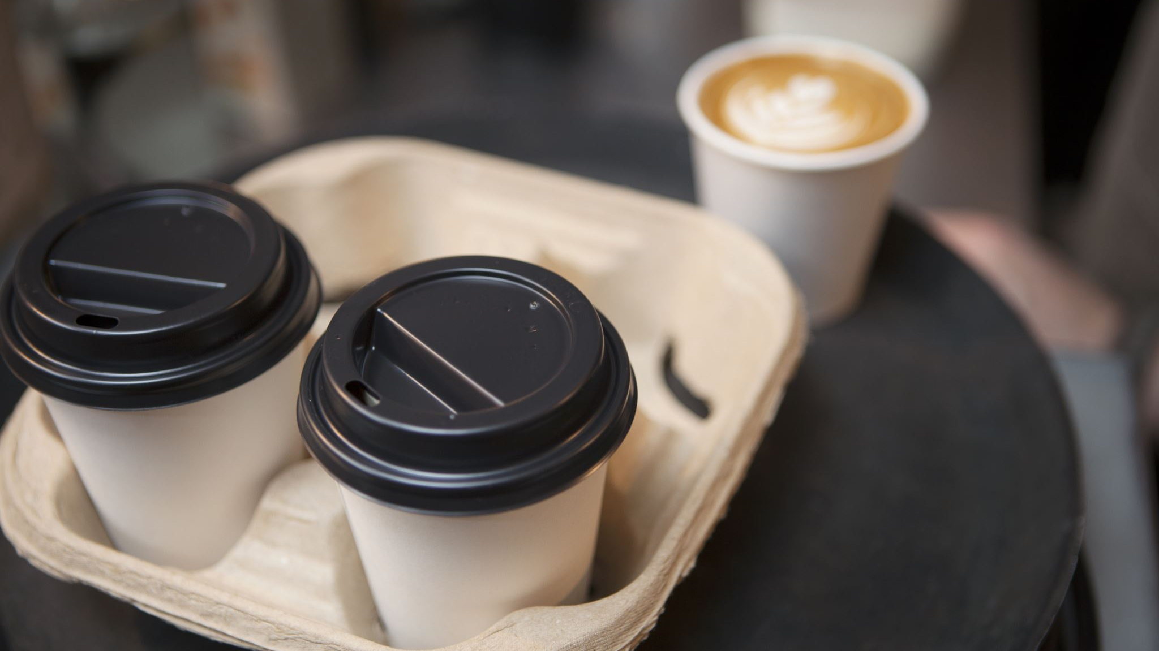
Data science And MAZ caffe
Mutab Alzubair

Slide 2
Will opening a cafe in the busiest stations and the target market is to know the number of transportation entrants (MTA)
In order to increase the number of visitors to the store, the project will be limited to establishing stations that have more entrants in the MTA stations.

Slide 3
Analytical Approach
Publicly available MTA turnstile data for the three months of 2019 were analyzed to determine the stations with the highest daily entry. The standard here is the high rate of entry during the morning commute hours.
Data was grouped by station, date, and time. Since the data was audited over morning periods, the morning commute hours were set between 4 AM and 12 PM.

Slide 4
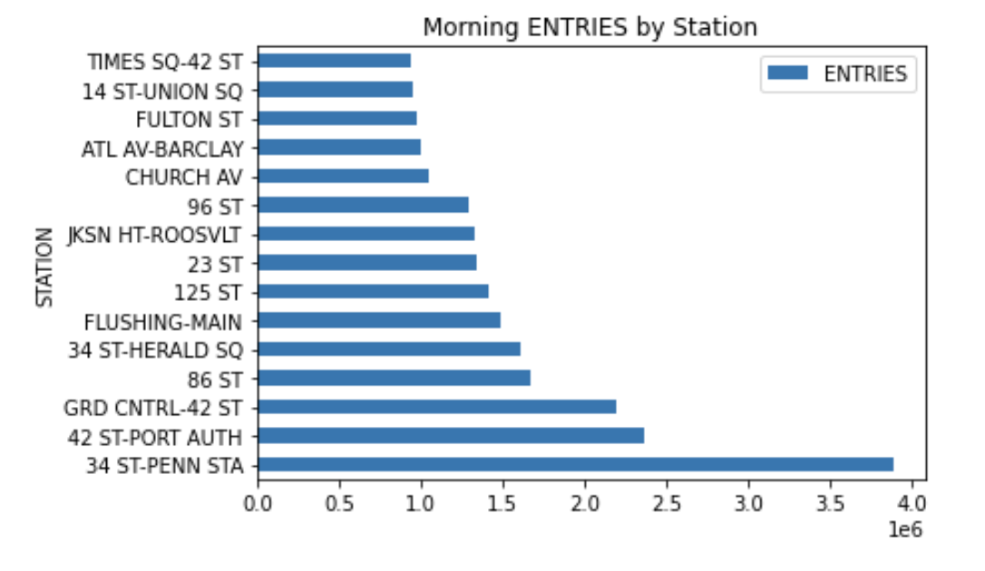
The busiest stations

Slide 5
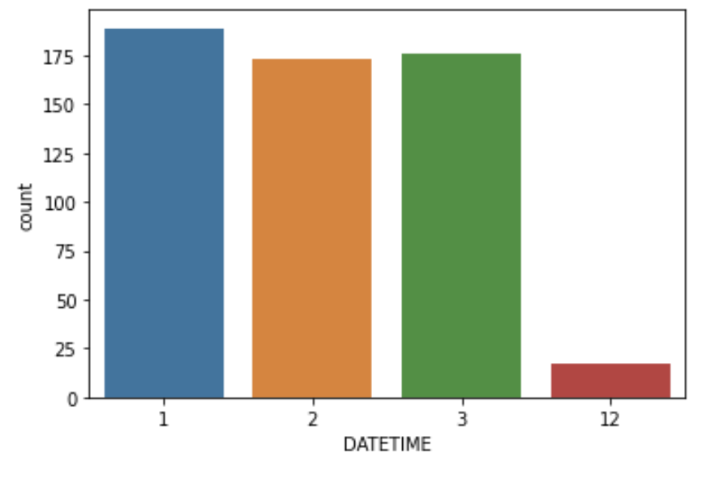
Number of People Entries 34 ST-PENN STA for the 3 Month

Slide 6
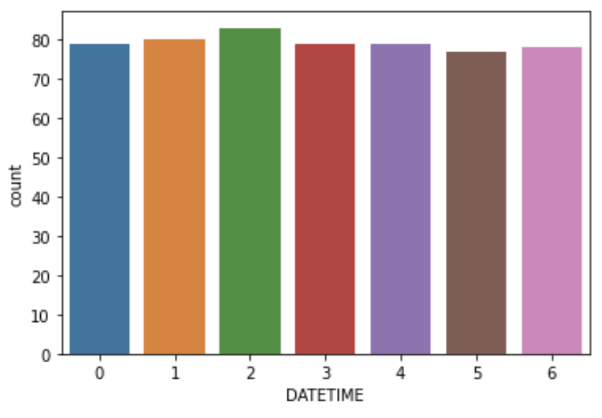
Number of People Entries 34 ST-PENN STA for One Week

Slide 7
Conclusion
In conclusion, the project strategy is to target stations with higher morning entry rates. The project must be opened in ST-PENN station, you will be successful due to the density of entrants to the station. Targeted ads in MTA stations with high nightlife traffic

Slide 8
Thank You
Mutab Alzubair

