Slide 1
Database ERD
Initial

Slide 2
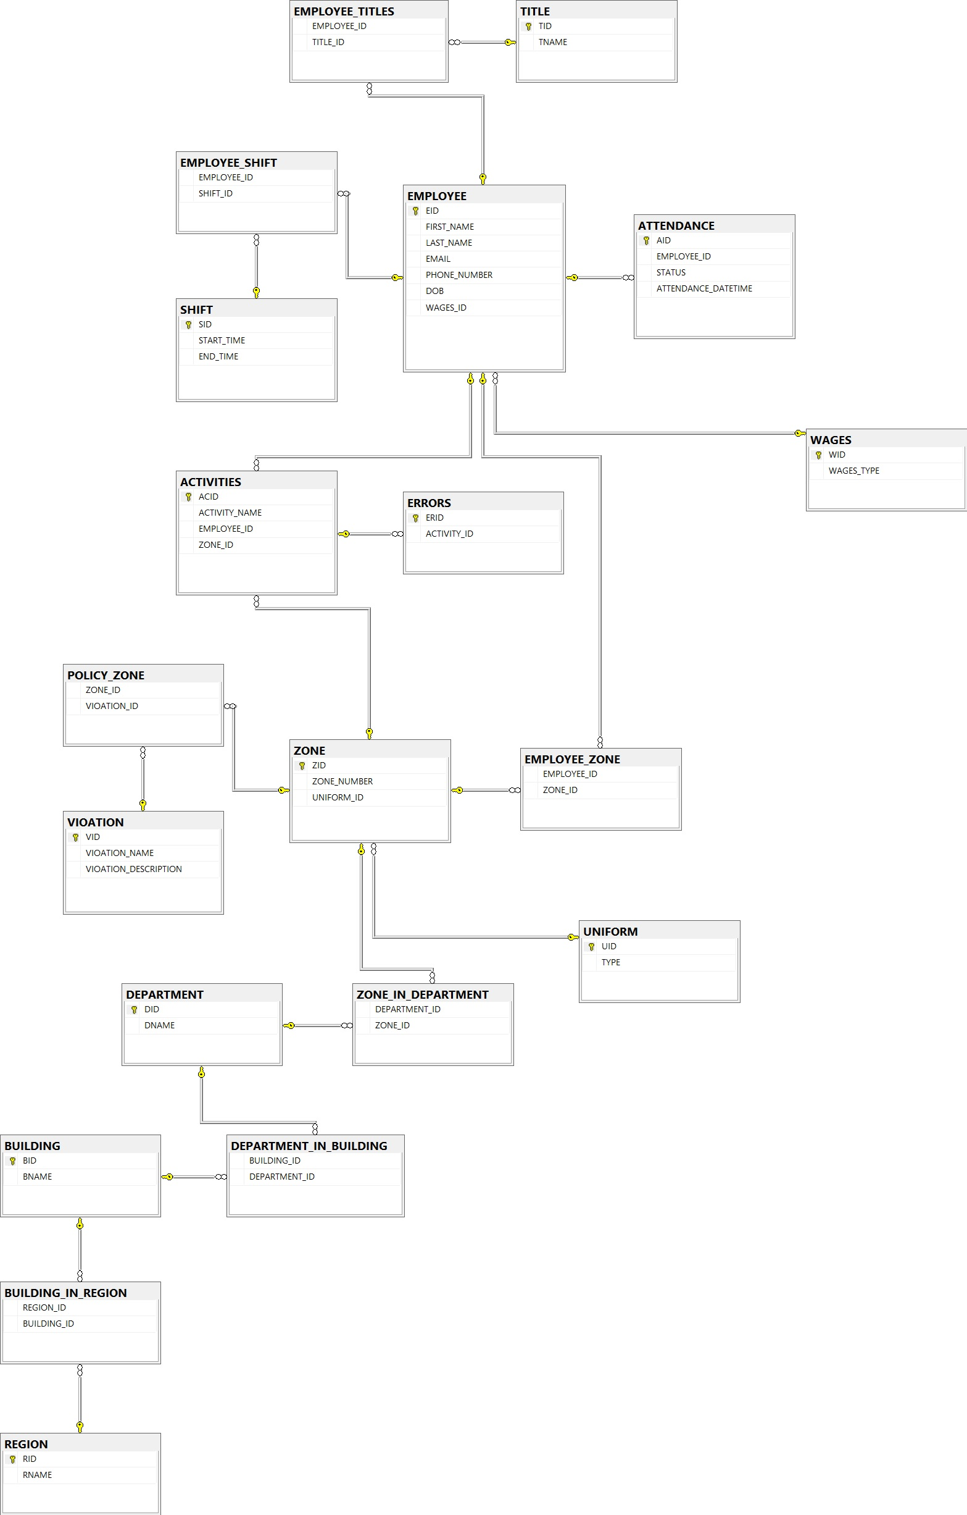
Not Normalized
Repeated Information
Not any centralized Table
Duty Rostrum Missing

Slide 3
Database ERD
Actual

Slide 4
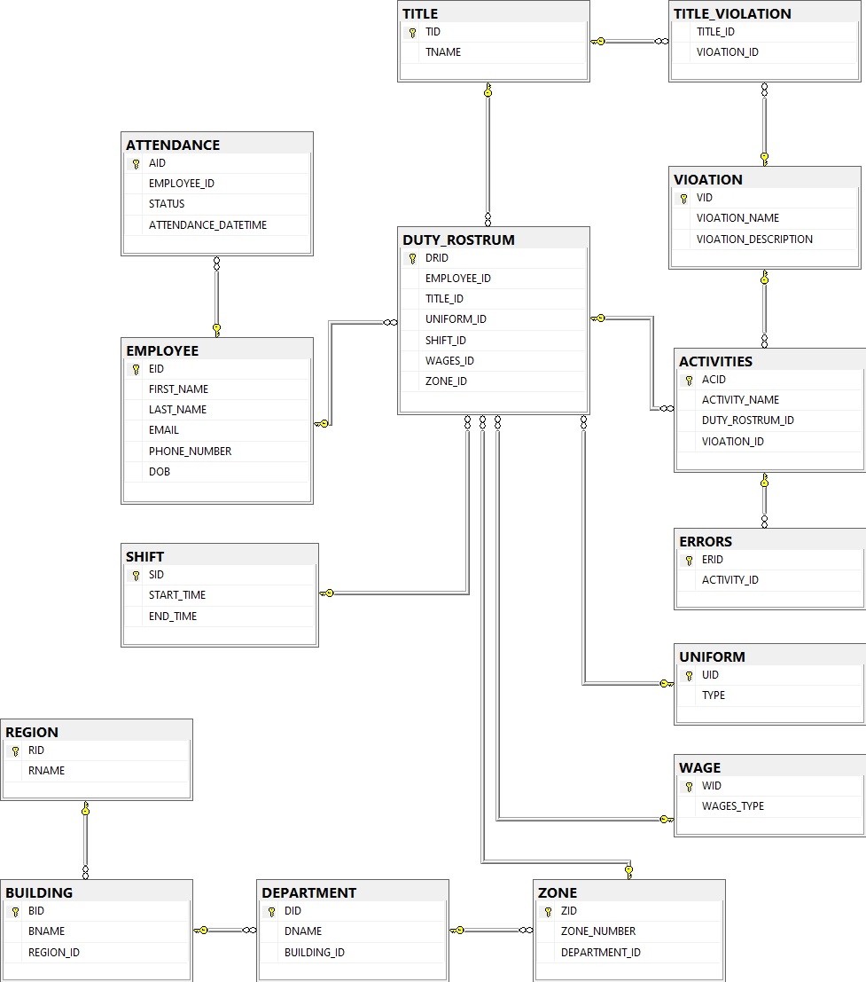
Normalized
Duty Rostrum
Centralized information

Slide 5
API and Database
Apache Thrift Services
Command: thrift --gen <language> <.Thrift File>
Reusable Interfaces
Server based on C# with Thrift
Client based on Python with Thirft
TBinary Protocol Layer
TSocket Transport Layer
MSSQL Server DB
DJango Admin Panel

Slide 6
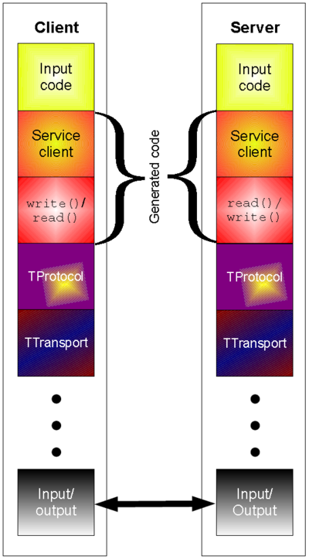
Thrift Architecture

Slide 7
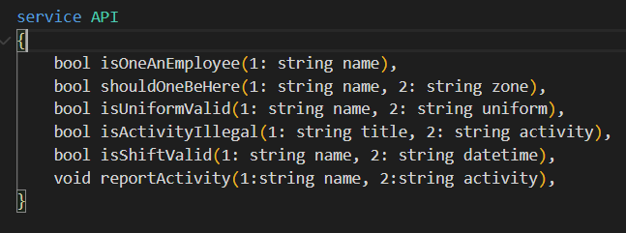
API interfaces

Slide 8
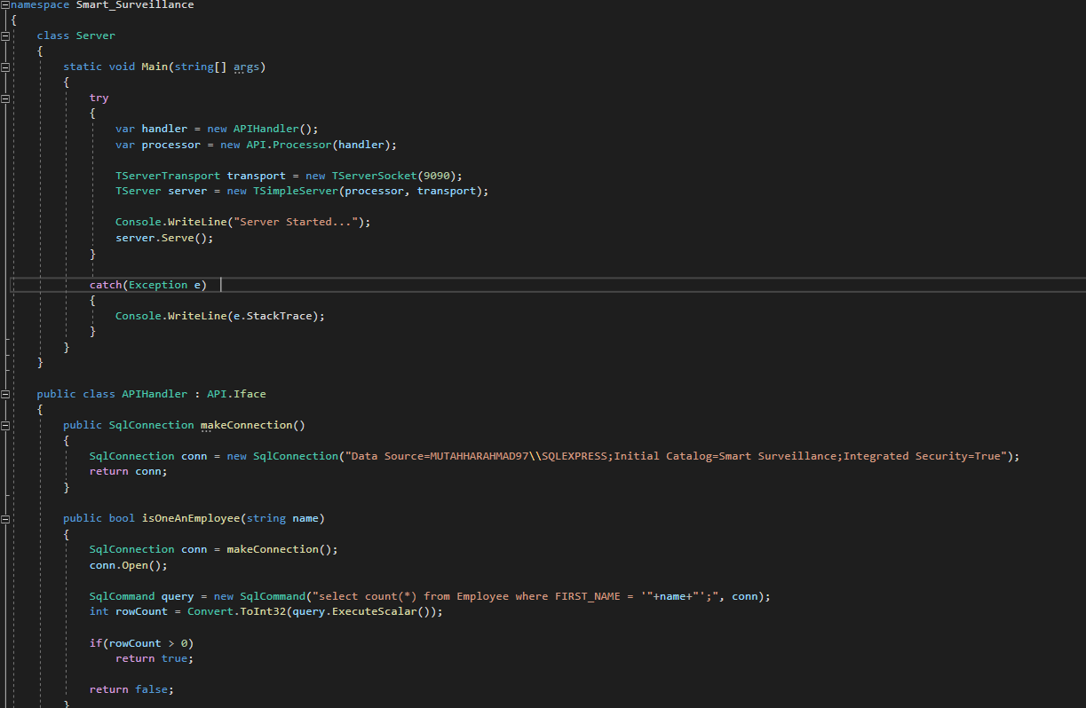
C# Thrift Server

Slide 9
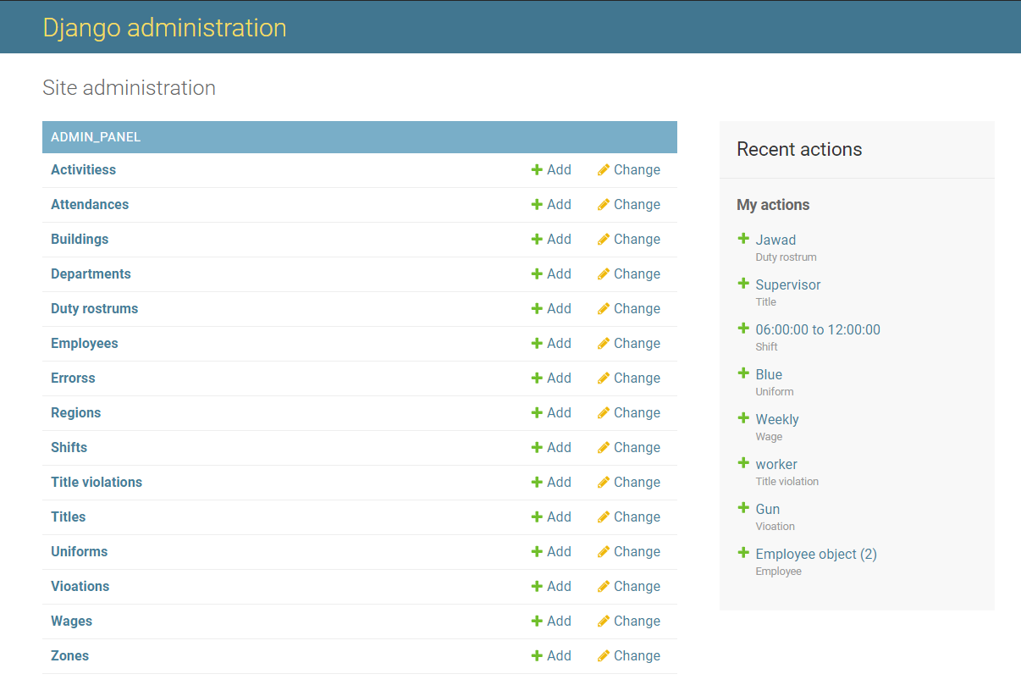
Django Admin Panel

Slide 10
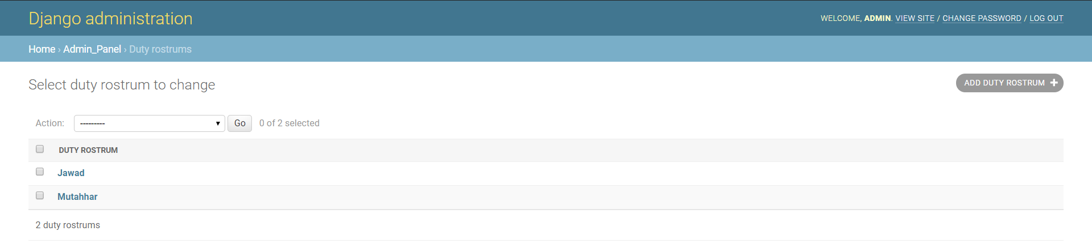
Django Admin Panel

Slide 11
User Interface
PyQt5

Slide 12
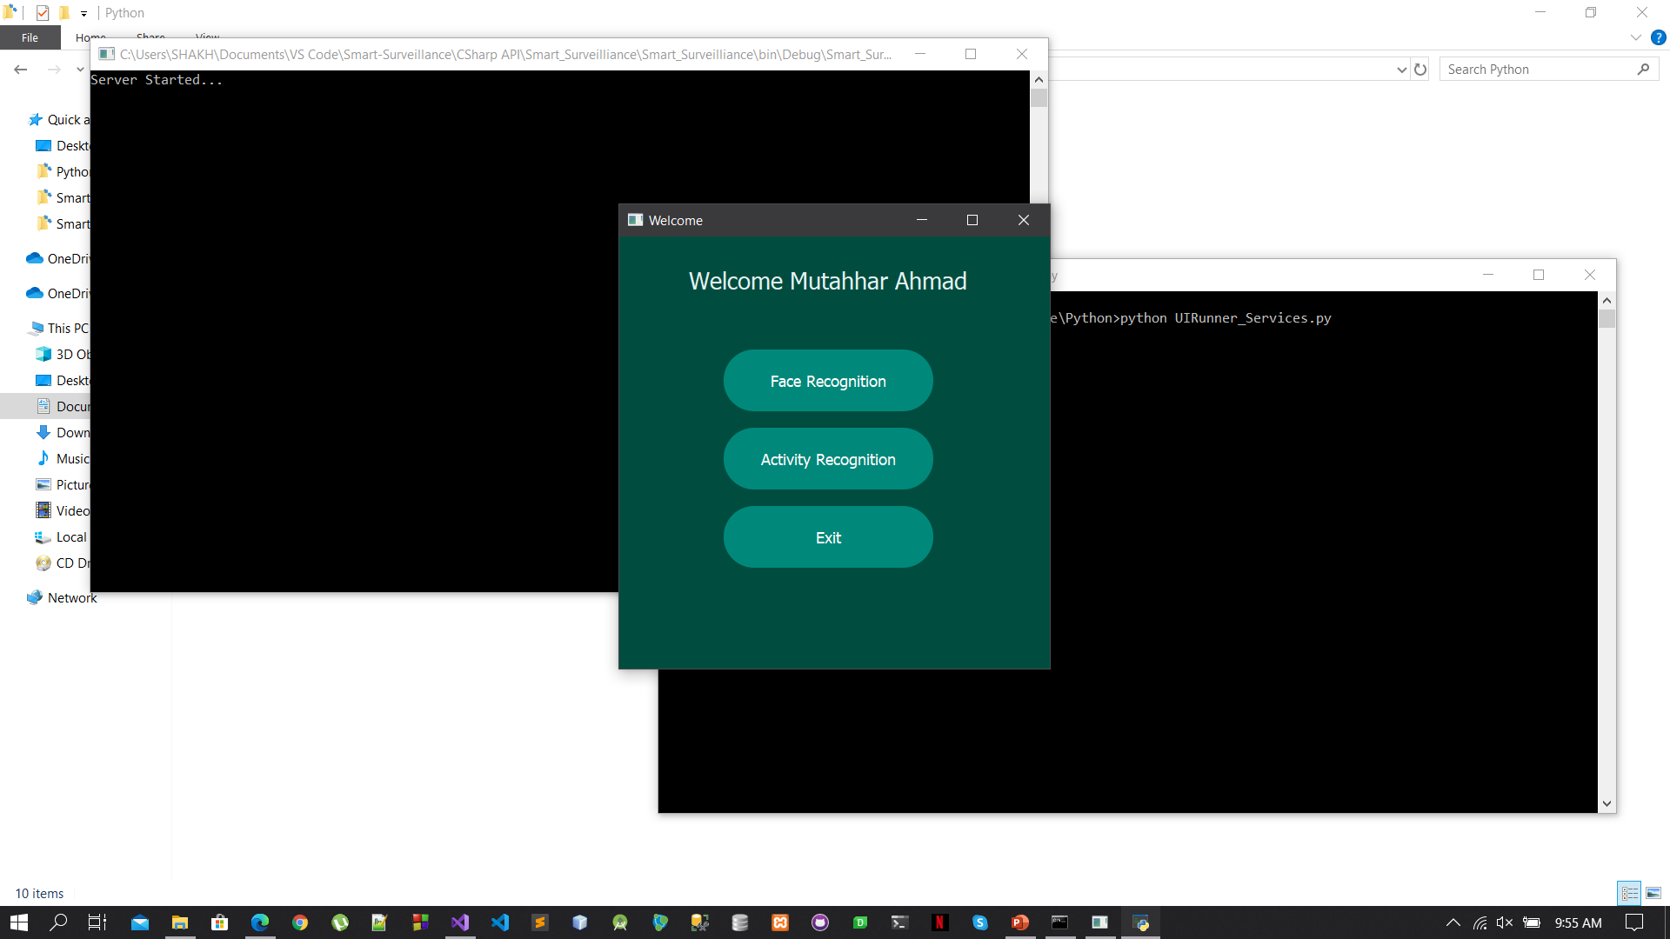
Application(UI)

Slide 13
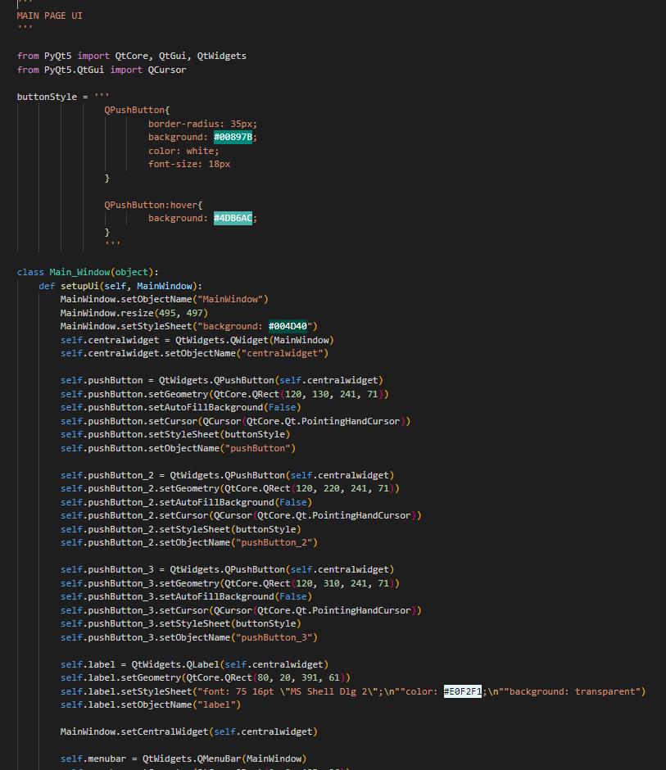
Application(UI Code)

Slide 14
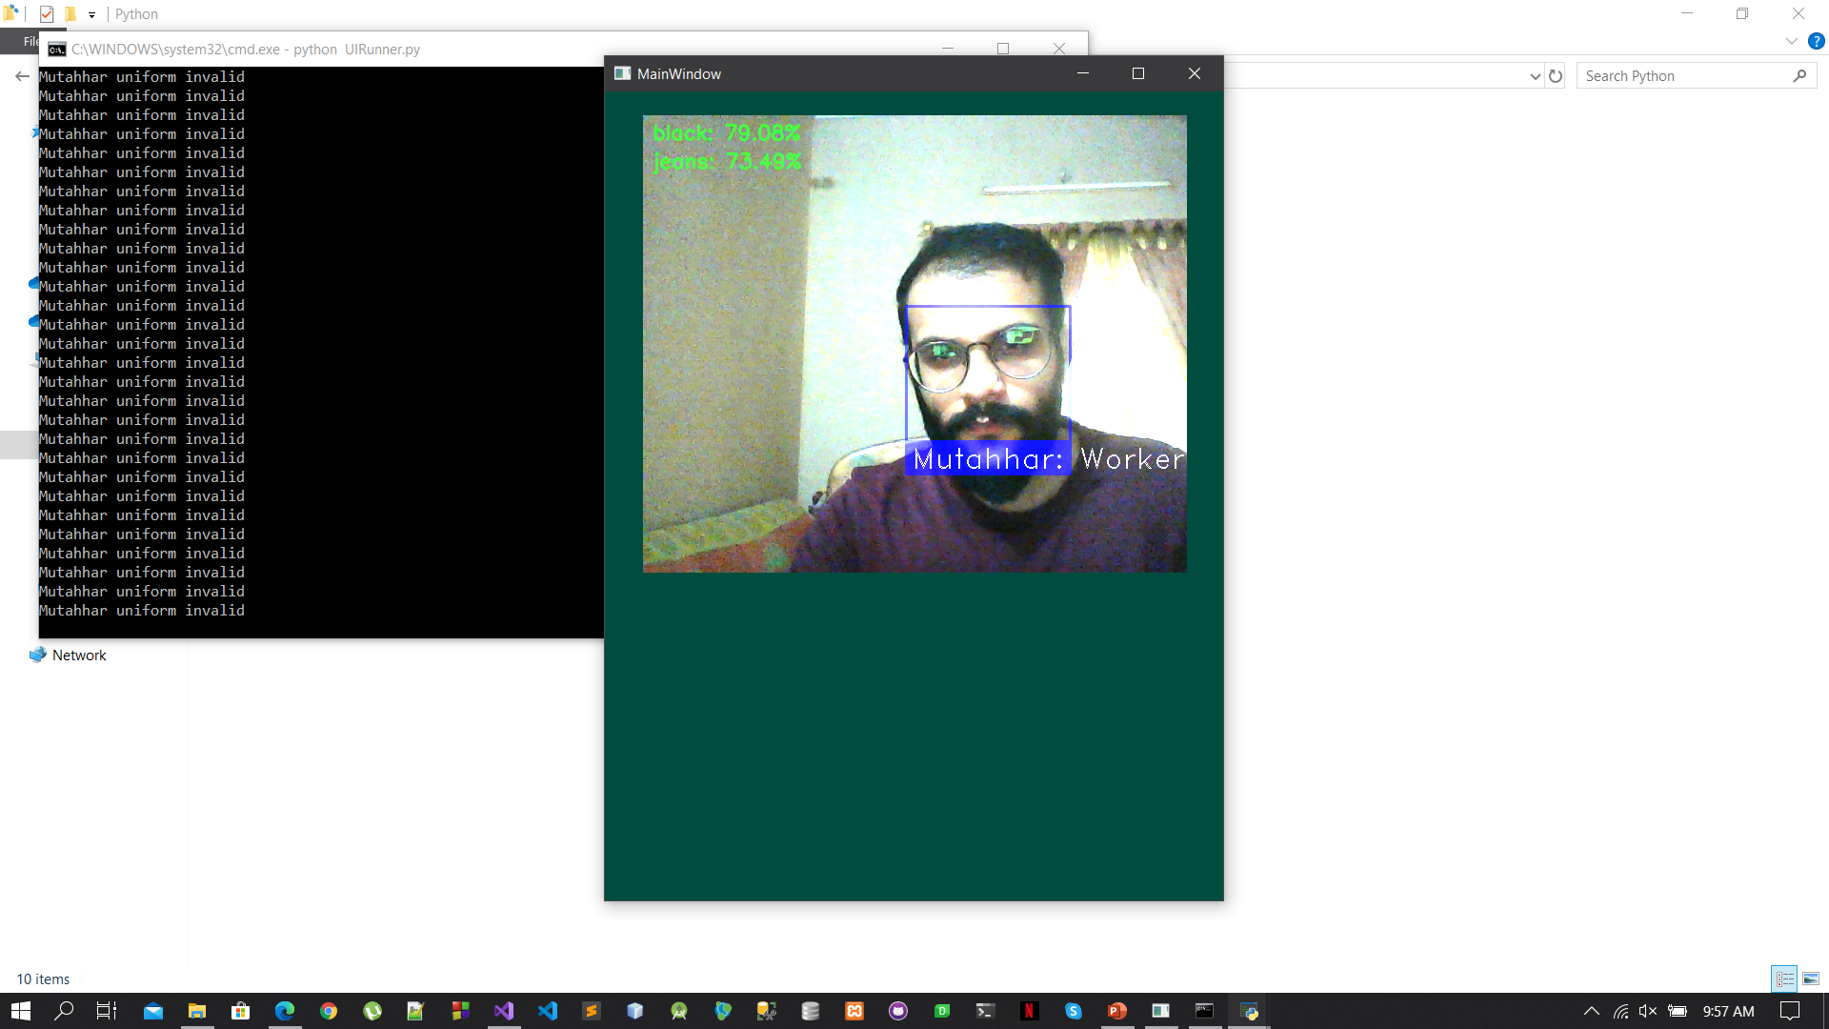
Output(UI)

Slide 15
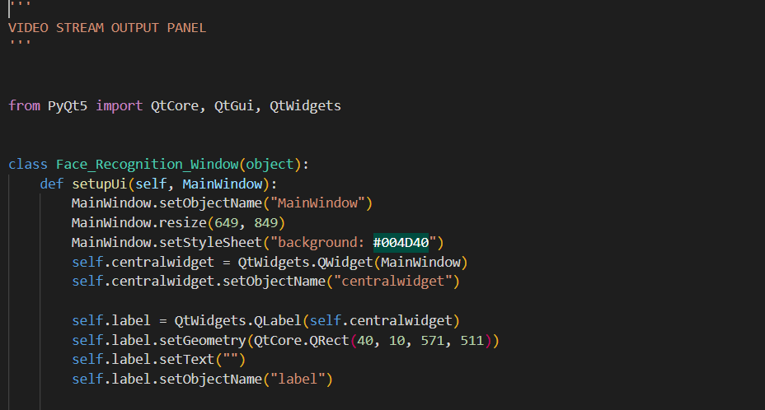
Output(UI Code)

Slide 16
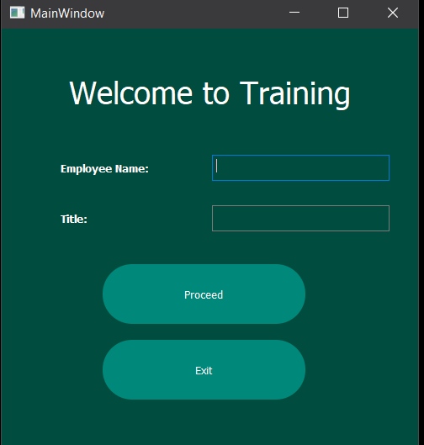
Training(UI)

Slide 17
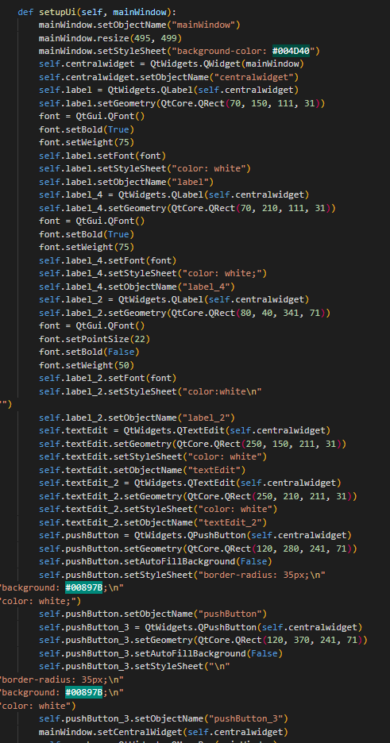
Training(UI Code)

Slide 18
Approaches for integration
Direct
Service Oriented (Distributed)

Slide 19
Direct Approach
Using models for prediction directly integrated in UI
Cannot use parallel approach for Recognitions
Can only be used on a single machine at a time

Slide 20
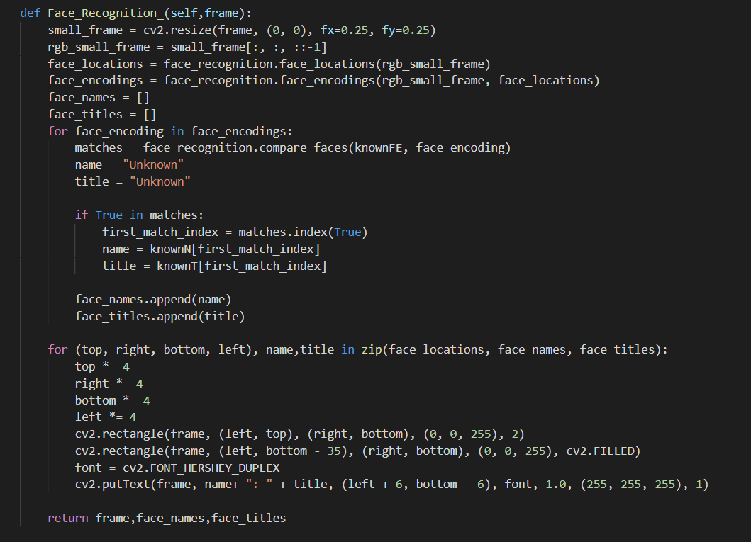
Direct Approach(Facial Recognition)

Slide 21
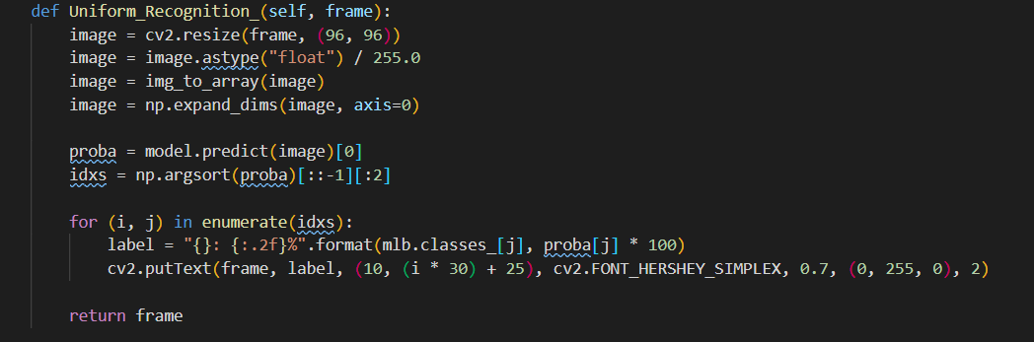
Direct Approach(Uniform Recognition)

Slide 22
Service Oriented Approach
Distributed Approach
Uses Django REST API services
All recognition applications are services
Parallel request handling for multiple requests
Uses POST request for data
JSON data for each service

Slide 23
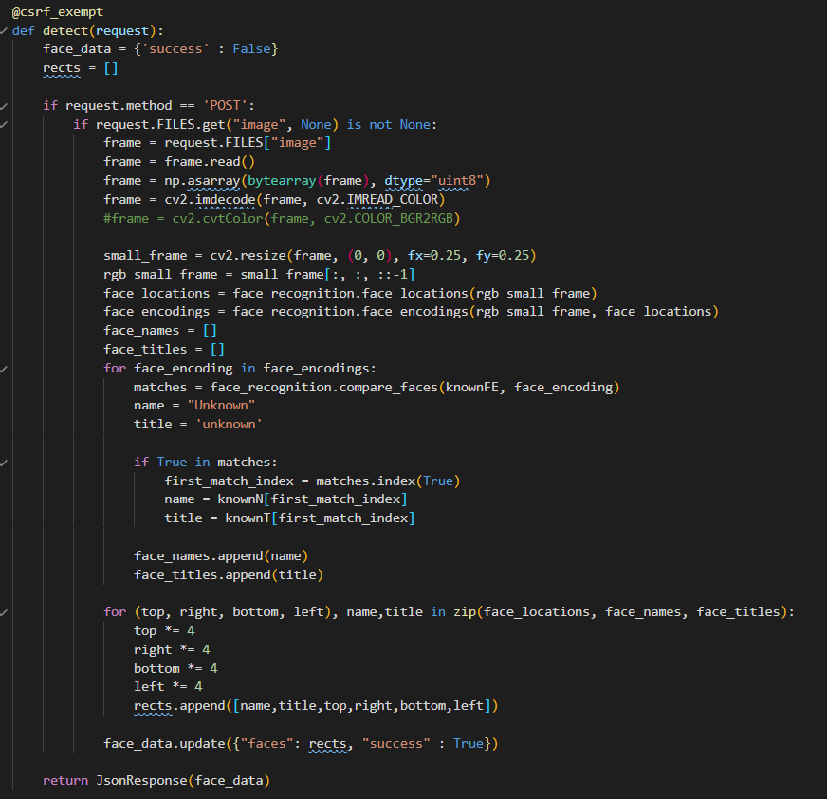
Service Oriented Approach(Facial Recognition-Django)

Slide 24
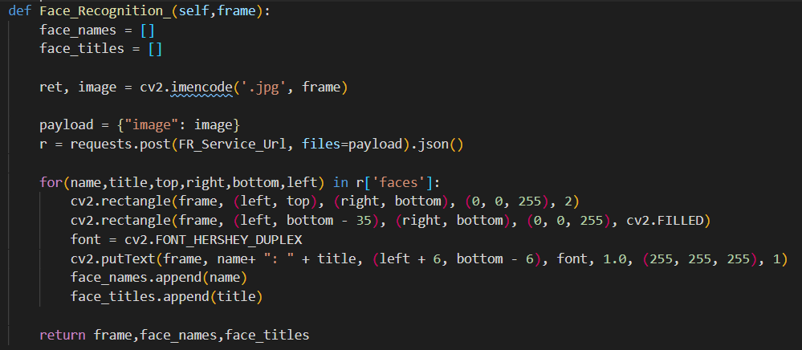
Service Oriented Approach(Facial Recognition-Request)

Slide 25
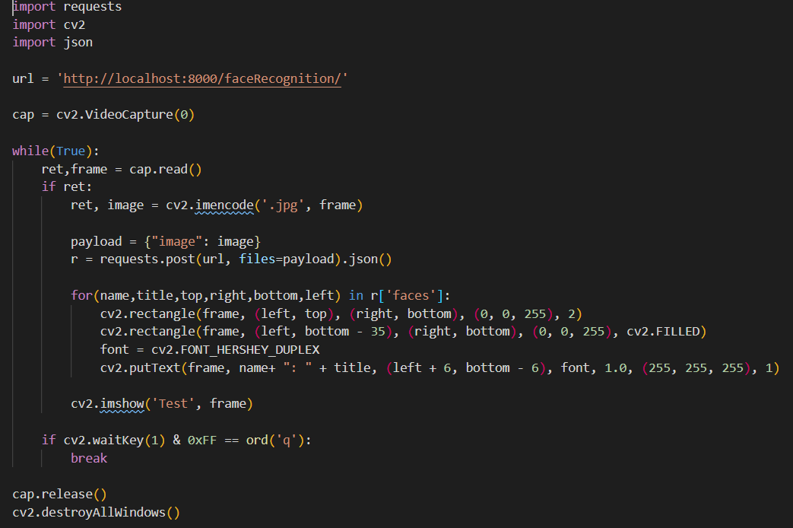
Service Oriented Approach(Facial Recognition-Request Test)

Slide 26
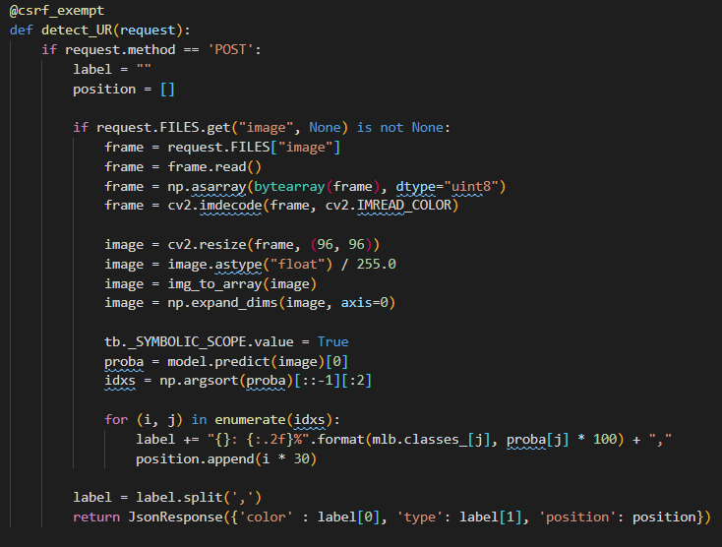
Service Oriented Approach (Uniform Recognition-Django)

Slide 27
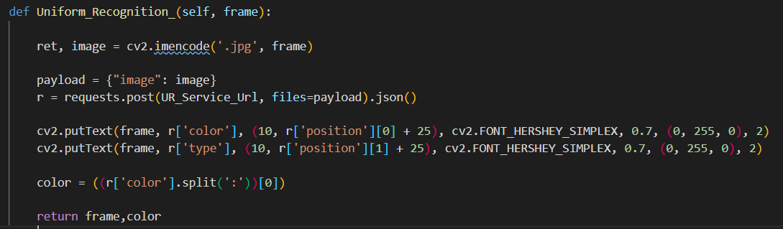
Service Oriented Approach (Uniform Recognition-Request)

Slide 28
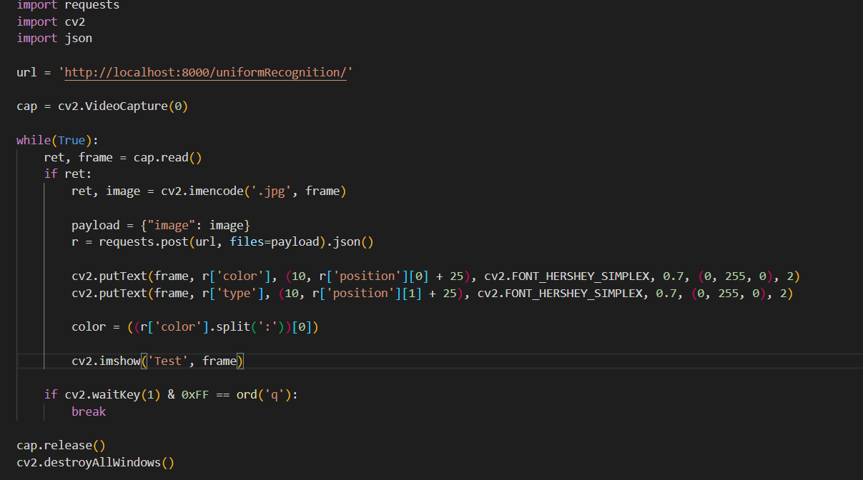
Service Oriented Approach (Uniform Recognition-Request Test)

Slide 29
Service Oriented Approach(Continue)
Facial Recognition Service
Input Frame
Output Frame and corresponding data respectively
Uniform Recognition Service
Activity Recognition Service

Slide 30
Facial Recognition
DLIB

Slide 31

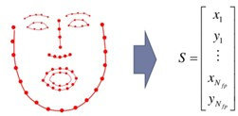
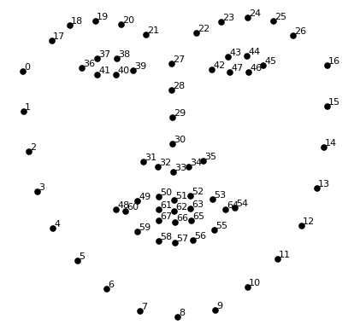
Functionalities
DLIB Face Detector
Face Location
CNN based
HOG based*
Face Encoding (128-bit encoding)
Compare Faces

Slide 32
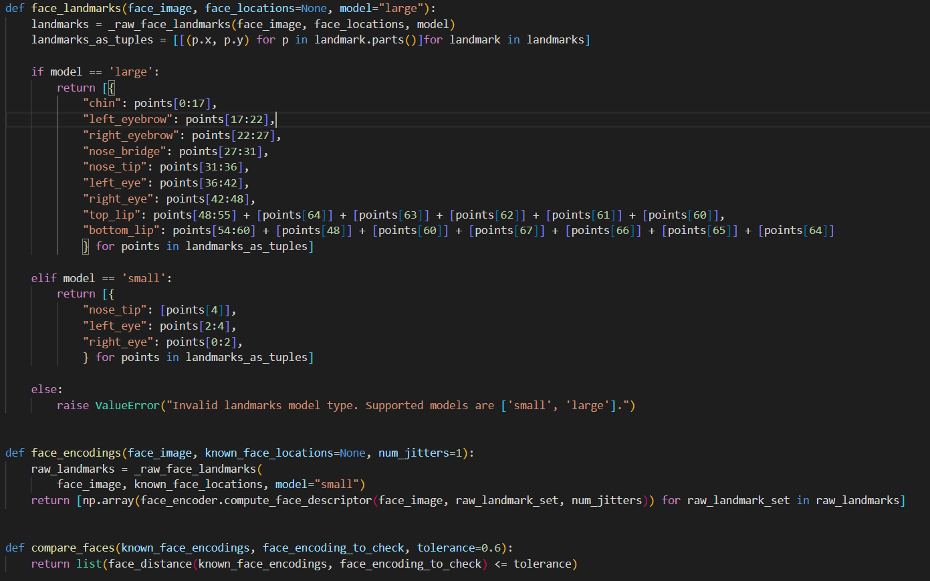
DLIB based Facial Recognition

Slide 33
Runtime Training
Frame, name and Title
Face Location
DLIB Face Detector
Face Encodings
Pickle
Data Dictionary

Slide 34
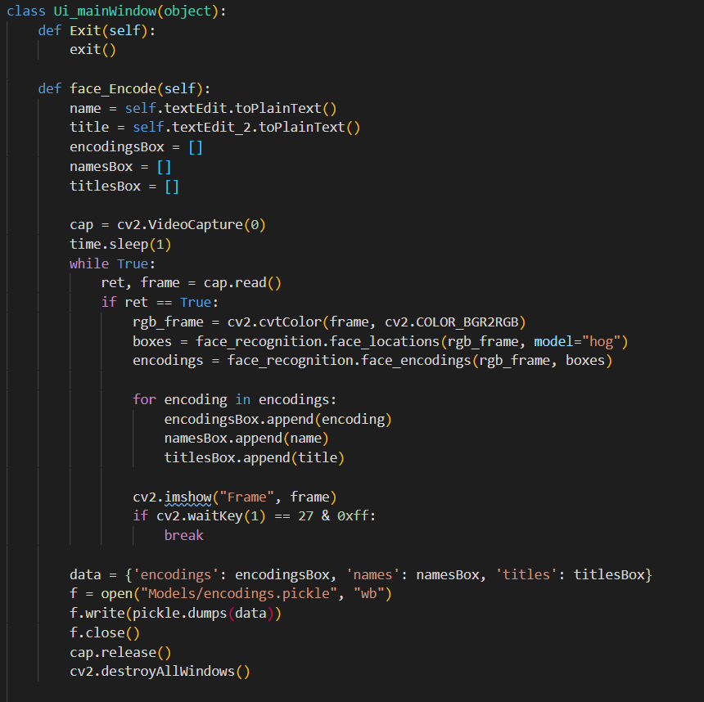
Runtime Training

Slide 35
Output
Frame
Face Location
DLIB Face Detector
Face Encoding
Output
Compare Faces
Load Pickle File

Slide 36
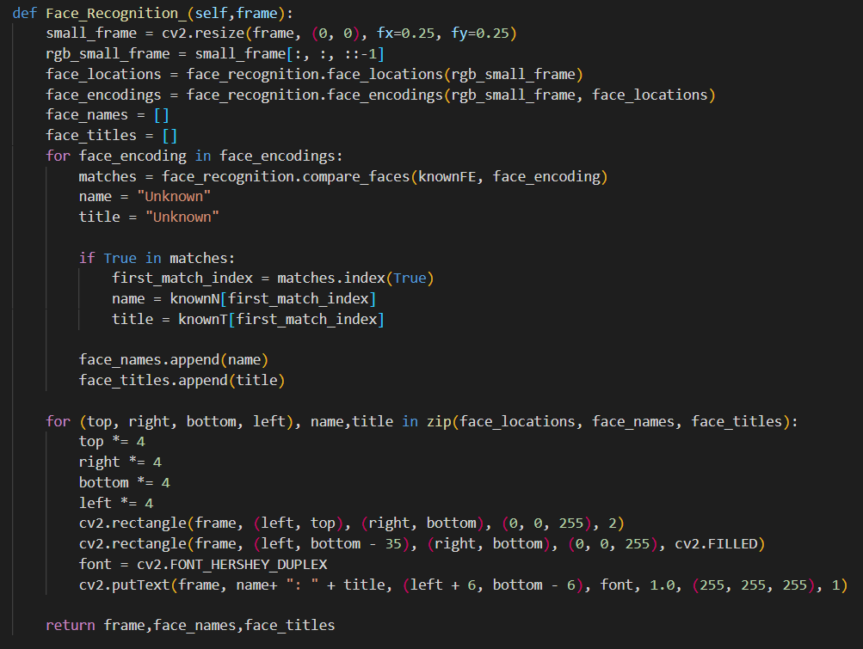
Output

Slide 37
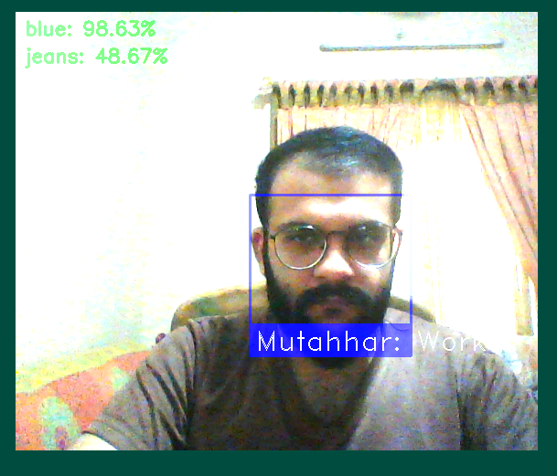
Output

