Slide 1
Database ERD
Initial

Slide 2
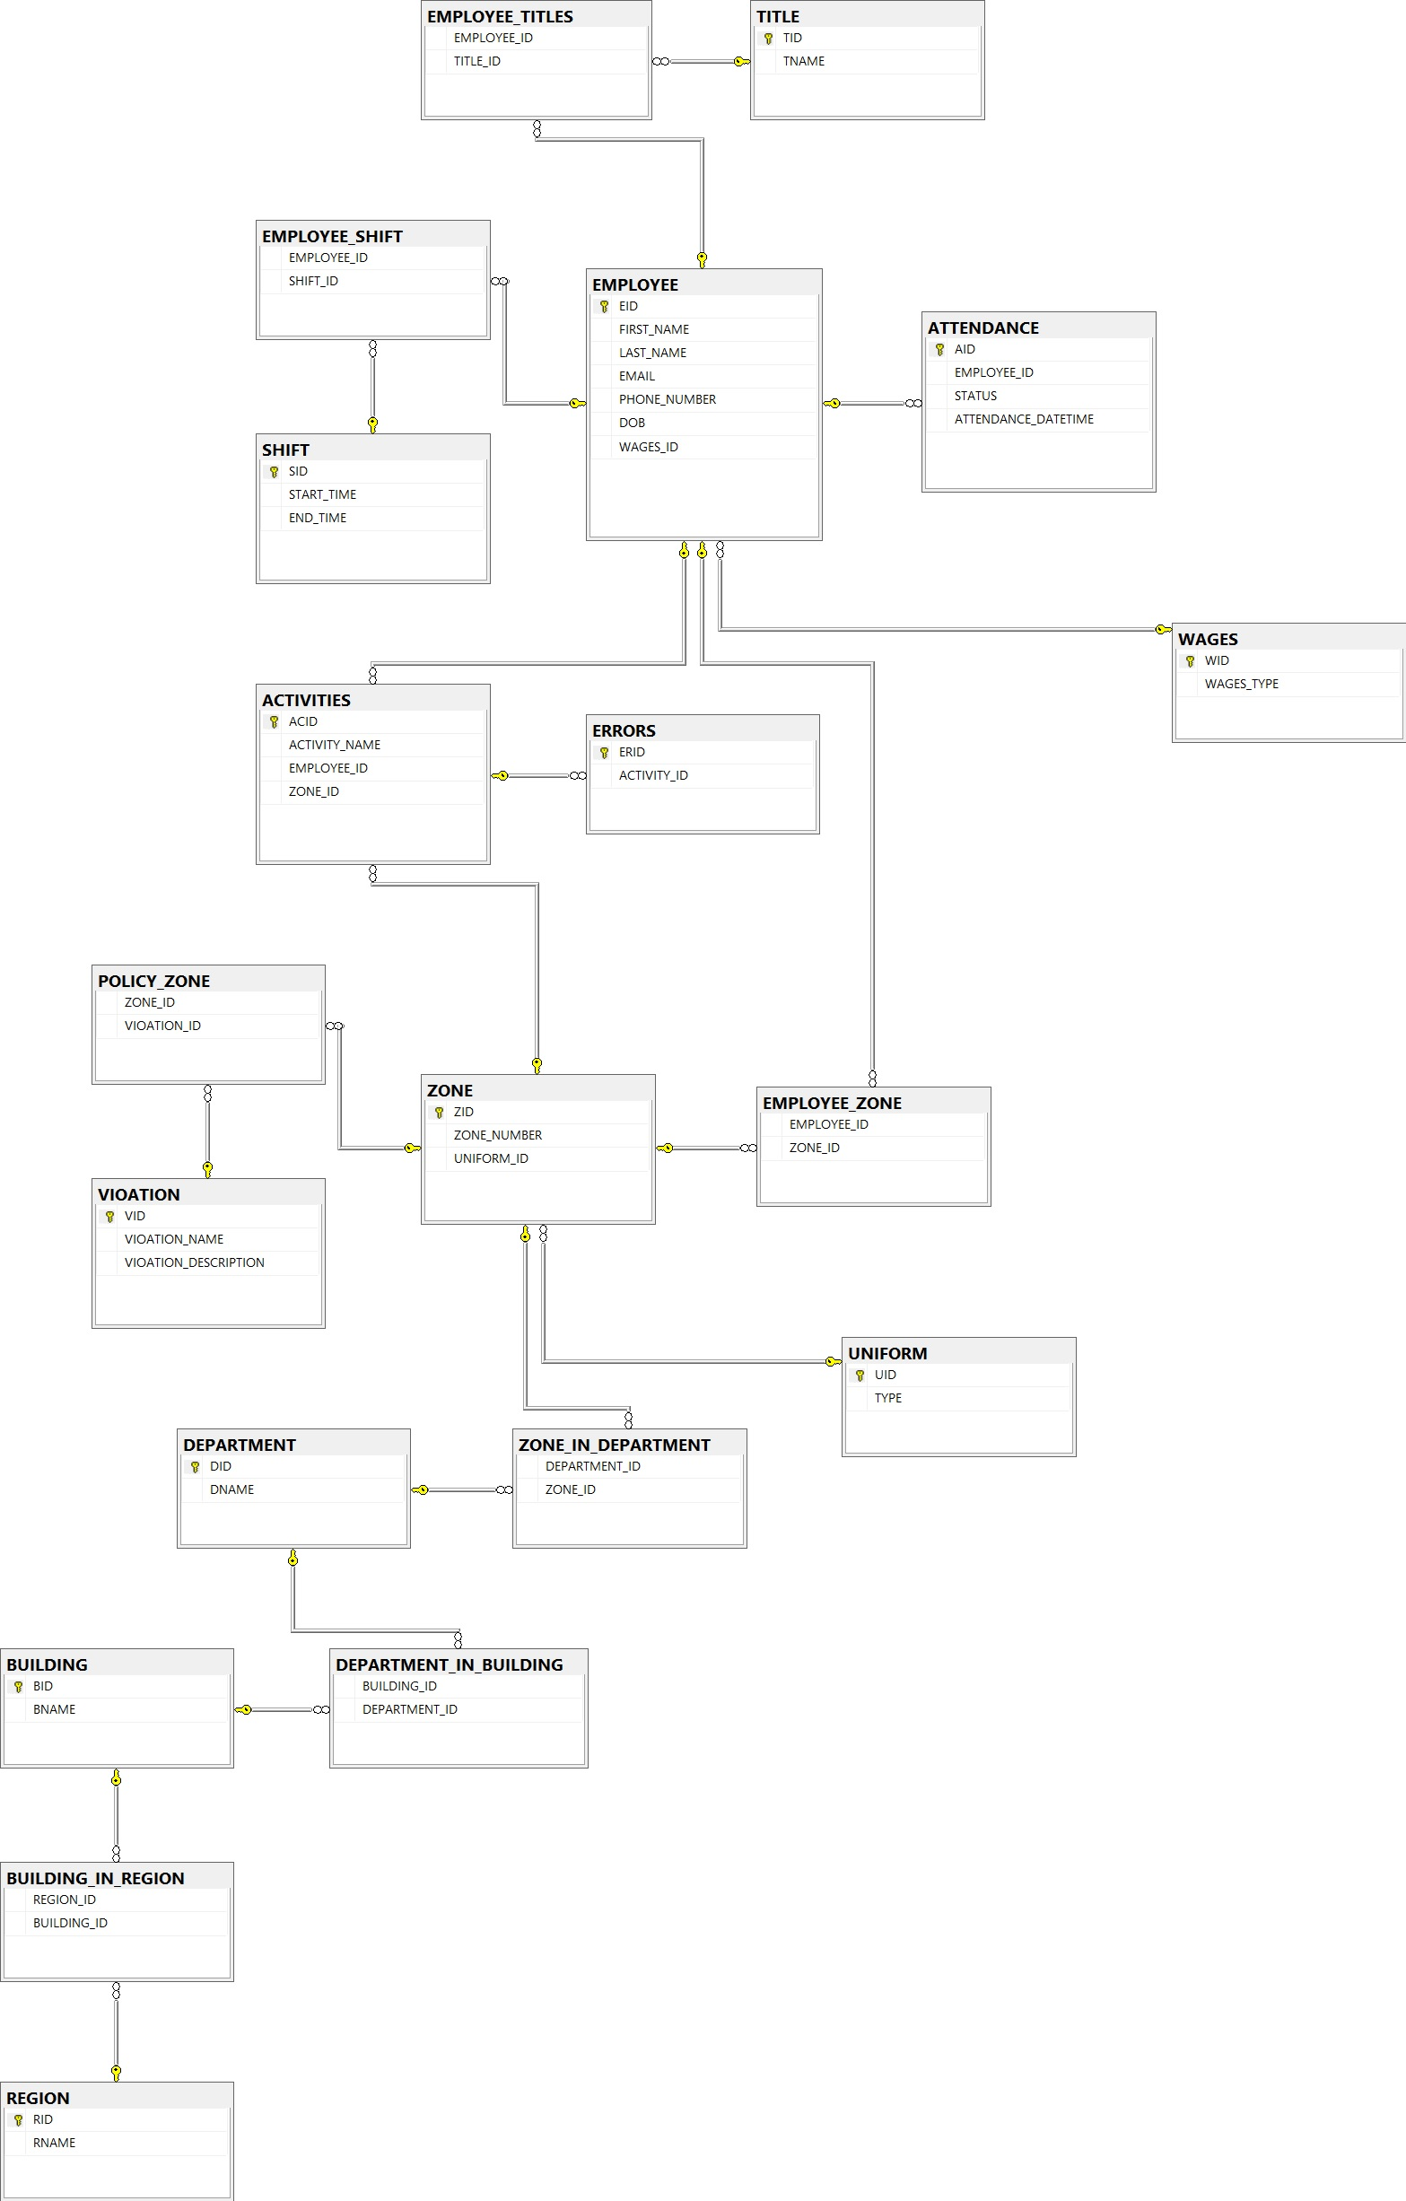
Not Normalized
Repeated Information
Not any centralized Table
Duty Rostrum Missing

Slide 3
Database ERD
Actual

Slide 4
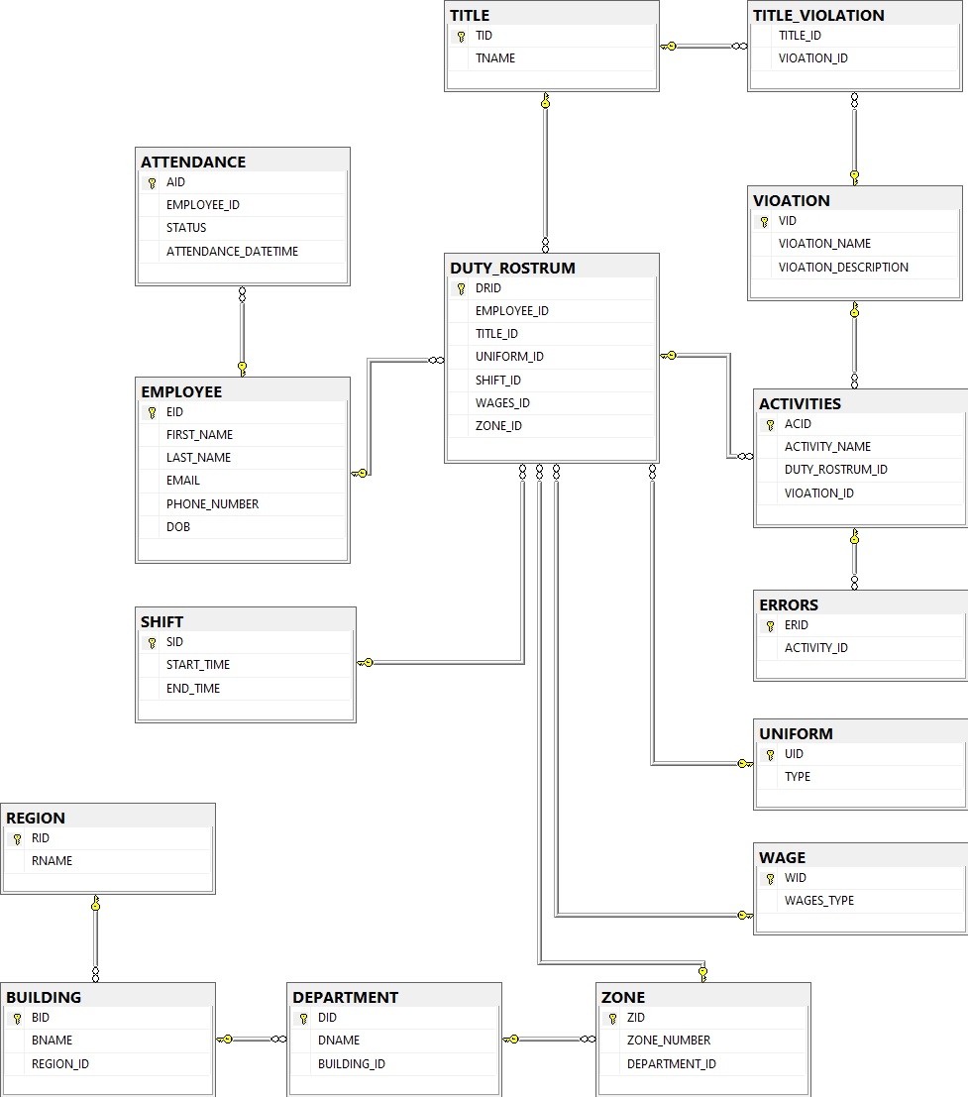
Normalized
Duty Rostrum
Centralized information

Slide 5
API and Database
Apache Thrift Services
Command: thrift --gen <language> <.Thrift File>
Reusable Interfaces
Server based on C# with Thrift
Client based on Python with Thirft
TBinary Protocol Layer
TSocket Transport Layer
MSSQL Server DB
DJango Admin Panel

Slide 6
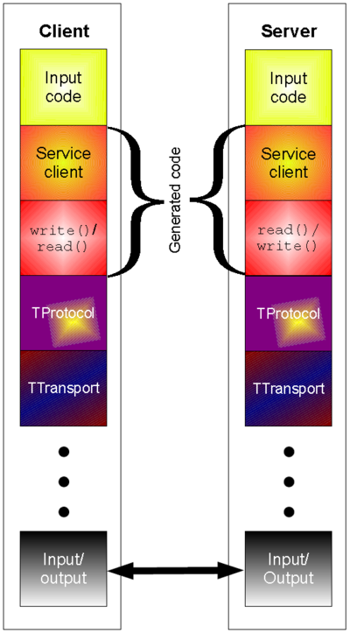
Thrift Architecture

Slide 7
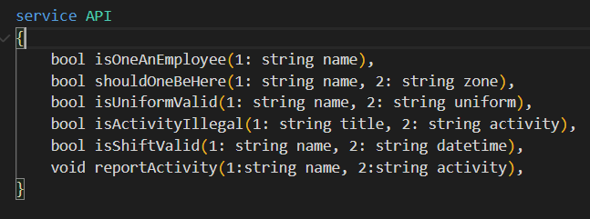
API interfaces

Slide 8
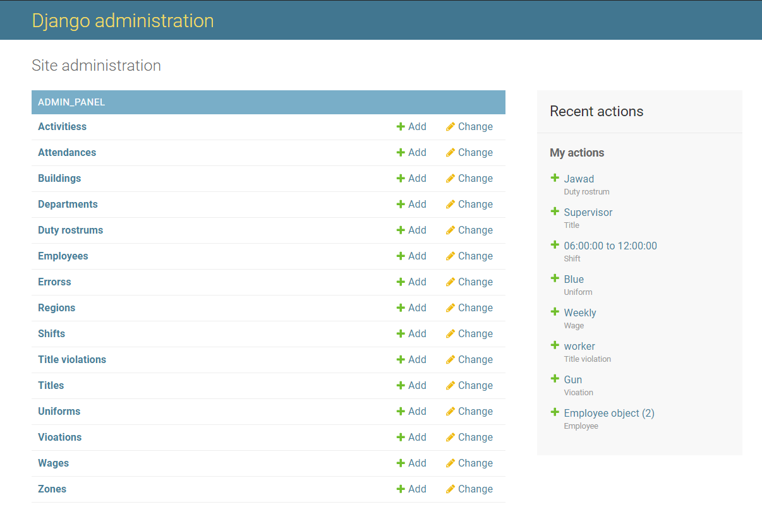
Django Admin Panel

Slide 9
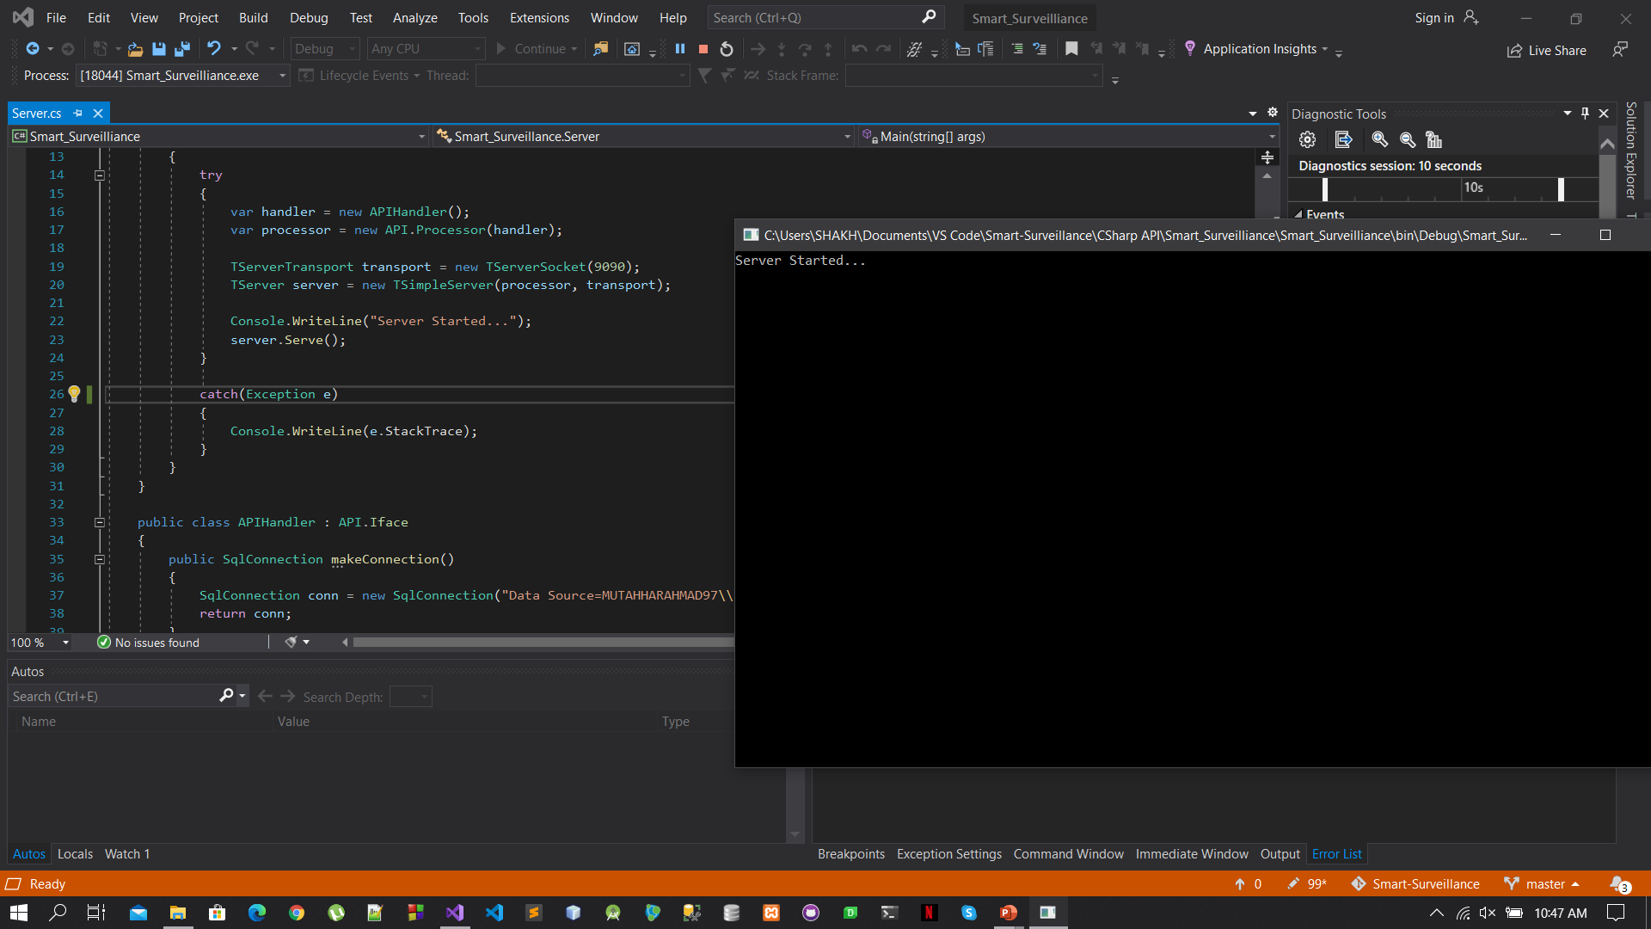
C# Thrift Server

Slide 10
User Interface
PyQt5

Slide 11
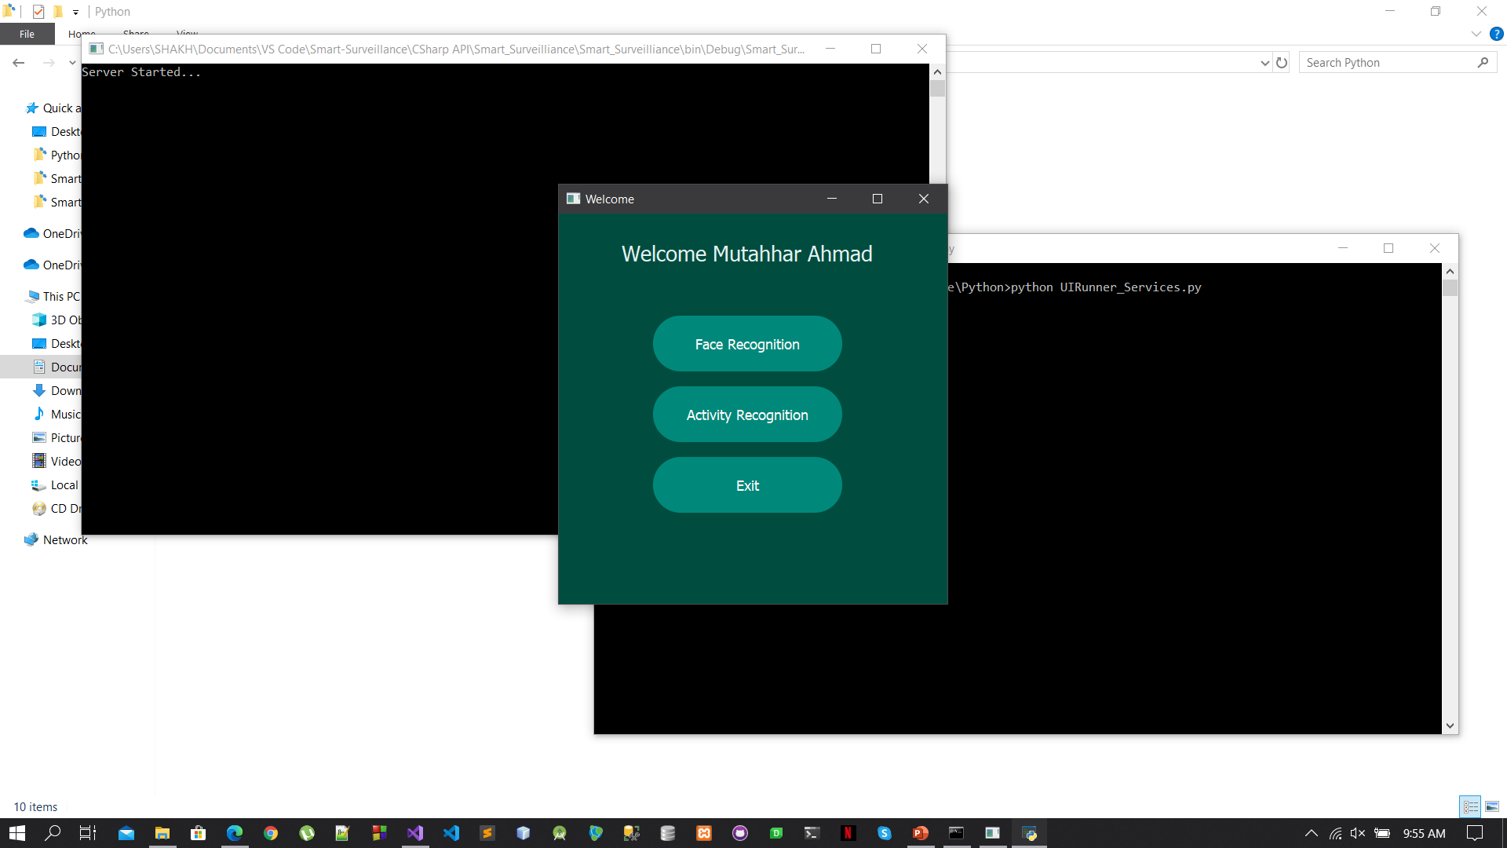
Application

Slide 12
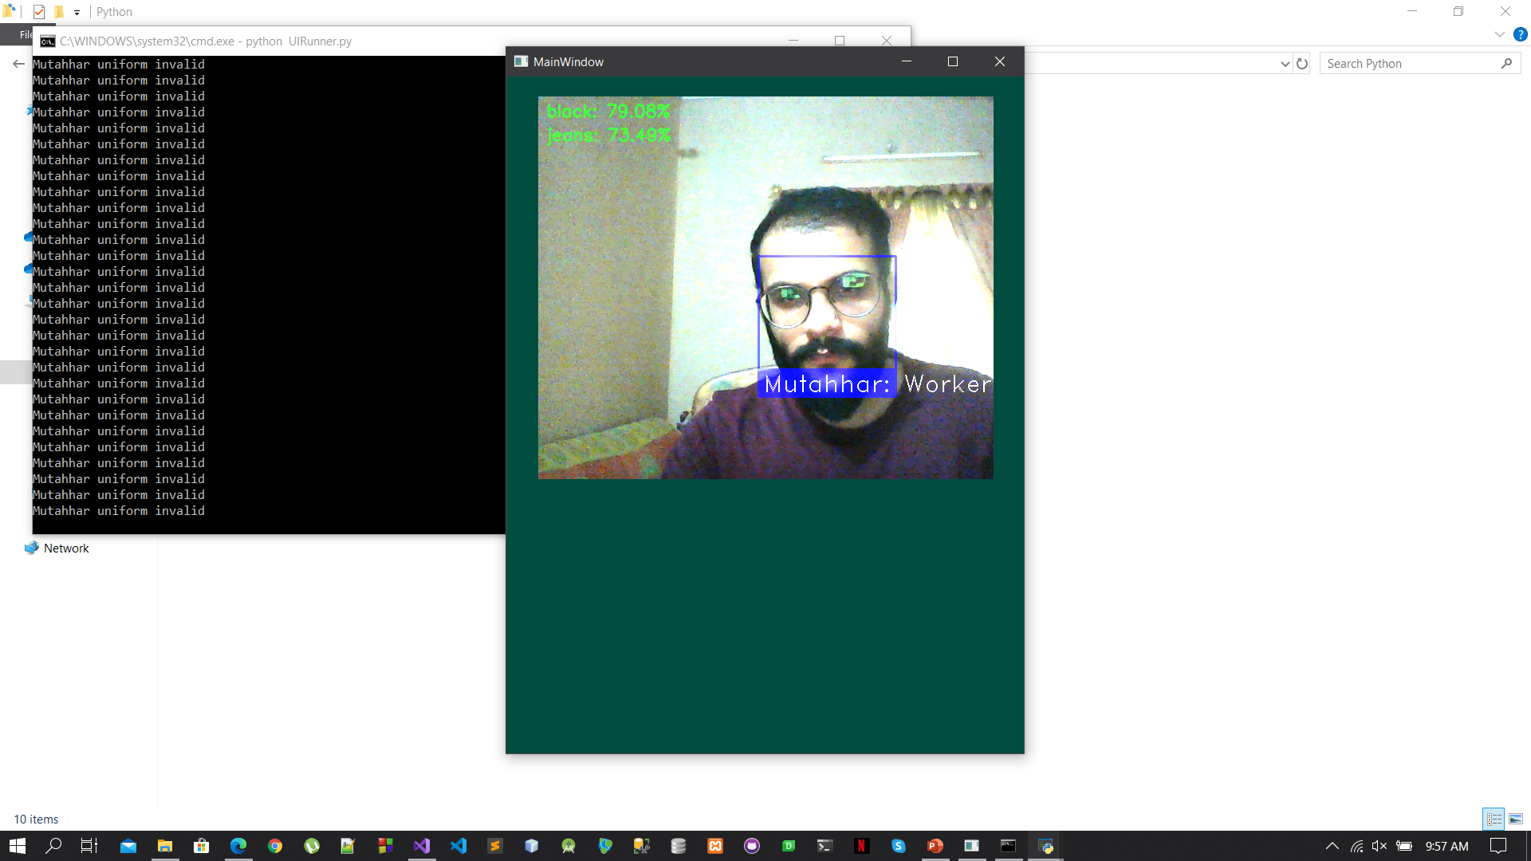
Output

Slide 13
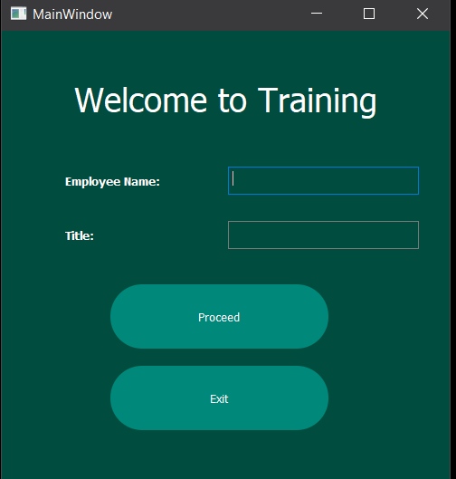
UI for Training

Slide 14
Approaches for integration
Direct
Service Oriented

Slide 15
Direct Approach
Using models for prediction directly integrated in UI
Cannot use parallel approach for Recognitions
Can only be used on a single machine at a time

Slide 16
Service Oriented Approach
Uses Django REST API services
All recognition applications are services
Parallel request handling for multiple requests
Uses POST request for data
JSON data for each service

Slide 17
Service Oriented Approach(Continue)
Facial Recognition Service
Input Frame
Output Frame
Uniform Recognition Service
Activity Recognition Service

Slide 18
Facial Recognition
DLIB

Slide 19

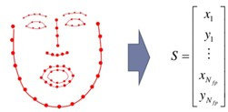
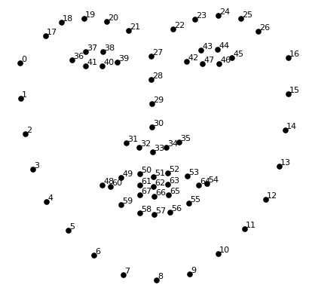
Functionalities
DLIB Face Detector
Face Location
CNN based
HOG based*
Face Encoding (128-bit encoding)
Compare Faces

Slide 20
Runtime Training
Frame, name and Title
Face Location
DLIB Face Detector
Face Encodings
Pickle
Data Dictionary

Slide 21
Output
Frame
Face Location
DLIB Face Detector
Face Encoding
Output
Compare Faces
Load Pickle File

