Slide 1
AngularJS

Slide 2
Agenda
Introduction
Features
Demo Application
Q & A

Slide 3
Introduction
A JavaScript based MVVM(Mode-View-ViewModel) framework for the Web
• The model : The data behind the application.
• The view: The UI that the user sees and interacts with.
• The controller: The business logic and presentation layer, which performs actions. Also known as viewmodel or presenter.

Slide 4
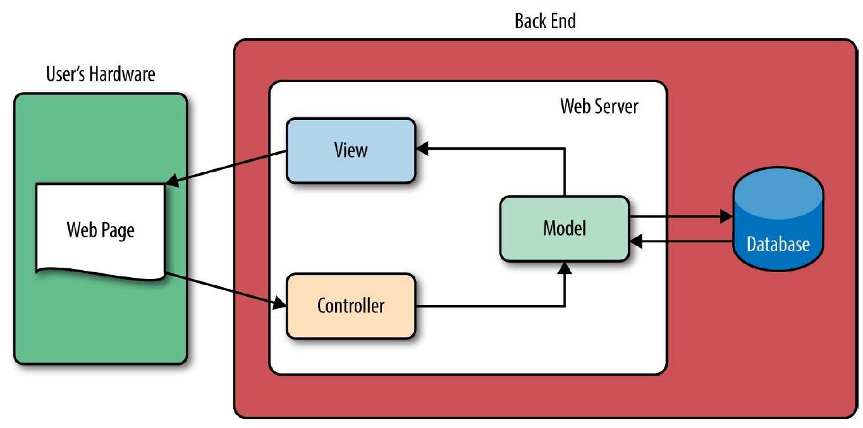
Traditional Web MVC Framework

Slide 5
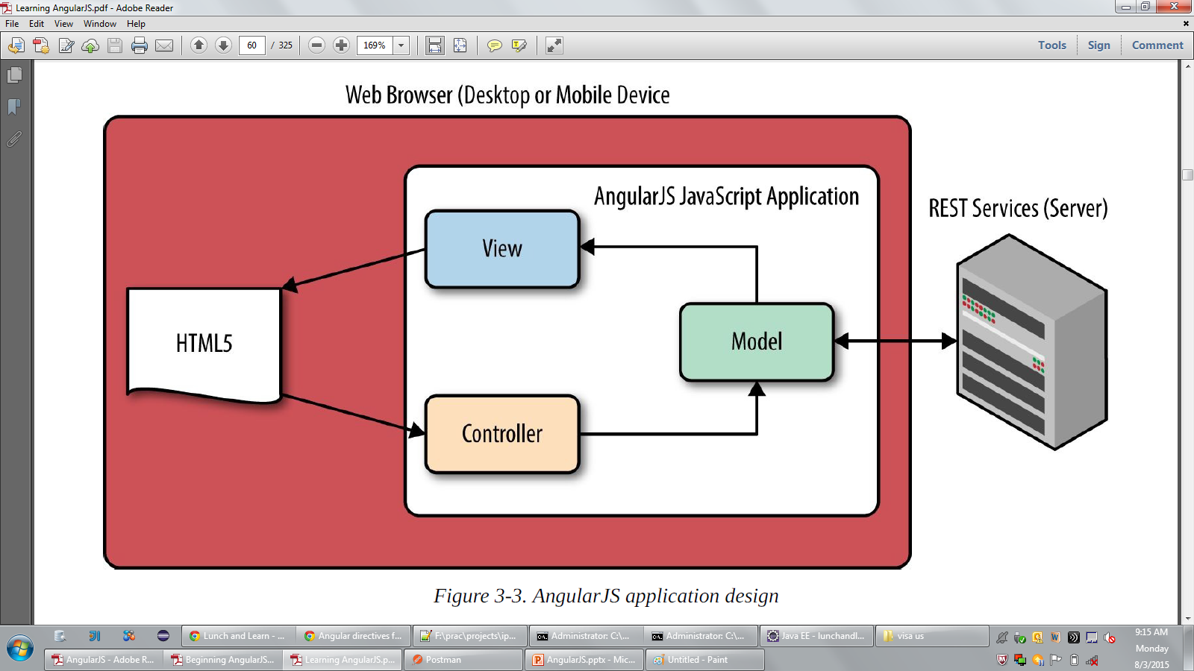
AngularJS Application Framework (MVVM)

Slide 6
Features
Data-driven (via data-binding)
Hello <span id="name"></span>
var updateNameInUI = function(name) {
$('#name').text(name);
};
// Lots of code here...
// On initial data load
updateNameInUI(user.name);
// Then when the data changes somehow
updateNameInUI(updatedName);
In AngularJS:
Hello <span>{{name}}</span>

Slide 7
Declarative
<ul class="nav nav-tabs">
<li>Home</li>
<li class="selected">Profile</li>
</ul>
<div class="tab1">
Some content here
</div>
<div class="tab2">
<input id="startDate" type="text"/>
</div>
<tabs>
<tab title="Home">Some content here</tab>
<tab title="Profile">
<input type="text“ datepicker ng-model="startDate"/>
</tab>
</tabs>

Slide 8
Separate your concerns
Need some business logic? Use the controller.
Need to render something differently? Go to the view
Dependency Injection
The controller, service, or function asking for the dependency does not need to know about its creation and dependency chain.
Extensible
Use directives to extend UI
Integration with jQueryUI, Bootstrap

Slide 9
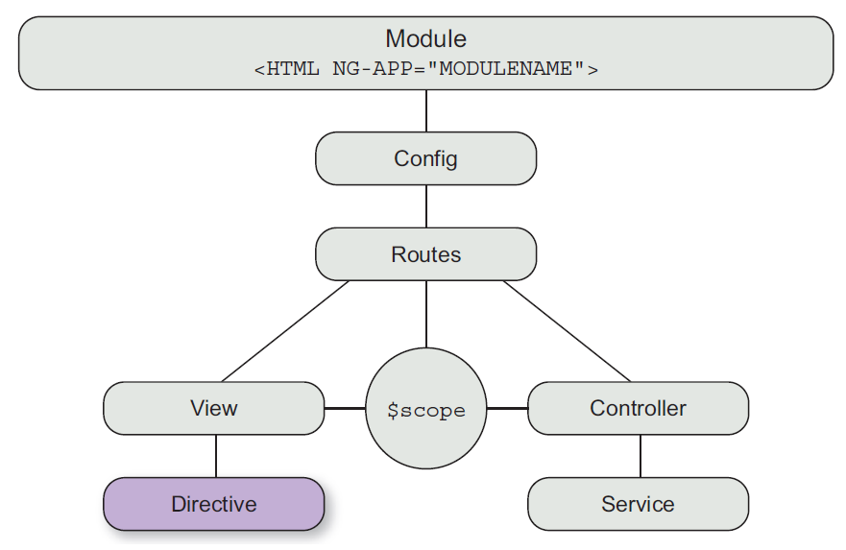
Eagle’s Eye View

Slide 10
Controller
JavaScript functions that perform or trigger the majority of our UI-oriented work.
Responsibilities:
Fetching the right data.
Deciding which parts of page to show.
Presentation logic.
User interactions.

Slide 11
Module
AngularJS way to package relevant code.
Define controllers, services, factories, and directives.
The module can also depend on other modules as dependencies
Model
POJO (Plain Old JavaScript Object)

Slide 12
Directives
UI or the HTML that the user sees.
Types:
Behavior modifiers - add or modify the existing UI behavior.
E.g. ng-show, ng-modal.
Reusable components – creates a whole new HTML structure. These directives have some rendering logic (how and what to display) and business logic(how to get data and what to do with it).
E.g. <tab>

Slide 13
Service
functions or objects that can hold behavior or state across the application.
Each service is instantiated only once.
E.g. $http, $routeProvider

Slide 14
Controller vs Service
Controllers | Services
Presentation logic | Business logic
Directly linked to a view | Independent of views
Drives the UI | Drives the application
Responsible for decisions like what data to fetch, what data to show, how to handle user interactions, and styling and display of UI | Responsible for making server calls, common validation logic, application-level stores, and reusable business logic

Slide 15
Filters
Filters are used to process data and format values to present to the user.
Applied on expressions in our HTML, or directly on data in our controllers and services.
Routes
Key to Single Page Application(SPA)
Promise
Asynchronous task

Slide 16
References
http://www.w3schools.com/angular/default.asp
https://docs.angularjs.org/api
http://www.w3schools.com/bootstrap/
https://angular-ui.github.io/
http://designsystem.pbi.global.pvt:8080/learn/
https://github.com/ranadeepak/angularjsstepbystep

Slide 17
Thank you

