Slide 1
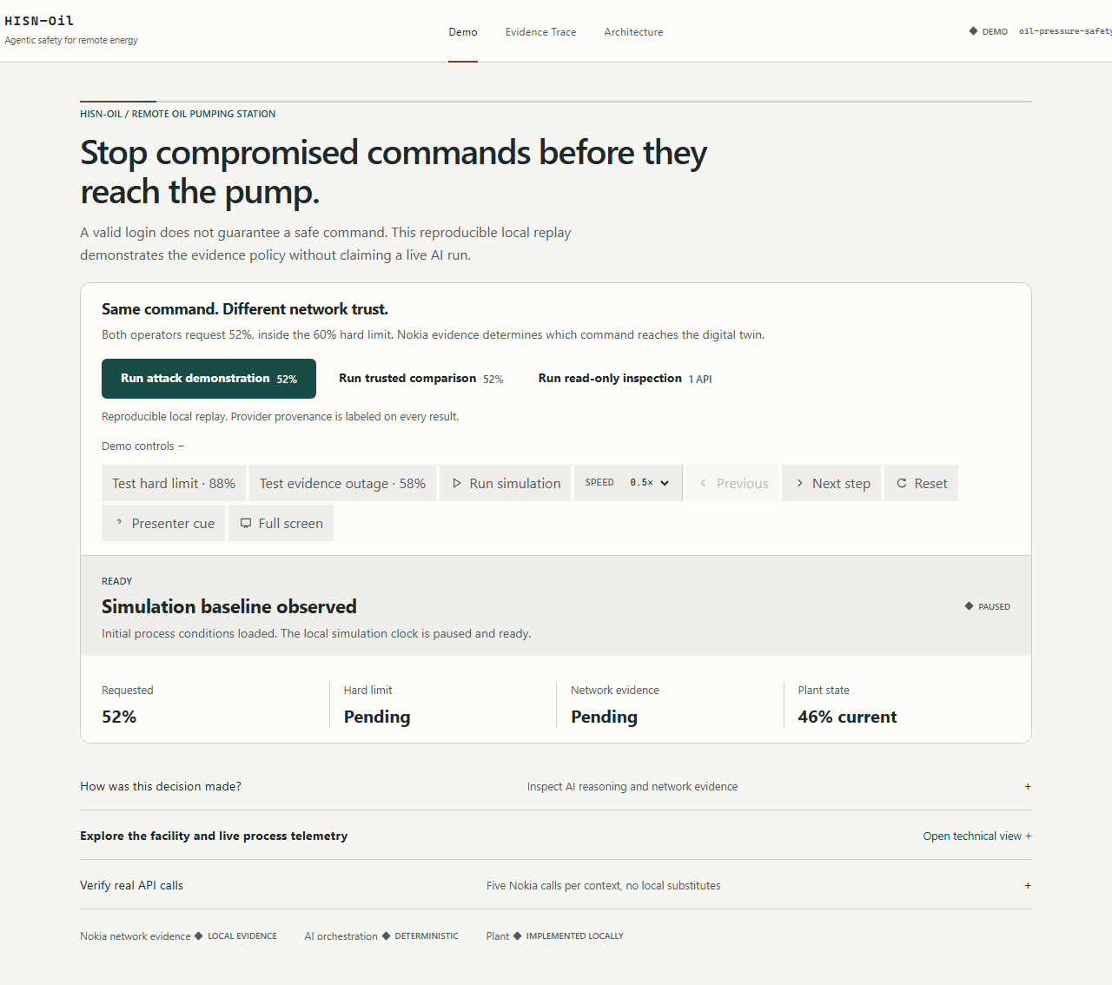
HISN-Oil
Network proof before industrial action
Agentic safety for remote oil pumping stations
Industrial & Enterprise AI Automation
GSMA MENA Ignite Hackathon 2026
Notes:
A valid login can still originate from a compromised device or SIM. HISN-Oil adds network evidence before a high-consequence command reaches the pump. Public demo: https://hisn-ot-prototype.vercel.app/#judge

Slide 2
PROBLEM
02
The command trust gap
A physically plausible command can still come from compromised context.
Valid account
01
Credentials accepted
Compromised context
02
SIM, device, or location risk
Credentials confirm account access.
52% request
They do not establish the expected device, SIM, location, or current mobile-network state.
03
Inside the 60% hard limit
Remote pump
04
Potential physical consequence
HISN-Oil | MENA Ignite Hackathon 2026
Notes:
The risk is strongest when the requested value sits inside the engineering limit. A setpoint rule alone cannot detect compromised command context. The facility image is an illustrative digital twin, not a physical deployment.

Slide 3
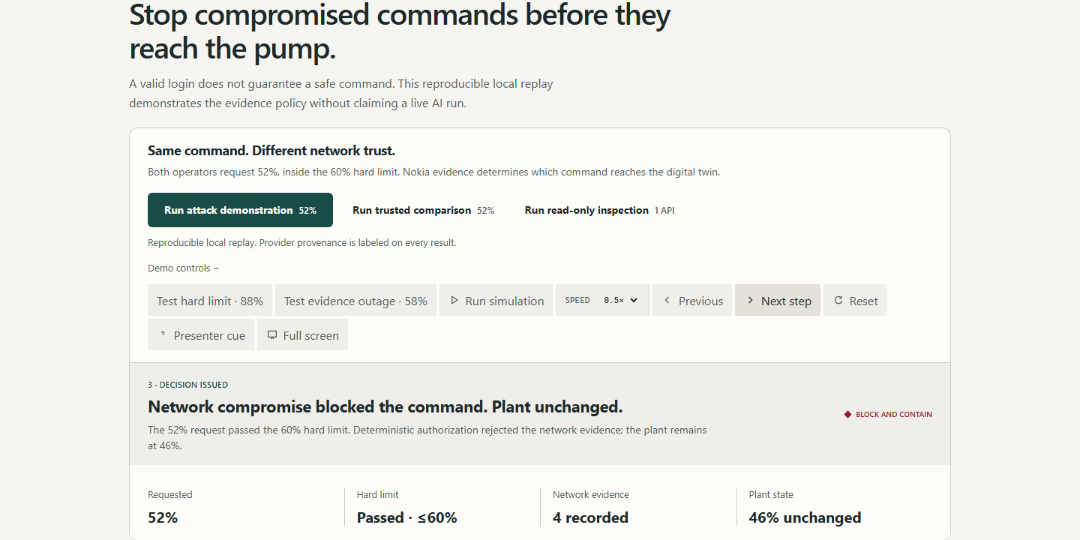
DEMONSTRATION
03
Network evidence changes the decision
REQUESTED
HARD LIMIT
NETWORK PROOF
PLANT STATE
52%
Passed <=60%
4 calls
46% unchanged
The same 52% request is allowed with trusted network evidence and blocked when Nokia signals show compromise.
Notes:
The 58% request passes the hard maximum. Nokia network evidence reveals compromised SIM, device, and location context. Deterministic policy issues BLOCK_AND_CONTAIN, and the accepted plant state remains 46%.

Slide 4
CONTROL PATH
04
Safety architecture
Command hold
LangGraph agent
Nokia NaC
Safety policy
Digital twin
No plant change during investigation
Selects allowed CAMARA tools
Returns network evidence
Issues final authorization
Accepts only an authorized state
AI advises
Policy authorizes
Plant state changes only after authorization
HISN-Oil | MENA Ignite Hackathon 2026
Notes:
The model selects tools and recommends a response. It cannot override engineering limits or actuate the pump. The deterministic policy remains the final authority. Nokia calls use the sandbox environment in this prototype.

Slide 5
WORKING PROTOTYPE
05
Verified connected attack
LIVE LANGGRAPH
Model-selected evidence, one bound decision record
FINAL
BLOCK AND CONTAIN
TOOL
RESULT
SOURCE
Location Verification
Outside approved area
NOKIA SANDBOX
Device Reachability
Reachable by SMS
NOKIA SANDBOX
Accepted pressure remained
SIM Swap
Recent change
NOKIA SANDBOX
46%
Device Swap
Recent change
NOKIA SANDBOX
hisn-cab4d306-ba4a-47c9-9c6e-44584ce0c7c2
Public connected run completed 12 September 2026
Notes:
This public run used live hosted reasoning and four successful Nokia Sandbox responses. Every call, recommendation, decision, and plant outcome shares one correlation ID. Verification record: docs/verification.md in the public repository.

Slide 6
AGENTIC AI
06
Agent responsibility and policy authority
AI agent
Deterministic policy
Understands the command
Selects allowed tools
Observes Nokia responses
Recommends an action
Enforces the evidence floor
Checks engineering limits
Issues final authorization
Guards every plant change
Hosted AI unavailable
Command stays held
HISN-Oil | MENA Ignite Hackathon 2026
Notes:
The hosted model has no physical authority. When Groq is unavailable or rate-limited, HISN-Oil records AGENT_UNAVAILABLE and keeps the command held. It does not substitute a local recommendation during a connected run.

Slide 7
ALLOW PATH
07
Positive controls
SAFE COMMAND
READ-ONLY INSPECTION
52% allowed
Allowed
Location Verification
Device Reachability
Device Reachability
2 successful Nokia Sandbox calls
1 successful Nokia Sandbox call
hisn-680ab711-07e2-4d22-9b61-fc6b6905c0e0
hisn-d0a8741b-5e97-4a9f-8149-c790eb8b4d2d
Both runs used live hosted reasoning and produced sealed incident records.
HISN-Oil | MENA Ignite Hackathon 2026
Notes:
The safe connected command reached 52% after successful Nokia Sandbox location and reachability calls. The read-only run used reachability and made no plant change. Both retained live reasoning provenance and sealed incident records.

Slide 8
COMMERCIAL PATH
08
One-site pilot
Buyer
OT security and industrial operations leadership
Discovery
01
Map one command workflow and identity path
Scope
Observation
02
One pumping site and one critical command family
Measure decisions without control writes
Validation
03
Review false blocks, latency, and audit quality
Commercial hypothesis
Per-site subscription with integration and assurance services
Integration
04
Connect an approved gateway under site controls
HISN-Oil | MENA Ignite Hackathon 2026
Notes:
The first pilot begins in observation mode. The team measures decision latency, false blocks, unavailable evidence, and audit completeness before any enforcement integration. Pricing remains a hypothesis until customer discovery validates it.

Slide 9
ROADMAP
09
Scale across remote critical assets
Operator identity
Subscriber consent and approved network access
HISN-Oil
Durable assurance
Reusable safety gate for cellular command paths
Tenant-isolated audit storage and operations controls
Certified integration
Validated OT interfaces for pumps, valves, and gateways
Potential sectors
Energy Utilities Ports Mines
HISN-Oil | MENA Ignite Hackathon 2026
Notes:
The prototype proves the control pattern. Production use still requires operator onboarding, approved network attachments, durable audit storage, certified OT interfaces, and formal safety validation.

Slide 10
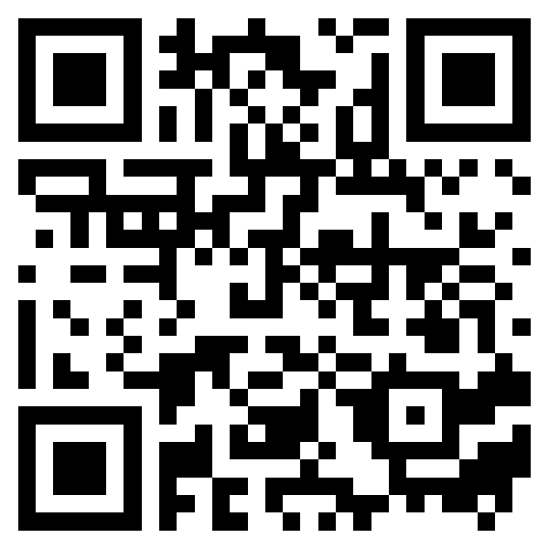
Pilot partner
Validate network proof on one real industrial command workflow.
Seeking an industrial operator or telecom partner for a one-site validation.
LIVE DEMO
hisn-ot-prototype.vercel.app/#judge
Scan to run the verified prototype
SOURCE
github.com/Mutasem-mk4/hisn-ot-prototype
Nokia Sandbox / Live LangGraph / Deterministic authorization
Notes:
The immediate request is access to a realistic command workflow, an operator identity integration path, and feedback from OT security and operations teams. The demo uses Nokia Sandbox and an illustrative digital twin; it does not claim live subscriber consent or physical PLC actuation.

