Slide 1
SmartHealth - AI-Enhanced Health Monitoring Platform
SOEN 6841 - Software Project Management
Fall 2024
Submitted by: Mutasiumur Rahman - 40232104 Tarek Ferdous - 40221751 Rafsan Shartaj Uddin - 40275033 Ishmam Raiyan Rouf - 40274734 Mohammad Shahidul Alam - 40230431

Slide 2
Agenda
1. Introduction and Feasibility Study
2. Solution Proposal
3. Key Features and Functional Requirements
4. Project Plan (WBS and Agile Development Approach)
5. Risk Assessment and Mitigation
6. Budgeting and Allocation
7. Conclusion

Slide 3
Feasibility Study
1. Scope and Functionalities:
- Personalized health insights, AI-powered virtual assistant, and secure data sharing.
- Remote monitoring for healthcare providers.
2. Technical Feasibility:
- Utilizes advanced AI algorithms, cloud computing, and robust security measures.
- GDPR and HIPAA compliance for data privacy.
3. Operational Feasibility:
- Aligns with healthcare trends for preventive care and user accessibility.
- Intuitive design ensures seamless integration into healthcare workflows.
4. Economic Feasibility:
- Cost savings through preventive care and subscription-based revenue model.
- Sustainable growth with high ROI projected within 3-5 years.

Slide 4
Solution Proposal
SmartHealth Platform Features:
- Cross-platform mobile and web applications for user engagement and healthcare provider access.
- Data analytics engine for personalized insights and real-time monitoring.
- Backend engine for secure data management and integration.
Key Objectives:
- Enhance health management through AI-driven insights.
- Support scalability and adaptability via modular design.

Slide 5
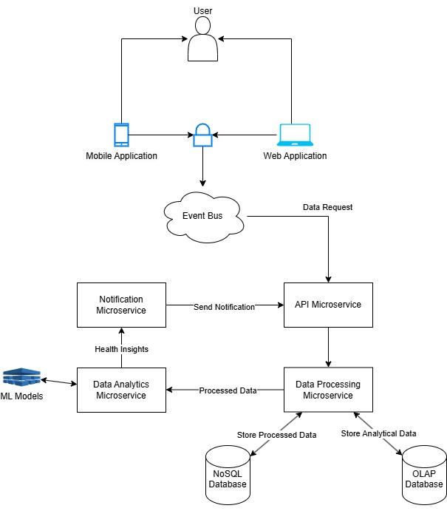
System Architecture Diagram

Slide 6
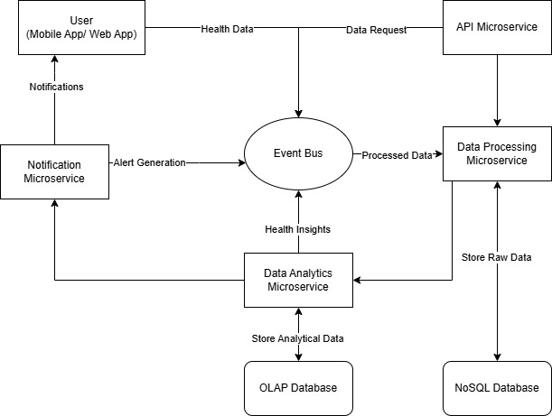
Data Flow Diagram

Slide 7
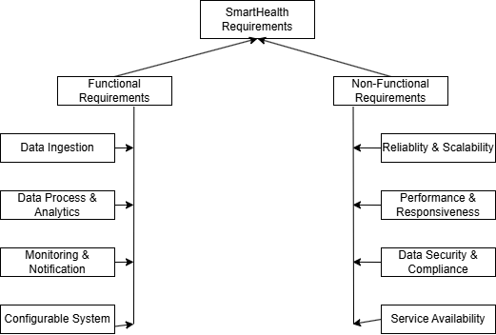
Functional and Non-Functional Requirements

Slide 8
Project Plan and Agile Approach
Work Breakdown Structure (WBS):
- Requirement Analysis, Architecture Design, Development, Integration, Testing, and Launch.
Agile Development Practices:
- Iterative sprints with regular feedback.
- Sprint reviews and retrospectives ensure continuous improvement.
- User and stakeholder feedback integrated into product backlog.

Slide 9
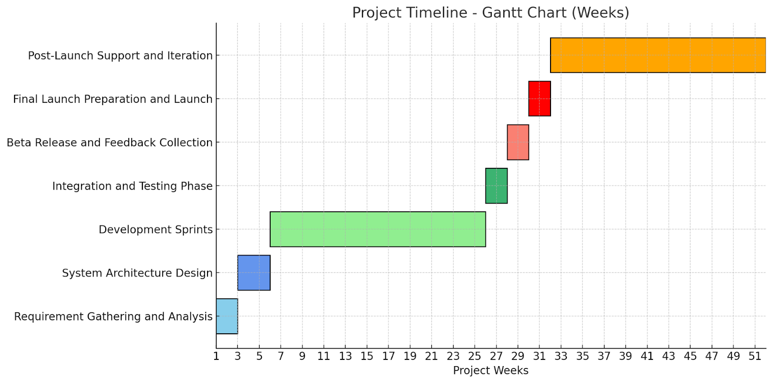
Project Timeline

Slide 10
Risk Assessment and Mitigation
Identified Risks:
- Technical: Integration with wearables, AI algorithm complexity.
- Operational: User adoption, technical glitches.
- Economic: Budget constraints, market competition.
Mitigation Strategies:
- Compatibility testing and partnerships for wearable integration.
- Rigorous AI model testing and user-centric design improvements.
- Proactive budget management and strategic feature differentiation.

Slide 11
Risk Impact Analysis Table
Risk | Likelihood | Impact | Priority Level
Integration Challenges with Wearable Devices | Moderate | High | High
Data Accuracy Concerns | Low | High | High
Budget Constraints Affecting Scalability | Low | High | High
Complexity in Developing AI Algorithms | Moderate | Moderate | Moderate
User Adoption Due to Poor Experience | High | Moderate | Moderate
Market Fluctuations | Moderate | Moderate | Moderate

Slide 12
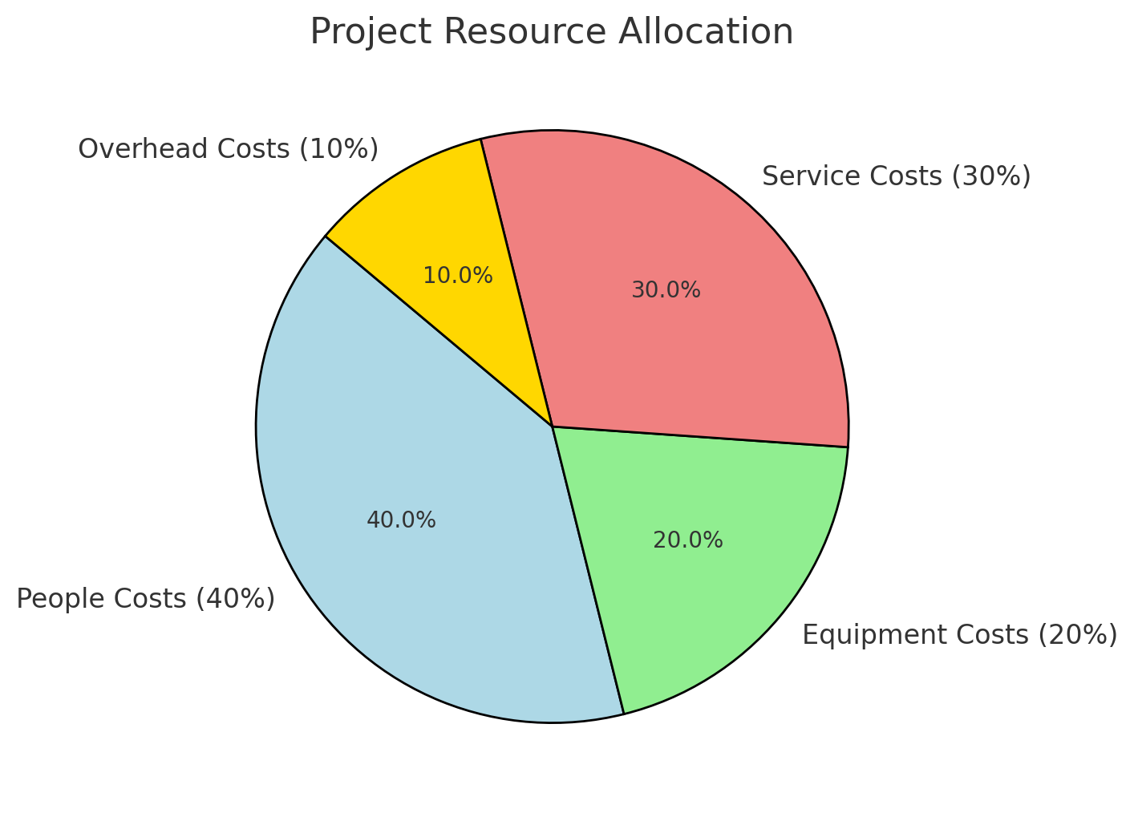
Budgeting and Allocation
Monitoring and Control:
- Regular expense reviews with tracking tools.
- Approval process for high-value expenses.
- Forecasting based on historical data for proactive adjustments.

Slide 13
Conclusion
SmartHealth Platform:
- Provides AI-driven, personalized health management tools.
- Supports healthcare providers with remote monitoring capabilities.
Key Takeaways:
- High feasibility across technical, operational, and economic dimensions.
- Robust risk mitigation and scalable project plan ensure long-term success.
- Budget and resource allocation support sustainable growth and innovation.

Slide 14
GitHub Link
https://github.com/Mutasimur/SOEN-6481_Software-Project-Management

