Slide 1

Team 8’s – RGU School of Computing Website
By Reuben Hadden, Jack Grundy, Scott Guy, Chloe Greenwood, Dominik Gyecseck and Craig Kennedy

Slide 2
Structure
There are seven main web pages, which can be accessed at any point from the menu
The seven web pages are:
Home
About
News and Events
Staff
Research
Study Information
Contact

Slide 3
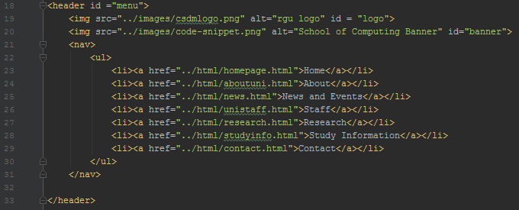
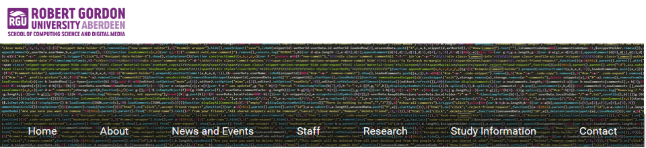
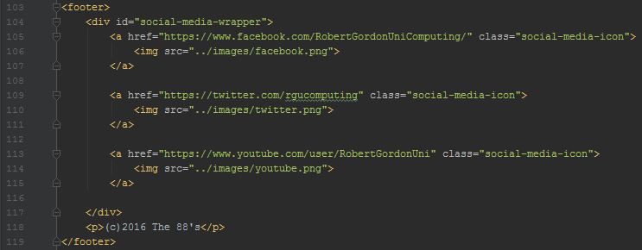
Menu and Footer
The menu consists of two images which overlap using a stylesheet
There are also ‘listed’ links which can take the user to any main parts of the website from any page
The footer contains the team name and RGU’s social media links
Can be accessed consistently across the website

Slide 4
Home
The main content of the webpage and also most of the website is split into two separate sections(66%-33%), using an unsemantic CSS grid
The Welcome information along with a YouTube video is on the left-hand side
On the right side there is information and links to courses in the School of Computing
Under the course information are embedded social media links

Slide 5
About
This page has a very similar design to the homepage

Slide 6
News and Events

Slide 7
Staff

Slide 8
Research

Slide 9
Study Information

Slide 10
Contact

