Slide 1
Team 8’s – RGU School of Computing Website
By Reuben Hadden, Jack Grundy, Scott Guy, Chloe Greenwood, Dominik Gyecseck and Craig Kennedy

Slide 2
HTML Structure
There are seven main web pages, which can be accessed at any point from the menu
The seven HTML web pages are:
Home
About
News and Events
Staff
Research
Study Information
Contact

Slide 3
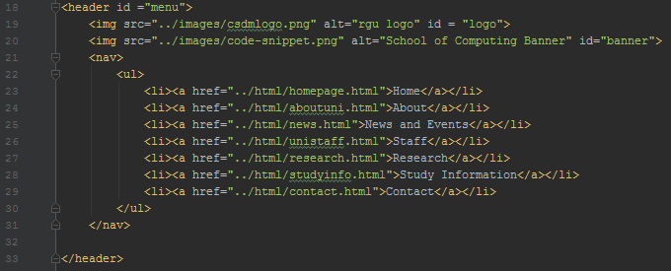
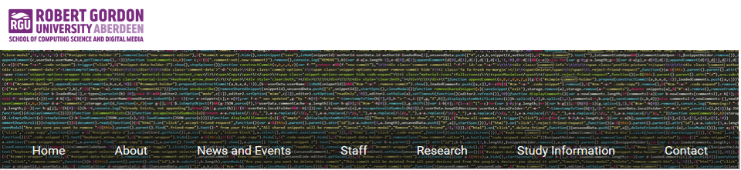
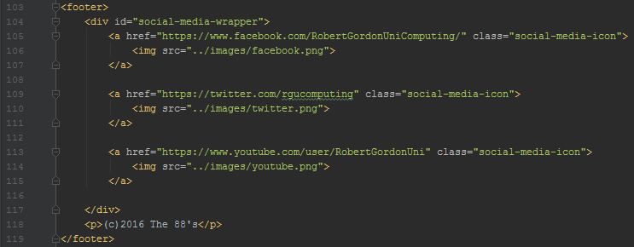
Menu and Footer
The menu consists of two images which overlap using a stylesheet
There are also ‘listed’ links which can take the user to any main parts of the website from any page
The footer contains the team name and RGU’s social media links
Menu and Footer can be accessed consistently across the website

Slide 4
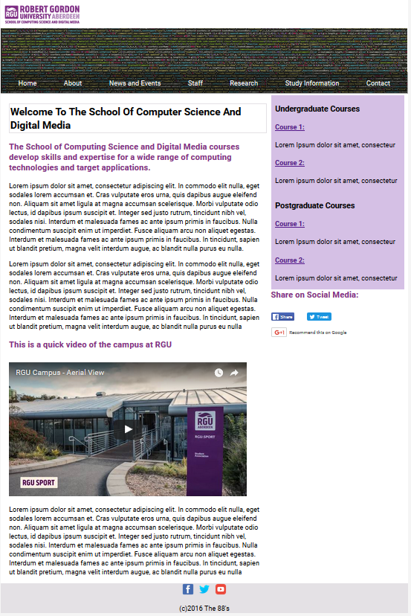
Homepage

Slide 5

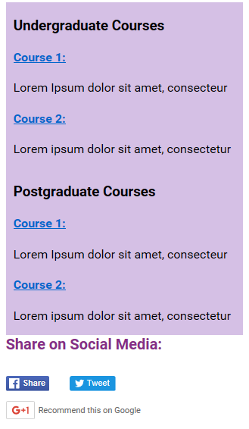
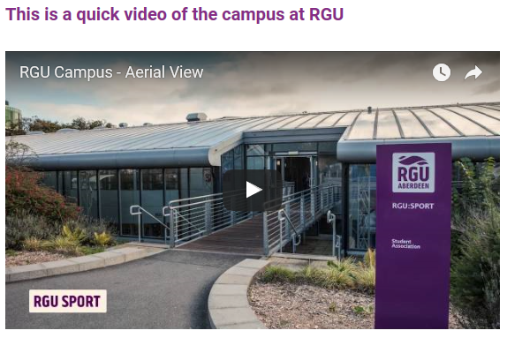
Homepage
The Homepage greets you with welcome information along with a YouTube video is on the left-hand side.
On the right side there are information and links to courses in the School of Computing.
Under the course information are embedded social media links, allowing the user to share the website

Slide 6
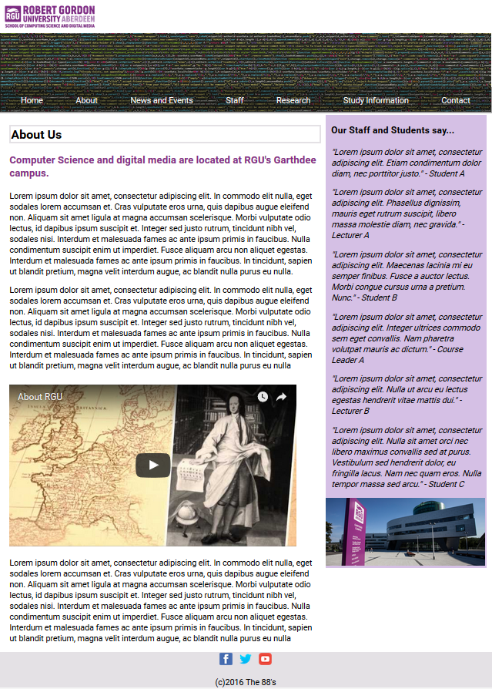
About

Slide 7
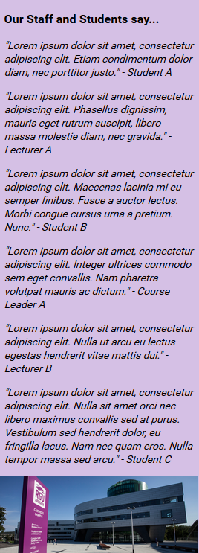
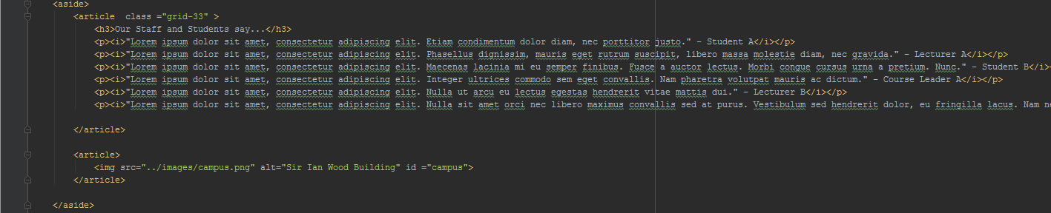
About
This page has a very similar design to the homepage
On the left side there is information on RGU and the Garthdee campus
Quotes from students and lecturers are located on the right

Slide 8
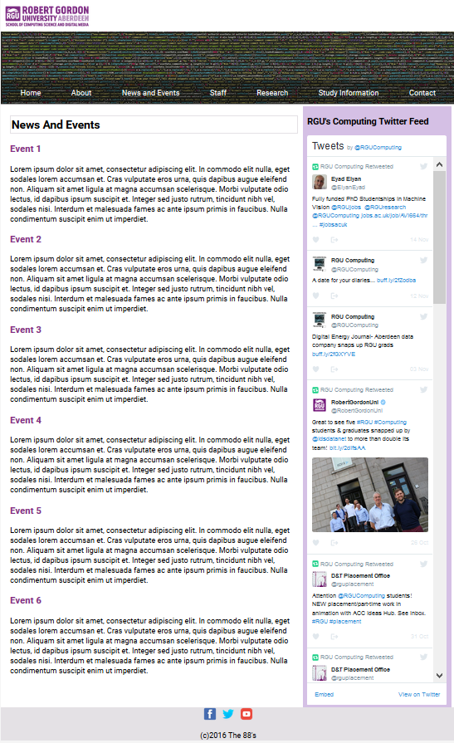
News and Events

Slide 9
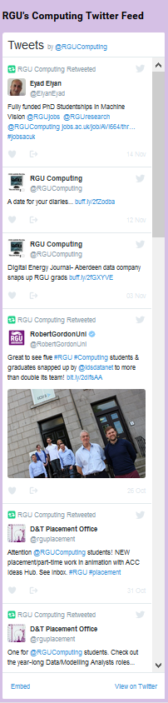
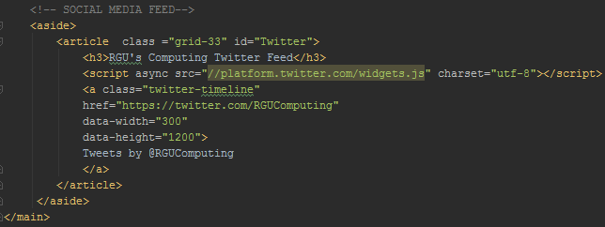
News and Events
Contains a live twitter feed, showing tweets from RGU computing
Events at RGU are easily visible in the center of the webpage

Slide 10
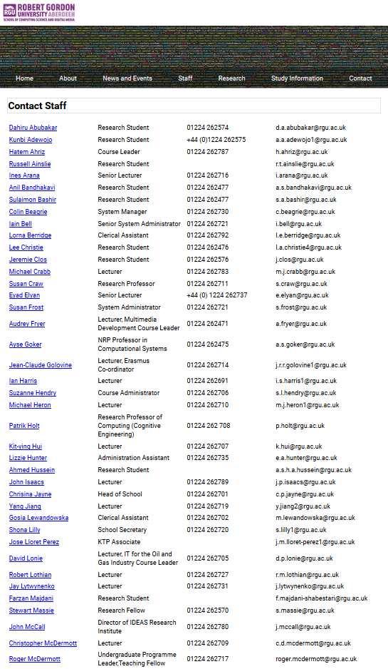
Staff

Slide 11
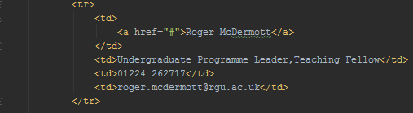
Staff
All of the staff and research student’s contact information are given in a table
Each name is a hyperlink which will take the user to the staff’s own webpage
This page is useful for current students and potential students looking to contact the lecturers and staff from School of Computing

Slide 12

Research

Slide 13

Research
This page explains the research groups and centers are located in the school of computing
The Unsemantic grid separates the groups into 3, making the page easier to read
Unsemantic Grid

Slide 14
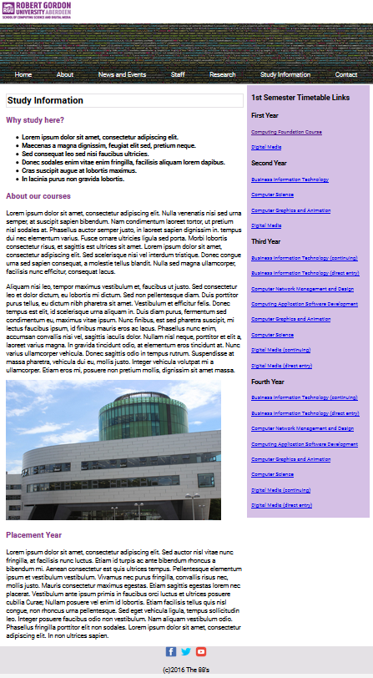
Study Info

Slide 15
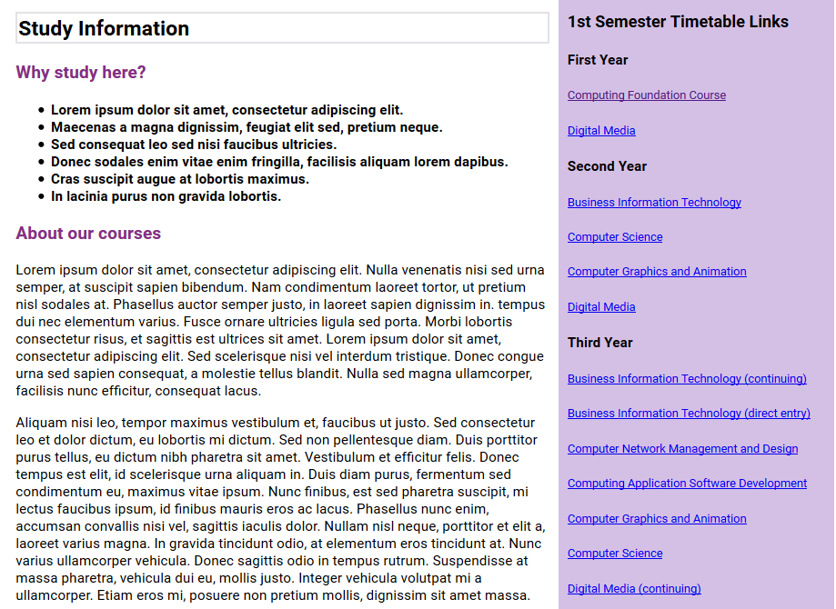
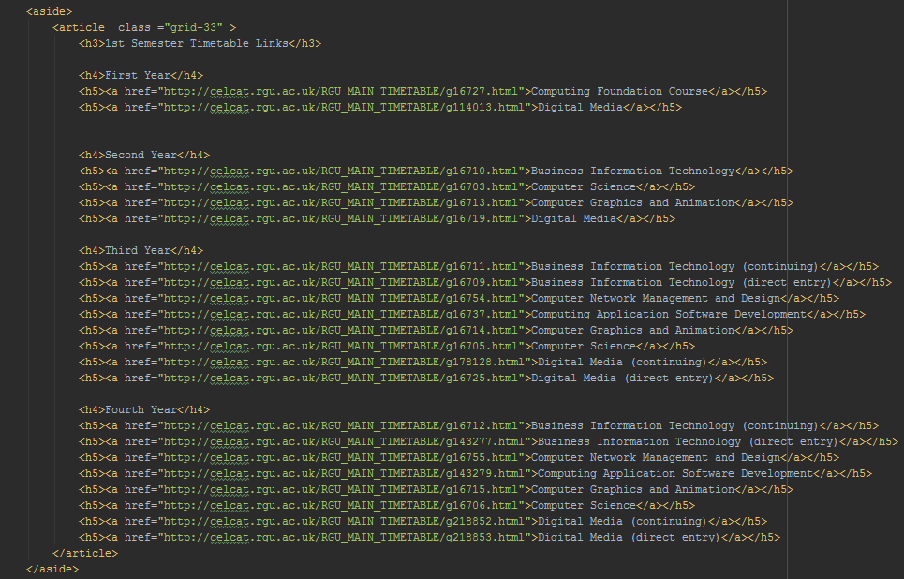
Study Information
The study information page shows the user information about courses and the bottom to the left side of the page a Placement Year in CS is mentioned
Links to timetable for the first semester are displayed down the right side of the page
Timetables

Slide 16
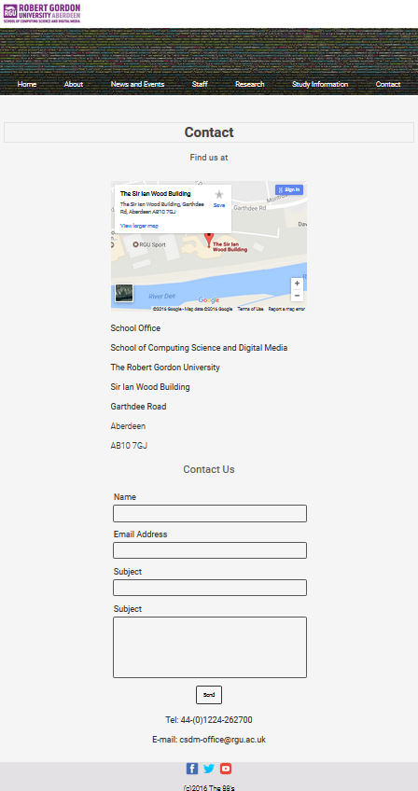
Contact

Slide 17
Contact
The contact page has an embedded google map link showing the location of The Sir Ian Wood Building
The address is also included
Below a form can be used to enter your details and contact the School of Computing

