Slide 1

Team 8’s – RGU School of Computing Website
By Reuben Hadden, Jack Grundy, Scott Guy, Chloe Greenwood, Dominik Gyecseck and Craig Kennedy

Slide 2
Structure
There are seven main web pages, which can be accessed at any point from the menu
The seven web pages are:
Home
About
News and Events
Staff
Research
Study Information
Contact

Slide 3
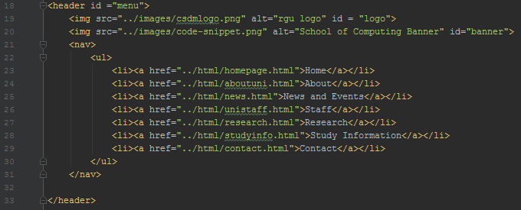
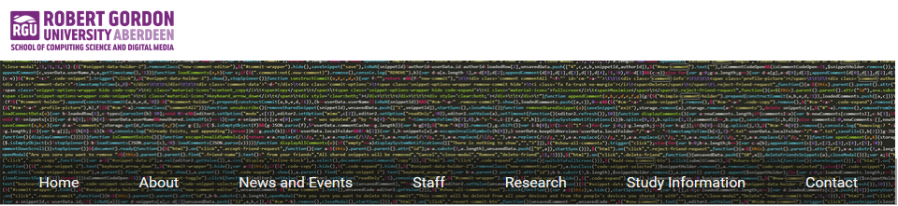
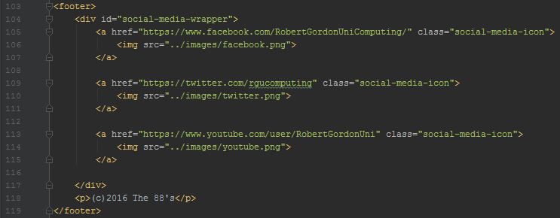
Menu and Footer
The menu consists of two images which overlap using a stylesheet
There are also ‘listed’ links which can take the user to any main parts of the website from any page
The footer contains the team name and RGU’s social media links
Can be accessed consistently across the website

Slide 4
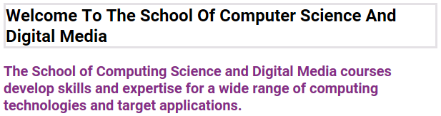
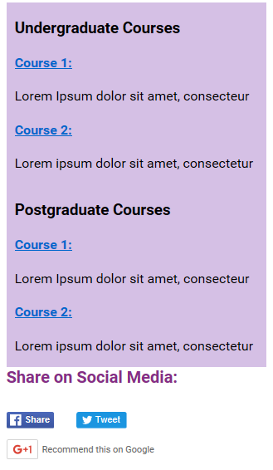
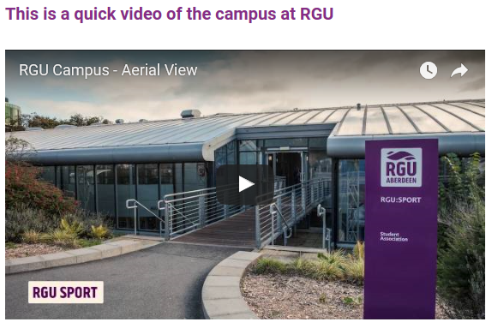
Home
The Homepage greets you with welcome information along with a YouTube video is on the left-hand side.
On the right side there is information and links to courses in the School of Computing.
Under the course information are embedded social media links, allowing the user to share the website.

Slide 5
About
This page has a very similar design to the homepage.
On the left side the website has another embedded YouTube video that tells you all about RGU.

Slide 6
News and Events

Slide 7
Staff

Slide 8
Research

Slide 9
Study Information
The study information page shows the user information about courses and the bottom of the page mentions a Placement Year in CS on the left side of the page.
Links to timetable for the first semester are displayed down the right side of the page.

Slide 10
Contact
The contact page has an embedded google map link showing the location of The Sir Ian Wood Building.
Below that is a place to enter your details to contact the School of Computing.

