Slide 1
Intrusion Detection Data
Muteb nidaa

Slide 2
Problem
Server attacks and suspicious content.
Detect if attack session normal or Suspicious

Slide 3
Classification Data
Normal
Suspicious
Unknown

Slide 4
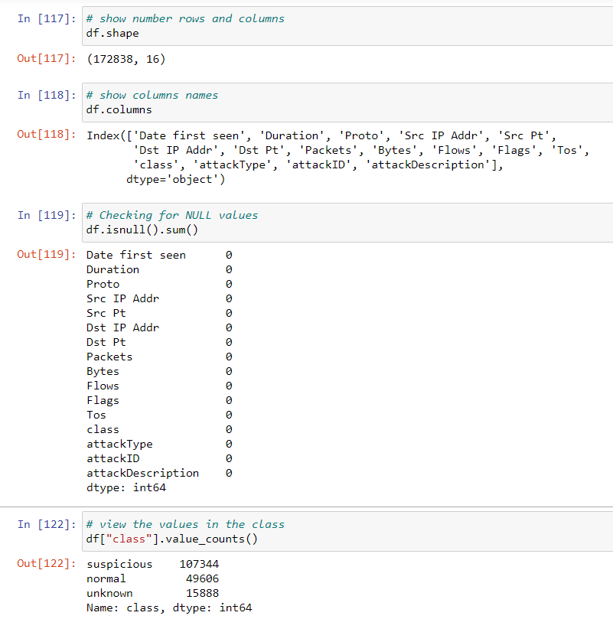
Data

Slide 5

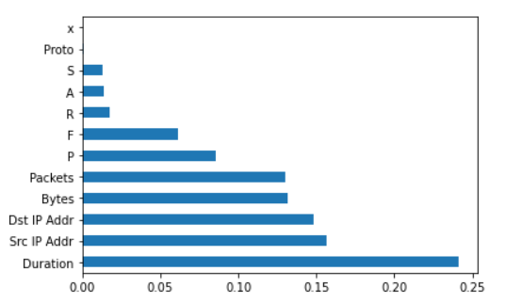
Feature importance

Slide 6
Feature
Duration
Dst IP Address,
Src IP Address, Packets, Bytes, Flags

Slide 7
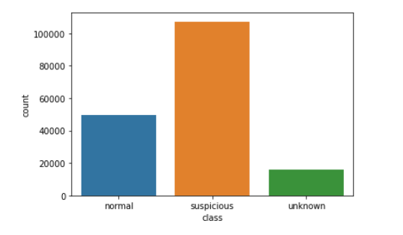
Noemal and Suspicious and Unknown

Slide 8
The model
K Nearest Neighbor(KNN)
Multi-layer Perceptron classifier
Gaussian Naive Bayes
Decision Tree
Random Forest

Slide 9
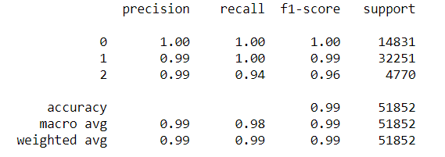
Random Forest
Accuracy: 98.9%
Cross Validatiion Score: 98.6%

Slide 10
Thank you

