Slide 1
Enhancing Safety: Helmet Detection with Machine Learning

Slide 2



Introduction
In this presentation, we will explore the use of Machine Learning for helmet detection to enhance safety in various industries. We will discuss the challenges, beneﬁts, and potential applications of this technology.

Slide 3


Ensuring helmet compliance is crucial for preventing head injuries in workplaces and high-risk environments. Machine Learning can automate the process of helmet detection, improving safety measures and reducing the risk of accidents.

Slide 4


Challenges in Helmet Detection
Detecting helmets in complex environments with varying lighting and angles poses signiﬁcant challenges.
Machine Learning algorithms must be
robust to detect helmets accurately in these conditions.

Slide 5


Various Machine Learning techniques such as object detection and image classiﬁcation can be employed for helmet detection. These techniques involve training models on diverse datasets to accurately identify helmets.

Slide 6
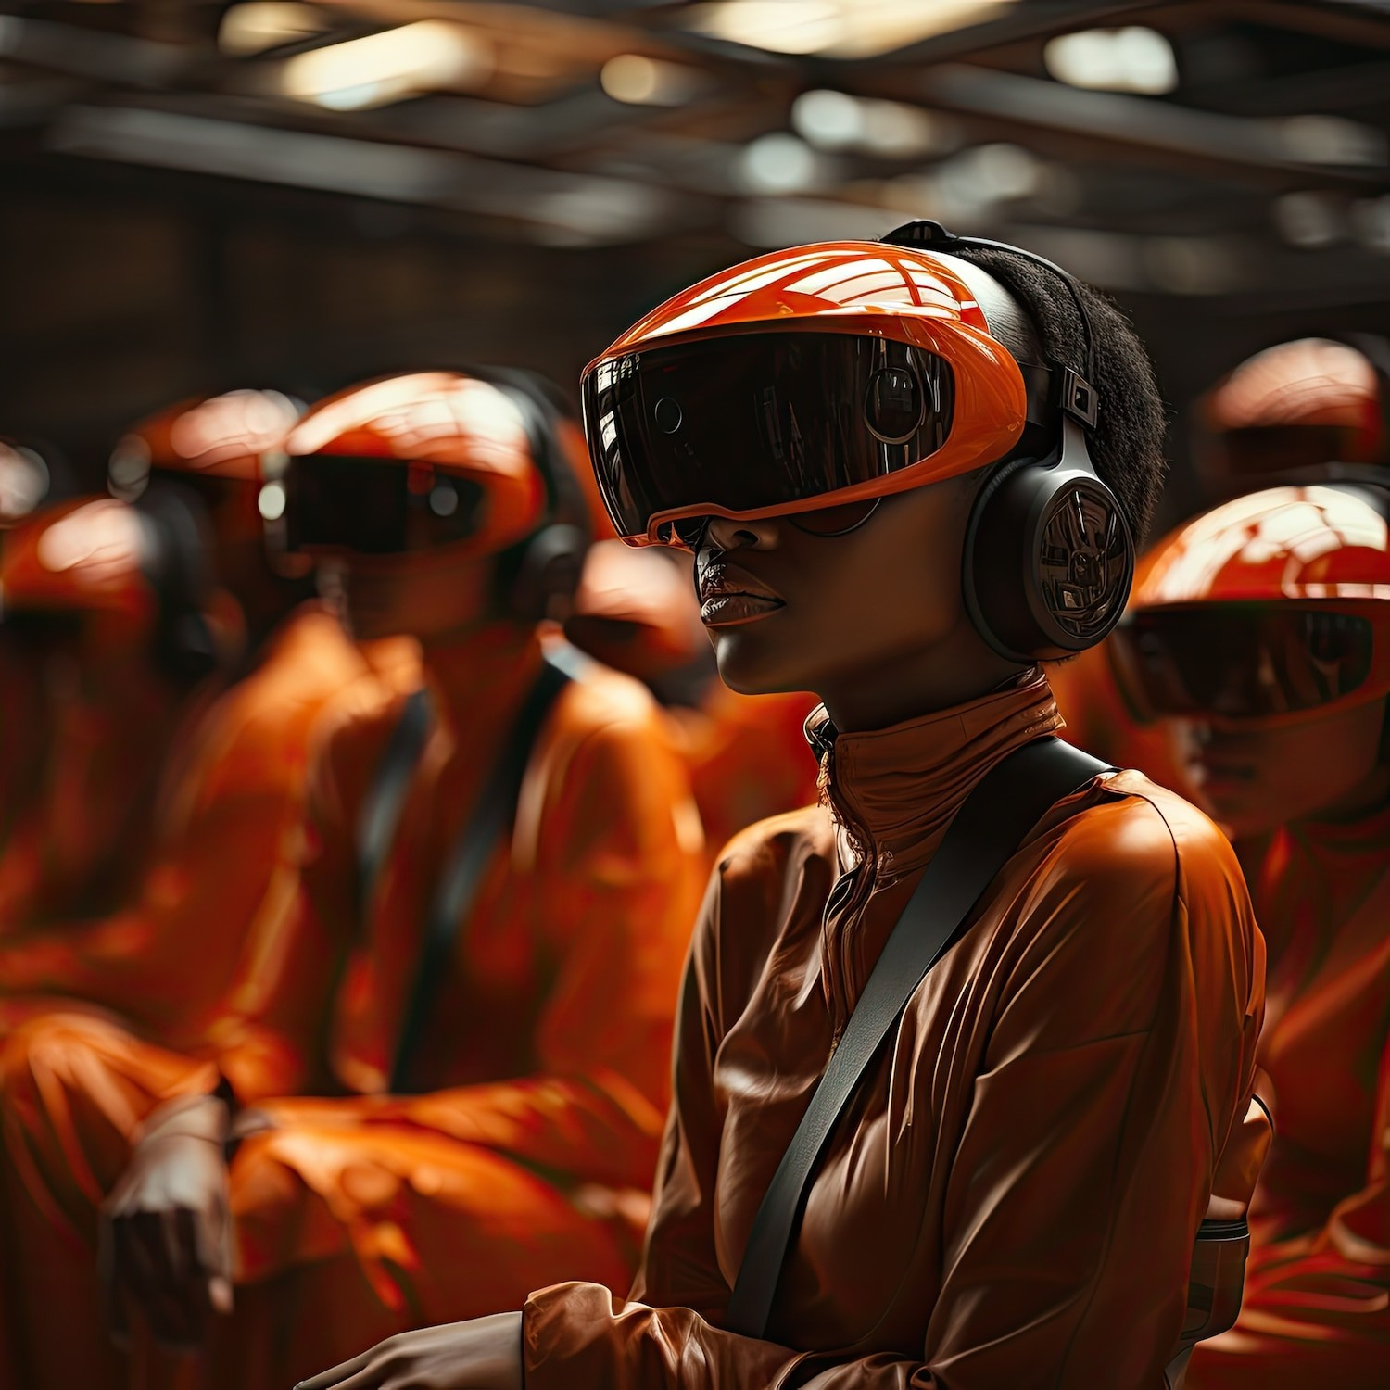
Applications in Different Industries
Helmet detection using Machine Learning has applications in construction, manufacturing, mining, and sports. It can improve safety protocols, compliance monitoring, and overall risk management in these industries.

Slide 7

Conclusion
The integration of Machine Learning for helmet detection offers a promising solution to enhance safety across various industries. By automating the process, it can signiﬁcantly reduce the risk of head injuries and improve overall safety standards.

Slide 8
Thanks!

