Slide 1



PROJECT TITLE :
Explainable Multilingual Fake News Detection using Contrastive learning and Fact Verification for low resource Languages
KONGU ENGINEERING COLLEGE
PERUNDURAI ERODE-638060
Department of Computer Science and Design
22CDP72 - PROJECT WORK II PHASE I
BATCH NO: 01
PROJECT GUIDE:
DR.R.THANGARAJAN
PRESENTED BY :
KAVIN RITHIK S – 23CDR071
MUTHAMIL S - 23CDR104
NIRANJANA Y -23CDR110

Slide 2
INTRODUCTION
Fake news spreads faster than it can be manually verified, and most detection research targets high-resource languages such as English.
Tamil is low-resource: in this project's corpus it accounts for 5,408 of 69,008 records, only 7.8% of the data.
A bilingual Tamil-English corpus of 69,008 labelled news records has been built from four public sources.
XLM-RoBERTa represents both languages in one shared 768-dimensional space, so a single model handles Tamil and English.
Supervised contrastive learning links same-label articles across languages, allowing Tamil to learn from the larger English pool.

Slide 3
OBJECTIVE
To build a labelled Tamil-English fake news corpus with recorded source provenance and leakage-controlled splits.
To represent both languages in one shared space using XLM-RoBERTa with mean pooling and L2 normalisation.
To strengthen the representation using supervised contrastive learning, so the minority language benefits from the majority language.
To classify each article as fake or real using an MLP classifier trained on the learned representation.
To evaluate accuracy, precision, recall, macro-F1 and ROC-AUC, reported overall and separately for Tamil and English.
To extend the framework with fact verification and explainability in the remaining modules.

Slide 4
LITERATURE SURVEY
S.NO | TITLE OF THE PROJECT | AUTHOR/JOURNAL/YEAR | PROPOSED MODEL | FUTURE WORK
1 | Explainable multi-granularity attribution reasoning framework for fake news detection | Wei Ji, Hongzhen Lv/ 25 March 2026 | EMAR-FND deep learning framework | Extend the model to support multiple languages.
2 | A simple contrastive embedding framework for low-resource fake news detection | Iftitahu Ni’mah/ 05 August 2025 | Contrast-BERT (Contrastive Learning) Stacking-based Ensemble Learning Ensemble of Multilayer Perceptrons (MLPs) | Add multilingual support. Integrate images and videos (multimodal detection).
3 | Multi-modal fake news detection: A comprehensive survey on deep learning technology, advances, and challenges | Li Li / 10 November 2025 | hybrid multimodal fusion models | Build better multimodal datasets. Improve cross-modal semantic understanding.
4 | A semi supervised fake news detection model using the grasshopper optimization algorithm | Ali Ghaffari/ 19 February 2026 | Grasshopper Optimization Algorithm (GOA) | Add explainable AI features.
5 | Early detection of fake news by integrating global structure and publisher credibility | Yantuan Xian/ 22 August 2025 | Bidirectional Graph Convolutional Network (Bi-GCN) | Apply causal reasoning to identify manipulated news propagation patterns.

Slide 5
S.NO | TITLE OF THE PROJECT | AUTHOR/JOURNAL/YEAR | PROPOSED MODEL | FUTURE WORK
6 | BiLSTM-LIME: integrating NLP and advanced machine learning models for fake news detection | Md. Jakir Hossen/ 17 January 2026 | BiLSTM-LIME Framework | Improve detection for low-resource languages.
7 | Fake news detection with GAN-augmented contrastive learning and multimodal | Cong Wu / 13 April 2026 | Multi-layer joint attention for text-image fusion GAN-based adversarial training | Improve generalization to unseen events. Add explainable AI features.
8 | Multimodal based Amharic fake news detection using CNN and attention-based BiLSTM | Alemu Desu Geto or Eshete Derb Emiru / 02 October 2025 | CNN with Attention-based BiLSTM FastText embeddings for Amharic text. | Add image captioning. Expand and enrich datasets.
9 | Hybrid optimization driven fake news detection using reinforced transformer models | Koteswararao Ch / 28 April 2025 | Modified Transformer (mT5-based) with three-stage fine-tuning. PSODO (Particle Swarm Optimization + Dandelion Optimization) for model optimization. | Integrate explainable AI (SHAP/LIME).
10 | Fusing non-textual cues with classical NLP for enhanced multimodal fake news spread detection | Jing Dang / 09 April 2026 | Multi-Modal Deep Learning Architecture | Add temporal modeling and explainable AI. Extend to image, video, and audio analysis.

Slide 6
S.NO | TITLE OF THE PROJECT | AUTHOR/JOURNAL/YEAR | PROPOSED MODEL | FUTURE WORK
11 | Transfer learning driven fake news detection and classification using large language models | Deema Mohammed Alsekait / 05 August 2025 | Multi-Stage Transfer Learning Framework Uses: RoBERTa as the pre-trained language model. | Enable early fake news prediction without relying on comments.
12 | Addressing data scarcity in multilingual fake news detection: an LLM-based dataset augmentation approach | Razieh Chalehchaleh / 28 August 2025 | LLM-based Data Augmentation Framework | Improve synthetic data quality. Optimize augmentation rates and strategies.
13 | A hybrid deep learning framework for fake news detection using LSTM-CGPNN and metaheuristic optimization | ramesh kumar ayyasamy / 24 November 2025 | Hybrid Deep Learning Framework | Model temporal evolution of fake news. Integrate SHAP, LIME, and attention visualization for explainability.
14 | A sophisticated feature vectorization-based stacked machine learning approach for fake news detection in Bangla and English | Anichur Rahman, Hezerul Abdul Karim or Abu Saleh Musa Miah / 31 December 2025 | TF-IDF + Stacked Ensemble Machine Learning Model Uses: TF-IDF for feature extraction. SMOTE for class balancing. | Use advanced models such as BERT, BanglaBERT, RoBERTa, GPT, DistilBERT, and ALBERT.
15 | Leveraging data analytics for detection and impact evaluation of fake news and deepfakes in social networks | Yu-wang Chen / 08 July 2025 | Hybrid Fake News and Deepfake Detection Framework | Improve fake news and deepfake detection accuracy.

Slide 7
RESEARCH GAP
Fake news detection research is concentrated on high-resource languages; Tamil has very limited labelled data and few published baselines.
Translating Tamil into English before detection loses linguistic nuance and introduces translation error.
Most models report only a label and do not check the claim against any external evidence.
Existing systems are black-box; they do not show which parts of an article influenced the decision.
No single framework combines multilingual support, contrastive representation learning, fact verification and explainability.

Slide 8
PROBLEM STATEMENT
There is no unified framework that detects fake news accurately in both Tamil and English while remaining evidence-grounded and explainable. This project builds a Tamil-English framework that represents both languages in one XLM-RoBERTa space, applies supervised contrastive learning so the minority language benefits from the majority, and classifies each article as fake or real.

Slide 9
PROPOSED WORK-LIST OF MODULES
IMPLEMENTED — MODULES 1 to 6
REMAINING — MODULES 7 to 10
1
Dataset Collection
7
Fact Verification
Tamil and English public news sources
Retrieve evidence and verify the claim
2
Data Preprocessing
8
Decision Fusion
Clean · de-duplicate · encode · stratified split
Combine classifier and verifier outputs
3
Feature Extraction
9
Explainable AI
XLM-RoBERTa → 768-d contextual embeddings
Token-level attribution for the prediction
4
Contrastive Learning
10
Application & Demo
Supervised contrastive representation learning
Web interface for end-to-end verification
5
Classification
MLP classifier → Fake / Real
The Fake / Real prediction and its probability become the input to fact verification, which supplies evidence to the fusion stage.
6
Model Evaluation
Accuracy · Macro-F1 · ROC-AUC · per language

Slide 10
MODULE COMPLETION STATUS
Module | Work completed
1 Dataset Collection | 69,089 records from 4 public Tamil/English sources
2 Data Preprocessing | 69,008 clean records; stratified 70/15/15 split
3 Feature Extraction | 138,016 XLM-RoBERTa embeddings (768-d, L2-normalised)
4 Contrastive Learning | Supervised contrastive training; 8-configuration ablation
5 Classification | MLP classifier trained; configuration selected on validation
6 Model Evaluation | Accuracy, precision, recall, macro-F1, ROC-AUC, per language

Slide 11
MODULE 1 & 2 — DATASET AND PREPROCESSING
Module 1 — Dataset Collection
Module 2 — Data Preprocessing
Source | Lang | Real | Fake | Total
WELFake | en | 28,882 | 34,790 | 63,672
aanirudh_headlines | ta | 2,285 | 2,893 | 5,178
Daily Thanthi | ta | 214 | 11 | 225
BOOM Tamil | ta | 2 | 12 | 14
TOTAL | — | 31,383 | 37,706 | 69,089
• 514 missing titles repaired → 0 remaining
• 70 documents below length floor removed
• 11 exact duplicates removed (69,019 → 69,008)
• Labels encoded 0 = real, 1 = fake (0 invalid)
• Language verified — 0 mismatches
• Stratified on (language, label), seed 42
English 63,673 · Tamil 5,416 (7.8% of corpus)
Fake 37,706 · Real 31,383
Split | Records | Share
Train | 48,305 | 70%
Validation | 10,351 | 15%
Test | 10,352 | 15%
Leakage check passed: train∩val = train∩test = val∩test = 0

Slide 12
MODULE 3 & 4 — FEATURES AND CONTRASTIVE LEARNING
Module 3 — XLM-RoBERTa Feature Extraction
Module 4 — Supervised Contrastive Learning
Positives: same-label articles in the batch, including Tamil–English pairs. Negatives: opposite-label articles.
1. Tamil / English text → SentencePiece tokenizer
2. xlm-roberta-base encoder, max_length 512
3. Attention-mask weighted mean pooling
4. L2 normalisation → 768-d unit vector
Parameter | Value
Loss | Supervised contrastive
Temperature | 0.07
Optimizer | AdamW, lr 5 × 10⁻⁴
Batch size | 256
Max epochs / run | 30 / 13 (early stop)
Ablation | 2 pooling × 2 samplers × 2 methods
Setting | Value
Model | xlm-roberta-base
Embedding dimension | 768
Pooling | mean (and CLS)
Normalisation | L2, unit length
Vectors generated | 138,016

Slide 13
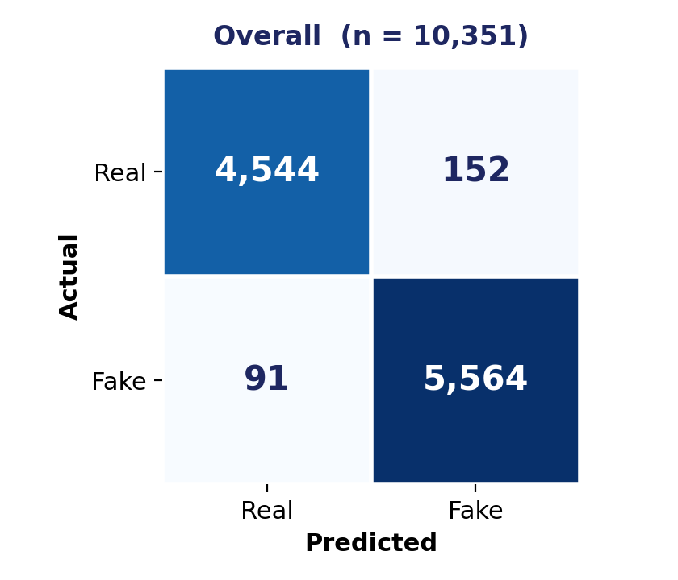
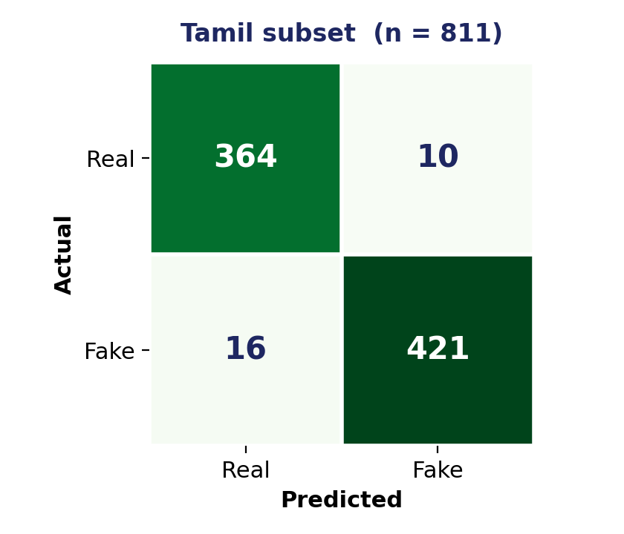
MODULE 5 & 6 — CLASSIFICATION AND EVALUATION
MLP 768→512→128→2 · CrossEntropyLoss · AdamW, lr 1×10⁻³ · batch 512 · 50 epochs, early stopping (patience 8) on validation macro-F1
Model / configuration | Accuracy | Precision | Recall | Macro F1 | ROC-AUC
Majority-class baseline | 0.5463 | 0.2732 | 0.5000 | 0.3533 | 0.5000
Logistic regression (CLS) | 0.7922 | 0.7915 | 0.7881 | 0.7893 | 0.8807
Logistic regression (mean) | 0.8139 | 0.8151 | 0.8088 | 0.8107 | 0.8986
SupCon + linear head | 0.9686 | 0.9689 | 0.9678 | 0.9683 | 0.9940
MLP classifier (selected) | 0.9765 | 0.9769 | 0.9758 | 0.9763 | 0.9969
Language | n | Accuracy | Macro F1 | ROC-AUC
English | 9,540 | 0.9773 | 0.9770 | 0.9971
Tamil | 811 | 0.9679 | 0.9678 | 0.9951

Slide 14
ABLATION AND BEST RESULT
All 8 ablation configurations (validation macro-F1)
Best result achieved so far
Configuration | Macro F1
mean · uniform · CE-MLP (selected) | 0.9763
mean · language-aware · SupCon | 0.9736
mean · language-aware · CE-MLP | 0.9734
cls · uniform · CE-MLP | 0.9713
cls · language-aware · CE-MLP | 0.9686
mean · uniform · SupCon | 0.9683
cls · uniform · SupCon | 0.9661
cls · language-aware · SupCon | 0.9594
Metric | Value
Accuracy | 0.9765
Precision (macro) | 0.9769
Recall (macro) | 0.9758
Macro F1 | 0.9763
Observations
• Best model exceeds the strongest classical baseline by +0.1656 macro-F1.
• Mean pooling outperformed CLS pooling in every configuration tested.
• Contrastive training keeps Tamil within 0.009 macro-F1 of English.
• Modules 1–6 complete; remaining modules are in progress.

Slide 15
REFERENCES
[1] W. Ji and H. Lv, "Explainable multi-granularity attribution reasoning framework for fake news detection," npj Artificial Intelligence, 2026.
[2] I. Ni'mah et al., "A simple contrastive embedding framework forlow-resource fake news detection," Neural Computing and Applications, vol. 37, pp. 21407–21433, 2025.
[3] L. Li et al., "Multi-modal fake news detection: A comprehensive survey on deep learning technology, advances, and challenges," Journal of King Saud University – Computer and Information Sciences, 2025.
[4] A. Ghaffari et al., "A semi-supervised fake news detection model using the grasshopper optimization algorithm," Discover Artificial Intelligence, 2026.
[5] Y. Xian et al., "Early detection of fake news by integrating global structure and publisher credibility," Information Processing & Management, 2025.
[6] H. Hossain, M. Z. Rahman, M. S. Islam, and S. Kar, "BanFakeNews: A dataset for detecting fake news in Bangla," in Proc. 12th Language Resources and Evaluation Conf. (LREC), Marseille, France, 2020,
pp. 2862–2871.
[7] A. Conneau et al., "Unsupervised cross-lingual representation learning at scale," in Proc. Annu. Meeting Assoc. Computational Linguistics (ACL), 2020.
[8] P. Khosla et al., "Supervised contrastive learning," in Advances in Neural Information Processing Systems (NeurIPS), vol. 33, 2020.
[9] R. Mirnalinee et al., "A novel dataset for fake news detection in Tamil regional language," in Proc. SPELLL, 2022.

Slide 16


