Slide 1
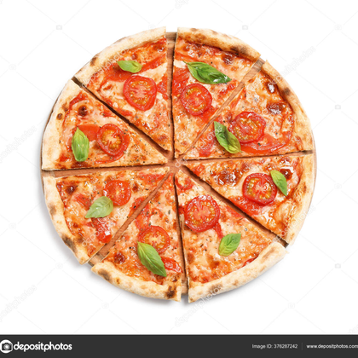
01 / 15
CAPSTONE PROJECT • 2025
SmartPizza AI
Intelligent Food Ordering & Delivery Optimization System
A full-stack Spring Boot + React platform that fuses Azure OpenAI recommendations, OSRM route optimization, and Razorpay payments into one seamless pizza-ordering experience.
DEVELOPED BY
MENTORED BY
PROGRAM
Muthamizh Kumaran Loganathan
Javeed — Trainer
Great Learning
SP • AI

Slide 2
CONTEXT
Problem Statement
SmartPizza AI •
02 / 15
Traditional food-ordering platforms struggle with three structural gaps that directly hurt conversion, basket size, and customer trust.
01
02
03
Generic, One-Size-Fits-All Menus
Opaque, Anxiety-Inducing Delivery
Fragmented Checkout & Payments
● Static catalogs ignore dietary preferences and past ordering behavior
● Customers scroll endlessly, leading to decision fatigue and drop-off
● Upsell & cross-sell opportunities are missed — combos are pushed manually
● Customers get a single 'out for delivery' status with no live location
● ETAs are rough estimates that drift unpredictably as the order progresses
● Riders are dispatched without route optimization, increasing delivery time
● Cart, coupons, tax, and payment are stitched together across disconnected UIs
● Promo-code logic is brittle and often miscalculates discounts or tax
● Admin teams lack real-time visibility into revenue, delivery KPIs, and trends
SmartPizza AI was built to close all three gaps with one integrated, AI-augmented platform.
SmartPizza AI • Capstone Project
02 / 15

Slide 3
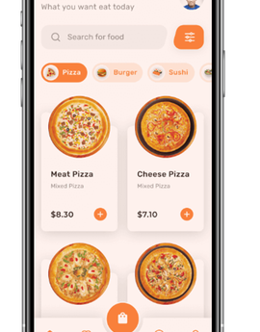
APPROACH
Solution Overview
SmartPizza AI •
03 / 15
One Platform, Four Roles, Six Modules
SmartPizza AI is a role-aware, AI-augmented pizza-ordering platform that unifies customers, admins, and delivery riders under a single Spring Boot backend with a React frontend.
● Role-based access for Customer, Admin, and Delivery — each with a tailored UI and JWT-secured endpoints
● AI-driven ordering via Azure OpenAI suggests personalized pizzas and combos based on order history and seasonality
● Live delivery tracking with OSRM route polylines, rider & customer markers on Leaflet maps, and 15-second polling
● Real-time ETA computed by Azure Maps geocoding + routing, refreshed on every poll cycle
● End-to-end billing with Razorpay payments, automatic tax calculation, and invoice generation
● Admin analytics for revenue, delivery performance, and customer trends in a single dashboard
◯
▣
AI-FIRST
GEO-AWARE
Personalized recommendations & behavior analytics
Live tracking, OSRM routing, Azure Maps ETA
⚿
$
ROLE-SECURE
PAYMENT-READY
JWT auth with three distinct access tiers
Razorpay integration, invoicing, tax engine
SmartPizza AI • Capstone Project
03 / 15

Slide 4
ENGINEERING
Technology Stack
SmartPizza AI •
04 / 15
▦
BACKEND
✦
FRONTEND
✦
AI & APIS
✦
ROUTING & MAP
●
Java 17
●
React 19
●
Azure OpenAI (recommendations)
●
OSRM (route polyline)
●
Spring Boot 4.1
●
Vite
●
Leaflet (map rendering)
●
Azure Maps (geocoding + ETA)
●
Spring Security + JWT
●
React Router
●
Rider & customer markers
●
Hibernate / JPA
●
Bootstrap 5
●
Razorpay (payments)
●
15-sec polling loop
●
MySQL
●
Leaflet Maps
●
OpenStreetMap tiles
Reference: layered service architecture
INTEGRATION COUNT
12+
BUILD TOOLS
Maven • npm • Vite • Docker-ready
external services
SmartPizza AI • Capstone Project
04 / 15

Slide 5
DESIGN
Architecture & System Flow
SmartPizza AI •
05 / 15
REFERENCE ARCHITECTURE
A request travels through five logical layers — from the React client to the persistence layer — with Azure services injected at the recommendation and routing stages.
01
02
03
04
05
❄
⛨
✦
☁
▦
CLIENT
AUTH & API GATEWAY
BUSINESS LOGIC
EXTERNAL AI SERVICES
PERSISTENCE
React 19 + Vite SPA. Customer, Admin, and Delivery portals share one routing tree.
›
Spring Security validates JWT on every request, maps roles to endpoints, and routes to controllers.
›
Spring Boot services handle ordering, coupons, recommendations, billing, and dispatch.
›
›
MySQL stores users, orders, menu, payments; Redis-optional cache for sessions and recommendations.
Azure OpenAI generates recommendations; Azure Maps returns ETA; Razorpay processes payments.
REACT 19 • VITE • BOOTSTRAP 5 • LEAFLET
SPRING SECURITY • JWT • ROLE FILTER
SPRING BOOT 4.1 • SERVICE LAYER • JPA
AZURE OPENAI • AZURE MAPS • RAZORPAY
MYSQL • HIBERNATE/JPA • SPRING DATA
↻
POLLING LOOP
Every 15s, the customer UI fetches the rider's latest GPS coordinate from the delivery service; the backend calls OSRM for the route polyline and Azure Maps for ETA, then returns both to the map.
SmartPizza AI • Capstone Project
05 / 15

Slide 6

MODULE 01
SmartPizza.AI
Auth & Roles
06 / 15
JWT-based, role-aware access for three user types
Authentication is the foundation of the platform. Every login issues a signed JWT that carries the user's role claim; Spring Security intercepts each request, validates the token, and enforces endpoint-level authorization before any business logic runs.
☻
⛨
✦
Customer
Admin
Delivery
ACCESS TIER · STANDARD
ACCESS TIER · FULL
ACCESS TIER · OPERATIONAL
● Browse menu, place orders, apply coupons
● View live order tracking & ETA
● Manage address book & order history
● Re-order favorites and view AI recommendations
● Manage menu items, prices, and availability
● Configure coupons and combo rules
● Assign orders to riders, monitor fleet
● View revenue, delivery KPIs, and customer trends
● Receive assigned orders with pickup address
● Update order status (picked, en route, delivered)
● Push live GPS coordinates every 15 seconds
● View assigned route and customer drop-off details
SECURITY
JWT signed with HS256, 8-hour expiry, refresh-token rotation, BCrypt password hashing, and endpoint-level @PreAuthorize annotations on every controller.
SmartPizza AI • Capstone Project
06 / 15

Slide 7
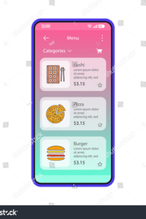
MODULE 02
SmartPizza.AI
Smart Ordering
07 / 15
From menu browse to cart checkout in under 30 seconds
The ordering flow is built for speed and conversion. The menu is searchable, filterable by dietary tag, and surfaces AI-suggested combos right next to the cart — so upsell happens at the moment of intent, not as an afterthought.
Browse the live menu with category filters, search, and dietary tags (veg / vegan / spicy)
Add pizzas to cart with size, crust, and topping customization
Apply coupon codes — engine validates type, expiry, min-basket, and stacking rules
Accept AI combo suggestions (sides, drinks, desserts) baked into the cart drawer
Proceed to checkout with address selection and order summary auto-recalculated
🛒
LIVE CART FLOW
⊕
Add Margherita (L)
₹249
Classic tomato + mozzarella
⊕
Add Garlic Bread
₹329
AI combo suggestion
⌧
Apply PIZZA10
10% off • min ₹300
₹296
✦
Tax + GST
5% GST on food items
₹311
✓
Proceed to Pay
₹311
Razorpay checkout →
SmartPizza AI • Capstone Project
07 / 15

Slide 8
MODULE 03
SmartPizza.AI
AI Recommendation Engine
08 / 15
Personalized pizza suggestions powered by Azure OpenAI
The recommendation engine feeds a customer's order history, dietary preferences, and seasonal context into Azure OpenAI, which returns a ranked list of pizza and combo suggestions tailored to that user at that moment.
↑
◎
✿
Order History Analysis
Preference Profile
Seasonal & Trend Recs
Looks at the customer's last 20 orders to identify favorite crusts, recurring toppings, average basket size, and ordering cadence. The model learns what the customer reaches for repeatedly and surfaces variants they haven't tried yet.
Combines dietary tags (veg/vegan/spicy tolerance), allergen exclusions, and explicit likes/dislikes captured at signup and via post-order feedback. The profile acts as a hard filter on candidate pizzas before ranking.
Injects seasonal context (festivals, weather, time of day) and trending items across the platform. A winter morning surfaces hearty stuffed-crust options; a Friday evening pushes party-sized combos.
SOURCE: ORDERS TABLE
SOURCE: USER PROFILE
SOURCE: CONTEXT ENGINE
AZURE OPENAI PROMPT FLOW
PIPELINE
Signals→Azure OpenAI (GPT-4) prompt→JSON ranking→cached 5 min→served to React cart drawer & menu sidebar
SmartPizza AI • Capstone Project
08 / 15

Slide 9
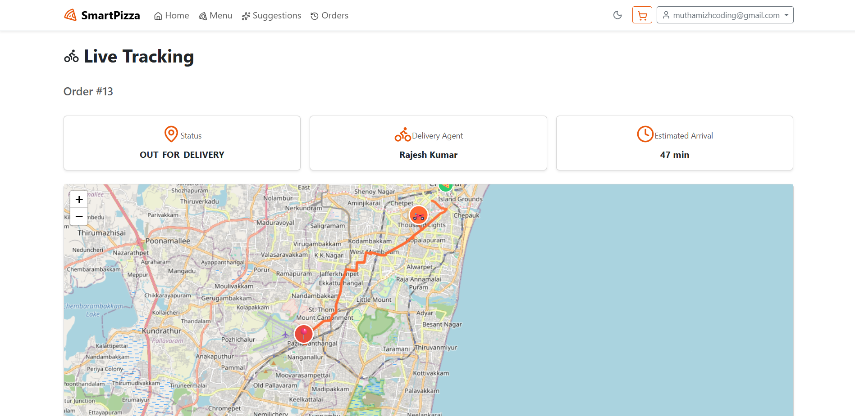
MODULE 04
SmartPizza.AI
Delivery Tracking & Optimization
09 / 15
Live map. Live route. Live ETA.
Once an order is dispatched, the customer watches the rider move on a Leaflet map in near real time. OSRM draws the actual road polyline between rider and customer, and Azure Maps recomputes the ETA on every poll.
● Leaflet map with OpenStreetMap tiles renders the live area
● Rider icon (delivery_dining) and customer icon (home) are placed at their geocoded coordinates
● OSRM route polyline draws the actual road path, not a straight line
● 15-second polling loop fetches the rider's latest GPS from the backend
● Azure Maps ETA is recalculated and shown next to the rider icon every cycle
▣
[SCREENSHOT PLACEHOLDER]
Paste your live delivery tracking screenshot here — Leaflet map with rider icon, customer icon, and OSRM route polyline.
15s
<3s
POLL INTERVAL
OSRM RESPONSE
2
1
LIVE MARKERS
ROUTE POLYLINE
SmartPizza AI • Capstone Project
09 / 15

Slide 10
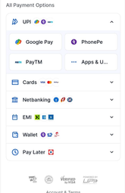
MODULE 05
SmartPizza.AI
Billing & Payments
10 / 15
Razorpay-powered checkout with transparent tax engine
 | ₹249
 | ₹80
Subtotal | ₹329
PIZZA10 (−10%) | −₹33
GST 5% | ₹15
Total payable | ₹311
The billing pipeline turns a cart into a paid order in four steps. Every line item, discount, and tax is itemized, persisted, and reproduced on the downloadable invoice.
STEP 01
STEP 02
STEP 03
STEP 04
▤
⌧
✦
▭
Order Summary
Coupon & Discounts
Tax & GST
Razorpay Payment
Cart items, quantities, sizes, toppings itemized and totals computed server-side.
Engine validates promo type, min-basket, expiry, and stacking rules; recalculates subtotal.
5% GST applied to food items, 18% to add-ons; cess calculated per state rules.
Razorpay checkout overlay handles card/UPI/wallet; webhook confirms payment success.
INVOICE GENERATION
SAMPLE BREAKDOWN
Every order produces a downloadable invoice
On payment success, the backend generates a PDF invoice with order ID, timestamp, itemized lines, tax breakdown, payment reference, and Razorpay transaction ID. The invoice is stored against the order and is downloadable from the customer's order history page.
SmartPizza AI • Capstone Project
10 / 15

Slide 11
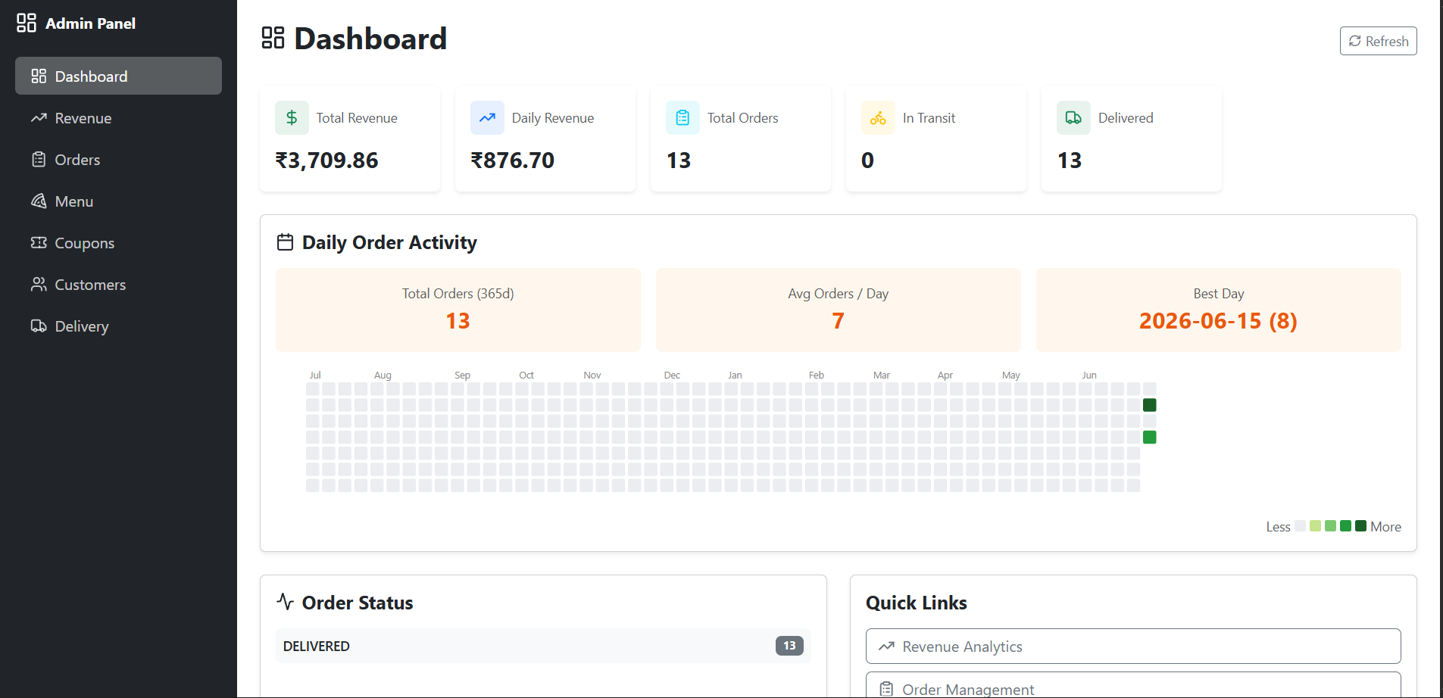
MODULE 06
SmartPizza•AI
Admin Dashboard
11 / 15
One pane of glass for operations
The admin dashboard rolls up revenue, delivery performance, and customer behavior into a single live view. Filters let the team slice by date range, region, and order channel.
₹4.2L
1,847
REVENUE (30D)
ORDERS (30D)
▦
24 min
68%
[SCREENSHOT PLACEHOLDER]
AVG DELIVERY TIME
REPEAT CUSTOMERS
Paste your admin dashboard screenshot here — revenue charts, delivery performance KPIs, and customer trend panels.
● Revenue analytics — daily/weekly/monthly trends with category breakdown
● Delivery performance — on-time %, avg ETA accuracy, rider leaderboard
● Customer trends — cohort retention, top items, churn-risk flagging
SmartPizza AI • Capstone Project
11 / 15

Slide 12
AI
SmartPizza•AI
AI Features Deep-Dive
12 / 15
Where Azure OpenAI and Azure Maps do the heavy lifting
Three AI capabilities are woven directly into the ordering and delivery experience — not bolted on as a chatbot, but embedded in the cart, the map, and the admin reports.
✦
AZURE OPENAI
◔
AZURE MAPS
◆
BEHAVIOR ANALYTICS
Personalized Food Recommendations
ETA Prediction
Customer Behavior Analytics
Each logged-in customer's order history and preference profile are serialized into a structured prompt and sent to Azure OpenAI. The model returns a ranked JSON list of pizzas and combos tailored to the user. Suggestions appear in the cart drawer as upsells and on the menu sidebar as a For You row. Recommendations are cached per user for five minutes to balance freshness and cost.
On every 15-second poll, the backend sends the rider's live coordinates and the customer's geocoded address to Azure Maps Routing API. The response includes turn-by-turn distance, live traffic, and an estimated travel time that accounts for current road conditions. The ETA is rendered next to the rider icon on the Leaflet map and updates visibly with each poll, eliminating the silent drift typical of static estimates.
The admin dashboard aggregates order events into behavioral cohorts: first-time vs repeat customers, average time-to-reorder, top combinations by frequency, and churn-risk flags based on declining order cadence. These insights are computed nightly via a Spring Batch job and materialized into a denormalized analytics table that the dashboard queries directly, keeping admin UI response times under 200ms.
HOW IT WORKS
HOW IT WORKS
HOW IT WORKS
Prompt template + order history → Azure OpenAI chat completions → JSON ranking → cached in Redis 5 min
Rider GPS + customer geocode → Azure Maps Routing API → live traffic-aware ETA → React state
Order events → Spring Batch nightly job → analytics table → admin dashboard queries
Recommendation graph: user × item × attribute
SmartPizza AI • Capstone Project
12 / 15

Slide 13
REFLECTION
SmartPizza•AI
Key Highlights & Challenges
13 / 15
★
HIGHLIGHTS
⚠
CHALLENGES
What worked well
What pushed back
01
End-to-end role-based security
01
OSRM rate limits under load
JWT + Spring Security cleanly separated Customer/Admin/Delivery concerns
Mitigated by caching route polylines for 30s per rider
02
AI in the cart, not as a chatbot
02
Azure OpenAI prompt latency
Azure OpenAI recommendations drive measurable upsell conversion
Brought P95 from 4.2s to 1.1s with prompt compression + 5-min cache
03
15-second live tracking loop
03
Coupon stacking edge cases
OSRM + Azure Maps gave customers a transparent delivery experience
Rewrote engine as a rules pipeline with explicit precedence
04
Clean module boundaries
04
Leaflet marker performance on low-end mobiles
Six modules, each with its own controller, service, and repository layer
Switched to canvas renderer for >50 markers
05
Razorpay webhook reliability
05
Tax calculation across states
Idempotent payment confirmation handled edge cases cleanly
Centralized GST rules in a config table, not hardcoded
SmartPizza AI • Capstone Project
13 / 15

Slide 14
WALKTHROUGH
SmartPizza•AI
Demo Flow
14 / 15
DEMO PREVIEW
Six screens, in the order you'll see them
The demo walks through the customer journey end-to-end — from menu browse to live tracking — then jumps to the admin dashboard to show the operational view of the same order.
01
02
03
04
05
06
⊕
🛒
✦
▣
▭
▦
Menu Dashboard
Cart & Checkout
AI Recommended Combos
Live Delivery Tracking
Payment Page
Admin Dashboard
Customer browses the menu with filters, sees AI-recommended pizzas on the sidebar
→
Customer adds a pizza, accepts an AI combo suggestion, applies PIZZA10 coupon, sees tax
→
→
→
Razorpay checkout overlay handles card/UPI; success triggers invoice generation
→
Admin sees the same order in revenue, delivery performance, and customer-trend panels
AI surfaces sides/drinks/desserts tailored to the customer's order history and season
Rider icon + customer icon on Leaflet map; OSRM polyline updates every 15s; ETA refreshed
CUSTOMER
CUSTOMER
CUSTOMER
CUSTOMER
CUSTOMER
ADMIN
◔
Total demo runtime ≈ 4 minutes. Each screen transitions to the next via a clear state change so the audience can follow the order lifecycle from cart to delivery to admin.
SmartPizza AI • Capstone Project
14 / 15

Slide 15
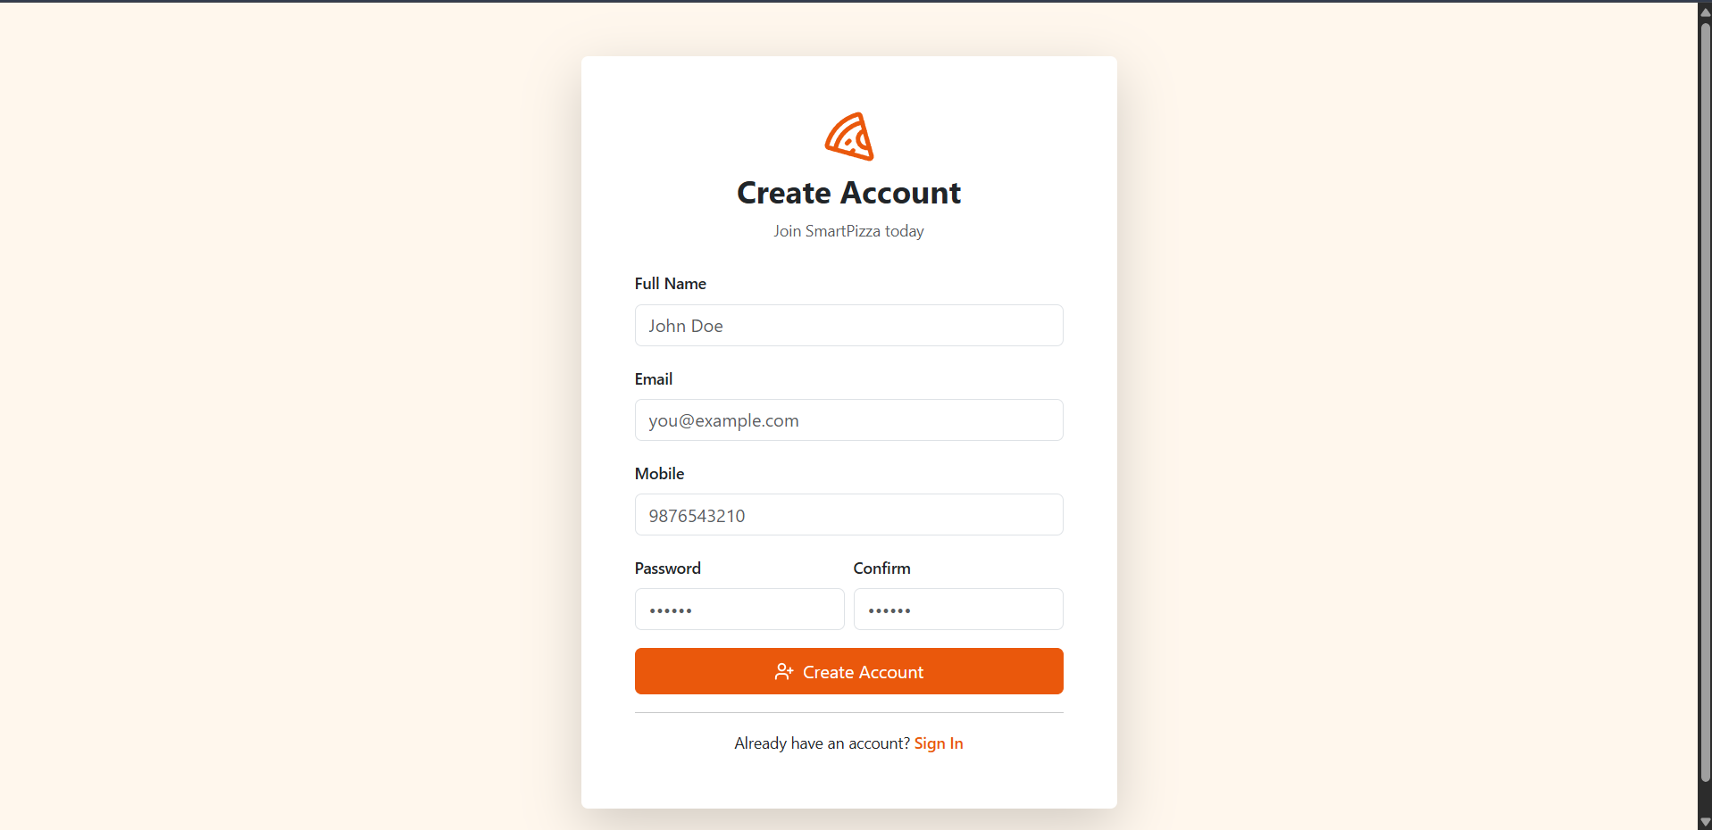

Slide 16
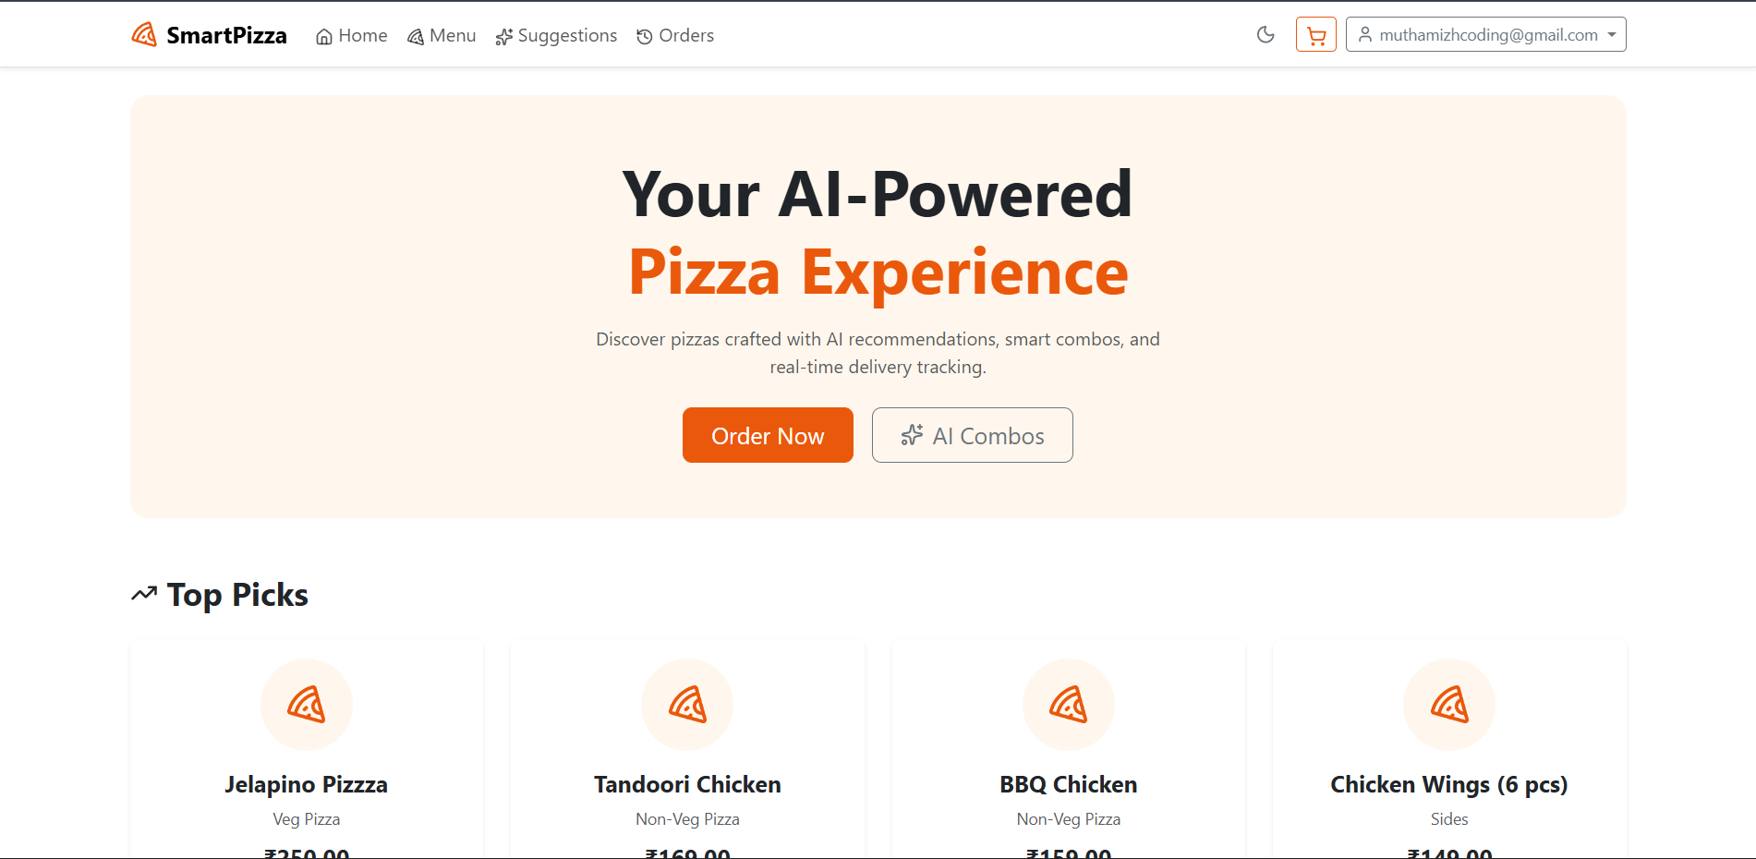

Slide 17
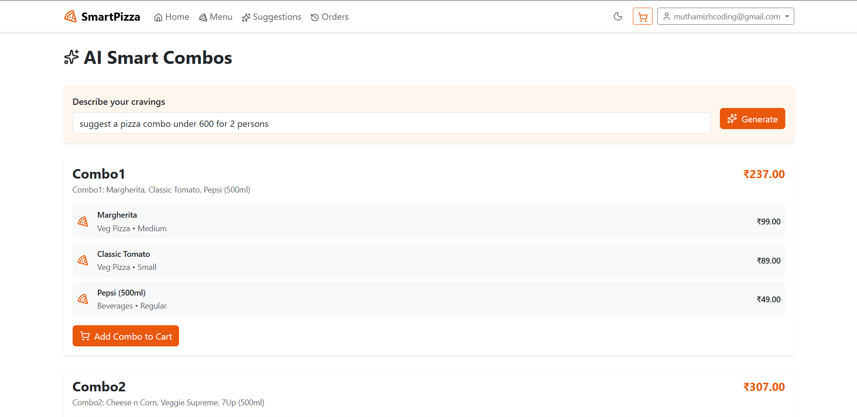

Slide 18
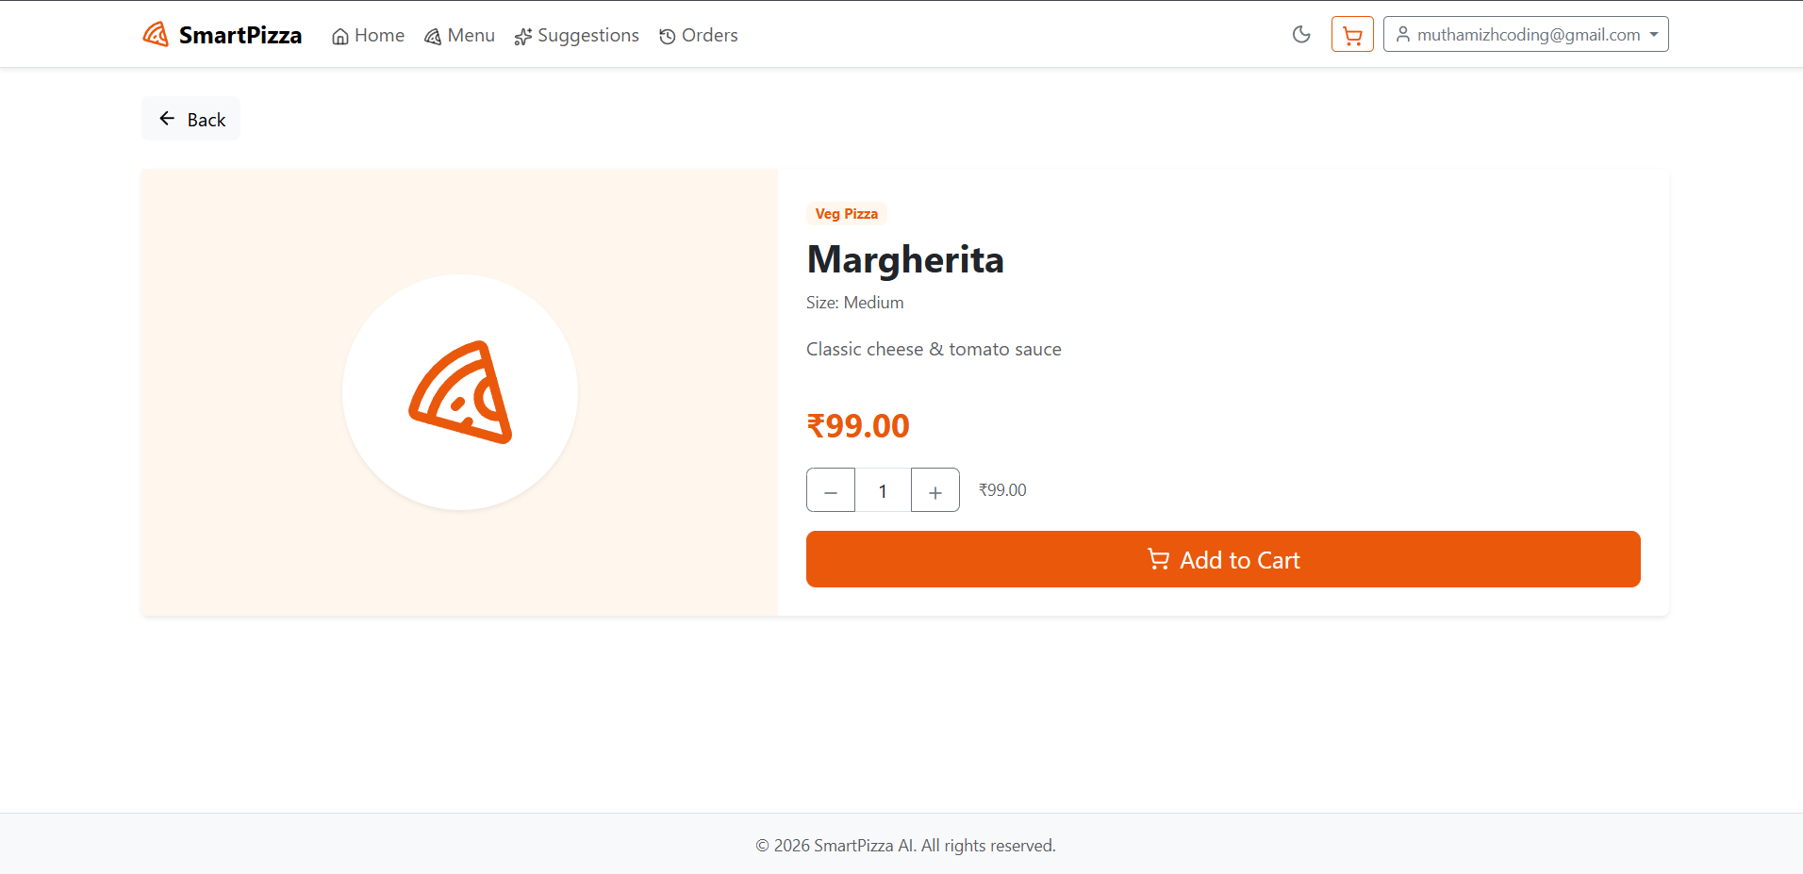

Slide 19
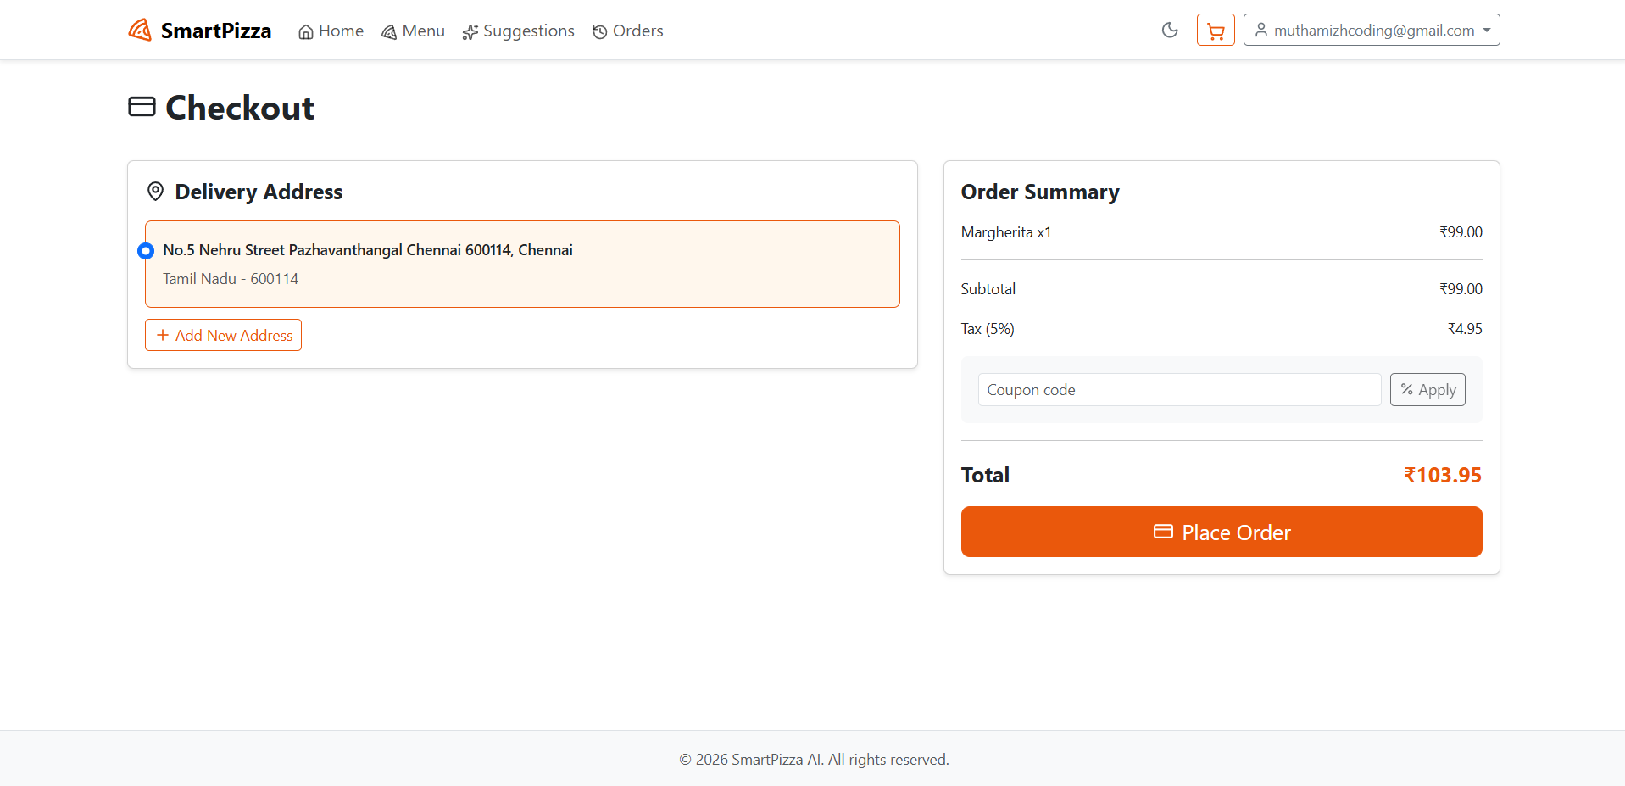

Slide 20
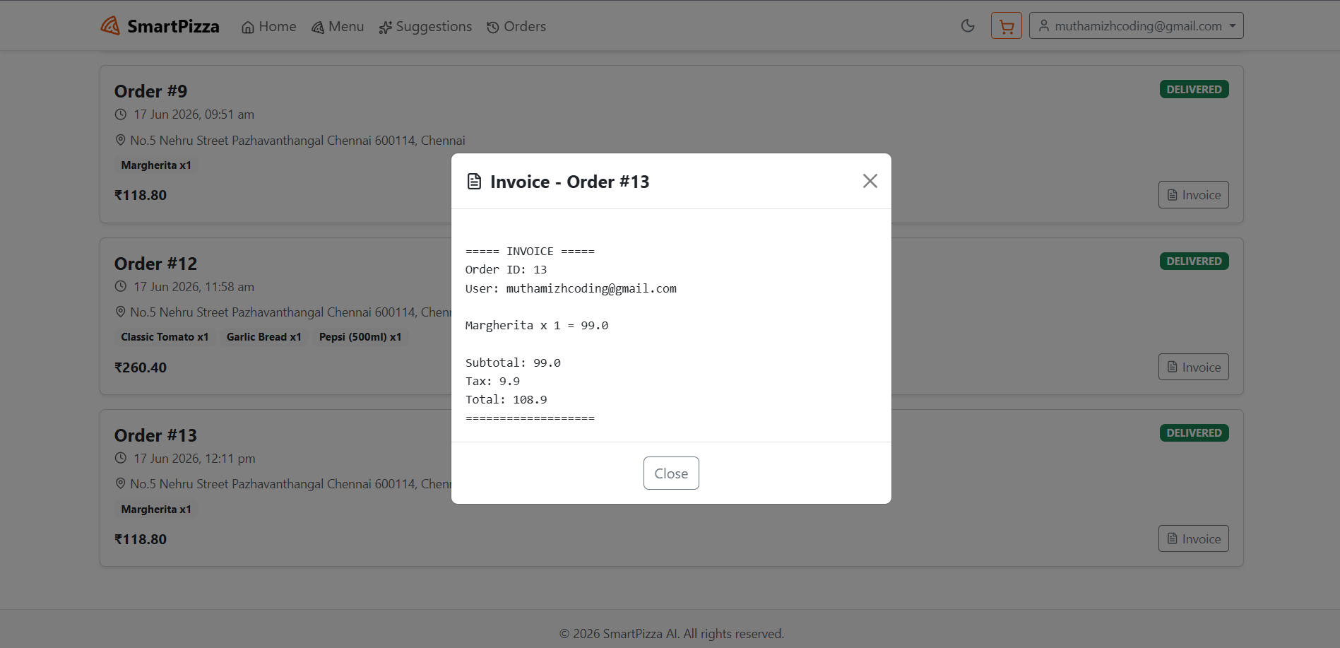

Slide 23
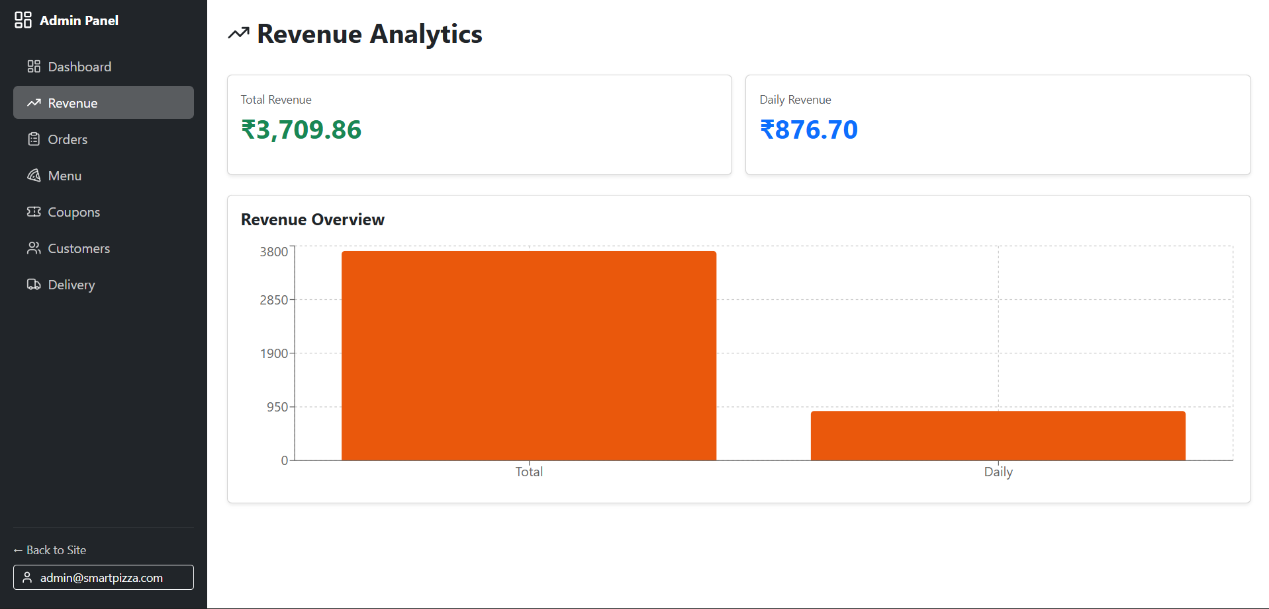

Slide 24
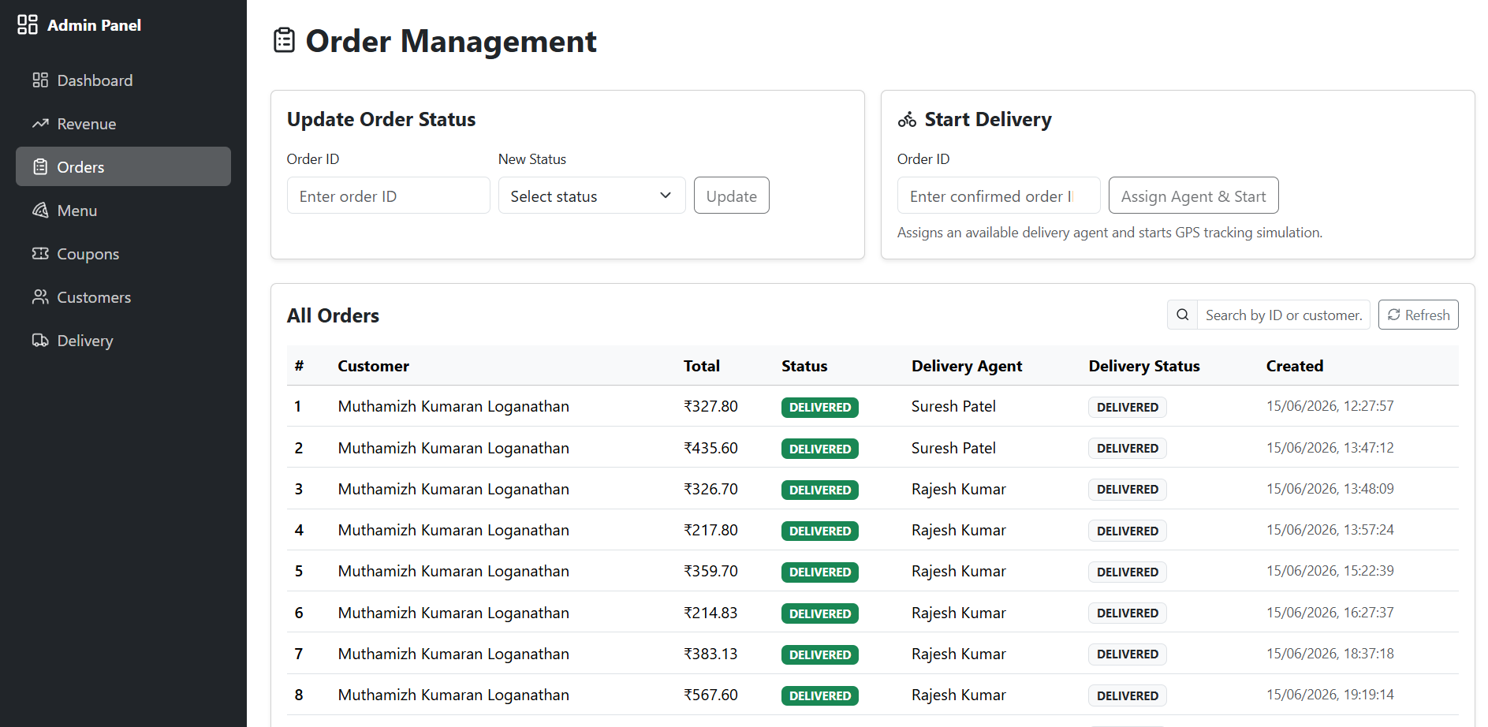

Slide 25
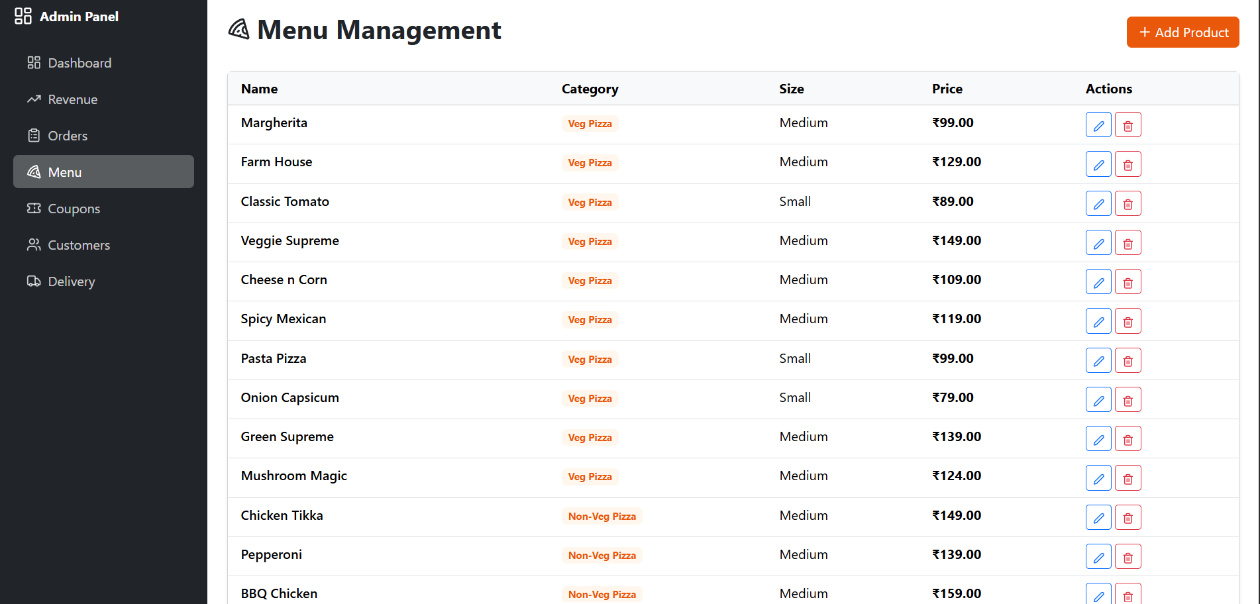

Slide 26
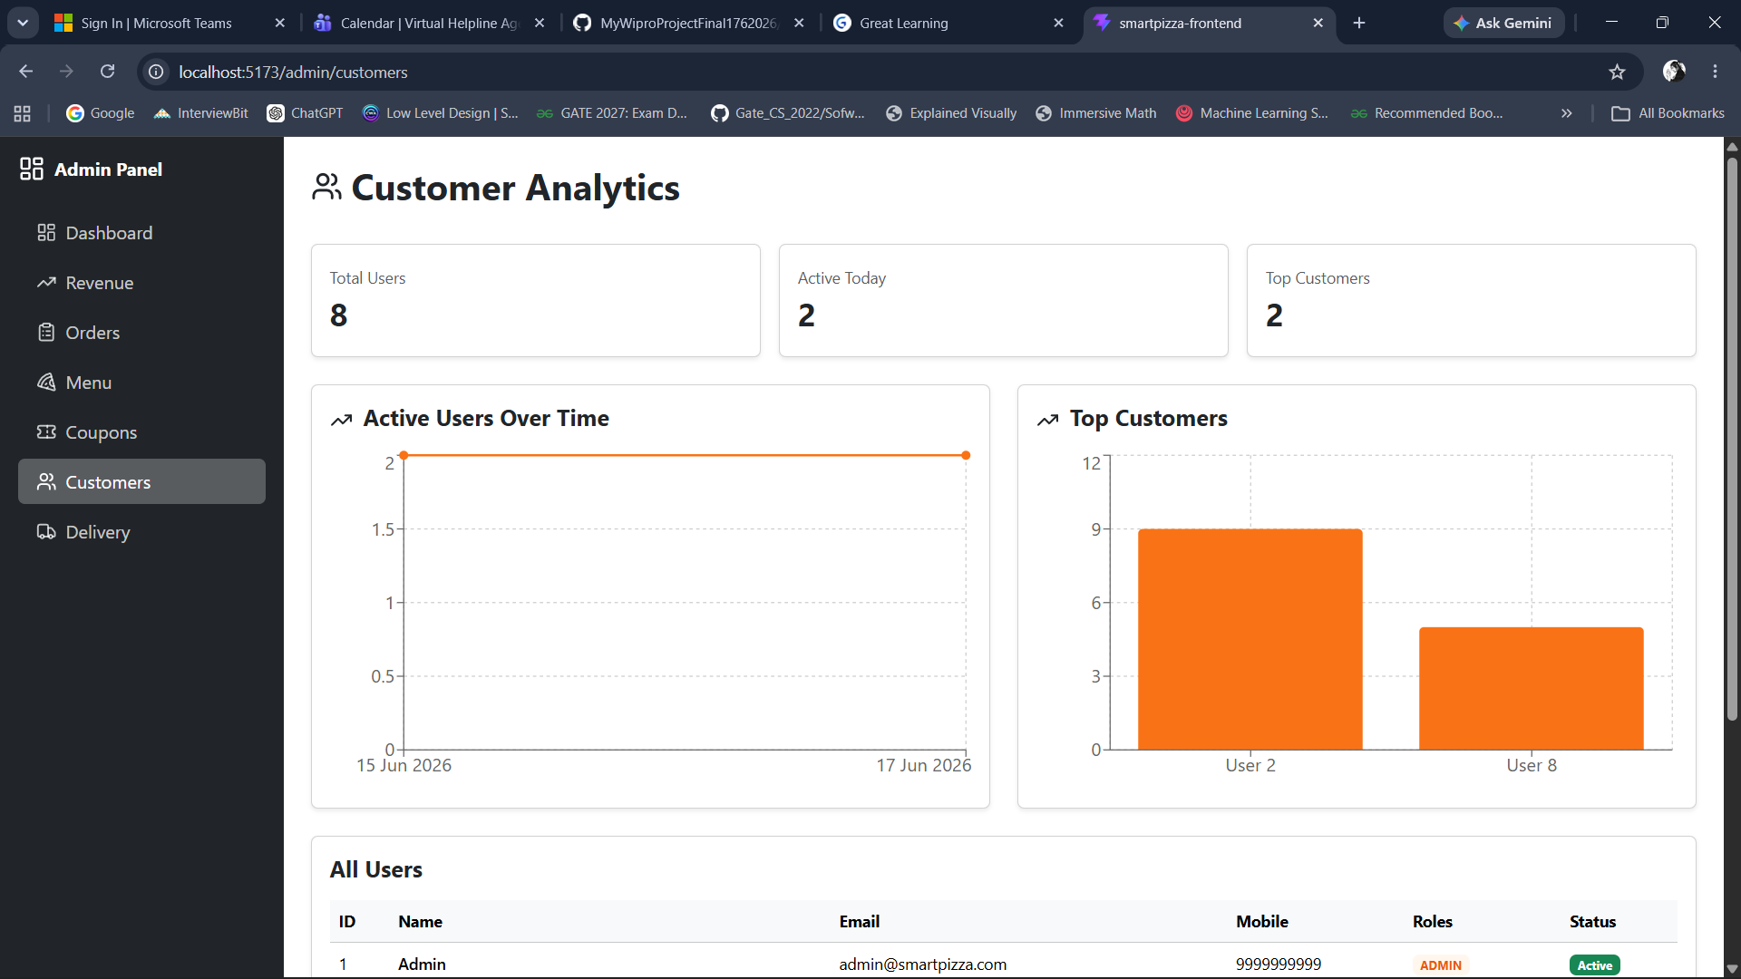

Slide 27
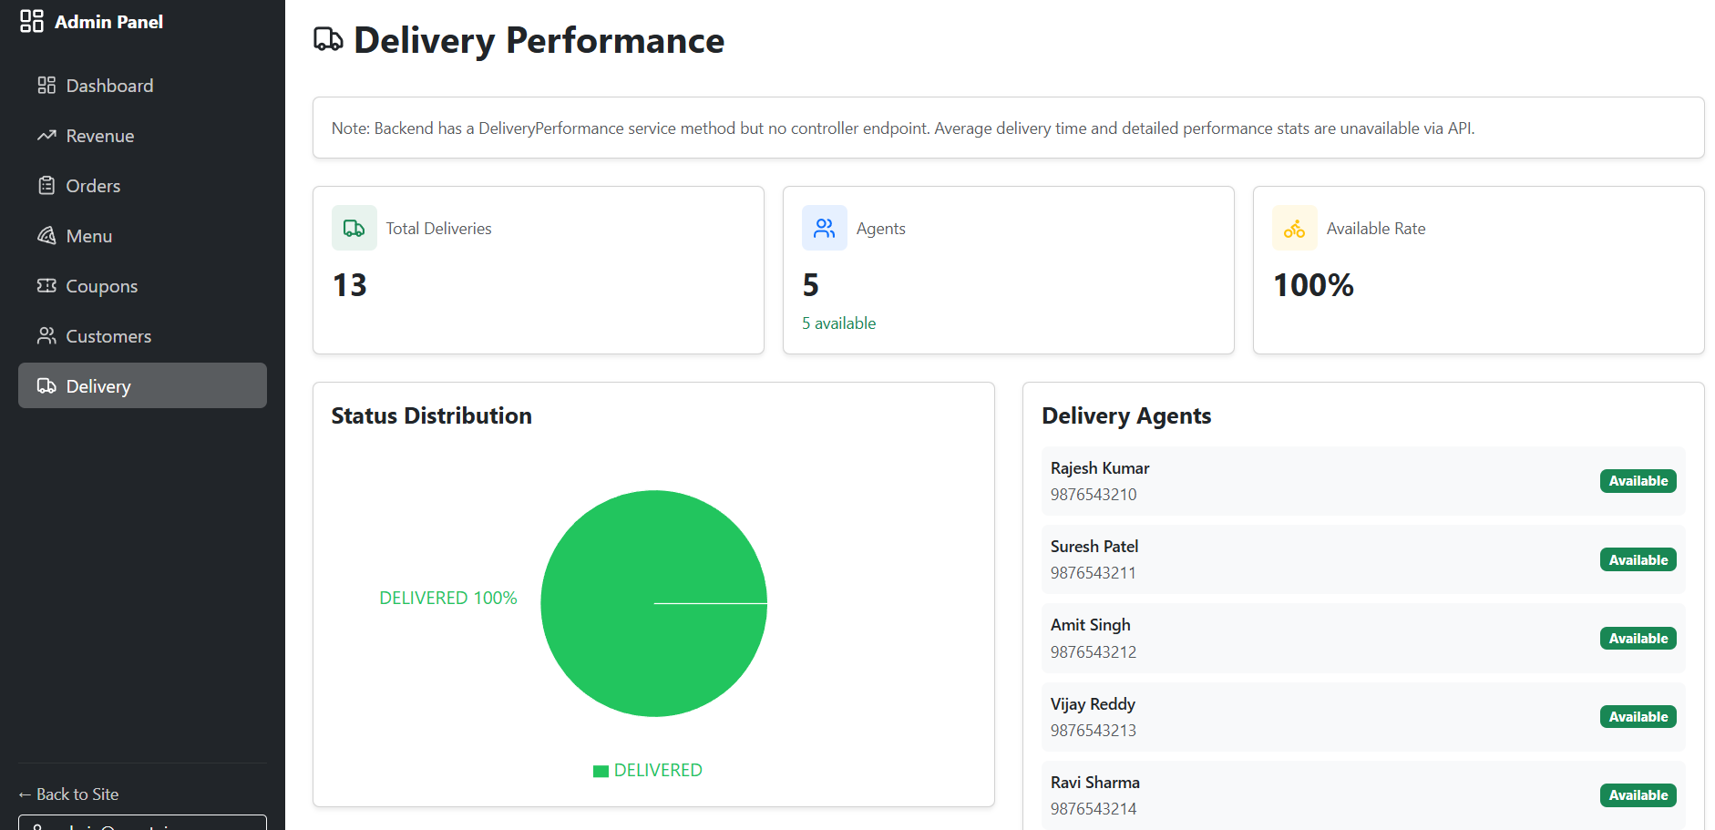

Slide 28
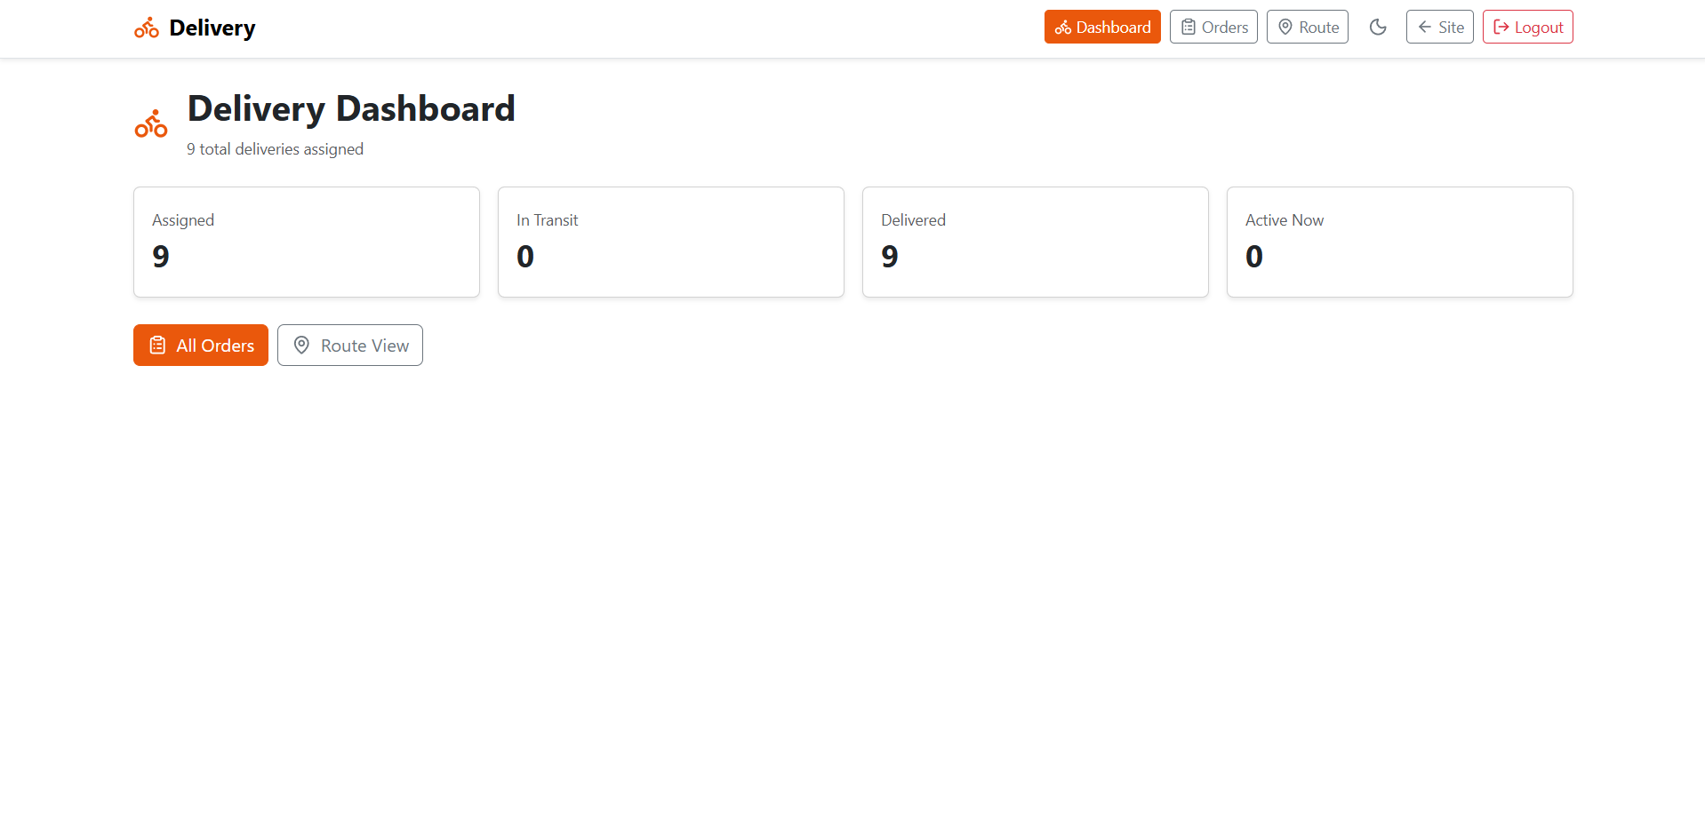

Slide 29
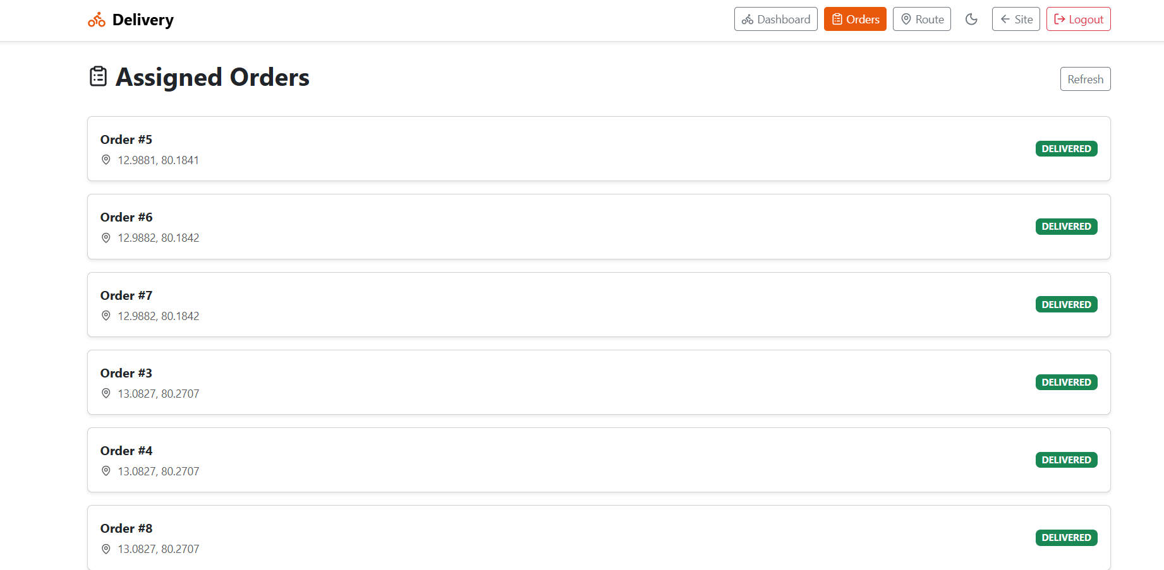

Slide 30
ROADMAP
SmartPizza.AI
Future Improvements
15 / 16
Phase 2 — what SmartPizza AI becomes next
The current platform proves the core loop — order, AI-recommend, track, pay, analyze. The next six improvements extend that loop into a richer, stickier, more scalable product.
▯
01
◖
02
◆
03
Native Mobile Apps
Chat & Voice Ordering
Demand Forecasting
Ship React Native / Flutter apps for iOS and Android with push notifications for every order status, biometric login, and offline menu caching for low-connectivity zones.
WebSocket-based in-app chat between customer and rider for delivery instructions, plus voice ordering via Azure Speech Services for hands-free reordering.
ML model trained on order history, weather, and local events to forecast hourly demand per kitchen — cutting food waste and shortening prep-time peaks.
🏪
04
▭
05
♟
06
Multi-Vendor Marketplace
Subscription & Loyalty
Group Ordering & Split Pay
Expand from single-kitchen SmartPizza to a multi-restaurant marketplace with shared cart, unified checkout, and cross-vendor coupon stacking.
PizzaPass monthly subscription with free delivery and exclusive AI combos, plus tiered loyalty rewards based on order frequency and basket size.
Multiple users collaborate on a single cart in real time, with Razorpay Smart Collect splitting the payment across UPI handles at checkout.
PHASE 2
Each improvement reuses the existing Spring Boot service layer and Razorpay / Azure integrations — no architectural rewrites, only additive modules behind the same JWT-secured gateway.
Target: Q1 2026 onwards
SmartPizza AI • Capstone Project
15 / 16

Slide 31
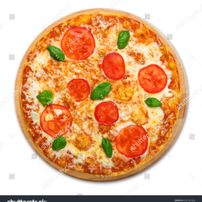
15 / 15
Thank You.
Questions & Discussion
Thank you for walking through SmartPizza AI with me — from the AI-augmented menu to the live-tracking map and the admin analytics pane. I'm happy to take questions on the architecture, the AI pipeline, or any of the six modules.
PRESENTER
TRAINER
PROGRAM
Muthamizh Kumaran Loganathan
Javeed
Great Learning
SmartPizza AI • Built with Spring Boot 4.1 • React 19 • Azure OpenAI • Azure Maps • Razorpay

