Slide 1
Toyfinity
Online Toy Store
Project Presentation by Muthesh K

Slide 2
Internship Report on-
Project: Toyfinity - Online Toy Store
In the domain of
“Full Stack Web Development”
BY
Name: Muthesh K (U19KU22S0111)
Under the Guidance of MS. NAMRATA ASWATHI
&
“PRINSTON SMART ENGINEERS”

Slide 3
Abstract
Toyfinity is an interactive online toy store that allows users to browse, search, and purchase toys. It features user authentication, shopping cart, order placement, and a responsive UI.

Slide 4
Introduction
Toyfinity is a full-stack web application built to simulate a real-world toy e-commerce platform. It helps users explore toy products and experience seamless online shopping.

Slide 5
Hardware and Software Requirements
Hardware:
- Laptop/Desktop
- 4GB RAM or more
- Stable Internet
Software:
- Node.js
- MongoDB
- React.js
- Express.js
- VS Code or any IDE

Slide 6
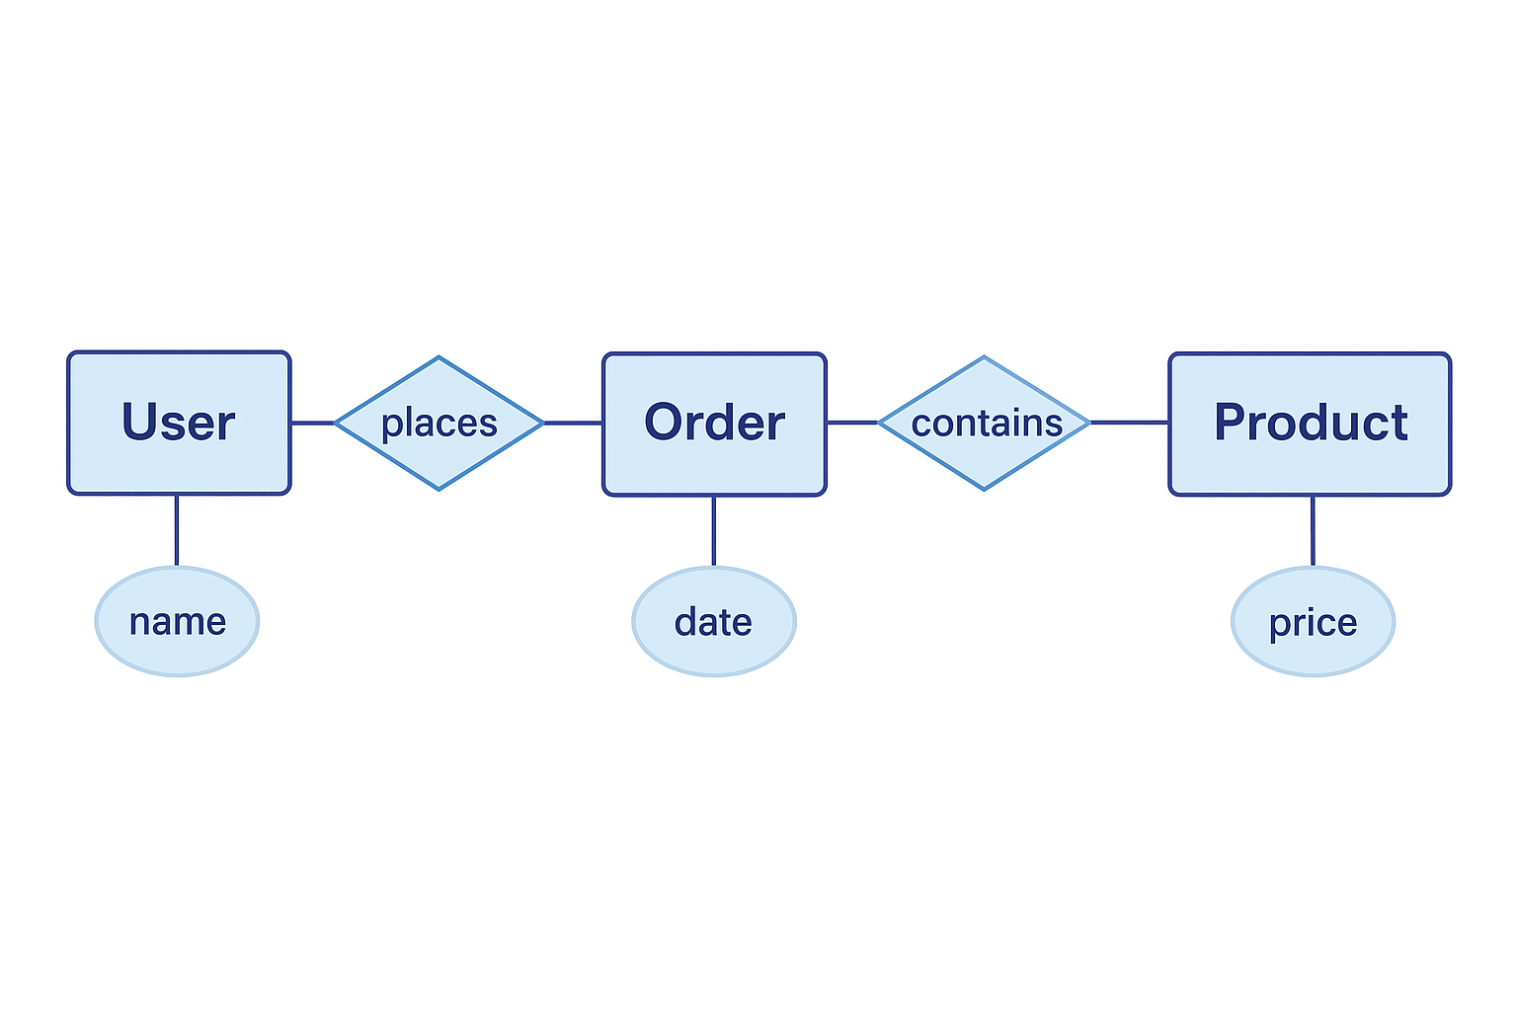
ER Diagram and DFD
Entity-Relationship (ER) Diagram
The following diagram illustrates the relationships between entities in the Toy Store system such as User, Product, Order, and Cart:

Slide 7
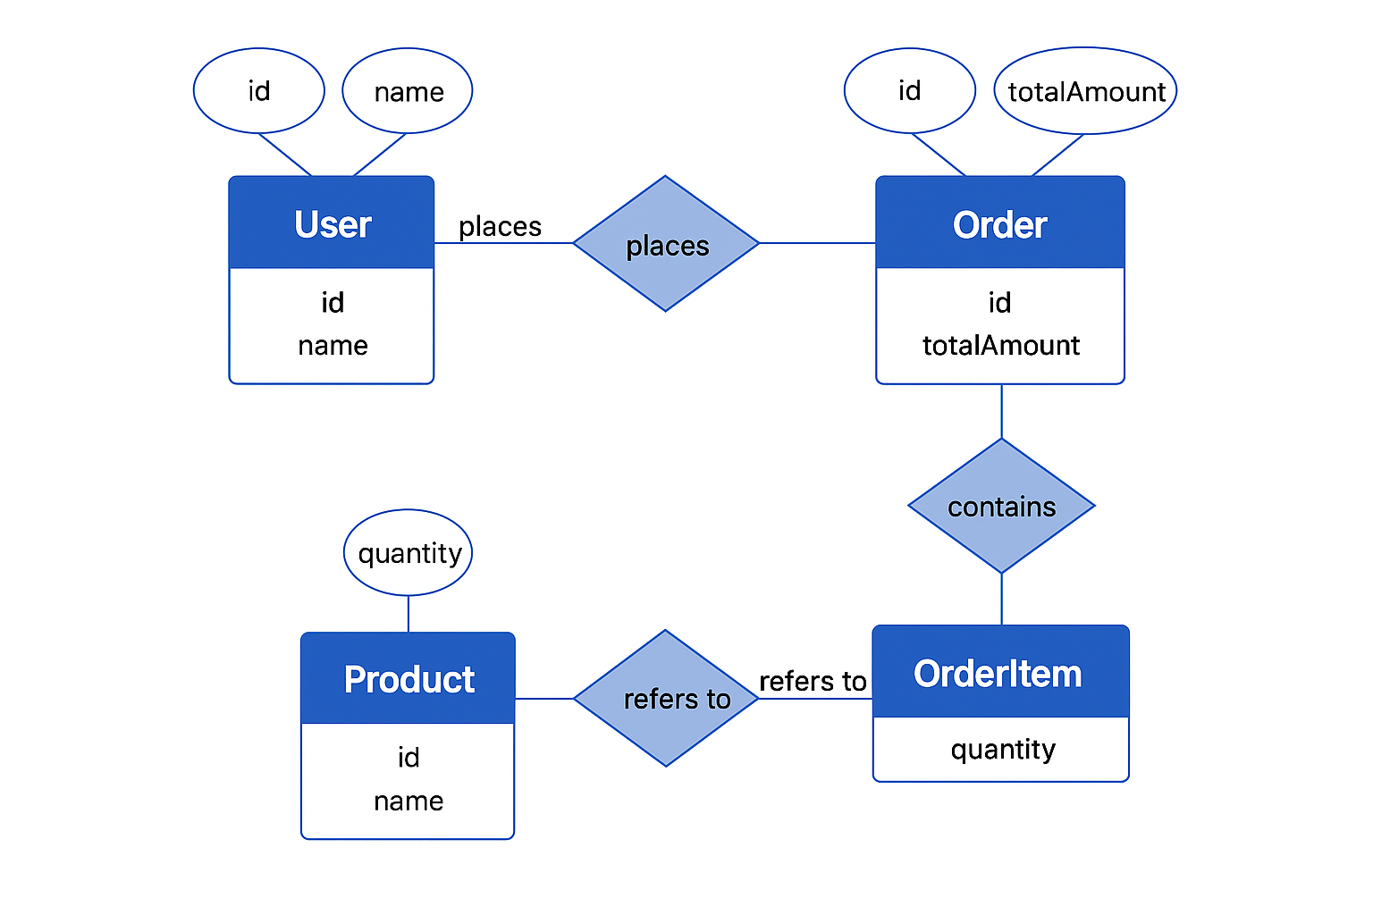
Data Flow Diagram (DFD)
This DFD illustrates how data flows between various components of the Toy Store web application including the Product DB, User Auth, Cart System, and Payment Gateway:

Slide 8
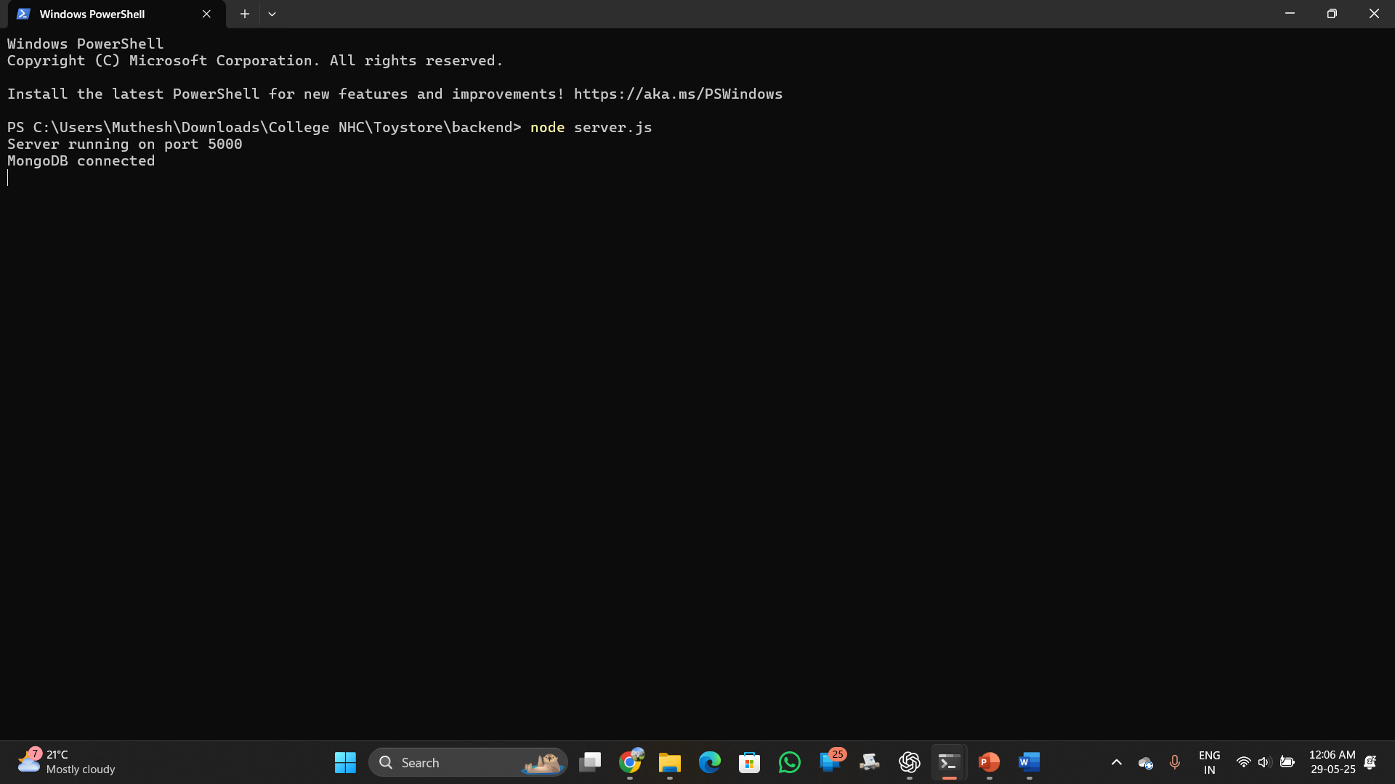
Project Snapshots:

Slide 9
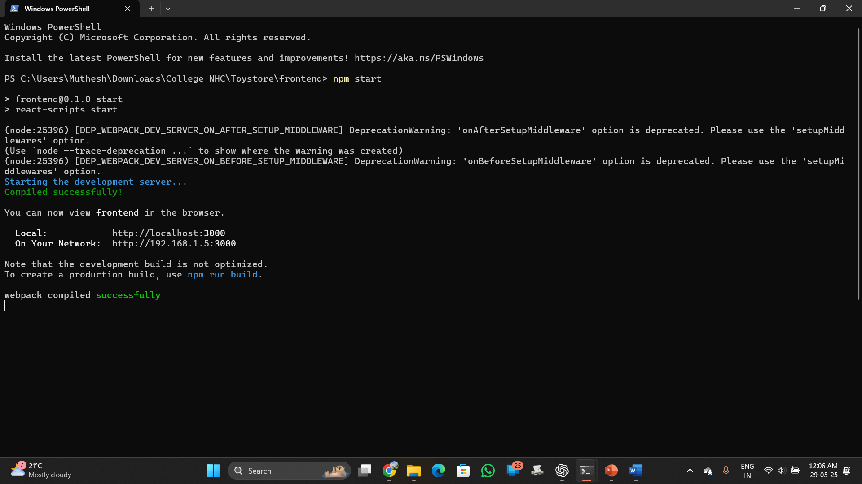

Slide 10
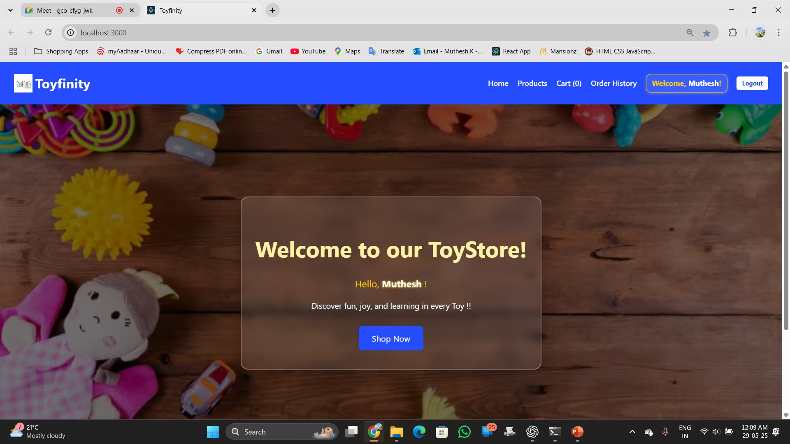

Slide 11
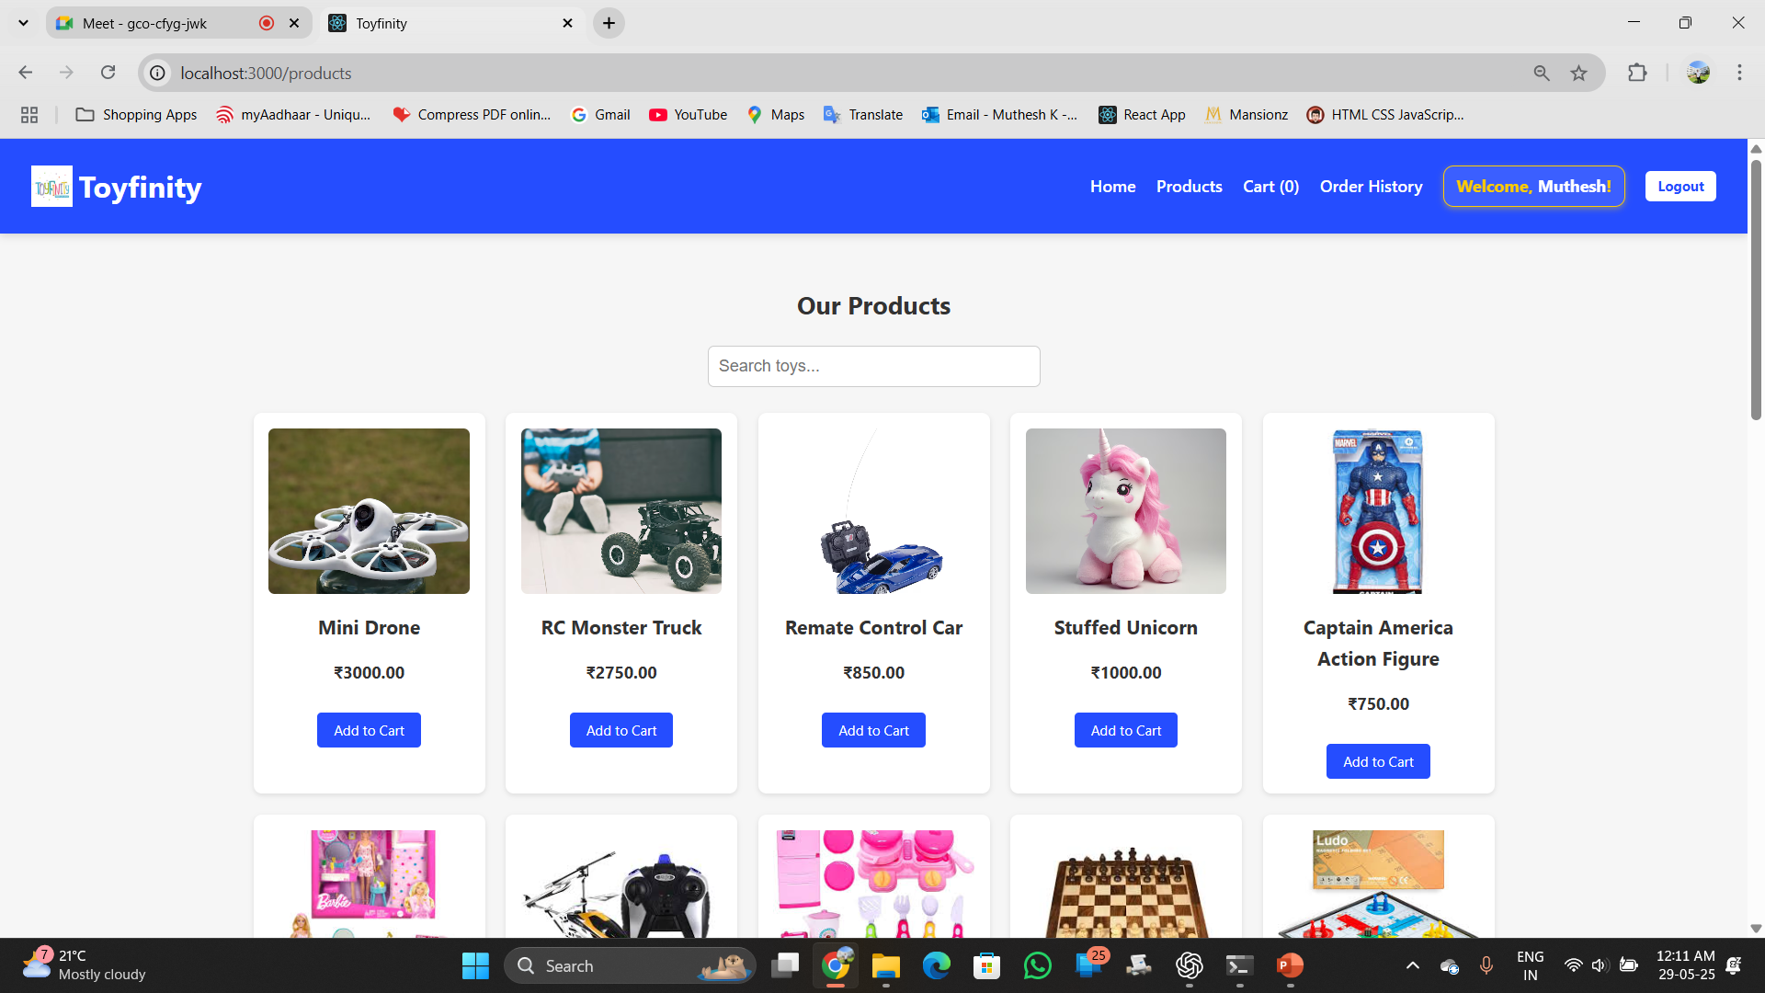

Slide 12
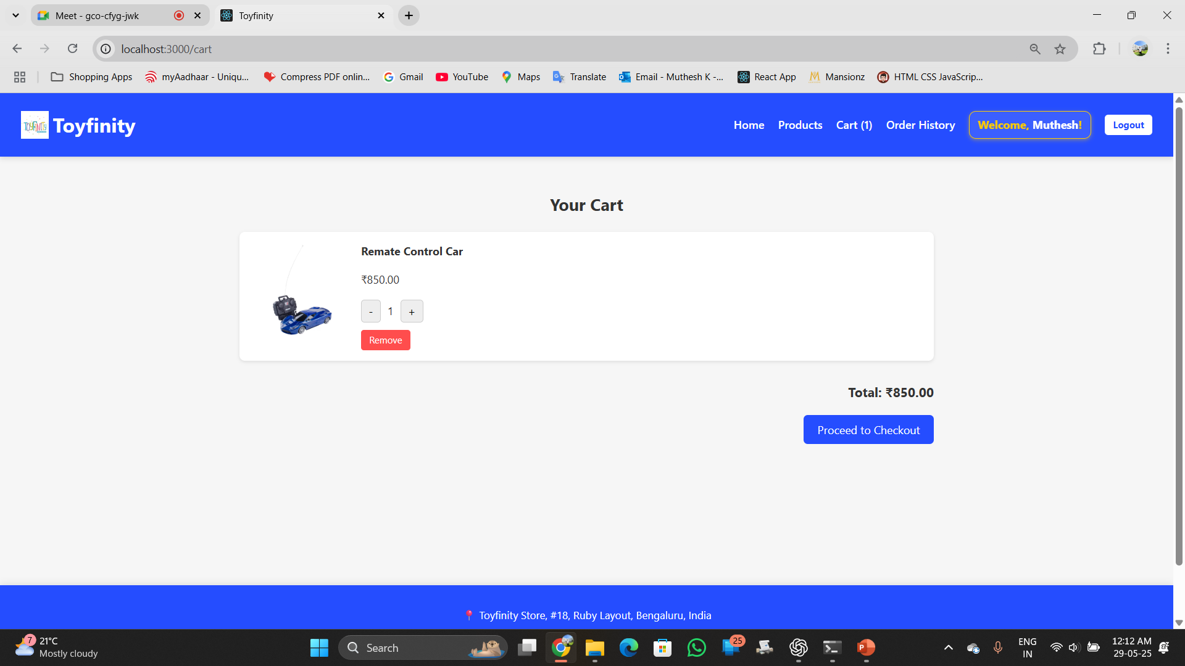

Slide 13
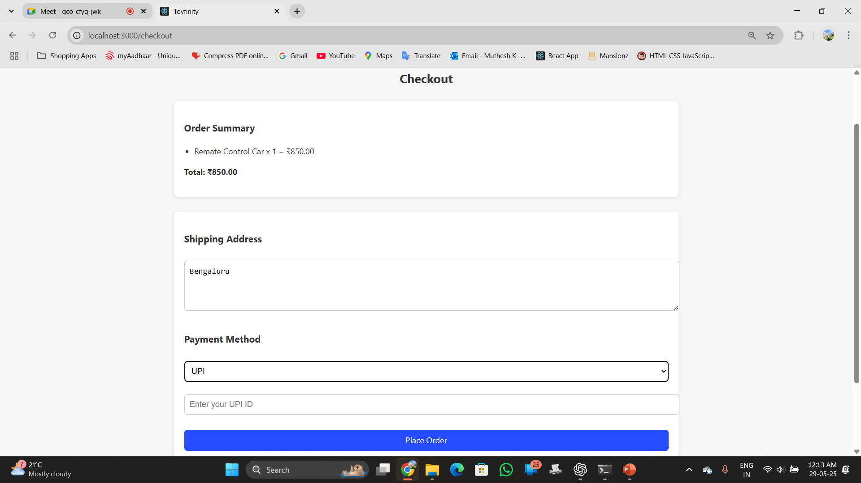

Slide 14
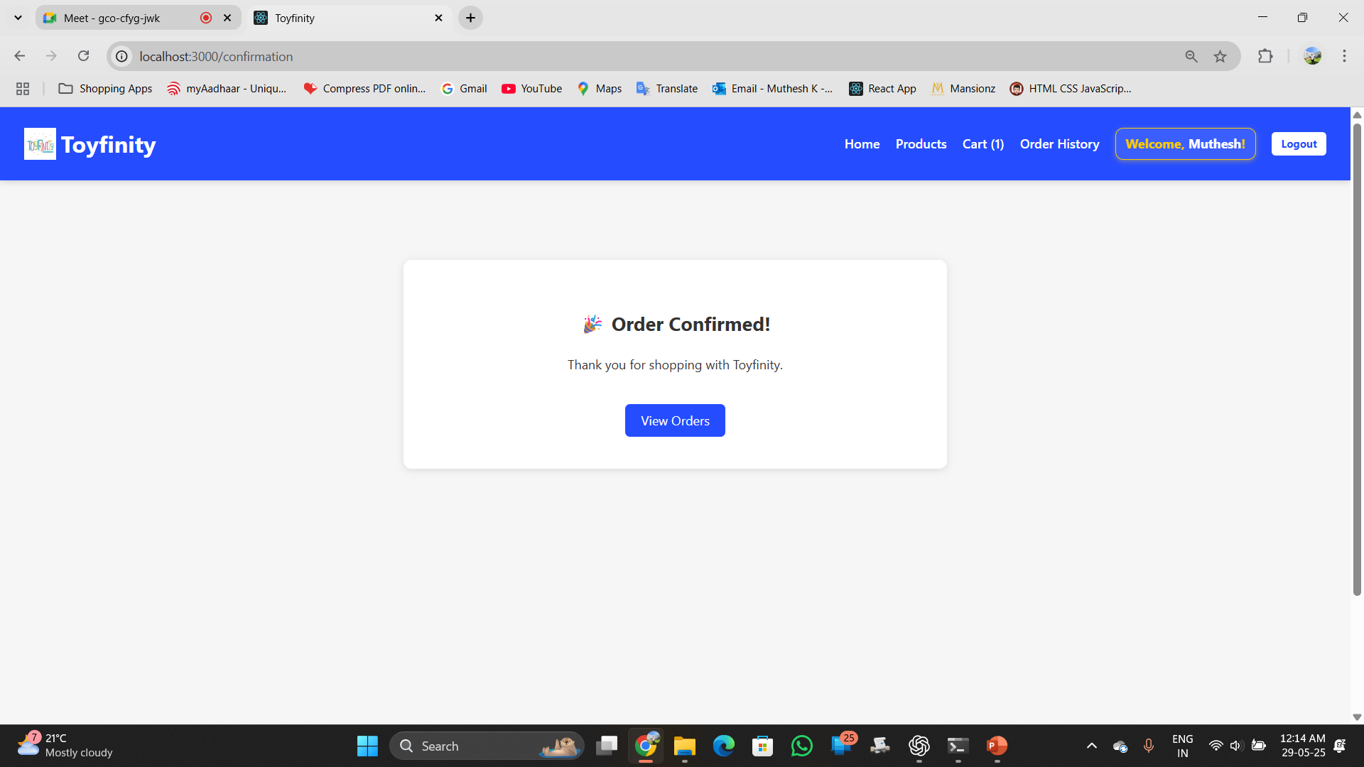

Slide 15
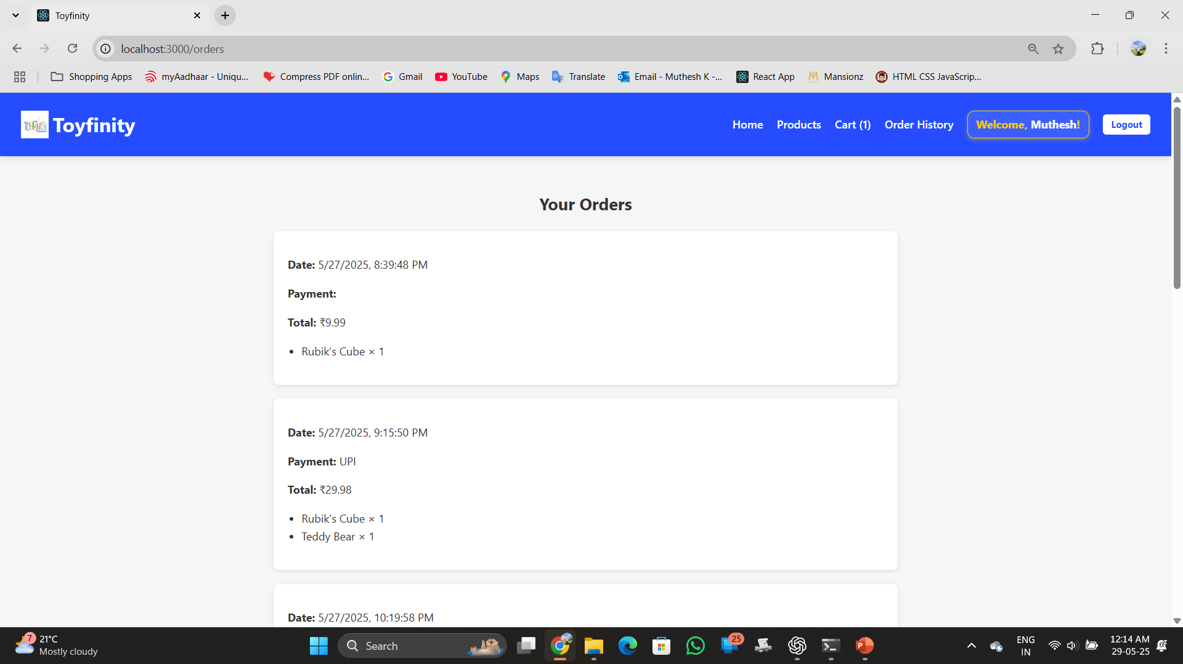

Slide 16
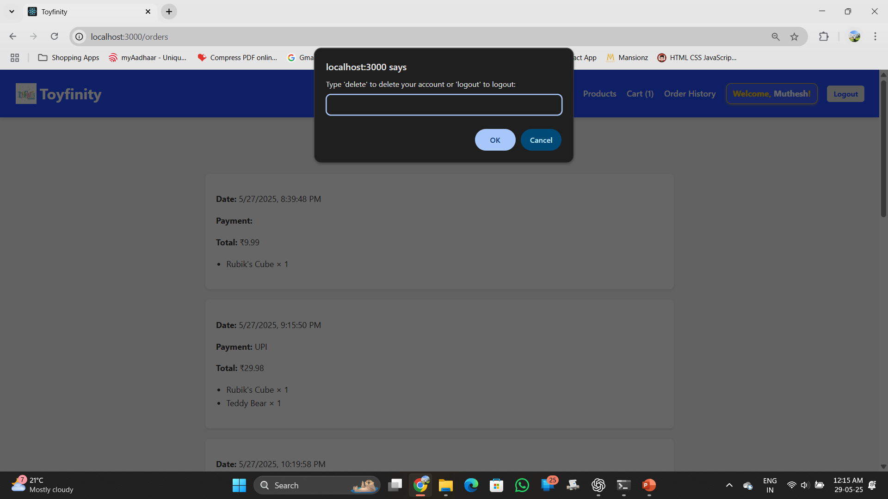

Slide 17
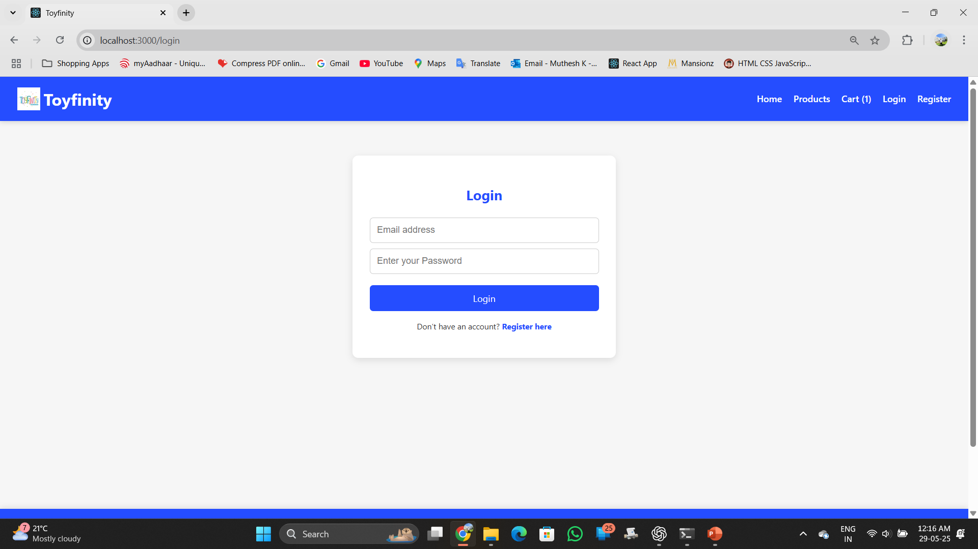

Slide 18
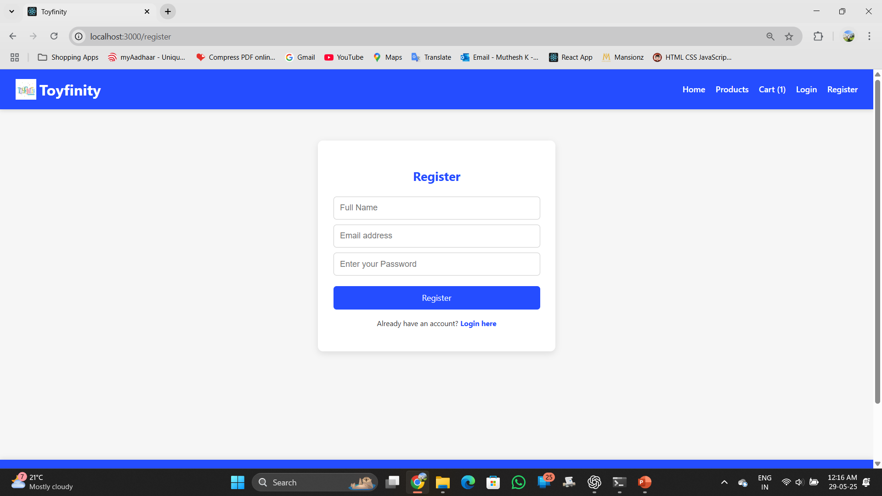

Slide 19
Database Details
Database: MongoDB
Collections:
- Users: Stores user credentials
- Products: Toy products data
- Orders: Purchase order records

Slide 20
Conclusion
Toyfinity demonstrates a functional full-stack toy shopping application with modern UI, search, cart, checkout, and order history features.

Slide 21
Bibliography
- React.js Documentation
- MongoDB Documentation
- Node.js and Express.js Docs
- Stack Overflow

