Slide 1
Understanding Movie Success:
An Analysis of IMDB (2010-2019)
Strategic deep-dive into genres, production volume, personnel, and runtime.
MUTHEU MUNENE

Slide 2
Executive Summary
Key Market Findings:
Market Saturation: Aggressive production volume has increased competition for audience attention.
Leading Genre: Documentary hybrids consistently dominate audience satisfaction.
Personnel Impact: Securing top-tier directors is a highly predictable indicator of a movie's success.
Runtime Influence: Extreme length doesn't guarantee high ratings, audiences also undeniably dislike short films.

Slide 3
Ensuring Trustworthy Insights
Data Limit: Exclusively analyzed 2010–2019 releases to ensure data is modern and relevant.
Null Handling: Excluded incomplete records (e.g., missing genres or runtimes) to prevent calculation errors.
Audience Baseline: Required a minimum of 100 verified user reviews per film to prevent obscure outliers from skewing averages.
Market Volume: Required a minimum of 100 films produced per genre category to ensure market-proven consistency.

Slide 4
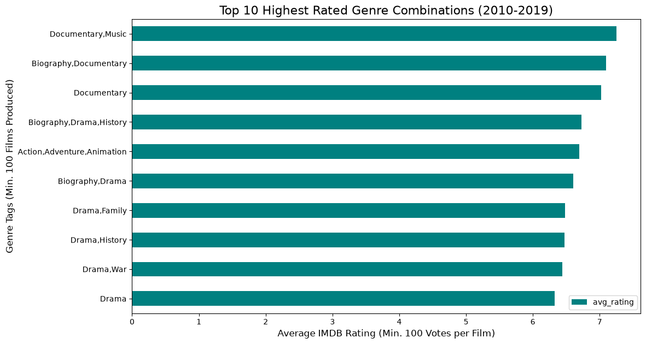
Genre Performance
Documentaries Lead Market Reception:
Hybrid formats (Documentary + Music/Biography) yield the highest average ratings (> 7.0/10).
Traditional narrative genres (like pure Drama, Action, or Comedy) failed to break into the top 10.
Takeaway: Pure fiction requires significantly more effort to achieve the baseline audience satisfaction that documentaries naturally command.

Slide 5
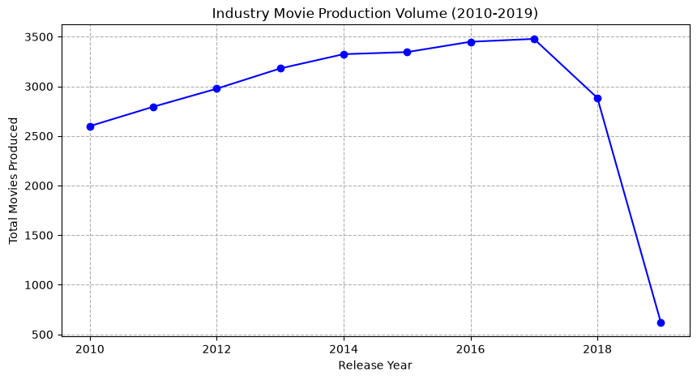
Production Volume
The Industry is Getting Crowded:
Movie production grew aggressively from 2010 to 2019.
Takeaway: Studios can no longer rely on volume to generate revenue; individual film quality is required to cut through the noise.

Slide 6
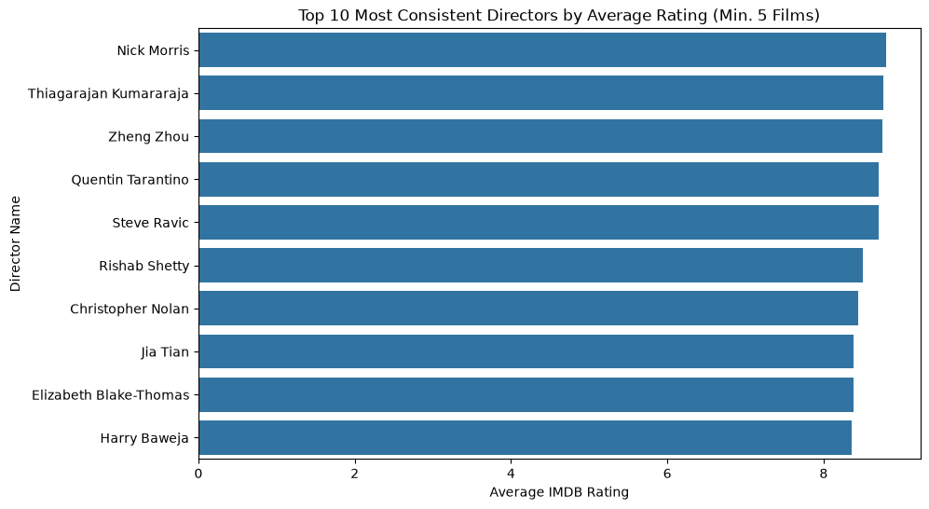
The Personnel Factor
Top Directors Mitigate Risk:
Analyzed directors with a proven track record (5+ films in the decade).
The top 10 directors consistently maintain average ratings well above an 8.0/10.
Takeaway: A proven director acts as a safety net for audience reception, heavily reducing the risk of a flop.

Slide 7
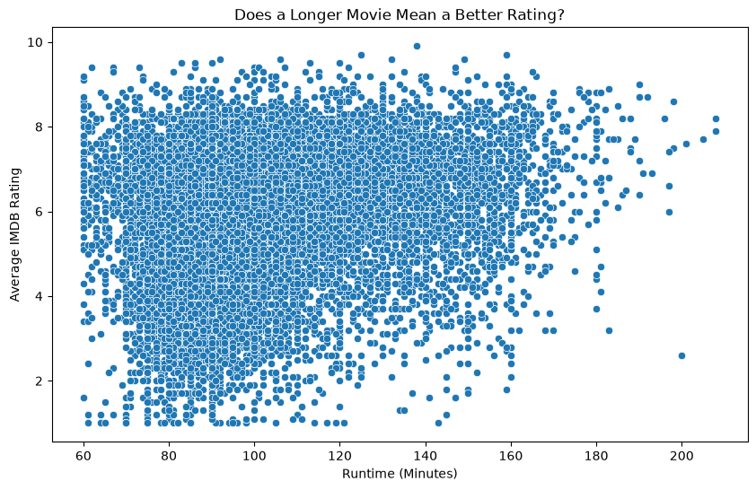
Content Duration
Does a Longer Movie Mean a Better Rating?:
Standard feature films (90-120 minutes) form a dense cluster of average ratings (5.0 - 7.0).
As films push past 140 minutes, the risk of severe poor ratings (below 4.0) drops near zero.
Takeaway: Audiences are willing to sit through longer films if the story requires it, but artificially padding runtime does not guarantee a 9/10 score.

Slide 8
Strategic Business Question
Formulating Our Next Steps:
• Core Question:
Given that highly-rated documentary hybrids naturally outperform narrative features in audience reception, do they yield a proportionately higher financial Return on Investment (ROI)?
• Why it matters:
This will guide whether the studio should fund multiple low-cost documentaries versus one high-budget narrative feature.

Slide 9
Strategic Recommendation & Next Steps
Moving Forward:
Audience ratings are measurably influenced by measurable metrics like personnel history and genre formats.
Next Step: Integrate box office financial data (production budgets vs. global revenue) into our SQL database.
Goal: Validate the financial ROI of documentaries to guide future portfolio allocation away from saturated narrative markets.

Slide 10
Conclusion
THANK YOU

Slide 11
Q & A
Open for Discussion

