Slide 1
CAPSTONE PROJECT
KEYLOGGERS AND SECURITY
Presented By:
Student Name: M.Muthu Sabitha
College Name: VV COLLEGE OF ENGINEERING
Department: CSE

Slide 2
OUTLINE
Problem Statement (Should not include solution)
Proposed System/Solution
System Development Approach (Technology Used)
Algorithm & Deployment
Result (Output Image)
Conclusion
Future Scope
References

Slide 3
Problem Statement
Example: In today's digital age, where cybersecurity threats loom large, one of the significant concerns is the proliferation of keyloggers, stealthy software tools designed to monitor and record keystrokes on a user's computer without their knowledge. Keyloggers pose a severe threat to individuals and organizations as they can capture sensitive information such as passwords, credit card details, and other personal data, leading to identity theft, financial loss, and privacy breaches..

Slide 4
Proposed Solution
Aim: Develop comprehensive cybersecurity strategies aimed at detecting, preventing, and mitigating keylogger attacks.
Data Collection: Gather historical data on keylogger incidents Collecting data from various sources such as cybersecurity reports, incident databases, and user feedback.
This data includes information on past keylogger attacks, attack vectors, target demographics, and affected systems.The goal is to gather insights into keylogger prevalence, distribution methods, and attack patterns.
Data Preprocessing: Clean and preprocess collected data
This involves removing noise, inconsistencies, and irrelevant information from the collected data.
Data preprocessing techniques may include data cleaning, normalization, feature scaling, and handling missing values.The aim is to prepare the data for analysis and model training by ensuring its quality and suitability.
Machine Learning Algorithms:
Machine learning algorithms are applied to analyze patterns in the preprocessed data and detect keylogger activity.
Algorithms may include supervised learning models (e.g., classification algorithms), unsupervised learning models (e.g., clustering algorithms), or hybrid approaches.ML algorithms leverage features such as keystroke dynamics, user behavior, and system anomalies to identify suspicious activity indicative of keyloggers.
Deployment: Implement trained models into security systemsTrained machine learning models are deployed into security systems to continuously monitor and detect keylogger activity in real-time.
Deployment may involve integrating ML models into existing security infrastructure, such as intrusion detection systems (IDS) or endpoint security solutions.The aim is to create proactive defense mechanisms that can automatically detect and respond to keylogger threats.
Evaluation: Regularly evaluate model effectivenessModel performance is evaluated using metrics such as detection accuracy, false positive rate, and response time.Evaluation involves testing models on real-world data, conducting simulations, and analyzing performance against known benchmarks.The goal is to assess the effectiveness of deployed models, identify areas for improvement, and refine cybersecurity defense mechanisms accordingly.

Slide 5
System Approach
The "System Approach" section outlines the overall strategy and methodology for developing and implementing the In today's digital age. Here's a suggested structure for this section:
System requirements
Library required to build the model

Slide 6
Algorithm & Deployment
In the Algorithm section, describe the machine learning algorithm chosen for today ‘sdigital age. Here's an example structure for this section:
Algorithm Selection: In this step, appropriate machine learning algorithms are chosen to detect keyloggers effectively.Algorithms commonly used for this purpose include decision trees, random forests, support vector machines (SVM), logistic regression, and neural networks.The selection is based on factors such as the nature of the data, complexity of the problem, and desired performance metrics
Data Input: Data input involves collecting relevant data that will be used to train the machine learning model.This includes historical data on keylogger incidents, user behavior patterns, system logs, and any other relevant data sources.The data is typically structured into features (e.g., keystroke dynamics, system activities) and labels (indicating whether a keylogger is present).
Training Process: In the training process, the selected machine learning algorithm is trained on the input data.The algorithm learns patterns and relationships within the data to distinguish between normal user behavior and keylogger activity.Training involves iterative optimization of the algorithm's parameters to minimize prediction errors and maximize performance.
Prediction Process:
Once the model is trained, it can be used to predict whether keylogger activity is present in new, unseen data.During the prediction process, the trained model analyzes input data and generates predictions or probabilities indicating the likelihood of keylogger activity.Predictions are based on learned patterns and decision boundaries derived from the training data, allowing the model to classify instances as either benign or indicative of a keylogger threat.

Slide 7
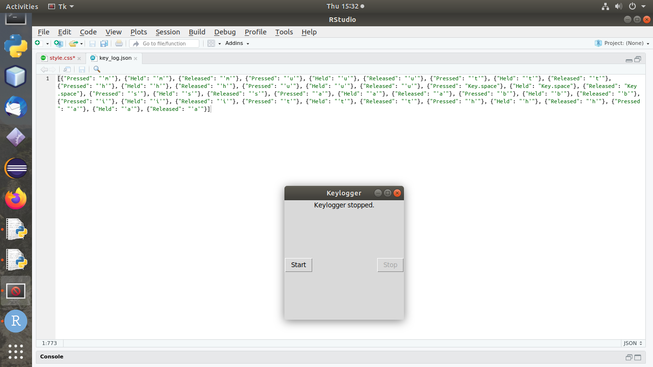
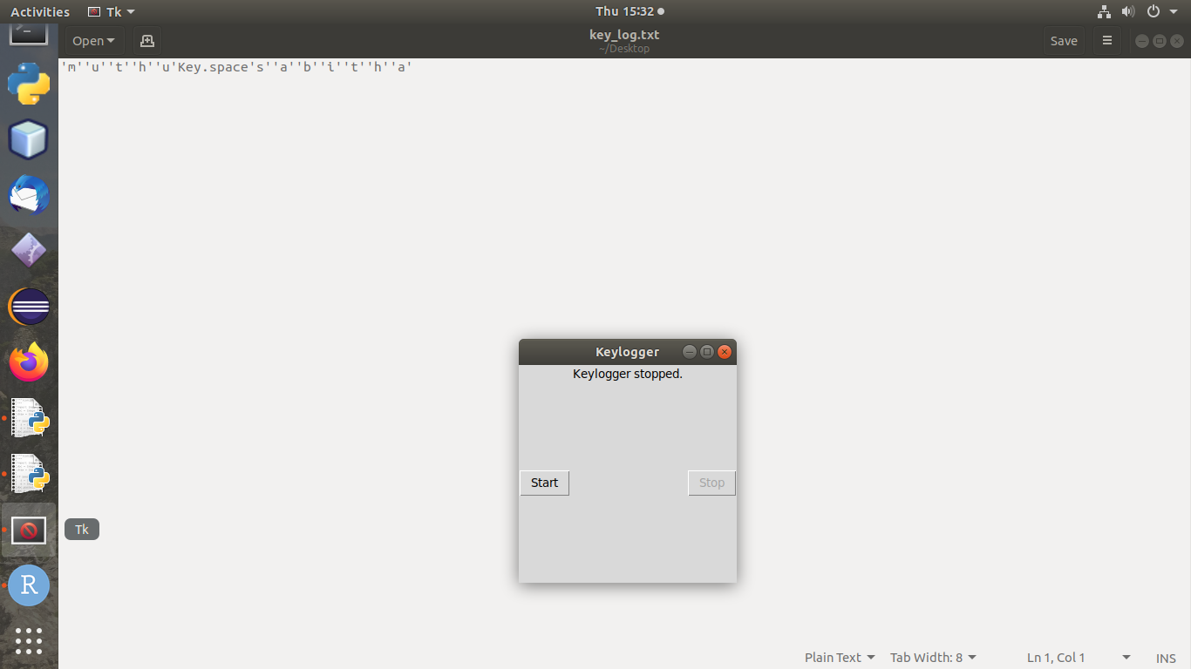
Result

Slide 8
conclusion
The proliferation of keyloggers represents a critical challenge in the contemporary digital landscape, where cybersecurity threats are prevalent. These stealthy software tools can clandestinely capture sensitive information, posing significant risks to individuals and organizations alike. The consequences of keylogger attacks, including identity theft, financial loss, and privacy breaches, underscore the urgent need for robust cybersecurity measures. By fostering awareness, implementing preventive measures, and leveraging advanced technologies, individuals and organizations can mitigate the threat posed by keyloggers and safeguard against the devastating impact of cyber threats in today's digital age.

Slide 9
Future scope
Ongoing research and development efforts to stay ahead of emerging keylogger threats, anticipate future attack vectors, and innovate new countermeasures to protect against evolving cybersecurity risks.

Slide 10
References
"A Study of Keyloggers and Detection Techniques" by Richa Singh and Mayank Dave
"Keylogger Detection Using Machine Learning Techniques" by Yuming Zhang, Jianwei Niu, and Shuai Li
"Enhancing Computer Security against Keyloggers" by Quynh Nguyen and Madhusudan Singh
"Machine Learning-Based Keylogger Detection System" by Ashraf El-Sisi and Eslam Gamal
"A Survey of Keylogger Detection and Prevention Techniques" by T. Kavitha and N. Balakumar

Slide 11
THANK YOU

