Slide 1
Smart Voice-Activated Dustbin: A Step Towards Intelligent Waste Management
TEAM MEMBERS:
R.SARAVANA MUTHUPANDI - 9922008161
L.SANTHOSPANDI - 9922008160
V.DHANUSH -9922008181
P.U.MOHAMED ITHREES -9922008185

Slide 2
ABSTRACT:
a voice-controlled trash system created for use in roadside areas to improve cleanliness and sanitation efforts while also safeguarding wildlife and encouraging waste management practices.
Roadside trash can often attract animals such as cows and dogs, which can accidentally consume materials, leading to health concerns. This innovative garbage bin aims to tackle these challenges by limiting access to authorized individuals using voice-activation technology
By utilizing Arduino-controlled servo motors and real-time voice recognition technology, the bin only opens in response to voice commands and closes automatically to uphold cleanliness

Slide 3
INTRODUCTION:
Traditional open bins attract stray cows and dogs, leading them to consume harmful materials like plastic.
Children playing near open bins are exposed to dangerous waste, increasing the risk of injury and infections.
Unauthorized access to waste increases exposure to rotten or toxic materials, posing health risks.
A voice-activated dustbin system offers a hygienic and secure waste disposal method.
Arduino-based technology allows the bin to open only through voice commands, preventing unauthorized access.
Voice-activated dustbin systems contribute to safer, healthier, and cleaner communities through technology-driven waste management.

Slide 4
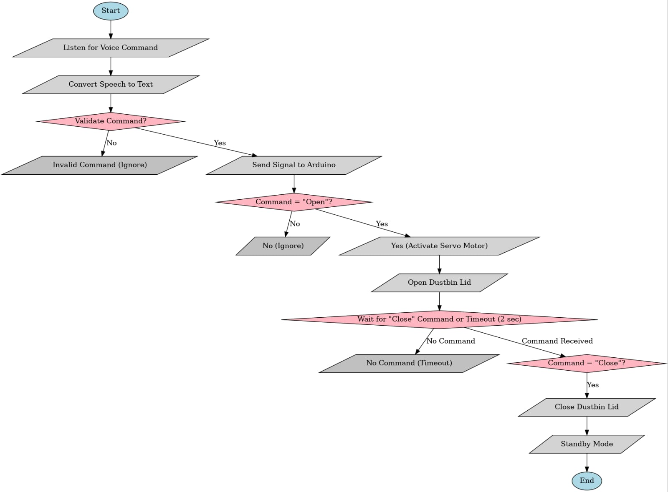
FLOW CHART:

Slide 5
PROPOSED METHODOLOGY:
The voice-activated dustbin is an advanced waste management solution integrating modern technology to ensure hygienic, hands-free disposal of waste.
It consists of Arduino Uno, a servo motor, and a speech recognition system that processes voice commands for lid operation.
Working Mechanism:
Voice Command Input: The microphone captures voice commands
Audio Processing: The Google Speech Recognition API converts voice commands into text.
Command Validation: The system identifies valid commands like "open" or "close.“
Signal Transmission: The Python script transmits recognized commands to Arduino Uno using serial communication via PySerial.
Servo Motor Control: The Arduino instructs the servo motor to open or close the dustbin lid.
Auto Closure Feature: If no "close" command is received within 2 seconds, the lid closes automatically.

Slide 6
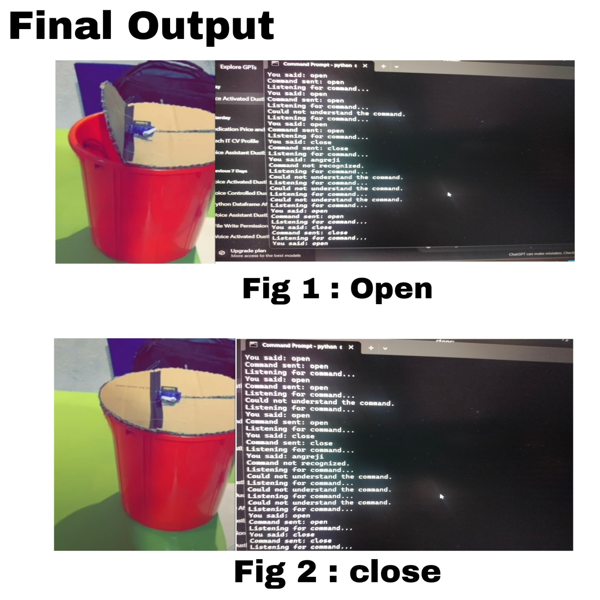
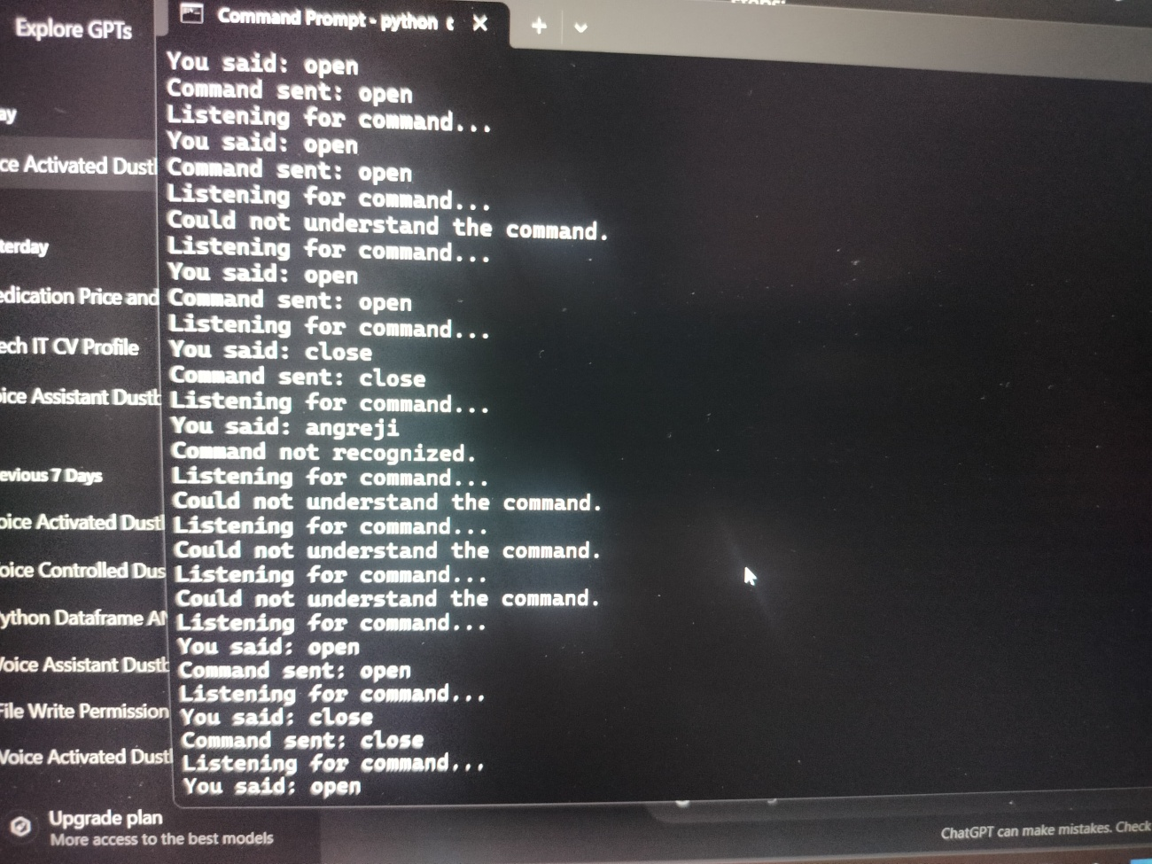
RESULT AND ANALYSIS:

Slide 7
ANALYSIS:
Metrics | Proposed system | Voice control Robot[10] | Voice control Waste system[12] | IoT Based waste bin[5,6]
Voice recognition accuracy -30db,60db,90db | 98%,90%,85% | 96%,85%,80% | 95%,87%,78% | N/A
Maximum Interaction distance(Quiet) | 3 meters | 3.5 meters | 3 meters | N/A
Maximum Interaction distance(Moderate) | 2.5 meters | 3 meters | 2.5 meters | N/A
Maximum Interaction Distance (High Noise) | 2 meters | 1.5 meters | 1.5 meters | N/A
Response Time | 1.3 – 1.7 secs | 2.0-2.5 secs | 2.0-2.5 secs | N/A
Servo motor success rate | 97% | 95% | 94% | 100%(Relay based)
Power consumption(Active mode) | 2.5W | 3.5W | 4W | 5W
Power consumption(Standby mode) | 0.3W | 0.7W | 0.5W | 0.5W

Slide 8
CONCLUSION:
The Voice-Activated Dustbin is an innovative, hygienic, and user-friendly solution for waste disposal.
The system reduces direct contact with waste, minimizing health risks and contamination.
The high speech recognition accuracy (98% in quiet conditions, 85% in noisy conditions) ensures efficient operation in various environments.
The automatic lid closure prevents odor spread, exposure to waste, and the growth of disease-causing bacteria.
The system has a fast response time (1.3 – 1.7 seconds), making it an effective real-time solution.
Built with affordable and easily available components, it is a cost-effective and scalable solution for public and household waste management.
The project successfully integrates voice recognition, automation, and environmental sustainability, encouraging smart waste management practices.

Slide 9
REFRENCES:
[1] C. Kolhatkar, B. Joshi, P. Choudhari and D. Bhuva, "Smart E-dustbin," 2018 International Conference on Smart City and Emerging Technology (ICSCET), Mumbai, India, 2018, pp. 1-3, doi: 10.1109/ICSCET.2018.8537245.
[2] V. B. Shalini, "Smart Health Care Monitoring System based on Internet of Things (IOT)," 2021 International Conference on Artificial Intelligence and Smart Systems (ICAIS), Coimbatore, India, 2021, pp. 1449-1453, doi: 10.1109/ICAIS50930.2021.9396019.
[3] J. Subhashini, Aayush Sharma, Budhaditya Dutta, Varnit Vijay, Shivam Verma; Voice-controlled movable smart dustbin. AIP Conf. Proc. 9 May 2022; 2357 (1): 020004.doi.org/10.1063/5.0080551
[4] V. B. Shalini, P. Meghana, K. Pavan, Y. N. Likhitha, T. G. Advitiya and R. V. Manohar, "IoT Powered Smart Glucose Monitoring System for Geriatric Person," 2024 8th International Conference on I-SMAC (IoT in Social, Mobile, Analytics and Cloud) (I-SMAC), Kirtipur, Nepal, 2024, pp. 117-121, doi: 10.1109/I-SMAC61858.2024.10714751.
[5] Singh, A. Gupta, and S. Raj, “IoT Based Smart Waste Management System Using Arduino,” in International Journal Of Research in Engineering, Science
and Management, vol. 3, no. 5, pp. 569-571, May 2020.
[6] Harith, Muhammad & Hossain, Mohammad Asif & Ahmedy, Ismail & Idris, Mohd & Soon, Tey & Md. Noor, Rafidah. (2020). Prototype Development of IoT
Based Smart Waste Management System for Smart City. IOP Conference Series: Materials Science and Engineering. 884. 012051. 10.1088/1757-899X/884/1/012051.
[7] W. Nasar, A. Karlsen, and I. Hameed, "A Conceptual Model of an IoT-Based Smart and Sustainable Solid Waste Management System: A Case Study of a Norwegian Municipality," Communications of the ECMS, vol. 34, no. 1, 2020. DOI: 10.7148/2020-0019. ISBN: 978-3-937436-68-5.
[8] VikrantBhor, Pankaj Morajkar, Maheshwar Gurav, Dishant Pandya, “A Smart Garbage Management System”, International Journal Of Engineering
Research & Technology (IJERT), Vol. 04, Issue 03, March 2015, Google Scholar.
[9] S.S.Navghane, M.S. Killedar, Dr.V.M. Rohokale, “IoT Based Garbage and Waste Collection Bin”, International Journal of Advanced Research in
Electronics and Communication Engineering (IJARECE), Vol. 5, Issue 5, May 2016. Google Scholar.
[10] VineethTeeda, K.Sujatha, Rakesh Mutukuru, “A Voice Controlled Robot using Arduino”, International Journal of Engineering and Advanced
Technology (IJEAT), ISSN: 2249 – 8958, Vol. 5, Issue-6, August 2016. Google Scholar.

Slide 10
THANK YOU

