Slide 1
PYTHON PROJECT
News Information
Aggregator
Project Scope
NewsAPI article collection
BeautifulSoup webpage enrichment
Pandas cleaning and duplicate removal
Matplotlib visual summaries
Tkinter graphical interface
Unit testing and modular code
Fetch, scrape, clean and visualise current news articles using API integration, web scraping, data processing and a simple GUI.
6
2
3
Core modules
Data sources
Visual outputs
Python Programming · Information Aggregator
TEAM MEMBERS
MUTHU KUMARAN CHANDRASEKAR JAYANTHI
SHESHAN MUNUSAMY NEELAVATHI
HEMANTH RAJAKUMAR
JEFFERSON ROZARIO ROZARIO RAJAN
01

Slide 2
OVERVIEW
What the application does
The project builds a working Python news aggregator that collects current articles from a public API, enriches the results through web scraping, cleans the dataset, saves it for reuse and presents simple visual outputs for analysis.
Input
Collection
Processing
Output
User chooses a category and article count through the GUI.
Program fetches matching articles from NewsAPI and article webpages.
The data is cleaned, combined, deduplicated and exported.
Charts and results help users understand article sources and author availability.
Assignment coverage
Why it matters
API integration, web scraping, OOP, data processing, visualisation, GUI and unit testing are demonstrated in one system.
The application turns unstructured online news into a reusable dataset and simple insights for quick exploration.
02

Slide 3
WORKFLOW
End-to-end system flow
1
User input
2
News API
3
Scraper
4
Processor
5
Visualiser
6
GUI / CSV
Category and number of articles
Fetch current headlines
Extract extra webpage content
Clean, merge and remove duplicates
Generate source and author charts
Show results and save dataset
Reliable by design
Reusable outputs
Modular system
Exception handling ensures one failed webpage does not stop the complete aggregation process.
The final cleaned dataset is exported to CSV so it can be reviewed or reused later.
Each stage is separated into classes, making the code easier to test and extend.
03

Slide 4
COLLECTION
API integration and web scraping
NewsAPI Fetching
BeautifulSoup Scraping
• Connects to a public News API to retrieve current articles.
• Supports category-based searches.
• Parses article title, source, author, description, content, URL and publication date.
• Uses fallback handling when API fields are missing or incomplete.
• API key is managed through configuration rather than hard-coded values.
• Visits article URLs to enrich the original API result.
• Extracts additional webpage text where available.
• Handles different site structures and failed requests safely.
• Preserves the API data when scraped content cannot be collected.
• Keeps the program running even when some sites block scraping.
04

Slide 5
OOP DESIGN
Clean class-based architecture
NewsArticle
BaseFetcher
NewsAPIFetcher
ArticleScraper
GUI
Structured article object used across the program.
Abstract parent class for fetching behaviour.
Connects to NewsAPI and returns article data.
Extracts webpage content using BeautifulSoup.
Runs user interaction through Tkinter.
Encapsulation
Inheritance
Polymorphism
Each class manages its own task, keeping implementation details separated.
The API fetcher builds on the base fetcher design to reduce repeated logic.
The fetcher structure can be extended for other APIs or sources in future versions.
05

Slide 6
PROCESSING
Cleaning, duplicate removal and export
The processing stage turns raw API and scraped results into a consistent dataset that can be saved, reviewed and visualised.
Data cleaning
Duplicate control
CSV export
Missing authors, descriptions, dates and content are handled with fallback values so the final dataset stays usable.
Repeated articles are removed mainly through URLs and key article fields to improve dataset quality.
The processed dataset is saved in the data folder, making the result reusable after the program closes.
Result
The final output is cleaner, more consistent and easier to analyse than the original mixed API and webpage responses.
06

Slide 7
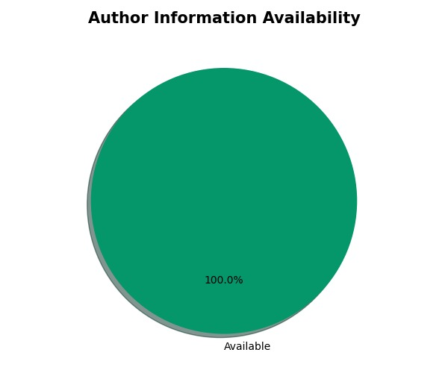
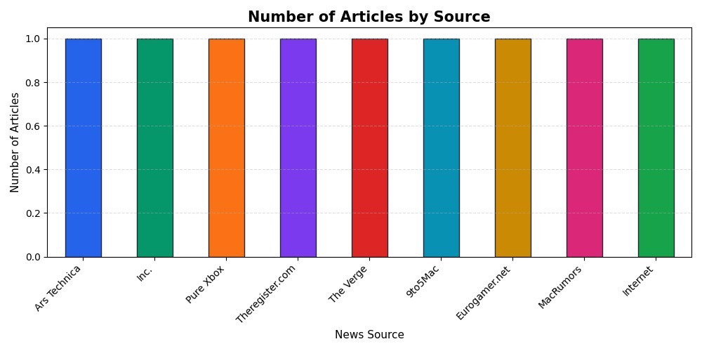
Number of Articles by Source
VISUAL OUTPUTS
Source distribution and author availability
Number of Articles by Source
Author Information Availability
07

Slide 8
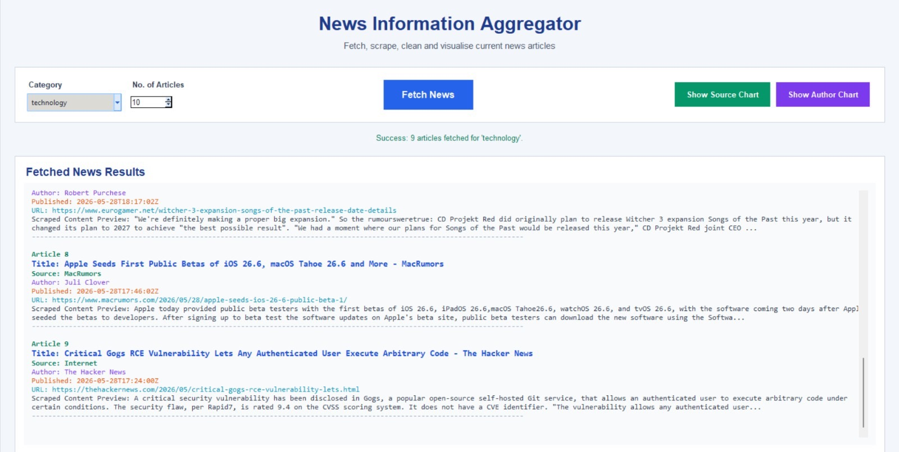
INTERFACE
GUI screenshot from the running application
The interface allows the user to select a category, enter the number of articles, fetch news, and view source/author charts without using command-line input.
08

Slide 9
CHALLENGES
Key issues handled during development
Missing API fields
Scraping restrictions
Duplicate articles
Some articles had no author, description, content or publication date, so fallback values and cleaning steps were needed.
Some websites blocked scraping or used JavaScript-loaded content, so exception handling was necessary.
Similar stories appeared across different sources, so duplicate removal improved the final dataset.
Component integration
Maintainability
Usability
API fetching, scraping, processing, charts, testing and GUI had to work as one combined application.
The code was divided into classes and modules instead of one long script.
The GUI was included so users can interact with the program more easily.
09

Slide 10
LIMITATIONS & FUTURE WORK
How the project can be improved
Current limitations
Future improvements
Scraped content is not always available because websites use different structures, block automated access or load article text dynamically. In these cases, the application keeps the API information and continues running.
Add keyword search, more news APIs, interactive Plotly charts, Excel export, improved scraping rules and stronger unit testing for GUI and API components.
Keyword
search
Excel
export
Interactive
charts
More
APIs
Better
tests
10

Slide 11
Conclusion
A complete Python-based information aggregation system
The project successfully combines API integration, web scraping, data cleaning, CSV export, visualisation, object-oriented programming, unit testing and a Tkinter GUI. The modular design makes the program easier to understand, maintain and extend, while exception handling helps manage real-world website limitations.
Main achievement
The system turns online news data into a structured, reusable and visualised dataset.
Strong design
Classes and modules separate responsibilities clearly and support testing.
Practical outcome
Users can collect and review news without writing command-line commands.
News Information Aggregator · Python Programming
11

