Slide 1
Handwritten digit recognition using neural network
By :
Name : J . Muthu Kumar
Degree : B.E
Branch : CSE
College : PET Engineering College
NM ID : au963221104035
Email ID : cse21.muthukumar@petengg.ac.in
kumarmuthu3695@gmail.com

Slide 2
outline
Problem Statement
Proposed System/Solution
System Development Approach
Algorithm & Deployment
Result
Conclusion
References

Slide 3
Problem Statement
Problem Statement : The aim is to develop a neural network model to recognize handwritten digits from the MNIST dataset.
Methodology : It is implemented by a feedforward neural network with one hidden layer trained using the L-BFGS-B optimization algorithm. The model is trained on the MNIST dataset, and accuracy is evaluated over multiple epochs.
Objective : To train a neural network model capable of accurately classifying handwritten digits.

Slide 4
Proposed solution
Data Preprocessing : Load the MNIST dataset using ‘ loadmat ’ from ‘ scipy.io’ . Normalize the pixel values of the images to the range [0, 1]. Split the dataset into training and testing sets.
Neural Network Architecture : Define the architecture of the neural network with one hidden layer . Initialize the weights and biases of the network using random values . The input layer has 784 neurons (28x28 pixels), the hidden layer has 100 neurons, and the output layer has 10 neurons representing digits 0 through 9.
Training : Implement the ‘ neural network ‘ function to compute the cost function and gradients using forward and backward propagation . Use the L-BFGS-B optimization algorithm provided by ’ scipy.optimize.minimize ‘ to train the neural network . Iterate over multiple epochs, updating the network parameters to minimize the cost function.

Slide 5
Proposed solution – cont.
Evaluation : Evaluate the trained model on the testing set . Calculate the accuracy of the model predictions . Visualize the accuracy over epochs to monitor the training progress.
Results Visualization : Visualize some randomly selected examples from the testing set along with their predicted and actual labels . Generate a confusion matrix to analyze the model's performance in classifying each digit.
Saving Trained Parameters : Save the trained parameters (weights and biases) of the neural network to text files for future use or deployment.

Slide 6
System approach
System Requirement :
Hardware Requirements:
A computer with sufficient processing power (CPU) and memory (RAM) to handle training and evaluation of neural networks. The specific hardware requirements may vary depending on the size of the dataset and complexity of the neural network architecture.

Slide 7
System approach – cont.
Software Requirements :
Python : The solution is implemented using Python programming language.
Python Libraries : Ensure the following libraries are installed:
NumPy : For numerical computing and array operations.
SciPy : For loading the MNIST dataset and optimization algorithms.
Matplotlib : For plotting accuracy over epochs and visualizing digit examples.
Seaborn : For creating visualizations, such as the confusion matrix.
scikit-learn : For metrics like confusion matrix and accuracy calculation.
TensorFlow or Keras : If you prefer to use deep learning frameworks for neural network implementation instead of manual implementation.
Tkinter : Python's standard GUI library, which comes pre-installed with Python.

Slide 8
Algorithm and deployment
Neural Network Architecture :
Input Layer : Consists of 784 neurons, representing the 28x28 pixel grayscale images of handwritten digits.
Hidden Layer : Contains 100 neurons with a sigmoid activation function.
Output Layer : Consists of 10 neurons representing digits 0 through 9, with a softmax activation function.
The neural network is trained using backpropagation and optimized using the L-BFGS-B optimization algorithm.
Training : Train the neural network on the MNIST dataset using backpropagation . Use the L-BFGS-B optimization algorithm to minimize the cost function.

Slide 9
Algorithm and deployment – cont.
Deployment:
Trained Model : Ensure that the trained model parameters (weights and biases) are saved in a format that can be loaded during inference.
Save the trained parameters ( ‘file1.txt’ and ‘file2.txt’ in this case) in a location accessible to the deployment environment.
GUI Integration:
Integrate the Tkinter-based GUI code into a larger application or package it as a standalone application for deployment.
Ensure that all necessary files, including the trained model parameters, are accessible in the deployment environment.

Slide 10
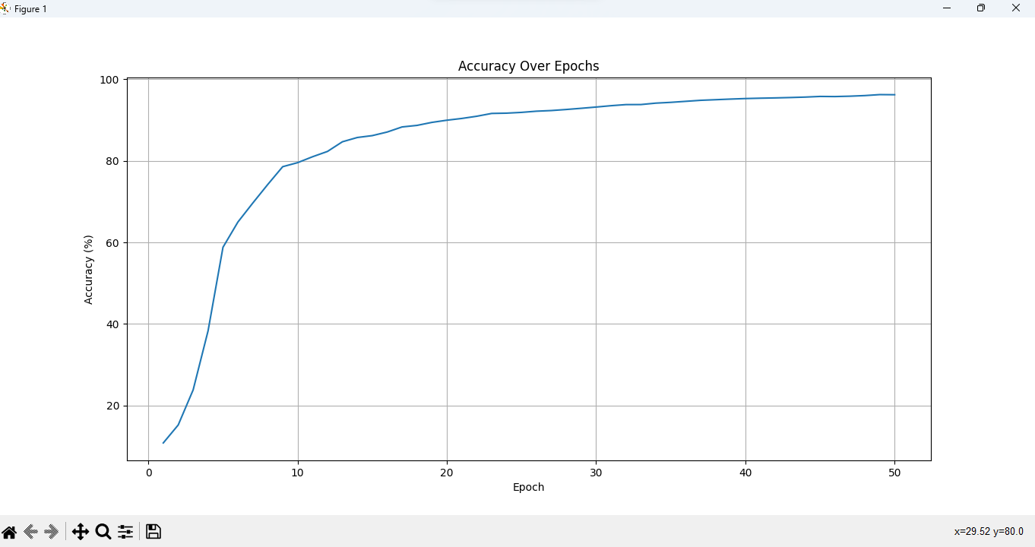
Result :

Slide 11
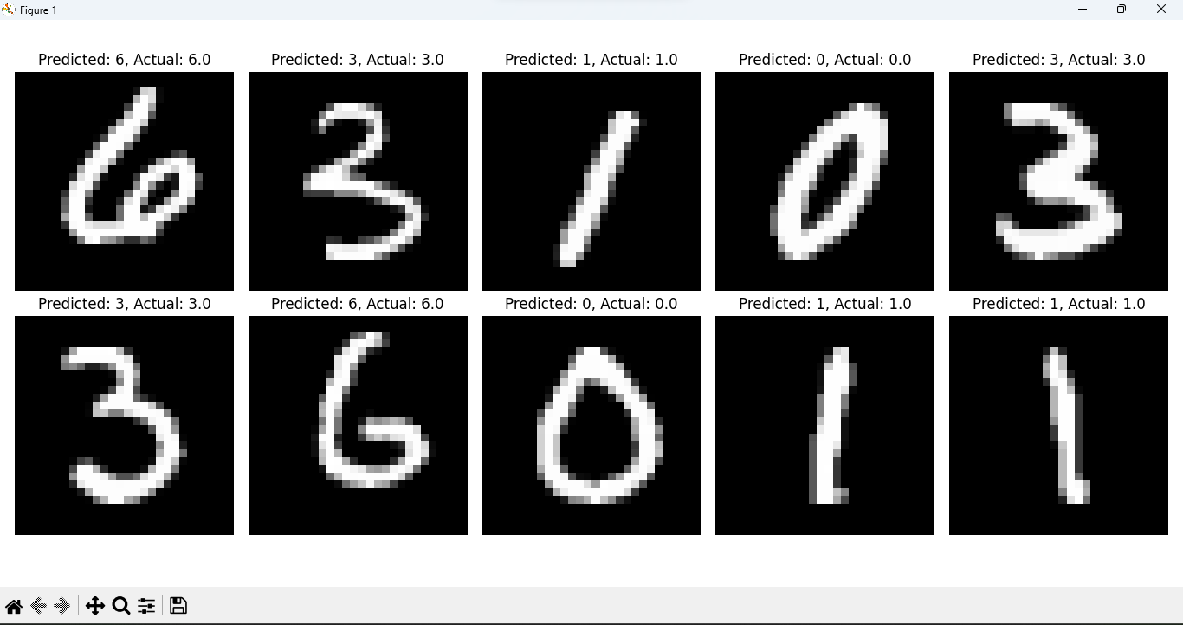
Result- cont.

Slide 12
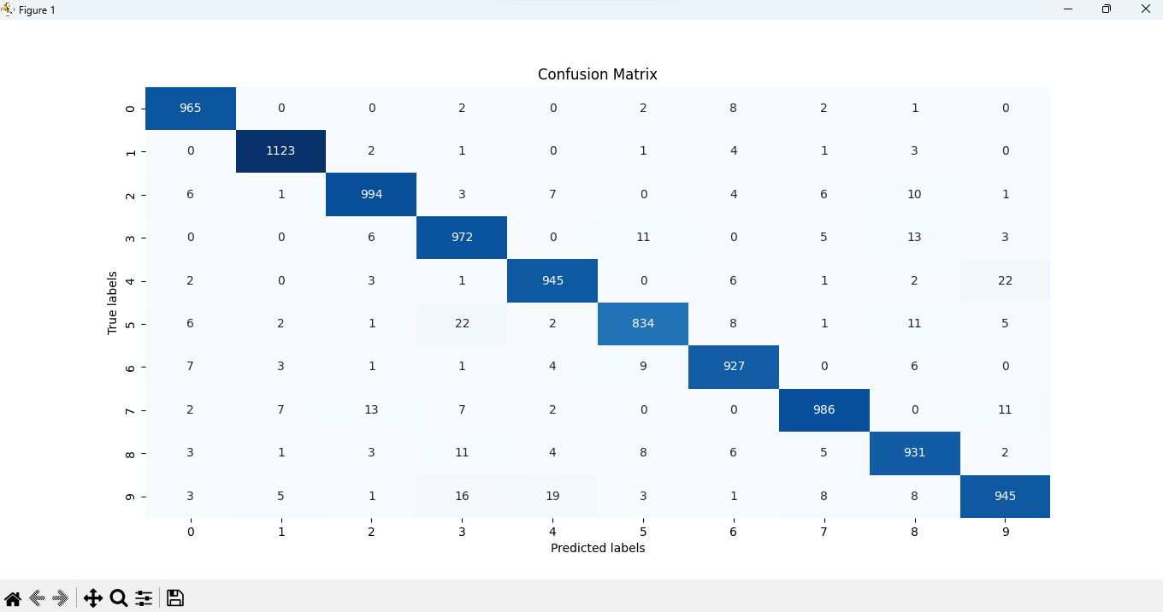
Result cont.

Slide 13
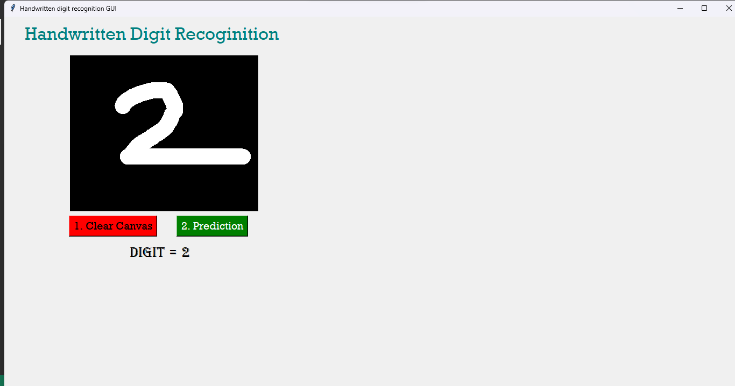
RESULT - GUI

Slide 14
conclusion
In conclusion, the project has successfully developed a neural network-based solution for handwritten digit recognition, achieving accurate classification results. The integration of a user-friendly GUI facilitates easy interaction, demonstrating the practical usability of the system. Through meticulous training and evaluation, the model showcases robust performance on the MNIST dataset. Deployment options offer versatility in application, enabling seamless integration into various environments. Overall, the project highlights the effectiveness of neural networks in image classification tasks and opens avenues for further advancements in pattern recognition technology.

Slide 15
references
http://yann.lecun.com/exdb/mnist/
http://neuralnetworksanddeeplearning.com/
https://www.tensorflow.org/guide
https://keras.io/guides/
https://docs.python.org/3/

