Slide 1
Muthu Palaniappan M
Sai University Guest Talk
Lecture on Model Context Protocol (MCP)
12th July 2025
USB-C port for AI applications

Slide 2

Agenda
Semantic Search
Retrieval-Augmented Gen…
What to expect from this session?
Model Context Protocol (MCP)
Hands-on
Acknowledgements

Slide 3
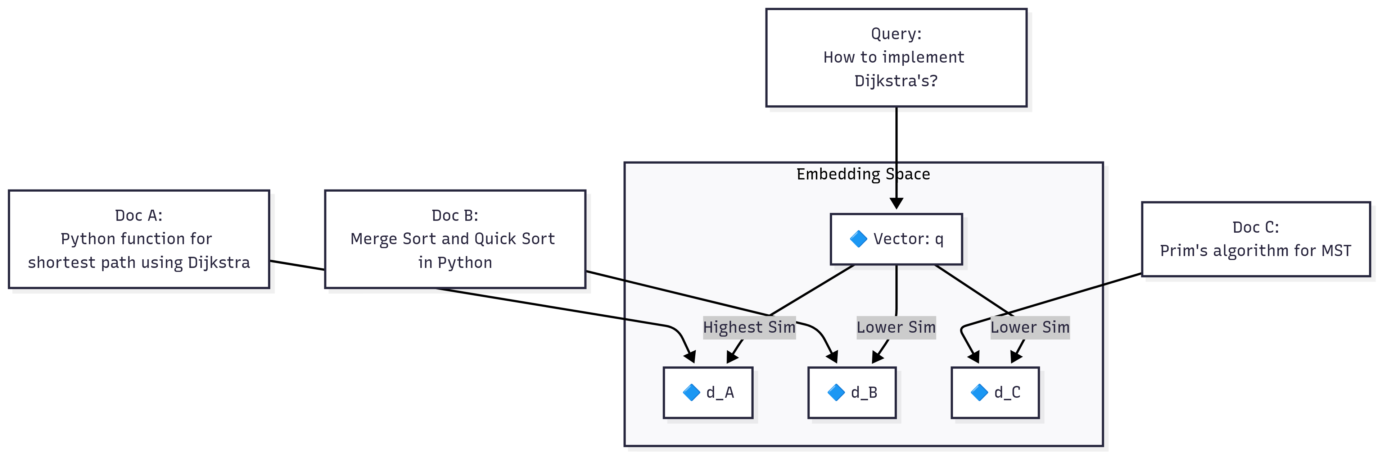
Semantic Search
Semantic Search is an information retrieval technique that uses vector representations of text to retrieve content that is semantically similar to a query, rather than relying on exact keyword matches.
Figure: Semantic Search Example
Knowledge Base
Embedding
Storage
Similarity Search
Documents
RAW data
Converts text into dense numerical vectors
Vector Datastore
Computes similarity between query and stored vectors
Most semantically similar matches to the query

Slide 4




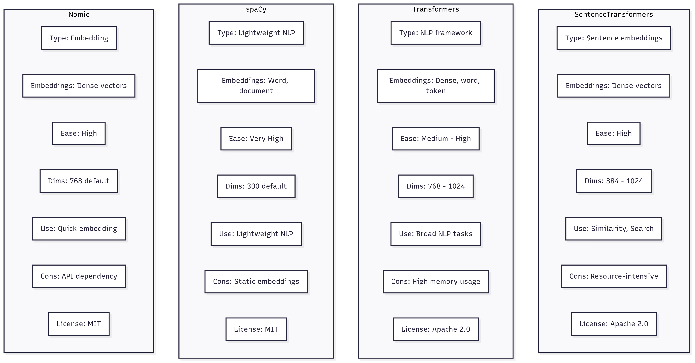
Embedding Library

Slide 5
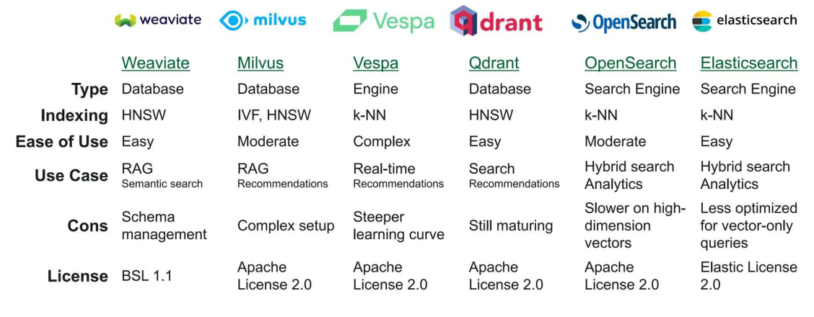
Vector Database

Slide 6
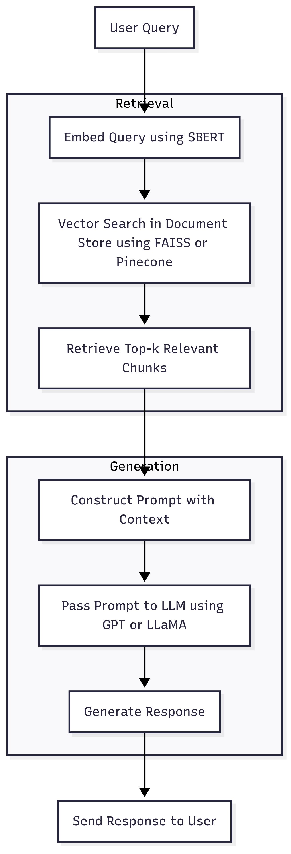
Retrieval-Augmented Generation
A hybrid approach that combines information retrieval with language generation, enabling LLMs to generate responses grounded in external knowledge
Use Cases
Chatbots with private or enterprise knowledge
Legal, medical, and financial assistants
Documentation and support agents
RAG allows grounding answers in up-to-date
LLMs have limited context window and factual accuracy.
Why RAG?
Avoids hallucinations by retrieving relevant documents before generation
Figure: RAG pipeline

Slide 7
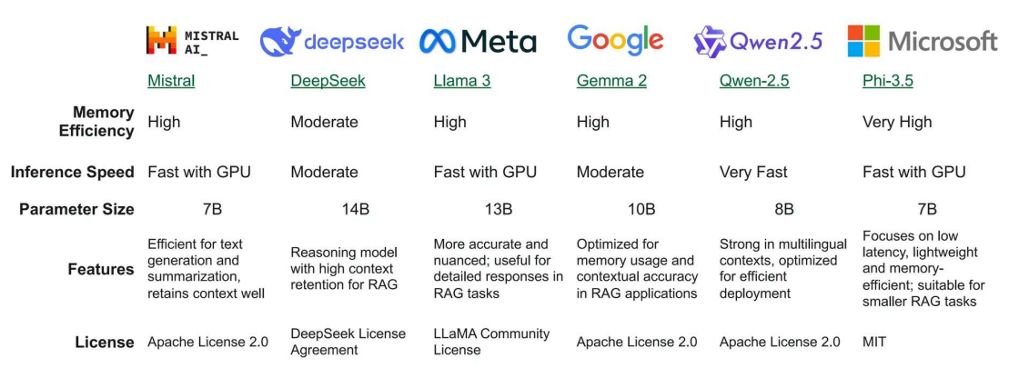
LLM Snapshot

Slide 8
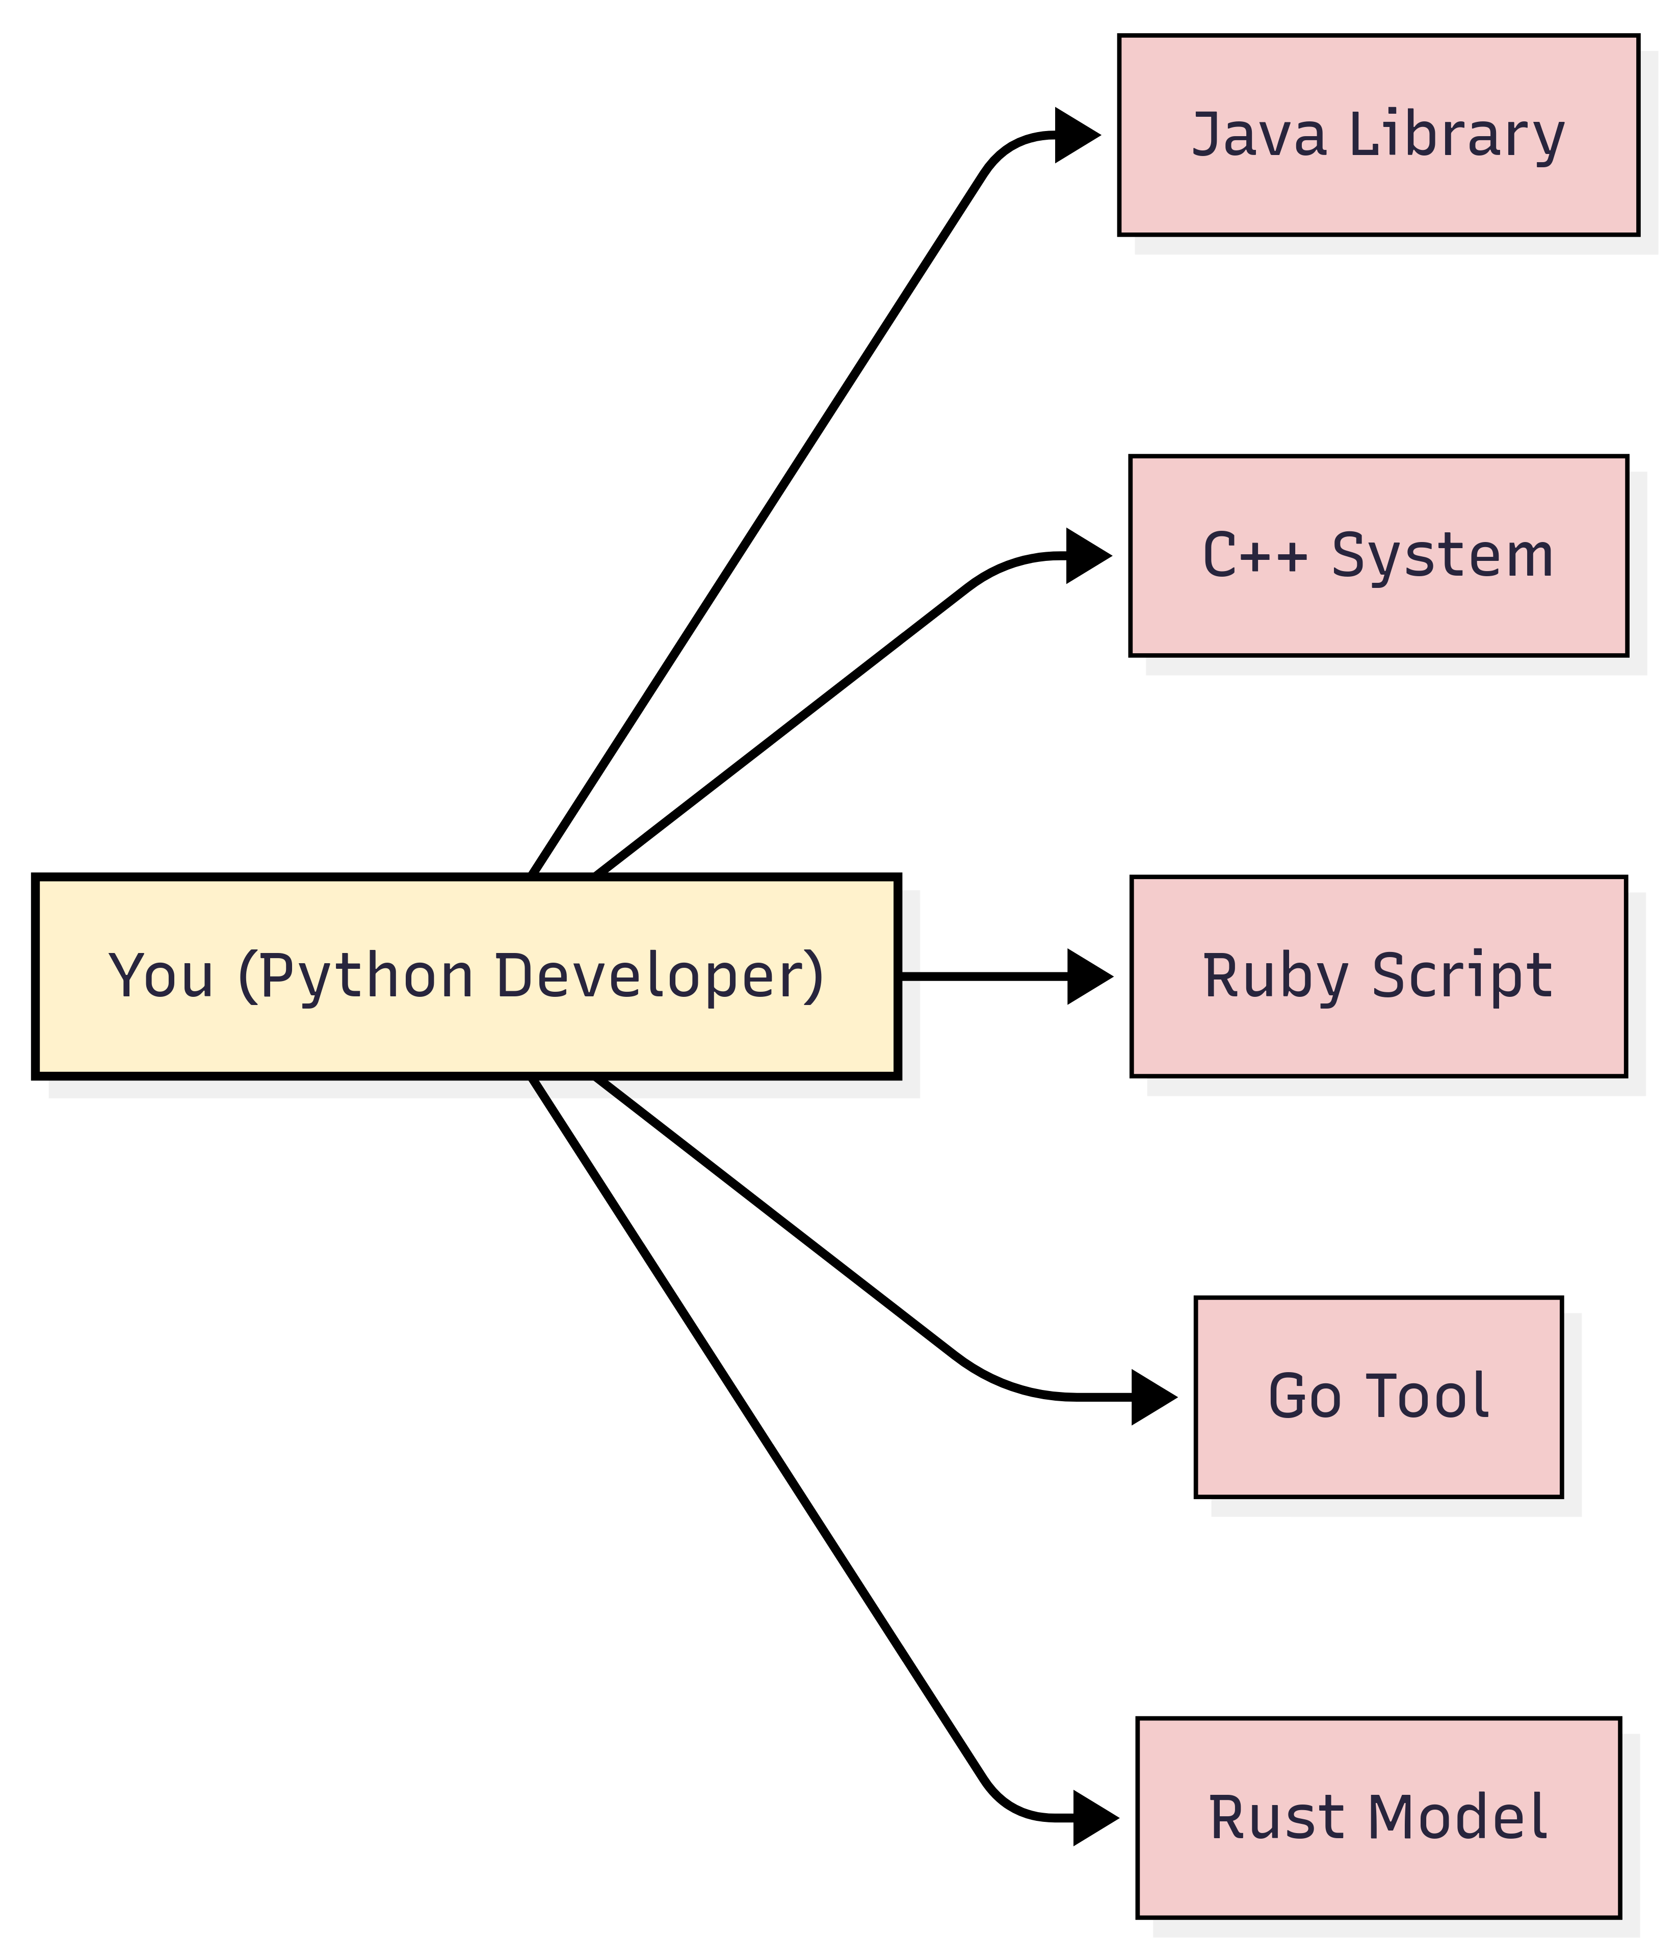
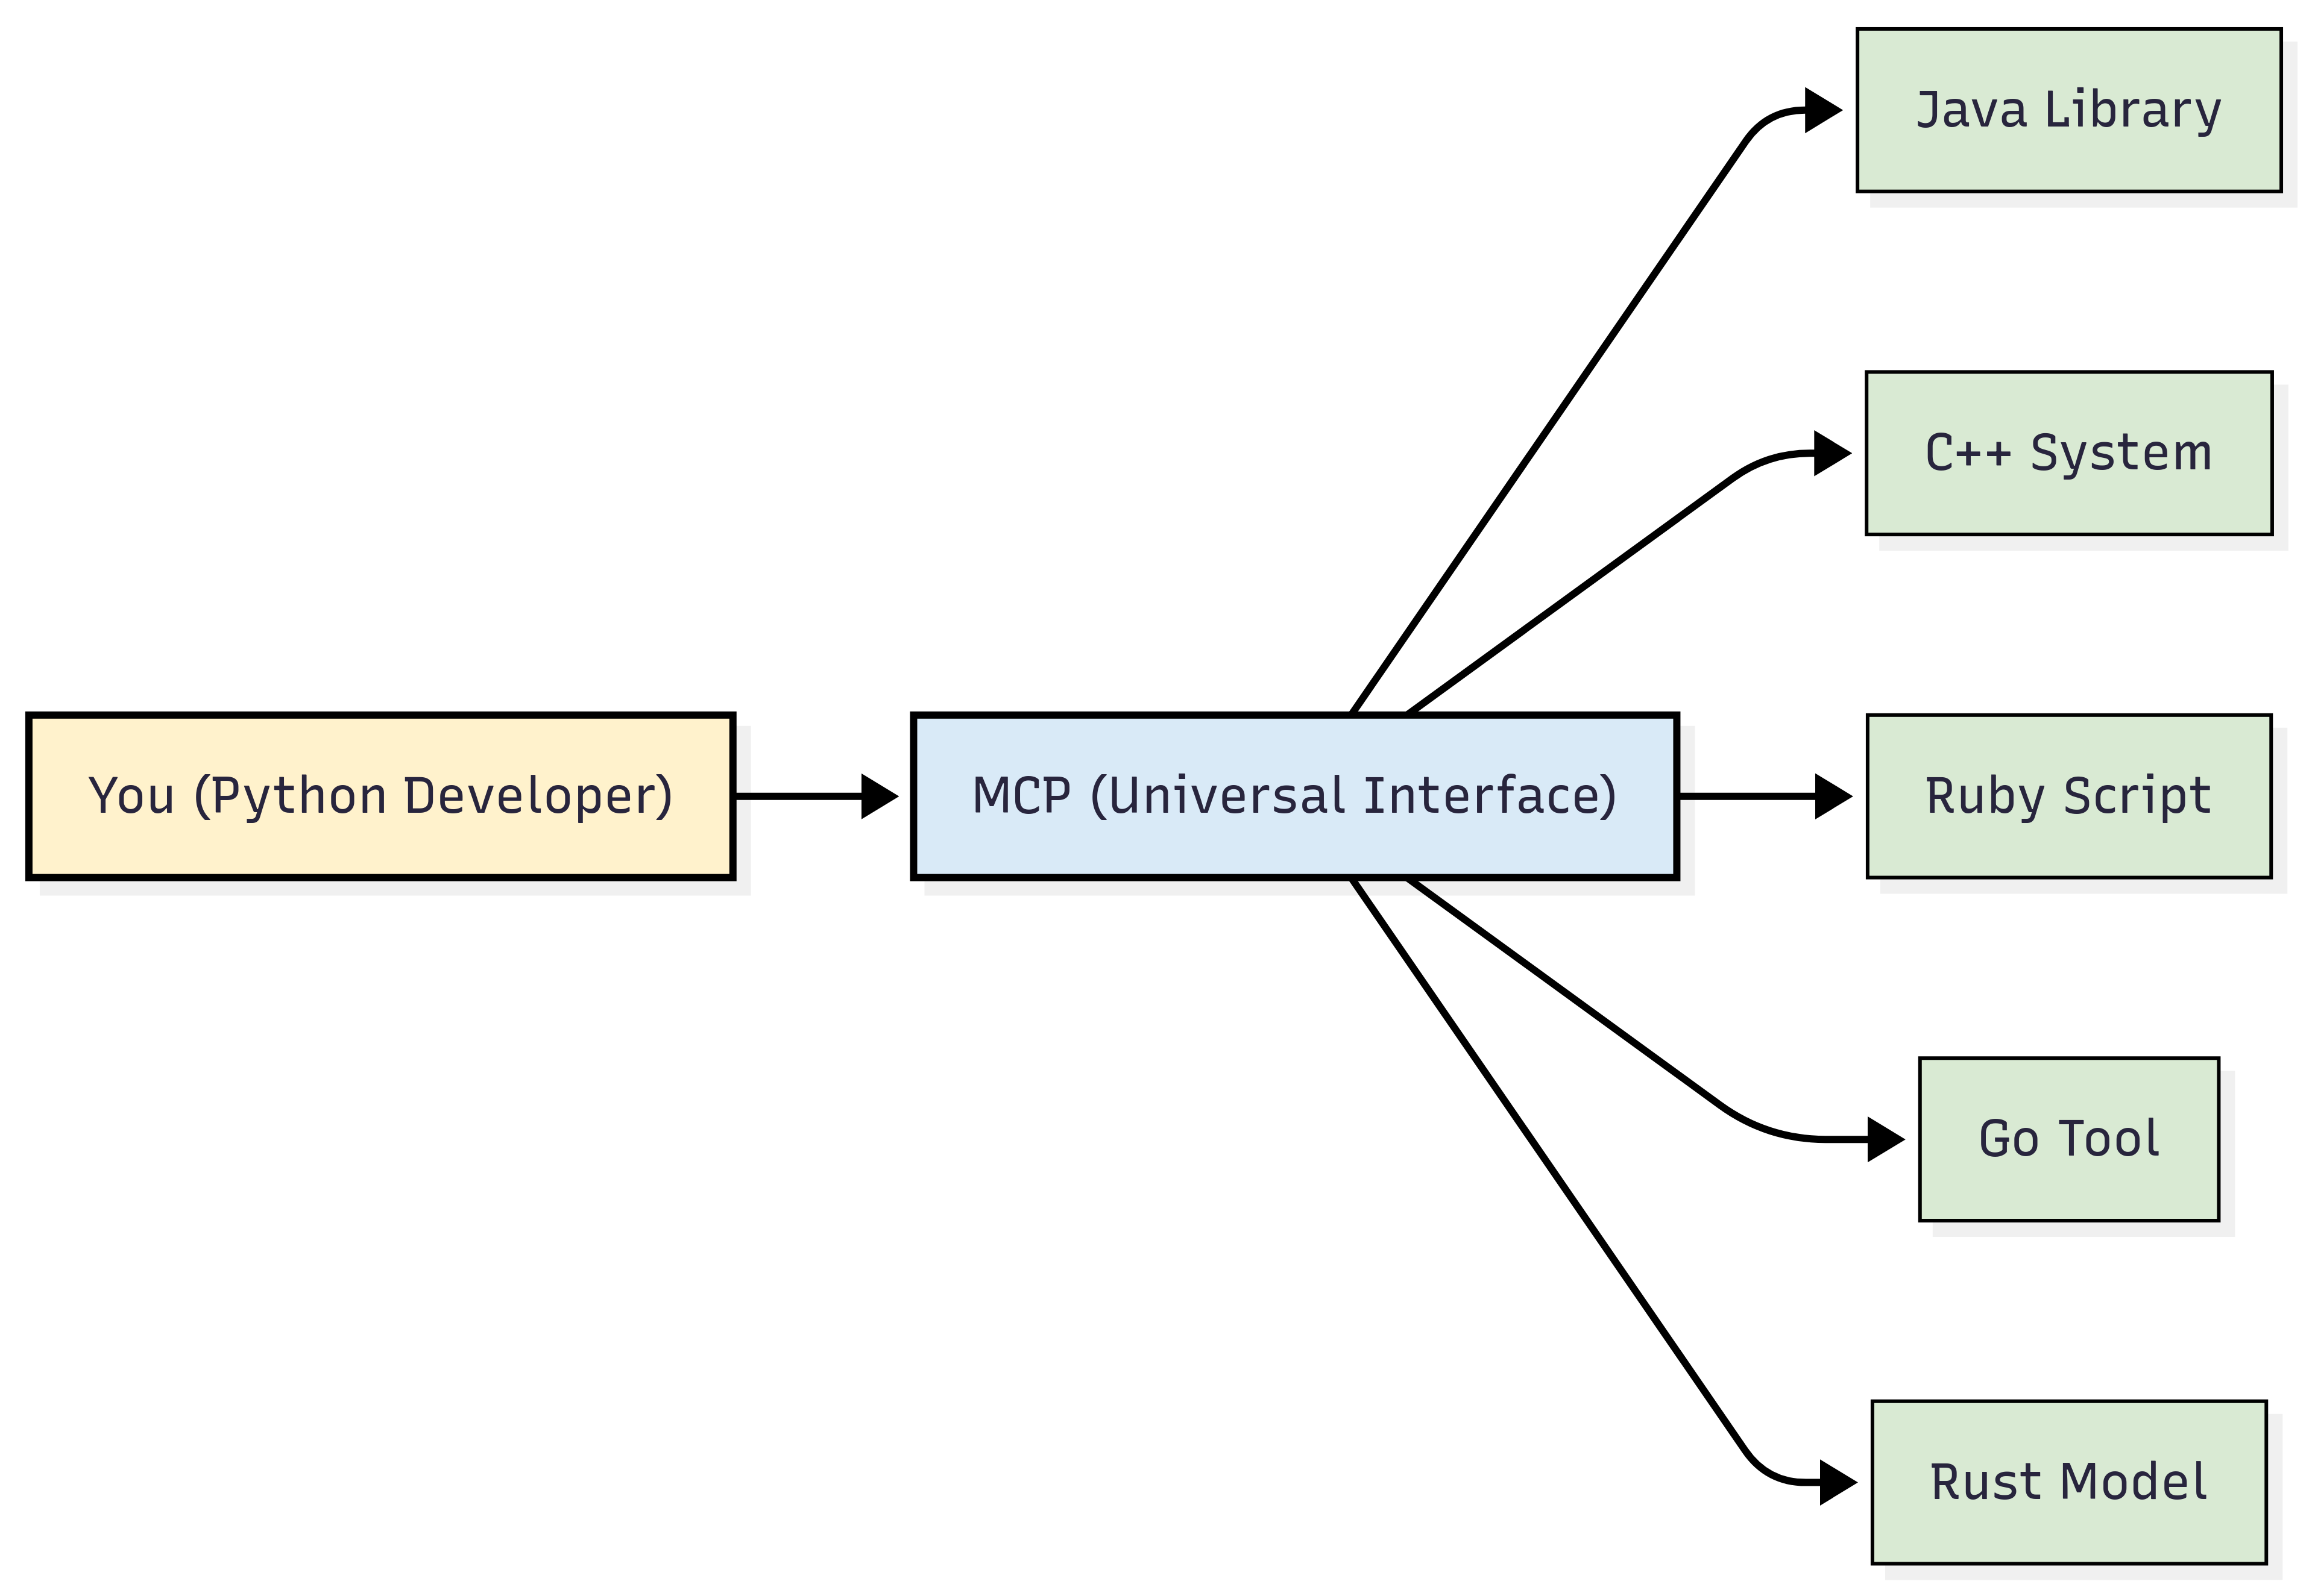
Model Context Protocol (MCP)
Imagine you're a developer who only knows Python. Now, you want to use tools written in different languages:
A library in Java
A system written in C++
A script in Ruby
A tool written in Go
A model served in Rust
To interact with each of these, you would need to learn each of those programming languages, which would be a nightmare and very inefficient.
But what if there’s a universal interface that can talk to all of them and just gives you what you need in Python?
That universal interface is like an MCP | it translates and connects you to different systems without requiring you to learn everything!
Figure: Before MCP
Figure: After MCP

Slide 9
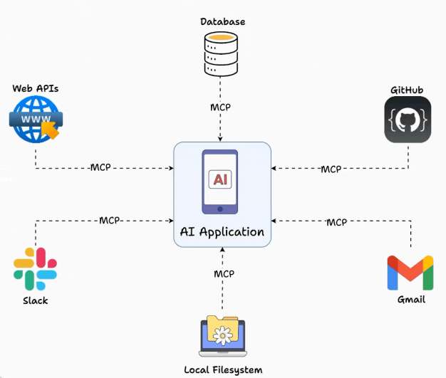
Model Context Protocol (MCP)
While LLMs possess impressive knowledge and reasoning skills, which allow them to perform many complex tasks, their knowledge is limited to their initial training data.
If they need to access real-time information, they must use external tools and resources on their own.
Model context protocol (MCP) is a standardized interface and framework that allows AI models to seamlessly interact with external tools, resources, and environments.
MCP acts as a universal connector for AI systems to capabilities (tools, etc.), similar to how USB-C standardizes connections between electronic devices
Figure: MCP

Slide 10
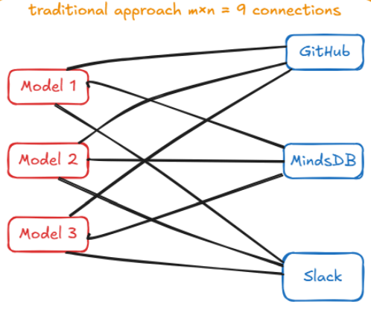
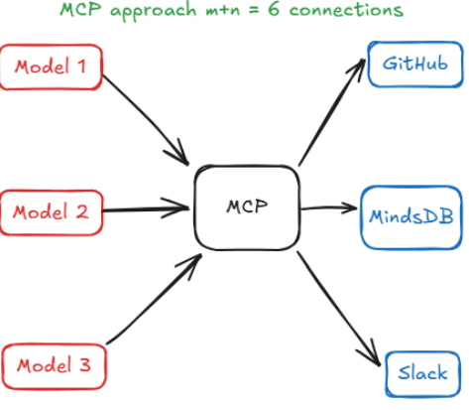
Why MCP ?
Without MCP, adding a new tool or integrating a new model was a headache.
Before MCP, the landscape of connecting AI to external data and actions looked like a patchwork of one-off solutions.
Either you hard-coded logic for each tool, managed prompt chains that were not robust, or you used vendor-specific plugin frameworks.
Infamous M×N integration problem
Essentially, if you have M different AI applications and N different tools/data sources, you could end up needing M × N custom integrations.
THE SOLUTION
MCP tackles this by introducing a standard interface in the middle. Instead of M × N direct integrations, we get M + N implementations: each of the M applications implements the MCP client side once, and each of the N tools implements an MCP server once.
Figure: MCP (MXN) | (M+N)

Slide 11
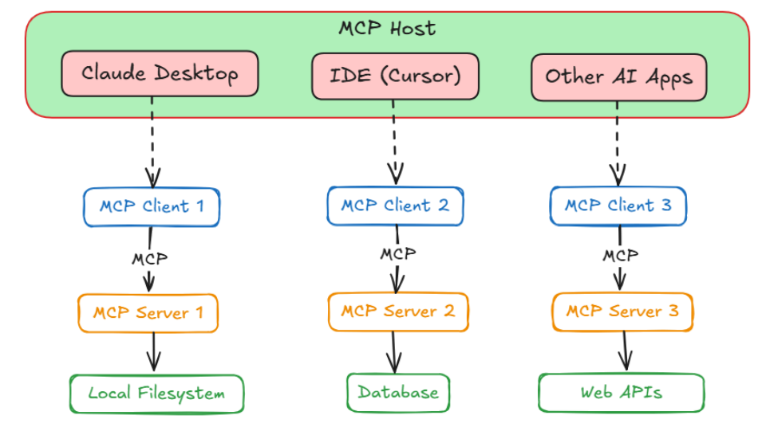
MCP Architecture
At its heart, MCP follows a client-server architecture (much like the web or other
network protocols)
Figure: Architecture Overview

Slide 12
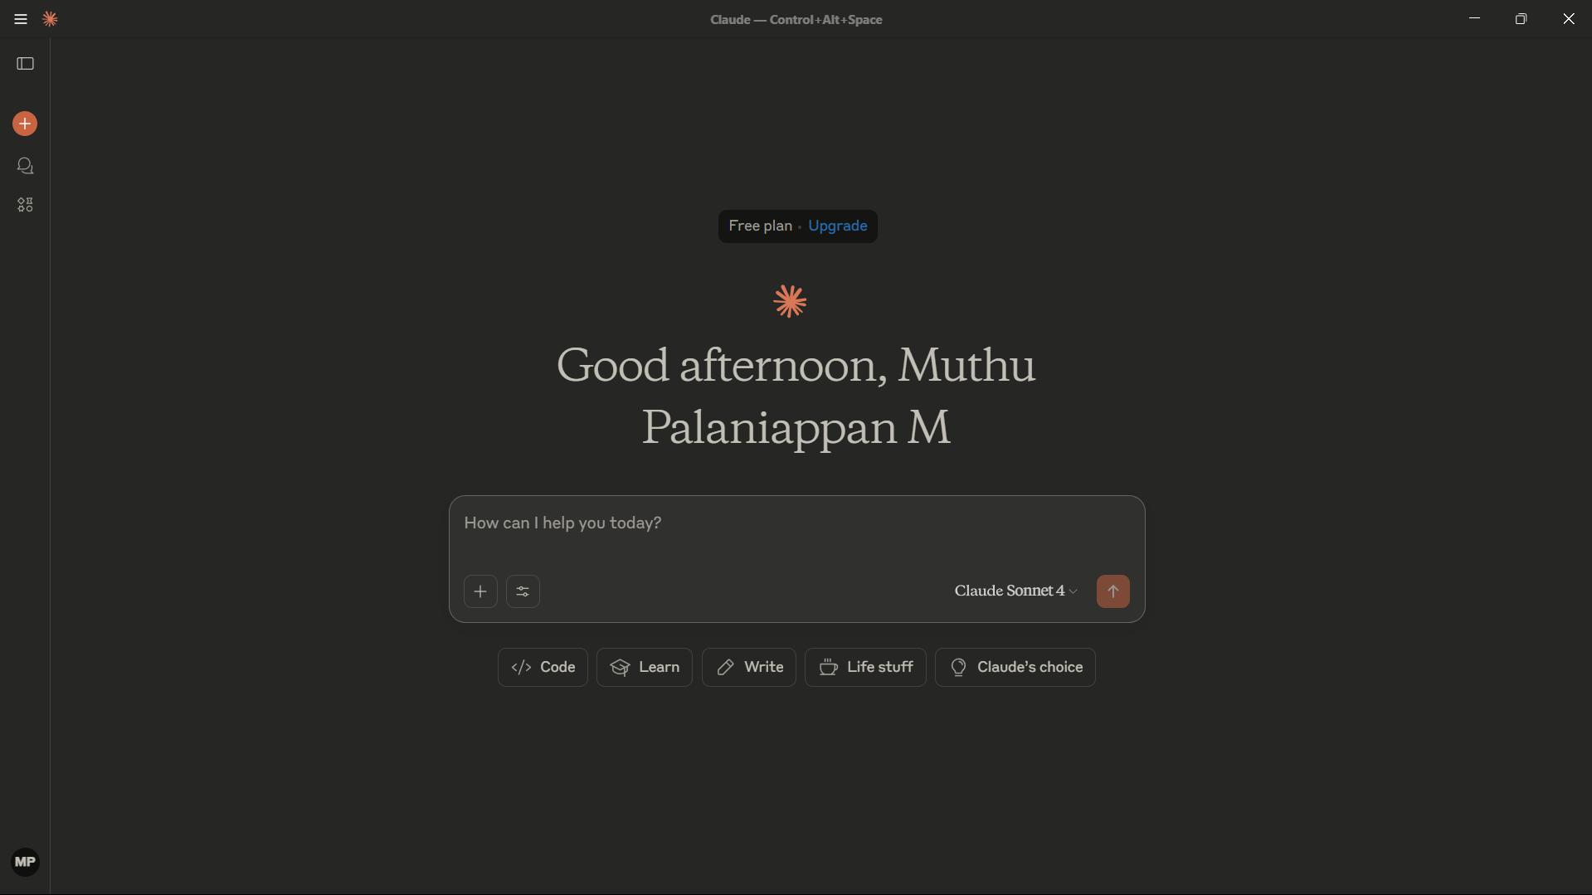
MCP Architecture - Host
The Host is the user-facing AI application, the environment where the AI model
lives and interacts with the user
This could be a chat application (like OpenAI’s ChatGPT interface or Anthropic’s
Claude desktop app), an AI-enhanced IDE (like Cursor), or any custom app that
embeds an AI assistant like Chainlit.
Figure: Claude Desktop (Host)

Slide 13
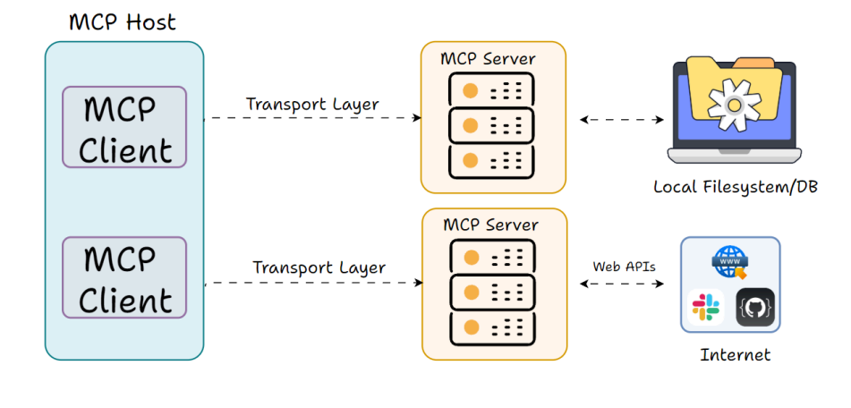
MCP Architecture - Client
The MCP Client is a component within the Host that handles the low-level
communication with an MCP Server
Figure: Client

Slide 14
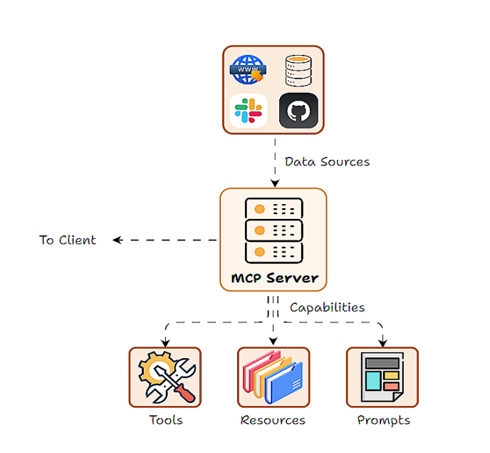
MCP Architecture - Server
The MCP Server is the external program or service that actually provides the
capabilities (tools, data, etc.) to the application.
An MCP Server can be thought of as a wrapper around some functionality, which
exposes a set of actions or resources in a standardized way so that any MCP
Client can invoke them.
Figure: Server

Slide 15
MCP Core Capabilities
Tools, prompts and resources form the three core capabilities of the MCP framework. Capabilities are essentially the features or functions that the server
makes available.
Tools: Executable actions or functions that the AI (host/client) can invoke (often with side effects or external API calls).
Resources: Read-only data sources that the AI (host/client) can query for information (no side effects, just retrieval).
Prompts: Predefined prompt templates or workflows that the server can supply.
Tools
Resources
MCP Core
Prompts
Figure: RAG pipeline

Slide 16
References
https://medium.com/@nimritakoul01/the-model-context-protocol-mcp-a-complete-tutorial-a3abe8a7f4ef
https://www.philschmid.de/mcp-introduction
https://codesignal.com/learn/courses/developing-and-integrating-a-mcp-server-in-python/lessons/exploring-and-exposing-mcp-server-capabilities-tools-resources-and-prompts
https://ramwert.medium.com/mcp-demystifying-mcp-resources-vs-tools-a-practical-guide-for-agentic-automation-cb07fcb82241
https://modelcontextprotocol.io/introduction

