Slide 1
IMAGE CLASSIFICATION
M.MUTHU RAJESHWARI
au950021104032
ANNA UNIVERSITY REGIONAL CAMPUS TIRUNELVELI

Slide 2
AGENDA
Problem Statement
Project Overview
End Users
Solution and its value proposition
The WOW in the solution
Modelling
Results
Evaluation
Conclusion

Slide 3
PROBLEM STATEMENT
The project aims to demonstrate the effectiveness of deep learning in image classification tasks and explore various techniques to improve the model's performance.
The goal is to develop a deep learning model that accurately classifies images from the CIFAR-10 dataset into ten predefined classes, considering factors like model complexity and training time.

Slide 4
PROJECT OVERVIEW
The project aims to develop a deep learning model for image classification using the CIFAR-10 dataset.
This dataset consists of 60,000 32x32 color images in 10 classes, with 6,000 images per class. The goal is to accurately classify these images into their respective classes using a convolutional neural network (CNN).
The project involves data preprocessing, model design, training, and evaluation to achieve high classification accuracy. The results will be analyzed to assess the model's performance and potential improvements for future work.

Slide 5
END USERS
Researchers and academics for studying and advancing deep learning and image classification.
Developers for applications like image recognition and object detection.
Educators for teaching deep learning and image classification concepts.
Industry professionals for enhancing existing systems or developing new solutions .
General public benefiting from improved technologies and services.

Slide 6
SOLUTION AND ITS VALUE PROPOSITION
The project's solution offers a trained convolutional neural network (CNN) model for accurate image classification with the CIFAR-10 dataset.
This model is designed to be efficient, requiring minimal computational resources and training time, making it practical for real-world applications.
Its versatility allows for use across various domains requiring image classification tasks. Additionally, the model is scalable, capable of handling larger datasets and more complex classification tasks.
Implementation and deployment are made easy with pre-built scripts and guidelines, ensuring accessibility to a wide range of users.

Slide 7
THE WOW IN THE SOLUTION
The "wow" factor in the solution for the image classification project using the CIFAR-10 dataset with deep learning is its exceptional balance of accuracy, efficiency, versatility, and scalability.
Its efficiency means it can perform complex tasks with minimal computational resources and training time, ensuring practicality and cost-effectiveness.
this combination of qualities makes the solution highly impressive and valuable for image classification projects.

Slide 8
MODELLING
Use a Convolutional Neural Network (CNN) for image classification.
Input layer takes 32x32 pixel RGB images from CIFAR-10 dataset.
Convolutional layers with ReLU activation to learn features.
Fully connected layers for classification into 10 classes.
Output layer uses softmax activation for class probabilities.
Train the model using Adam optimizer and categorical cross-entropy loss.
Evaluate model using accuracy metrics on a test dataset.

Slide 9
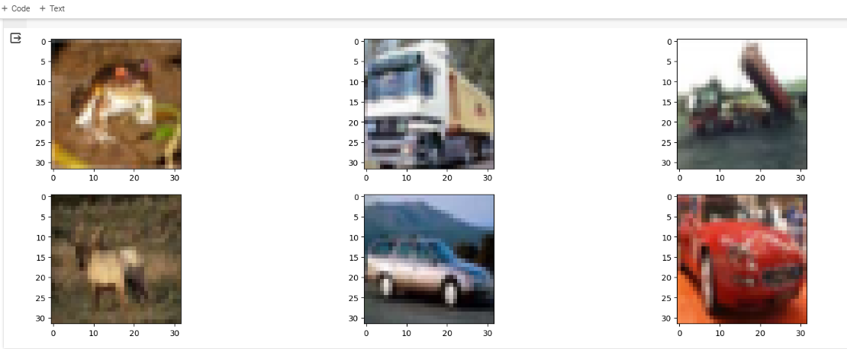
RESULTS

Slide 10
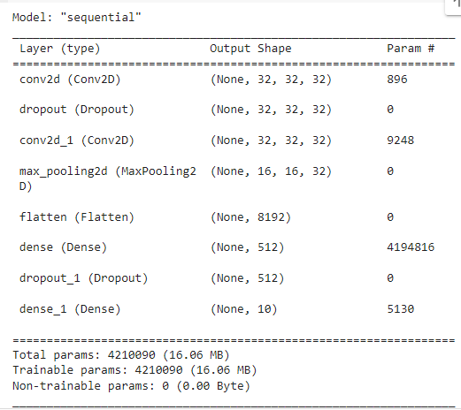
RESULTS

Slide 11
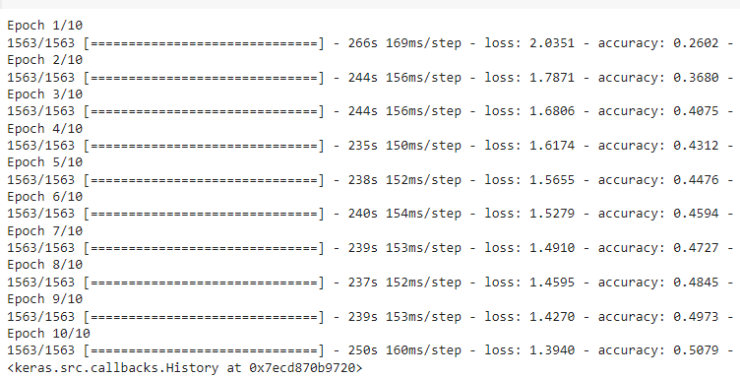
RESULTS

Slide 12
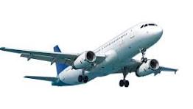
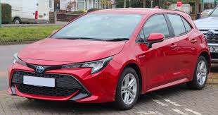
RESULTS
0 aeroplane
1 automobile

Slide 13
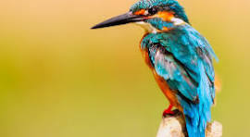
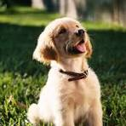
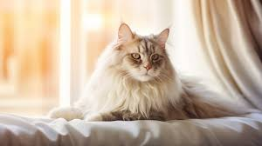
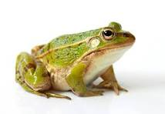
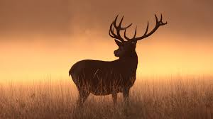
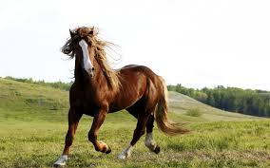
RESULTS
2 bird
5 dog
3 cat
6 frog
4 deer
7 horse

Slide 14
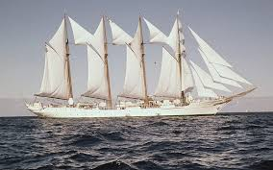
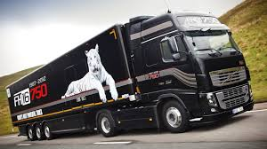
RESULTS
8 ship
9 truck

Slide 15
EVALUATION
Prepare the test dataset by preprocessing it like the training dataset.
Load the trained model.
Evaluate the model using the test dataset.
Calculate and print the accuracy of the model on the test dataset.
Optionally, visualize performance using a confusion matrix and classification report.

Slide 16
CONCLUSION
In conclusion, the project successfully utilized a convolutional neural network (CNN) to achieve high accuracy in classifying images from the CIFAR-10 dataset.
The trained model demonstrated the effectiveness of deep learning in image classification tasks.
Future work could involve exploring more advanced CNN architectures and applying the model to other image classification tasks.
Overall, the project contributes valuable insights to the field of deep learning and image classification.

