Slide 1
Web Scraper For Regulatory Intelligence -Project Report

Slide 2
OBJECTIVE
>To collect data from different sites about a particular product
>These data is compared with previously collected data
>Finally all the data can be use for analysis

Slide 3
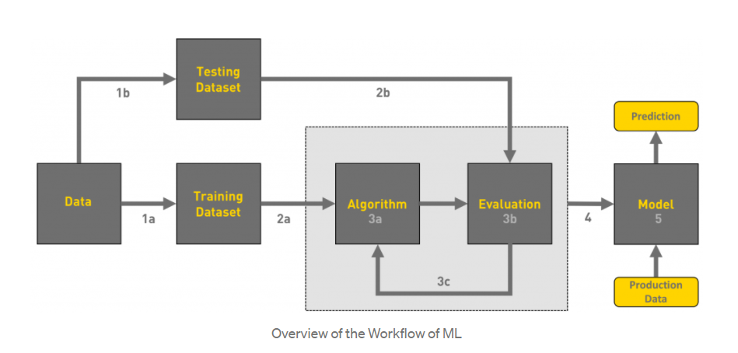
Process Flow Chart
Source :
https://towardsdatascience.com/workflow-of-a-machine-learning-project-ec1dba419b94

Slide 4
COLLECTING THE DATA
1.Search the net for relevant information
If
Information is relevant get into the site
If
Site is Updated
If
Symptoms found copy the text into data frame
Else
Go back to the search results
Continue the process till no new relevant data is found

Slide 5
ANALYSIS
Data Collected
Analysis
Name Of Medicine
Compositions
Side Effects Of Each
List Of All Side Effects
Percentage Of Medicines causing Similar side effects
Percentage Of These Medicines Having Similar Composition

Slide 6
PROJECT OUTPUT

Slide 7
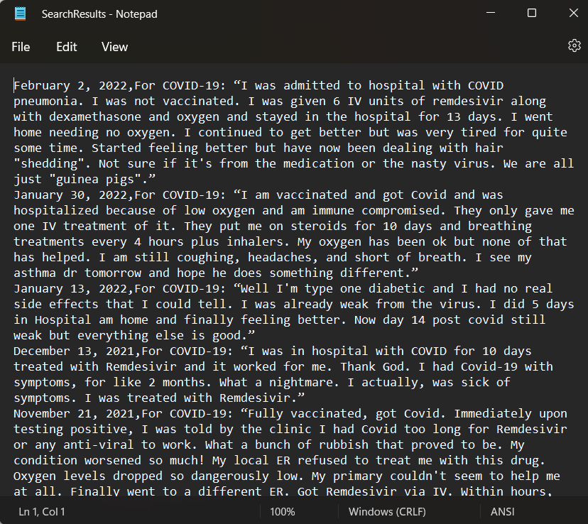
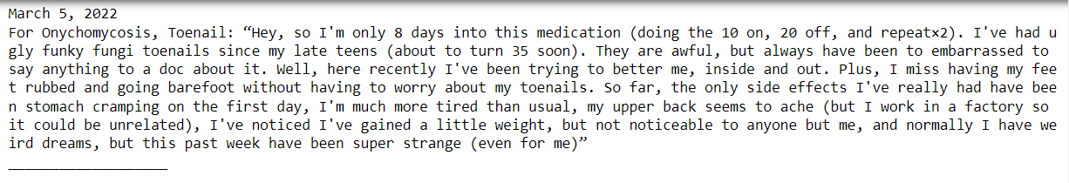
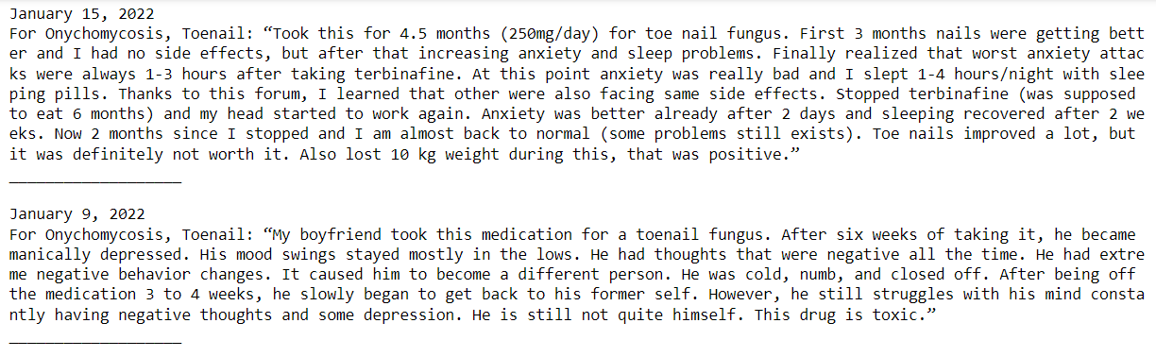
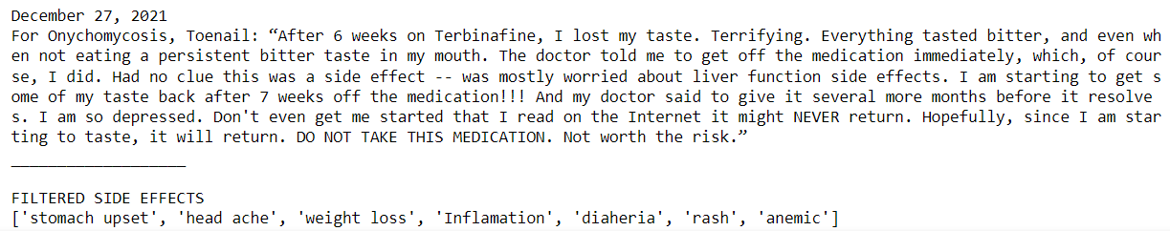
PORJECT OUTPUT
Reference Medicine : Terbinafine
Last Searched Date Kept as : December 10, 2021
Number Of Filtered Results : 4
Output File name : Searchresultes.csv
Project Source Code Github link: https://github.com/MuthuganeshKJ/Web-Scraper-For-Regulatory-Intelligence

Slide 8
Thank You
Project By J.Muthuanesh , project trainee Navital LLP. Under guidance of Mr.Alagappan, project manager Navitas LLP. mail id: kjmuthuganesh@gmail.com Ph no. +91 8248814647

