Slide 1
AI Recruitment Agent
An MCP-Based Recruitment System with AI-Driven Candidate
Matching, Ranking & Shortlisting
Project Understanding & Initial Implementation
Muthukrishnan • Monday, 31 August 2026

Slide 2
Project Objective
Build a working, end-to-end AI recruitment system: a recruiter describes who
they need in plain English, and the system finds, scores, ranks, and shortlists
real candidates — through an authenticated, audited tool layer.
1
Candidate & Job Management
Manage
Structured profiles and requisitions backing every match
Expose via MCP
2
MCP Server + Gateway
Recruitment tools exposed via MCP, guarded by auth & RBAC
Orchestrate
3
AI Agent Orchestration
Match & Rank
Claude interprets the request and drives the tool chain
4
Matching, Ranking & Shortlisting
Transparent, explainable scoring — not a black box

Slide 3
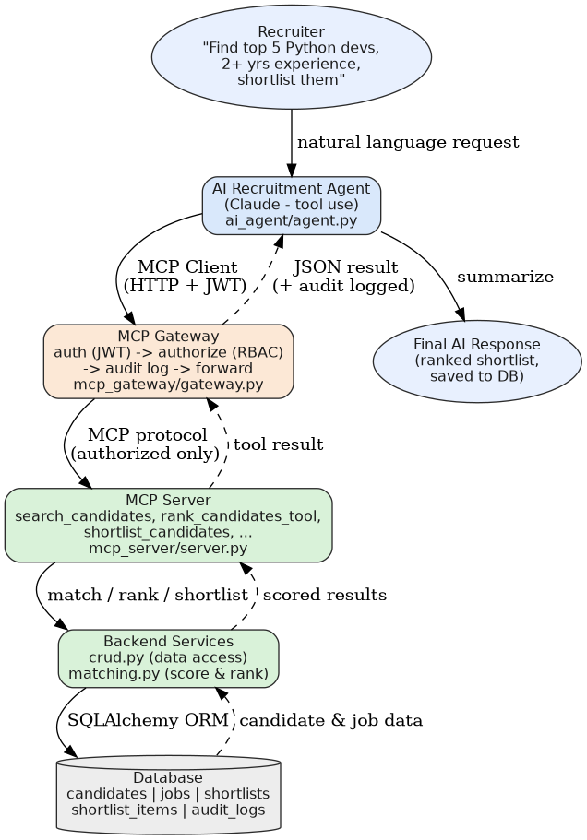
Proposed Architecture
Recruiter Request → AI Agent → MCP Client → MCP Gateway → MCP Tools → Backend → Database → Matching → Ranking → Shortlisting
Every arrow between the Gateway and everything below it is
authenticated, authorized by role, and logged to an audit trail.
The AI agent and a human-facing REST API
share one backend — matching logic never diverges.

Slide 4
Technology Stack
Backend
Database
Python, FastAPI, SQLAlchemy
SQLite (demo) → PostgreSQL / Supabase
MCP Layer
Auth & Security
Official mcp Python SDK (FastMCP), Streamable HTTP
JWT (python-jose), role-based authorization
AI Agent
Testing
Anthropic Claude — tool-use / function calling
pytest (matching engine, API, auth/RBAC)

Slide 5
MCP Server, Gateway & AI Agent — How They Fit Together
AI Agent
Understands the recruiter's request with Claude, decides which
tools to call, and summarizes the final result.
MCP Gateway
Authenticates every caller (JWT), checks their role against an
allow-list per tool, logs the call, then forwards it.
MCP Server
Exposes recruitment operations as MCP tools — search, rank,
shortlist — backed by the same logic as the REST API.

Slide 6
Example: End-to-End Workflow
“Find the top 5 Python developers with at least 2 years of experience and shortlist them.”
1
Agent parses the request → required_skills=[python], min_experience=2.0, top_k=5
2
Agent calls rank_candidates_tool via the MCP Gateway (as recruiter1)
3
Gateway authenticates the JWT, checks the role may call this tool, logs the call
4
MCP Server scores every candidate: skill overlap + experience fit → explainable score
5
Agent calls shortlist_candidates — the ranked result is persisted to the database
6
Agent returns a clear summary: names, scores, and why each candidate matched

Slide 7
Progress So Far
Implemented, running, and covered by 17 passing automated tests.
✓
Database models: candidates, jobs, shortlists, audit logs
✓
Candidate & Job Management REST API with validation + error handling
✓
Explainable matching & ranking engine (skill overlap + experience fit)
✓
MCP Server exposing 10 recruitment tools (FastMCP)
✓
MCP Gateway: JWT auth, role-based authorization, audit logging
✓
AI Agent: Claude tool-use loop driving the full pipeline
✓
17 automated tests: matching logic, REST API, auth/RBAC
✓
Git repository initialized with structured commit history

Slide 8
Timeline & Next Steps
1
Mon 31 Aug
2
Wed 2 Sep
3
Sat 5 Sep
Today
Review 1
Final
Architecture, stack, and initial working modules presented
MCP tools, backend/API, DB, AI agent flow, matching — live demo
Full testing, documentation, GitHub repo, architecture diagram, final demo

Slide 9
Thank You
Questions & Discussion
github.com/Muthukrishnan-sketch/recruitment-mcp-agent

