Slide 1
Generating Short Description of Videos
Karthikk Tamilmani
Thanigaiselvan Senthil Shanmugam
Muthukumar Rajendran
Srikrishna Sasidharan

Slide 2
Data Extraction
Extracted the subtitles from youtube videos and also the summary of those videos.
No punctuations in the YouTube subtitles
Found libraries – deepcorrect and punctuator to add punctuations to the dataset.
Extracted Short description/Summary did not meet the standard to be as “Golden Summary”
The summary in the videos was not enough and sometimes was a mere sentence.

Slide 3
Finding Dataset
Found BBC dataset which had both summary and article
Dataset had only 2000 records which held us from generating abstractive text summarization

Slide 4
Techniques Used – Extractive Text Summarization
TF-IDF SentenceRanking
Glove/Fasttext vector and SIF
Skip-thought vectors
Universal sentence encoder

Slide 5
TF-IDF Sentence Ranking
TF-IDF, short for term frequency–inverse document frequency, is a numeric measure that is used to score the importance of a word in a document based on how often did it appear in that document and a given collection of documents.
Sentence will be sorted based on the TF-IDF
Based on the value of information that has to be retained, the summarization length is defined. Optimal value is for 80 percent.
Sentences with high rank will be used for summarization
Notes:
Pre-processing - Removal of special character, digits and one letter words, stop words.
Calculate the frequency of each word. this is performed in the preprocessed data.
Calculate the sentence score using the TF-IDF.

Slide 6
Glove/ FastText and SIF
Glove word embedding- “Glove uses both Global and local statistics to obtain word vectors”.
FastText(by Facebook)- “n-grams of each word is feed into NN to avoid situations when no matching word vectors”.
SIF (smooth inverse frequency weighted continuous bag-of-words model of a sentence).
Cosine similarity is calculated based on SIF calculated for each sentence.
Notes:
Glove-(unlike Word2Vec, Glove doesn’t rely just on local context information i.e. semantics of a word is affected by only surrounding words in Word2Vec whereas Glove uses both local and global statistics to compute vectors for given word)
FastText feeds n-grams(ignoring starting and ending boundaries of a word). (Note: This helps identifying even rare words since it uses only n-gram vectors. Works even for unknown words.)
is an extension to Word2Vec approach instead of feeding words into the neural networks,

Slide 7
Skip-Thought Vectors and K-Means Clustering
NLTK Sentence tokenizer was used to tokenise the article based on sentence.
Skip-Thought is used to embed sentence into a fixed-dimensional vector.
Skip-Thought model encodes similar sentence in the nearby vector space and K-means cluster is used to group the related sentence.

Slide 8
Universal Sentence Encoder
Multi-task learning model
Understands the literal meaning of the word and embeds them.
State of the art model
PageRank algorithm

Slide 9
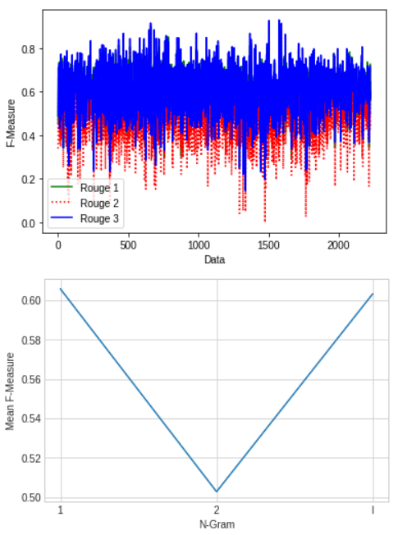
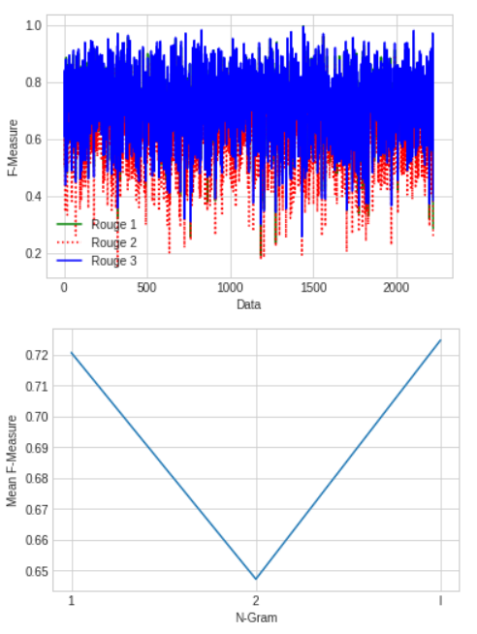
TF-IDF
Universal sentence encoder
Performance Comparison

Slide 10
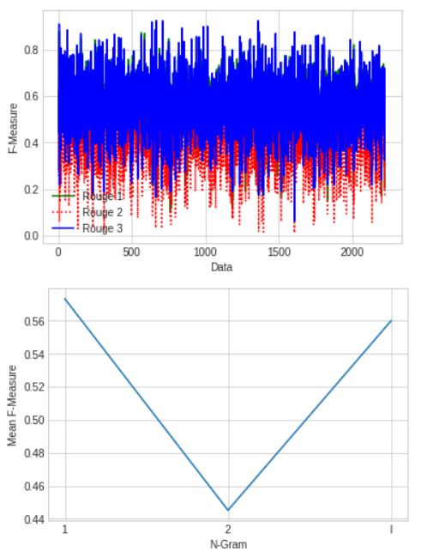
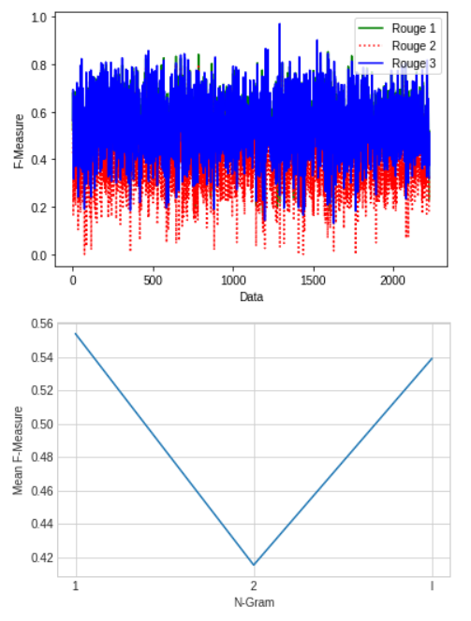
Skip-Thought
Glove/ FastText
Performance Comparison

Slide 11
Thank You

