Slide 1
Credit-card-Fraud-Detection
CAPSTONE PROJECT
Presented By:
1. MUTHUKUMAR.M - CARE College of Engineering –Mechanical Engineering .

Slide 2
OUTLINE
Problem Statement
Proposed System/Solution
System Development Approach
Algorithm & Deployment
Result
Conclusion
Future Scope
References

Slide 3
Problem Statement
The prevalence of credit card fraud poses a significant challenge to financial institutions and consumers alike. Fraudulent activities, such as unauthorized transactions and identity theft, not only lead to financial losses but also erode trust in the financial system. Detecting and preventing credit card fraud in real-time is crucial to mitigate its adverse effects.
The objective of this project is to design and implement a robust Credit Card Fraud Detection system named Cerid that can effectively detect and mitigate fraudulent activities in credit card transactions. The system should be capable of analyzing large volumes of transaction data and accurately identifying suspicious patterns indicative of fraud while minimizing false positives.

Slide 4
Proposed Solution
1. Data understanding and exploring 2. Data cleaning • Handling missing values 3. Exploratory data analysis • Univariate analysis • Bivariate analysis 4. Prepare the data for modelling • Check the skewness of the data and mitigate it for fair analysis 5. Split the data into train and test set • Scale the data (normalization)

Slide 5
System Approach
Continuous Monitoring and Improvement: Monitor the performance of deployed models in real-time and collect feedback on their effectiveness in detecting fraud. Collaboration and Information Sharing: Collaborate with other financial institutions, regulatory agencies, and industry partners to share insights and best practices for fraud detection and prevention. Participate in fraud detection networks and consortiums to leverage collective intelligence and enhance the effectiveness of fraud detection efforts across the industry. Systematic approach, financial institutions and credit card issuers can develop robust fraud detection systems that effectively identify and mitigate fraudulent activities, thereby safeguarding the interests of cardholders and maintaining trust in the financial ecosystem.

Slide 6
Algorithm & Deployment
Local Outlier Factor The Local Outlier Factor or LOF algorithm is an unsupervised anomaly detection method. It computes the local deviation of a given a data point with respect to its neighbors. Local Outlier Factor considers as outliers the samples that have a substantially lower density than their neighbors. Isolation Forest Algorithm The Isolation Forest ‘isolates’ observations by randomly selecting a feature and then randomly selecting a split value between the maximum and minimum values of the selected feature. Since recursive partitioning can be represented by a tree structure, the number of splitting required to isolate a sample is equivalent to the path length from the root node to the terminating node. This path length, averaged over a forest of such random trees, is a measure of normality and our decision function. Random partitioning produces noticeably shorter paths for anomalies. Hence, when a forest of random trees collectively produce shorter path lengths for particular samples, they are highly likely to be anoma.

Slide 7
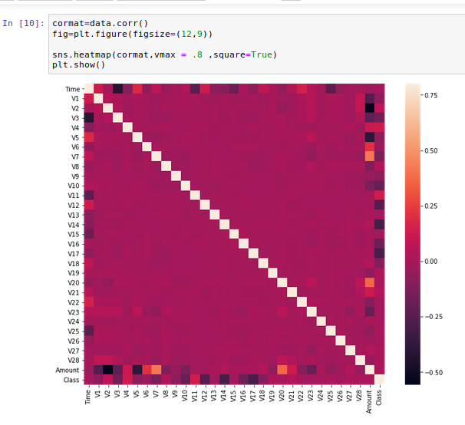
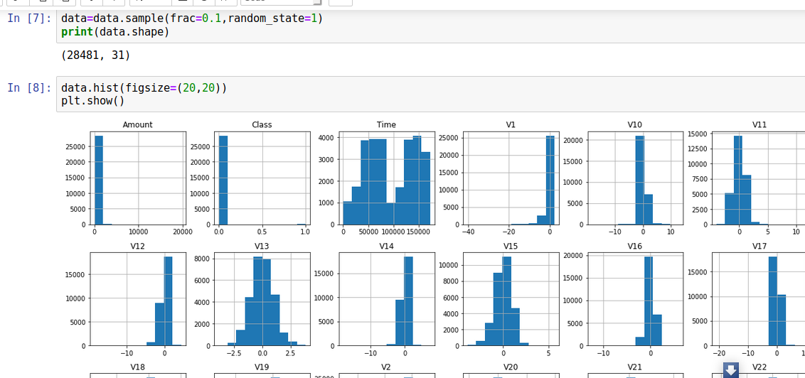
Result

Slide 8
Conclusion
In conclusion, Credit card fraud poses a significant threat to both financial institutions and cardholders. A well-designed credit card fraud detection system, built on a system approach, can significantly reduce financial losses and enhance security.

Slide 9
Future scope
The fight against credit card fraud is an ongoing battle, requiring continuous innovation and adaptation. The fight against credit card fraud is an ongoing battle, requiring continuous innovation and adaptation. Here are some exciting possibilities for the future of credit card fraud detection Advanced Machine Learning Techniques Unsupervised Learning Approaches Explainable AI (XAI)

Slide 10
References
Visit https://www.irjet.net/archives/V5/i11/IRJET-V5I11304.pdf
Visit https://acadpubl.eu/jsi/2018-118-7-9/articles/7/31.pdf
Visit https://arxiv.org/pdf/1811.02196.pdf
Visit https://towardsdatascience.com/anomaly-detection-with-isolation-forest-visualization-23cd75c281e2

Slide 11
THANK YOU

