Slide 1

DATA SCIENCE · TECHNICAL ASSIGNMENT
Royal Enfield App Review Analysis
L1/L2 User Intent Analysis · NLP Pipeline · 2,543 Reviews
Muthukumaran P
Data Scientist
@
muthuwr1998@gmail.com
P
+91 80562 15416
ROYAL ENFIELD
GH
github.com/Muthukumaran2098
Since 1901 · Pure Motorcycling
in
linkedin.com/in/muthukumaran98
April 2026

Slide 2
Royal Enfield App Review Analysis
Understanding User Intent through NLP | Data Science Technical Assignment
Manual sampling of reviews before building the classifier revealed a clear pattern: buffering service bookings, OTP failures, and unresolved complaints repeating across 4 years. This pipeline converts that signal into a data-driven, prioritised product roadmap.
THE PROBLEM
MY APPROACH
Context: Royal Enfield's RE-Prime app has 2,500+ reviews spanning 4 years — users flagging crashes, OTP failures, and unresolved service complaints. At this volume, critical signals get buried in noise. No team can manually read, categorize, and prioritize this feedback at scale — a structured NLP pipeline is the only practical solution
01
Scrape
google-play-scraper — chosen for its reliable pagination via continuation tokens, built-in rate limiting to avoid Play Store throttling, and review-level deduplication to ensure clean, unique data. Targets India region specifically since RE-Prime's primary user base is domestic.
Goal: Extracting structured L1 (topic) + L2 (business impact) intent from unstructured reviews — moving beyond star ratings to understand what users are frustrated about and why it matters to the business. The output is a prioritized, evidence-backed list that maps directly to engineering and product decisions
02
Classify
Keyword NLP assigns each review an L1 topic — chosen for its interpretability and zero infrastructure overhead, with the architecture designed to swap in a fine-tuned BERT model in production. L2 business impact is derived via rule mapping, translating topics directly into consequences the business cares about — retention, revenue, trust.
Outcome: Translating raw reviews into a data-driven, prioritised product roadmap — each issue scored P0 to P3 based on frequency and business impact. Product and engineering teams get a clear, ranked action list they can take straight into planning, without reading a single review manually.
03
Prioritize
L1 Intent (What)
L2 Impact (Why it matters)
Issues scored by Frequency (60%) + Impact (40%) — weighted because a problem affecting many users moderately outranks one affecting few users severely. Output maps directly to P0–P3 sprint priorities
Performance Bugs UI/UX Support
Security Billing Features
User Retention Brand Trust
Engagement Revenue Roadmap
KEY ASSUMPTIONS
04
Recommend
Scope: English-language reviews, India Play Store (en_IN), sorted newest-first Data: 3,000 reviews requested, 2,543 retained after dedup & length filter NLP: Keyword classifier chosen for POC — interpretable, fast, no GPU. Designed to upgrade to DistilBERT in production.
Findings translated into concrete action items — each tied to real review volume, verbatim user quotes as evidence, and a clear timeline. Paired with a scaling roadmap that takes this POC to a production-grade, real-time monitoring pipeline
Tech Stack: google-play-scraper > Keyword NLP (BERT-ready) > pandas / numpy > matplotlib / seaborn > pptxgenjs

Slide 3
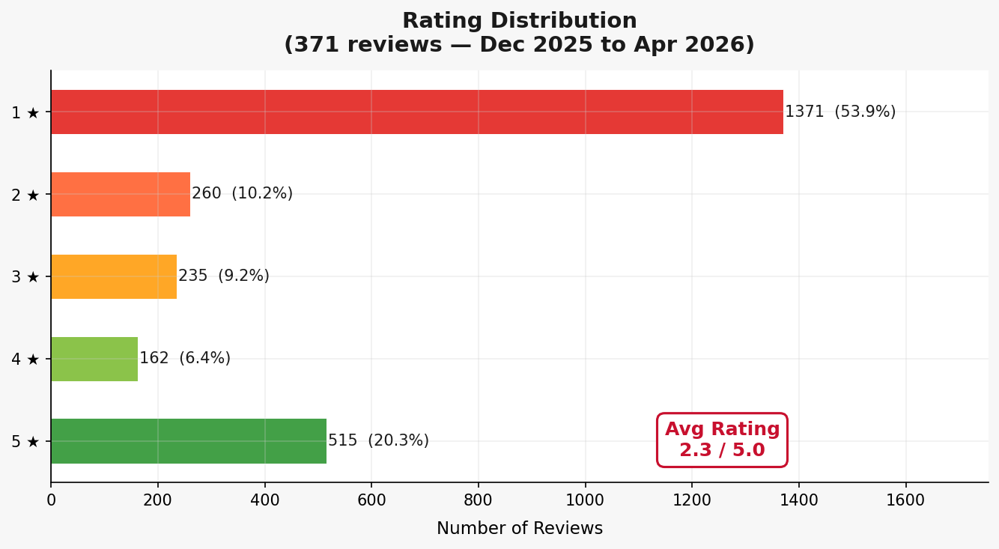
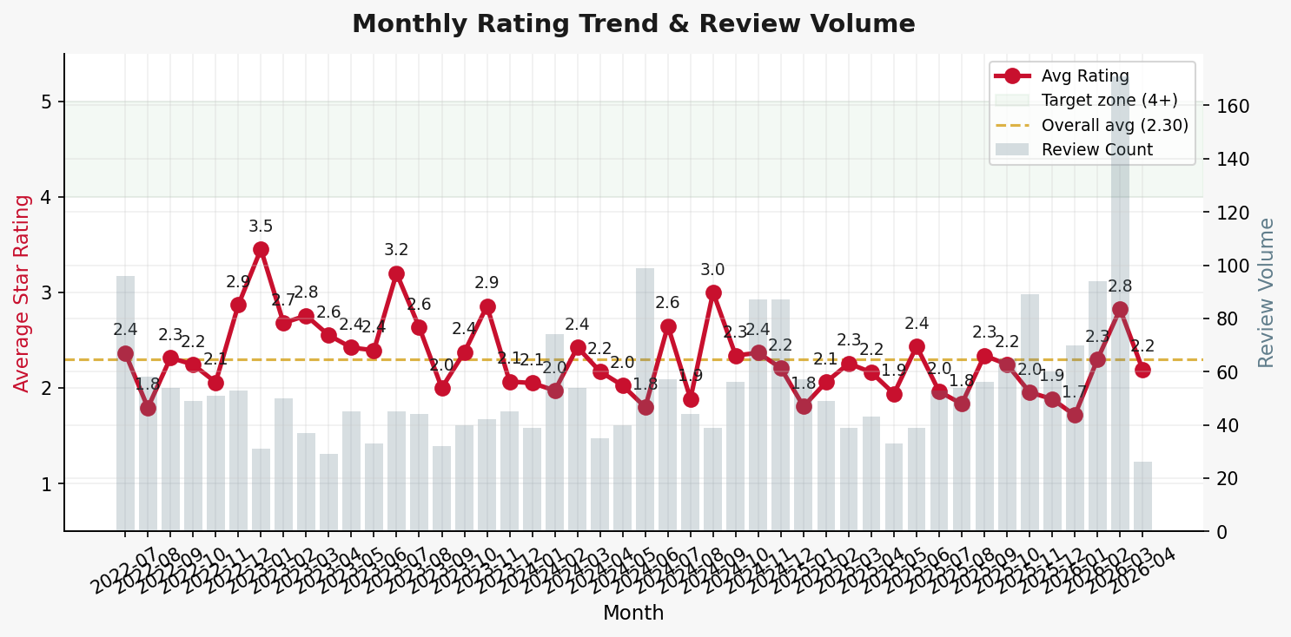
Data Overview — 2,543 Real Reviews (Jul 2022 to Apr 2026)
2,543
2.29 / 5.0
64%
4 Years
Total Reviews Scraped
Average Star Rating
Negative Sentiment
Data Coverage
With a 2.29 average rating and 1-star reviews at 53.9%, this isn't a vocal minority — it's sustained frustration spanning 4 years of app updates. The monthly trend chart (right) shows the rating has rarely crossed 3★ for any sustained period, and review volume spikes after major releases — suggesting updates are actively triggering new complaints rather than resolving existing ones. This is a systemic signal, not a temporary dip.

Slide 4
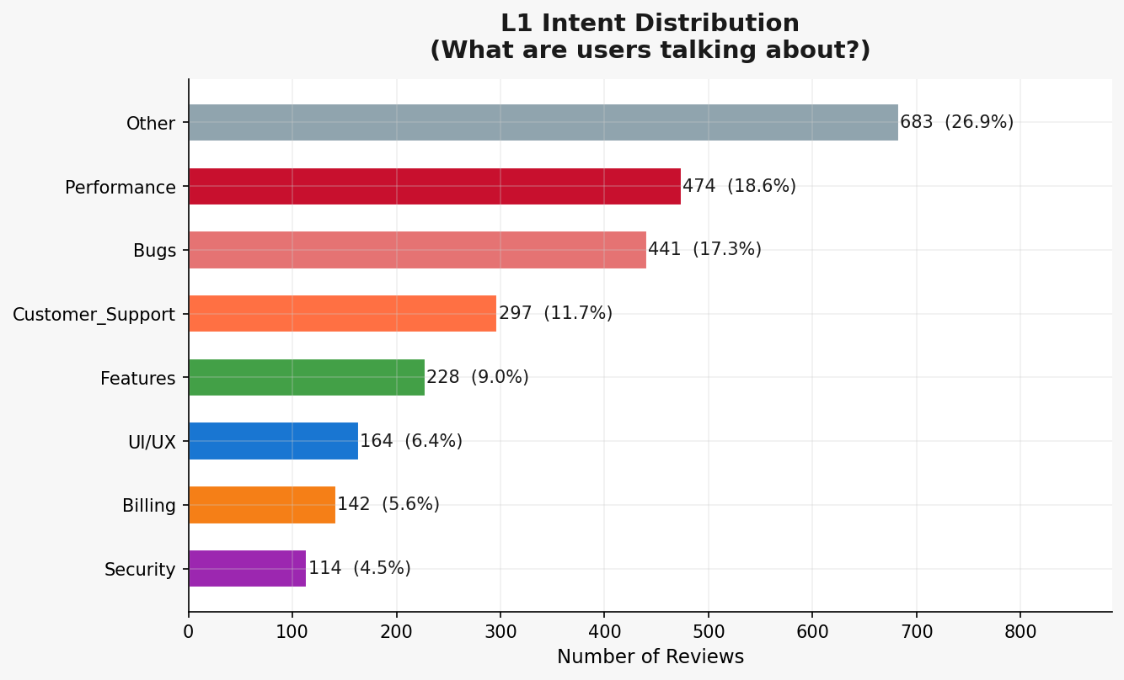
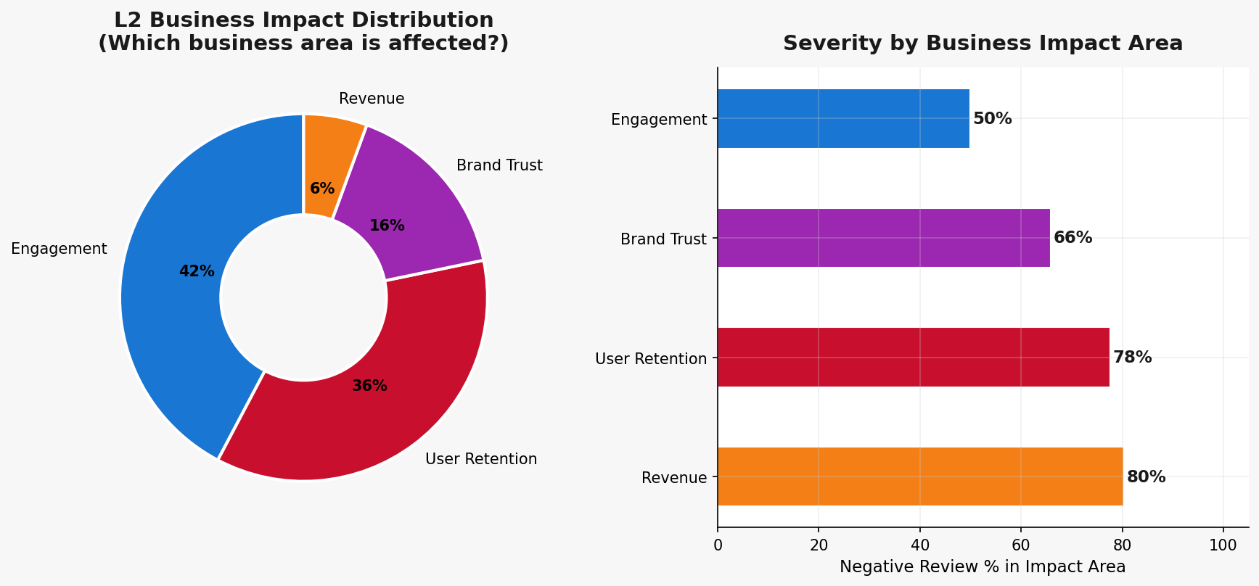
User Intent Analysis — L1 Topics & L2 Business Impact
L1 Topic | Negative % | L2 Business Impact | Severity
Performance | 79% | User Retention | CRITICAL
Bugs | 76% | User Retention | CRITICAL
Customer Support | 63% | Brand Trust | HIGH
Features (Strength) | 59% | Engagement | OPPORTUNITY
Pain: Performance (79% neg) + Bugs (76% neg) together account for 35.9% of all reviews — and it's the same complaints (buffering, login failures, firmware sync errors) repeating across multiple app versions. This is a systemic engineering issue, not a one-off regression. Direct churn risk.
Strength: 26.6% of users (4-5★) explicitly cite the bike configurator, service booking concept, and the RE community — proving the core product idea resonates when it actually works. That's a retention asset worth protecting while the fundamentals get fixed.

Slide 5
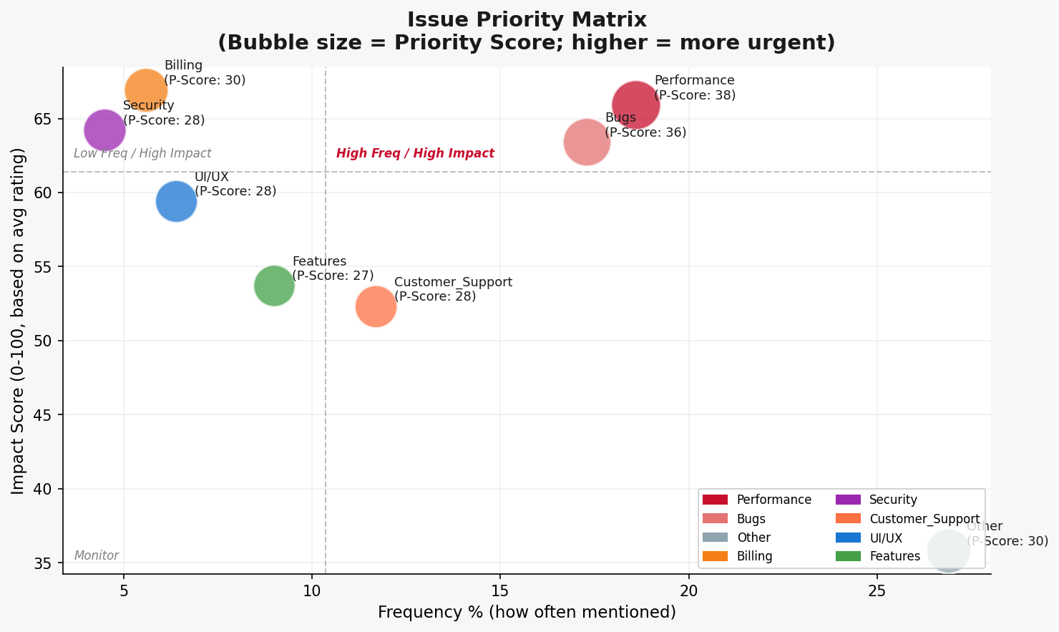
Issue Prioritization — What to Fix First
Priority score = Frequency% × 0.6 + Impact × 0.4 — mirrors RICE scoring used in product management. A crash affecting 18.6% of users at avg 1.70★ outranks a UI complaint at 6% with 2.03★, even if both are negative. Bubble size reflects review count; anything top-left needs immediate attention.
TOP PAIN POINTS (by Priority Score)
VERBATIM USER FEEDBACK
Topic | Frequency | Avg Rating | L2 Impact
Performance | 18.6% | 1.70 | User Retention
Bugs | 17.3% | 1.83 | User Retention
Customer Support | 11.7% | 2.39 | Brand Trust
Billing | 5.6% | 1.65 | Revenue
Security | 4.5% | 1.79 | Brand Trust
1*
"Third class app! I'm never able to book service through ur app. It just keeps buffering."
1*
"Unauthorised changing of the slot time by showroom people. No use of app when service centres can change it."
1*
"One of the worst app ever used. It always fails to fetch the latest firmware details."

Slide 6
Actionable Recommendations & Production Architecture
DATA-DRIVEN RECOMMENDATIONS
SCALING TO PRODUCTION
P0
The app fails at its most basic functions — users can't log in, book a service, or even open the app without crashing or buffering. Highest review volume, lowest average rating. Every day unfixed is a user lost.
Affects 18.6% of users (474 reviews) | Avg 1.70* | Impact: User Retention
Phase 1
Data Infrastructure
Week 1-2
Airflow DAG for daily scraping
Cloud storage (S3/GCS) + multi-region support
Data validation & deduplication pipeline
Immediate
P1
Core app workflows are broken — firmware updates fail to sync, OTPs don't arrive or expire before use, and sessions time out mid-action. Users are actively trying to engage with the app and being blocked at every step. Directly erodes trust and drives negative reviews.
Bugs = 17.3% of reviews (441), avg 1.83* | Impact: User Retention
4 Weeks
Phase 2
ML Upgrade
Week 3-4
Fine-tune DistilBERT for L1/L2 classification
Target 90%+ accuracy (vs 75% keyword baseline)
CPU-deployable model serving via FastAPI
P2
Users complain but hear nothing back — no ticket, no status, no resolution. The absence of an in-app complaint tracker means every support issue becomes a 1-star review. Improving support visibility directly reduces avoidable negative ratings and strengthens brand trust.
Customer Support: 11.7% (297 reviews), 63% negative | Brand Trust
Backlog
Phase 3
Insights Platform
Week 5-8
Live Streamlit / Superset dashboard
Slack/email alerts on P0 review spikes
PM feedback loop & roadmap integration
P3
The bike configurator, trip planning, and community features are what loyal users actually love — cited positively across 4-5 star reviews. These aren't urgent fixes but active growth levers. Investing here converts satisfied users into advocates.
Features: 9.0% of reviews, avg 2.32* | Engagement opportunity
Monitor
These recommendations aren't speculative — the P0 items (crashes, booking failures) directly address the single most-cited complaints across 2,543 reviews. The 3-phase roadmap upgrades this keyword POC (~75% accuracy) into a real-time monitoring system, so product teams catch P0 spikes before they surface as a visible rating drop on the Play Store.

Slide 7
Source Code & Dataset
Full pipeline — from web scraping to prioritised recommendations
GitHub Repository
https://github.com/Muthukumaran2098/royal-enfield-review-analysis
WHAT'S INSIDE
📓
Royal_Enfield_Review_Analysis.ipynb
🐍
Project/ (pipeline scripts)
End-to-end notebook: scraping → NLP → visualisations
classifier.py · analyzer.py · visualizations.py · main.py
📊
reviews_raw.csv
📈
outputs/charts/ & .pptx
2,543 real Play Store reviews (Jul 2022 – Apr 2026)
6 publication-ready charts + this presentation
pip install -r requirements.txt → python main.py → All analysis reproduced in minutes

