Slide 1



Design and Analysis of Algorithm
18AMC211T
Maximum Bipartite Matching
and Maximum Flow
By
K.Harish (927622BAL014)
D.S.Karpaga sivaraman (927622BAL021)
K.Muthukumar (927622BAL028)
S.Muthuram (927622BAL029)
Guided by,
Mrs.P.Vidhya

Slide 2
Maximum Bipartite Matching
A matching in a Bipartite Graph is a set of the edges chosen in such a way that no two edges share an endpoint.
A maximum matching is a matching of maximum size (maximum number of edges).
In a maximum matching, if any edge is added to it, it is no longer a matching.

Slide 3
For example, consider the following problem:
“There are M job applicants and N jobs. Each applicant has a subset of jobs that he/she is interested in. Each job opening can only accept one applicant and a job applicant can be appointed for only one job. Find an assignment of jobs to applicants in such that as many applicants as possible get jobs.”

Slide 4
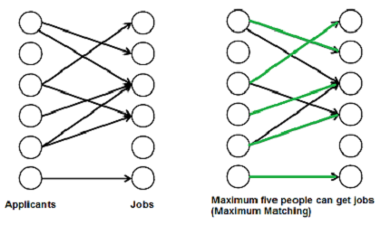

Slide 5
Advantages:
The max flow problem is a flexible and powerful modeling tool that can be used to represent a wide variety of real-world situations.
The Ford-Fulkerson and Edmonds-Karp algorithms are both guaranteed to find the maximum flow in a graph, and can be implemented efficiently for most practical cases.
The max flow problem has many interesting theoretical properties and connections to other areas of mathematics, such as linear programming and combinatorial optimization.

Slide 6
Disadvantages:
In some cases, the max flow problem can be difficult to solve efficiently, especially if the graph is very large or has complex capacity constraints.
The max flow problem may not always provide a unique or globally optimal solution, depending on the specific problem instance and algorithm used.

Slide 7
Real life applications using maximum flow problem
In many fields, there exist various crucial applications that can be handled as maximum flow problems.
Examples are:
electrical power
airline scheduling
communication networks
computer sciences

Slide 8
The Maximum flow problem

Slide 9
The Maximum flow problem
The Maximum Flow Problem is a classic problem in graph theory and network optimization.
It seeks to determine the maximum amount of flow that can be sent from a source node to a sink node in a flow network.
A flow network consists of nodes (representing entities such as cities, routers, or junctions) connected by edges (representing paths or channels) with capacities indicating the maximum amount of flow that can pass through them.

Slide 10

Source and Sink : There is a designated source node and a designated sink node.
Capacities : Each edge in the network has a capacity, indicating the maximum amount of flow that can traverse that edge.
Flow : Flow is the amount of material (such as water, data packets, or vehicles) that is sent through the network.
Objective : The objective is to find the maximum possible flow from the source to the sink without violating the capacity constraints on the edges.

Slide 11
The Ford Fulkerson Method
The Ford Fulkerson method, also known as ‘augmenting path algorithm’ is an effective approach to solve the maximum flow problem. The Ford Fulkerson method depends on two main concepts and they are,
Residual Network
Augmenting paths

Slide 12
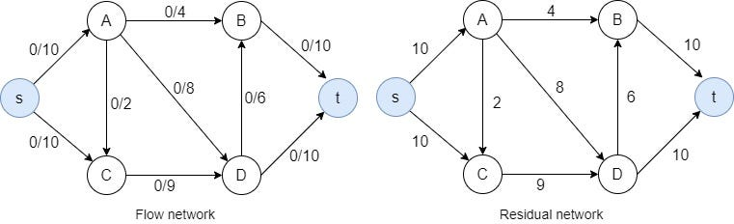
Problem Statement
Step 1: set the flow of every edge to 0

Slide 13
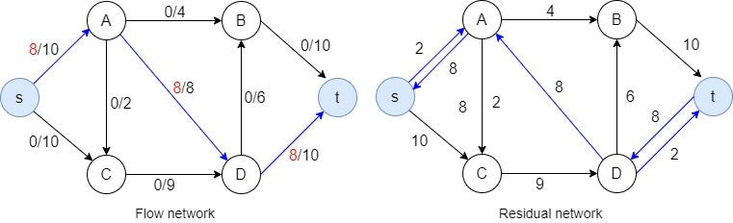
Step 2: Now, find an augmenting path in the residual network. Here, I select the path s -> A -> D -> t. Then we have to identify the bottleneck capacity (i.e. maximum flow for that path) for the selected path.

Slide 14
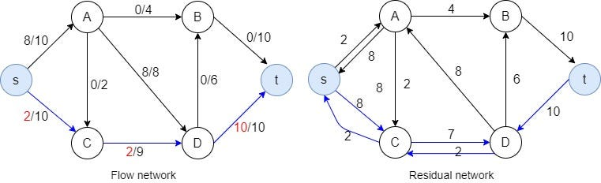
Step 3: Then I select the augmenting path s -> C -> D -> t. Now the bottleneck capacity is 2.

Slide 15
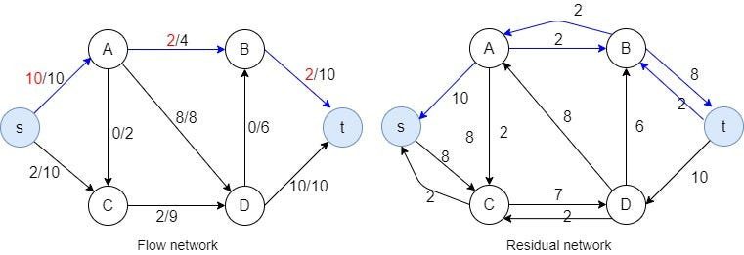
Step 4: The augmenting path s -> A -> B->t, the bottleneck capacity is 2.

Slide 16
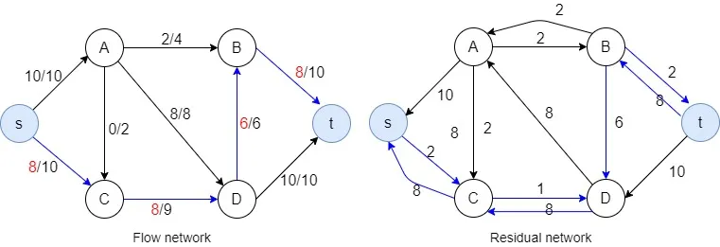
Step 5: augmenting path s -> C -> D -> B->t, the bottleneck capacity

Slide 17
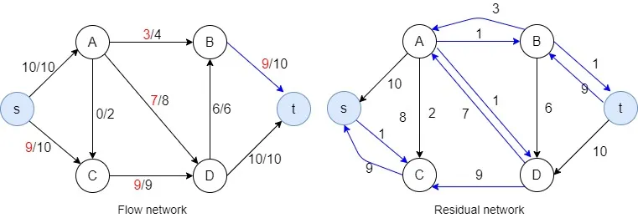
Step 6: augmenting path s -> C -> D -> A-> B->t, bottleneck capacity is 1.

Slide 18
Advantages
Versatility : Widely applicable across various fields.
Optimization : Efficient resource allocation.
Algorithmic Solutions : Well-established, efficient algorithms.
Flexibility : Adaptable to different constraints and variations.

Slide 19
Disadvantages
Complexity : NP-hard, computationally intensive.
Sensitivity to Inputs : Solutions can be sensitive to changes.
Memory and Runtime Requirements : High resource demands.
Not Always Applicable : May not capture all real-world complexities.

Slide 20
Applications
Transportation Networks : Optimizing traffic flow in road networks, airline routes, or railway systems to maximize throughput and minimize congestion.
Telecommunications : Managing data flow in communication networks, such as the internet or cellular networks, to ensure efficient data transmission and resource utilization.
Game Theory : Analyzing flow networks in economic or strategic games to model resource allocation, competition, and cooperation among players
Social Networks : Analyzing information flow in social networks, studying the spread of information, influence, or diseases, and identifying key influencers or critical nodes.

Slide 21
Thank you

