Slide 1




Predictive Analysis of Housing Prices Using Linear Regression Models
TEAM MEMBERS:
DIVYA DHARISHINI K M[ 927622BAL009]
MUTHUKUMAR K [ 927622BAL028]
RAMANA M [ 927622BAL038]

Slide 2
PROBLEM STATMENT
In the realm of real estate, predicting housing prices accurately is crucial for both buyers and sellers. However, this task is often complex due to many factors influencing housing prices.
To address this challenge, a predictive analysis using linear regression models can be employed.
The goal of this project is to develop a model that can predict housing prices based on various features such as location, size, number of rooms, and other relevant factors.
This model will help stakeholders make informed decisions about buying or selling properties by providing them with reliable price predictions.

Slide 3
ABSTRACTION
This project aims to develop a predictive model for housing prices using linear regression analysis. With the real estate market's complexity, accurate price prediction is crucial for informed decision-making.The model will utilize features like location, size, and number of rooms to provide reliable price estimates. This study can benefit buyers and sellers by offering insights for property transactions.

Slide 4
PROPOSED SOLUTION : Algorithm:
Data Collection:
Gather a dataset containing housing-related features (e.g., size, location, number of rooms, etc.) and corresponding prices.
Data Preprocessing:
Handle missing values by imputation or removal.
Encode categorical variables (e.g., location) into numerical values using techniques like one-hot encoding.
Split the dataset into training and testing sets.
Model Selection and Training:
Choose a linear regression model (e.g., ordinary least squares, ridge regression, lasso regression).
Train the model on the training dataset.

Slide 5
Model Evaluation:
Use the trained model to make predictions on the testing dataset.Evaluate the model's performance using metrics like mean squared error (MSE), root mean squared error (RMSE), and R-squared.
Model Tuning (Optional):
Perform hyperparameter tuning using techniques like grid search or randomized search to improve model performance.
Prediction:
Use the trained model to predict housing prices for new data.
Visualization:
Visualize the given predication and the tested datasets variance.

Slide 6
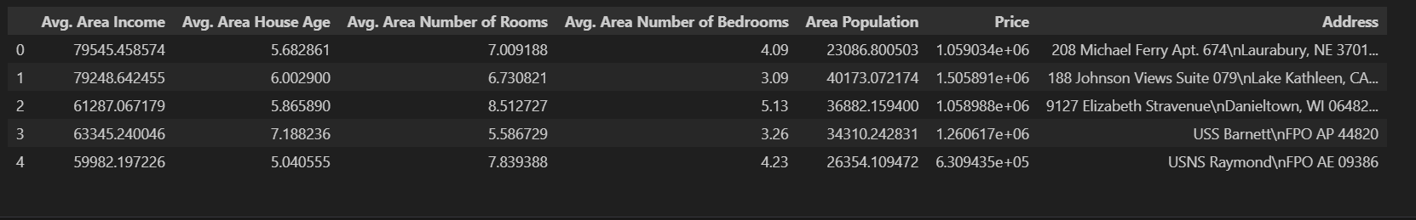
DATASET
Dataset:
Independent Value:
['Avg. Area Income', 'Avg. Area House Age', 'Avg. Area Number of Rooms',
'Avg. Area Number of Bedrooms', 'Area Population']
Dependent value:
['Price']

Slide 7
PRE-PROCESSING
import pandas as pd
from sklearn.model_selection import train_test_split
from sklearn.preprocessing import StandardScaler
X = df[['Avg. Area Income', 'Avg. Area House Age', 'Avg. Area Number of Rooms', 'Avg. Area Number of Bedrooms', 'Area Population']]
y = df['Price']
X = pd.get_dummies(X, columns=['Area Population'])
scaler = StandardScaler()
X_scaled = scaler.fit_transform(X)
# Split the data into training and testing sets
X_train, X_test, y_train, y_test = train_test_split(X_scaled, y, test_size=0.2, random_state=42)

Slide 8
PROJECT CODE
import pandas as pd
import numpy as np
import seaborn as sns
import matplotlib.pyplot as plt
%matplotlib inline
HouseDF = pd.read_csv('USA_Housing.csv')
HouseDF.head()
HouseDF.info()
HouseDF.describe()
HouseDF.columns
sns.pairplot(HouseDF)
sns.distplot(HouseDF['Price'])
sns.heatmap(HouseDF.corr(), annot=True)
X = HouseDF[['Avg. Area Income', 'Avg. Area House Age', 'Avg. Area Number of Rooms',
'Avg. Area Number of Bedrooms', 'Area Population']]

Slide 9
Cont…
y = HouseDF['Price']
from sklearn.model_selection import train_test_split
from sklearn.linear_model import LinearRegression
lm = LinearRegression()
lm.fit(X_train,y_train)
print(lm.intercept_)
coeff_df = pd.DataFrame(lm.coef_,X.columns,columns=['Coefficient'])
coeff_df
predictions = lm.predict(X_test)
plt.scatter(y_test,predictions)
sns.distplot((y_test-predictions),bins=50);
from sklearn import metrics
print('MAE:', metrics.mean_absolute_error(y_test, predictions))
print('MSE:', metrics.mean_squared_error(y_test, predictions))
print('RMSE:', np.sqrt(metrics.mean_squared_error(y_test, predictions)))

Slide 10
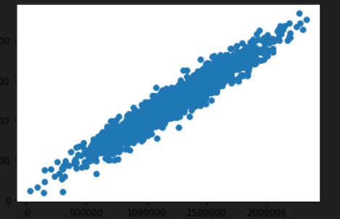
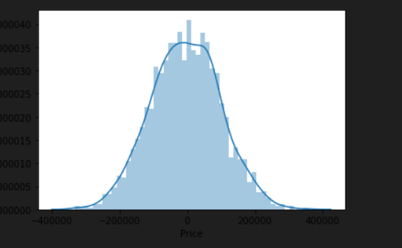
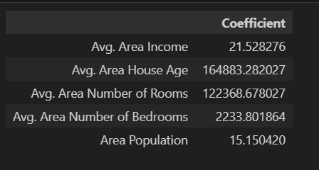
OUTPUT

