Slide 1



Use case presentation
Machine learning algorithm
18AMC208T
By
A.K.Monish (927622BAL026)
M.E.Mouli (927622BAL027)
K.Muthukumar(927622BAL028)
S.Muthuram (927622BAL029)
A.S.Muthuvel (927622BAL030)

Slide 2
STOCK MARKET PREDICTION USING MACHINE LEARNING

Slide 3
INTRODUCTION
Stock market prediction refers to the process of forecasting the future movements of stock prices or market trends based on historical data, statistical analysis, and various algorithms.
It's a crucial aspect of financial analysis and investment strategy, as accurate predictions can help investors make informed decisions about buying, selling, or holding stocks.

Slide 4
Importance of Predicting Stock Market Trends:
Risk Management
Maximizing Returns
Strategic Planning
Competitive Advantage
Investor Confidence

Slide 5
HISTORICAL DATA ANALYSIS
Historical data analysis is the process of examining and interpreting past data to extract insights, identify patterns, and make informed decisions. Here's an overview of historical data analysis covering its importance, methods, and applications

Slide 6
Importance of Historical Data Analysis:
Trend Identification: Historical data analysis helps in identifying trends and patterns over time, which is crucial for understanding market dynamics, consumer behavior, and business performance.
Performance Evaluation: Analyzing historical data allows businesses to assess their past performance, measure key metrics, and identify areas of improvement or success.
Risk Assessment: Historical data analysis is used in risk management to assess historical trends, identify potential risks, a nd develop strategies to mitigate them.

Slide 7
Methods of Historical Data Analysis:
Descriptive Statistics: Descriptive statistics such as mean, median, mode, standard deviation, and percentiles are used to summarize and describe historical data sets.
Time Series Analysis: Time series analysis involves studying data points collected over time to identify patterns, trends, seasonality, and anomalies. Methods like moving averages, exponential smoothing, and autocorrelation are commonly used in time series analysis.
Regression Analysis: Regression analysis is used to examine the relationship between dependent and independent variables in h istorical data sets. It helps in understanding how changes in one variable affect another and can be used for predictive modeling.

Slide 8
Con..
Data Visualization: Data visualization techniques such as charts, graphs, heatmaps, and dashboards are used to visually represent historical data, making it easier to interpret trends and patterns.
Machine Learning: Machine learning algorithms are applied to historical data for predictive modeling, clustering, classification, anomaly detection, and other advanced analytics tasks.

Slide 9
MACHINE LEARNING MODELS FOR STOCK PREDICTION
Linear Regression
Support Vector Machines (SVM)
Random Forest:
Recurrent Neural Networks (RNNs)
Long Short-Term Memory (LSTM) Networks
Gradient Boosting Machines (GBM)

Slide 10
PREDICTING STOCK PRICES WITH LSTM
Predicting stock prices with Long Short-Term Memory (LSTM) networks is a popular approach due to LSTM's ability to capture long-term dependencies in sequential data. Here's a general outline of how LSTM can be used for stock price prediction:
Data Preprocessing
Feature Engineering
Sequence Creation
Model Architecture

Slide 11
Con…
Training
Testing and Evaluation
Model Fine-Tuning
Prediction and Deployment

Slide 12
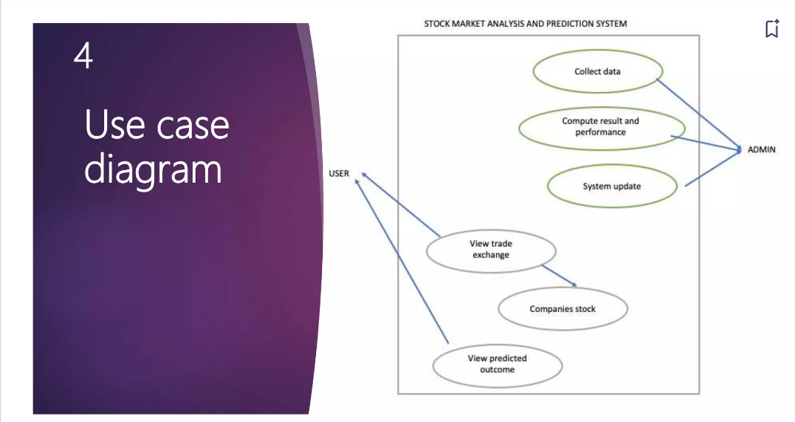

Slide 13
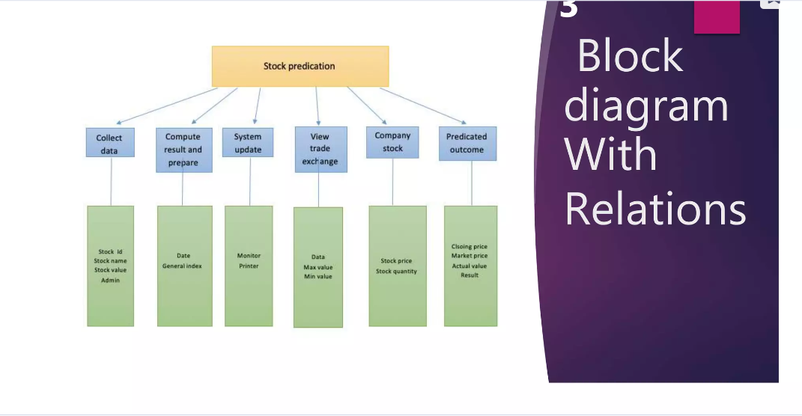

Slide 14
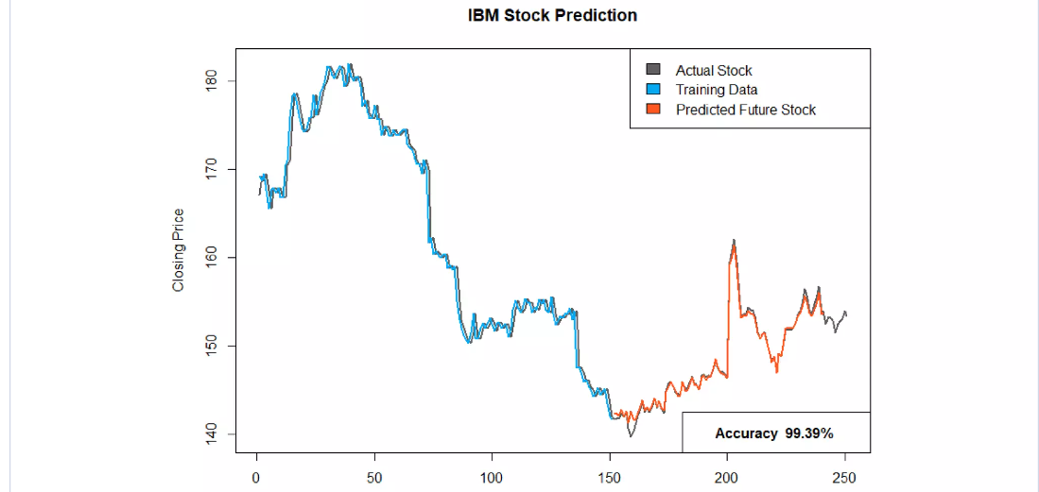

Slide 15


MODEL EVALUATION AND METRICS
Since stock prices prediction is essentially a regression problem, the RMSE (Root Mean Squared Error) and MAPE (Mean Absolute Percentage Error %) will be our current model evaluation metrics. Both are useful measures of forecast accuracy.

Slide 16
OPTIMIZATION OF INVESTMENT STRATEGIES
Risk Tolerance: Determine your risk tolerance level based on factors such as age, financial goals, investment horizon, and personal risk preferences.
Return Expectations: Set realistic return expectations aligned with your investment goals, whether they are short-term gains, long-term growth, income generation, or capital preservation
Asset Allocation: Allocate investments across different asset classes (stocks, bonds, real estate, commodities) to spread risk and reduce portfolio volatility.

Slide 17
Con…
Risk-Return Profile: Balance risk and return by adjusting asset allocation based on your risk tolerance, investment horizon, and market conditions.
Modern Portfolio Theory (MPT): Use MPT principles to construct efficient portfolios that maximize expected returns for a given level of risk or minimize risk for a given level of return.
Risk Parity: Implement risk parity strategies that allocate capital based on risk contributions from different asset classes rather than traditional market capitalization weights.

Slide 18
Con…
Risk Management:
Stop-Loss Orders: Implement stop-loss orders to automatically sell assets if they reach a predetermined price, limiting potential losses.
Cost Management:
Expense Ratio: Choose low-cost investment vehicles, such as index funds or exchange-traded funds (ETFs), to minimize management fees and expenses.

Slide 19
Con…
Rebalancing and Monitoring:
Rebalancing: Regularly rebalance the portfolio by adjusting asset allocations to maintain desired risk-return profiles and address market fluctuations.
Behavioral Finance Considerations:
Emotional Discipline: Avoid emotional biases (e.g., fear, greed) and stick to your investment plan and strategy during market fluctuations or periods of uncertainty.

Slide 20
Challenges and limitations
Market Volatility: Stock prices can be highly volatile, fluctuating rapidly in response to economic indicators, geopolitical events, corporate earnings reports, market sentiment, and news headlines. This volatility can lead to sudden price swings and increased risk for investors.
Market Uncertainty: Uncertainty in the stock market arises from unpredictable events, market speculation, regulatory changes, geopolitical tensions, and global economic conditions. Uncertainty can impact investor confidence, market stability, and decision-making processes

Slide 21
Liquidity Constraints: Liquidity refers to the ease of buying or selling assets without causing significant price movements. Some stocks may have low liquidity, making it challenging to execute trades at desired prices, especially during market downturns or periods of heightened volatility.
Information Asymmetry: Information asymmetry occurs when certain market participants have access to privileged or non-public information that canimpact stock prices. This can lead to unfair advantages, market manipulation, and regulatory concerns regarding insider trading.

Slide 22
FUTURE TRENDS AND DEVELOPMENTS
• Technology Integration: The stock market will likely continue to see advancements in technology, including the widespread adoption of artificial intelligence (AI), machine learning, data analytics, blockchain technology, and high-frequency trading (HFT). These technologies will enhance market efficiency, trading speed, risk management, and decision-making processes.
Sustainable and ESG Investing: Environmental, Social, and Governance (ESG) investing is gaining prominence, with investors focusing on sustainability, ethical practices, social impact, and corporate governance. Companies that prioritize ESG factors may attract more investment and see improved market performance.

Slide 23
Con…
• Digital Assets and Cryptocurrencies: The rise of digital assets, cryptocurrencies, and decentralized finance (DeFi) platforms could influence traditional stock markets. Regulatory clarity, institutional adoption, and technological innovations in blockchain may impact investment opportunities and market dynamics.
• Regulatory Changes: Regulatory changes, both domestically and internationally, can impact stock market trends. Policies related to taxation, trade agreements, monetary policy, consumer protection, and environmental regulations may influence investor sentiment and market performance.

