Slide 1
UNIT- I INTRODUCTION
NOTION OF AN ALGORITHM – FUNDAMENTALS OF ALGORITHMIC PROBLEM SOVING – IMPORTANT PROBLEM TYPES – FUNDAMENTALS OF THE ANALYSIS OF ALGORITHMIC EFFICIENCY – ASYMPTOTIC NOTATIONS AND THEIR PROPERTIES.ANALYSIS FRAMEWORK – EMPRICAL ANALYSIS – MATHEMATICAL ANALYSIS FOR RECURSIVE AND NON-RECURSIVE ALGORITHMS – VISUVALIZATION

Slide 2
NOTION OF AN ALGORITHM
An algorithm is a sequence of unambiguous instructions for solving problem, for obtaining a required output for any legitimate input in a finite amount of time
Problem to be solved
Algorithm
Input
Computer Program
Output

Slide 3
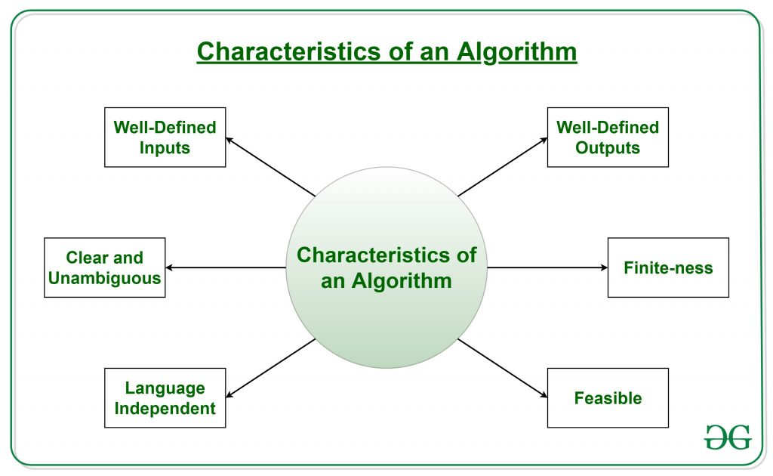
Characteristics of an Algorithm

Slide 4
Characteristics of an Algorithm
Clear and Unambiguous: The algorithm should be clear and unambiguous. Each of its steps should be clear in all aspects and must lead to only one meaning.
Well-Defined Inputs: If an algorithm says to take inputs, it should be well-defined inputs. It may or may not take input.
Well-Defined Outputs: The algorithm must clearly define what output will be yielded and it should be well-defined as well. It should produce at least 1 output.
Finite-ness: The algorithm must be finite, i.e. it should terminate after a finite time.
Feasible: The algorithm must be simple, generic, and practical, such that it can be executed with the available resources. It must not contain some future technology or anything.
Language Independent: The Algorithm designed must be language-independent, i.e. it must be just plain instructions that can be implemented in any language, and yet the output will be the same, as expected.

Slide 5
Properties of Algorithm
It should terminate after a finite time.
It should produce at least one output.
It should take zero or more input.
It should be deterministic means giving the same output for the same input case.
Every step in the algorithm must be effective i.e. every step should do some work.

Slide 6
Types of Algorithms
Brute Force Algorithm
Recursive Algorithm
Backtracking Algorithm
Searching Algorithm
Sorting Algorithm
Hashing Algorithm
Divide and Conquer Algorithm
Greedy Algorithm
Dynamic Programming Algorithm
Randomized Algorithm

Slide 7
Advantages and Disadvantages
Advantages of Algorithms:
It is easy to understand.
An algorithm is a step-wise representation of a solution to a given problem.
In Algorithm the problem is broken down into smaller pieces or steps hence, it is easier for the programmer to convert it into an actual program.
Disadvantages of Algorithms:
Writing an algorithm takes a long time so it is time-consuming.
Understanding complex logic through algorithms can be very difficult.
Branching and Looping statements are difficult to show in Algorithms

Slide 8
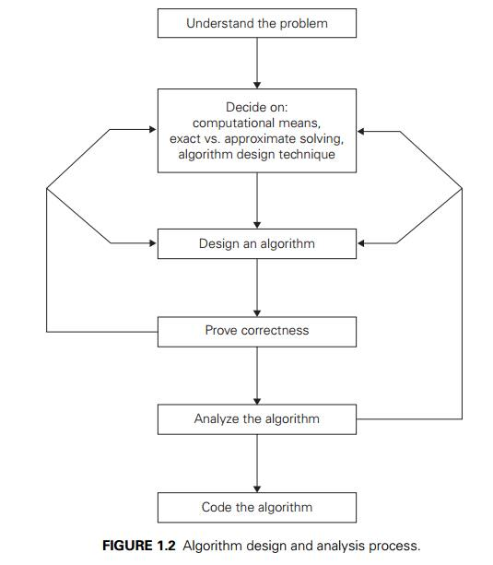
FUNDAMENTALS OF ALGORITHMIC PROBLEM SOLVING

Slide 9
FUNDAMENTALS OF ALGORITHMIC PROBLEM SOLVING
Step 1: Identify The Problem.
Step 2: Analyze The Problem.
Step 3: Develop The Solutions.
Step 4: Implement A Solution.
Step 5: Evaluate The Results.
Step 6: Standardize The Solution (and Capitalize on New Opportunities)

Slide 10
IMPORTANT PROBLEM TYPES
Sorting.
Searching.
String processing (e.g. string matching)
Graph problems (e.g. graph coloring problem)
Combinatorial problems (e.g. maximizes a cost)
Geometric problems (e.g. convex hull problem)
Numerical problems (e.g. solving equations )

Slide 11
Sorting
The sorting problem is to rearrange the elements of a given list in non
decreasing (ascending) or decreasing order (descending) order.
Examples of sorting algorithms
Selection sort
Bubble sort
Insertion sort
Merge sort
Number of key comparisons is used to determine time complexity of
sorting algorithms
Two properties related to sorting algorithms
Stability: A sorting algorithm is called stable if it preserves the
relative order of any two equal elements in its input.
In place: A sorting algorithm is in place if it does not require extra
memory, except, possibly for a few memory units

Slide 12
Searching
Find a given value, called a search key, in a given set.
Examples of searching algorithms
Sequential searching
Binary searching…

Slide 13
String Matching
A string is a sequence of characters from an alphabet.
Text strings: letters, numbers, and special characters.
String matching: searching for a given word/pattern in a text.
Text: I am a computer science graduate
Pattern: computer

Slide 14
Graph problems
A graph is a collection of points called vertices and edges
Examples of graph problems are graph traversal, traveling salesman problem, shortest path algorithm, topological sort and the graph-coloring problem

Slide 15
Combinatorial problems
These are problems for which it is required to generate permutations, and combinations, or a subset that satisfies certain constraints.
A desired combinatorial object may have an associated cost that needs to be minimized or maximized
In practical, the combinatorial problems are the most difficult problems in computing.
The traveling salesman problem and the graph coloring problem are examples of combinatorial problems

Slide 16
Geometric problems
Geometric algorithms deal with geometric objects such as points, lines, and
polygons.
Geometric algorithms are used in computer graphics, robotics etc..
Examples: closest-pair problem and the convex-hull problem

Slide 17
Numerical Problems
Numerical problems are problems that involve computing definite integrals, evaluating functions, mathematical equations, systems of equations, and so on

Slide 18
FUNDAMENTALS OF THE ANALYSIS OF ALGORITHM EFFICIENCY
The efficiency of an algorithm can be in terms of time and space. The algorithm efficiency can be analyzed by the following ways.
a. Analysis Framework.
b. Asymptotic Notations and its properties.
c. Mathematical analysis for Recursive algorithms.
d. Mathematical analysis for Non-recursive algorithms.

Slide 19
Analysis Framework
There are two kinds of efficiencies to analyze the efficiency of any algorithm.
They are:
Time efficiency, indicating how fast the algorithm runs
Space efficiency, indicating how much extra memory it uses.
The algorithm analysis framework consists of the following:
Measuring an Input’s Size
Units for Measuring Running Time
Orders of Growth
Worst-Case, Best-Case, and Average-Case Efficiencies

Slide 20
Analysis Framework
There are two kinds of efficiencies to analyze the efficiency of any algorithm.
They are:
Time efficiency, indicating how fast the algorithm runs
Space efficiency, indicating how much extra memory it uses.
The algorithm analysis framework consists of the following:
Measuring an Input’s Size
Units for Measuring Running Time
Orders of Growth
Worst-Case, Best-Case, and Average-Case Efficiencies

Slide 21
Measuring an Input’s Size
An algorithm’s efficiency is defined as a function of some parameter n indicating the algorithm’s input size.
In most cases, selecting such a parameter is quite straightforward. For example, it will be the size of the list for problems of sorting, searching.
Consider a spell-checking algorithm. If the algorithm examines individual characters of its input, then the size is measured by the number of characters.
In measuring input size for algorithms solving problems such as checking primality of a positive integer n. the input is just one number.
The input size by the number b of bits in the n’s binary representation is b=(log2 n)+1.

Slide 22
Units for Measuring Running Time
Some standard unit of time measurement such as a second, or millisecond, and so on can be used to measure the running time of a program after implementing the algorithm.
Drawbacks
Dependence on the speed of a particular computer.
Dependence on the quality of a program implementing the algorithm.
The compiler used in generating the machine code.
The difficulty of clocking the actual running time of the program.

Slide 23
Orders of Growth
A difference in running times on small inputs is not what really distinguishes efficient algorithms from inefficient ones.
For example, the greatest common divisor of two small numbers, it is not immediately clear how much more efficient Euclid’s algorithm is compared to the other

Slide 24
Worst-Case, Best-Case, and Average-Case Efficiencies
Consider Sequential Search algorithm some search key K
ALGORITHM SequentialSearch(A[0..n - 1], K)
//Searches for a given value in a given array by sequential search
//Input: An array A[0..n - 1] and a search key K
//Output: The index of the first element in A that matches K or -1 if there are no matching elements
i ←0
while i < n and A[i] ≠ K do
i ←i + 1
if i < n
return i
Else
return -1
Clearly, the running time of this algorithm can be quite different for the same list size n. In the worst case, there is no matching of elements or the first matching element can found at last on the list. In the best case, there is matching of elements at first on the list.

Slide 25
Empirical Analysis
Empirical analysis introduces many more factors that need to be controlled for in some way.
– Test platform (hardware, language, compiler)
– Measures of performance (what to compare)
– Benchmark test set (what instances to test on)
– Algorithmic parameters
– Implementational details
● It is much less obvious how to perform a rigorous analysis in the presence of so many factors.
● Practical considerations prevent complete testing.

Slide 26
Measures of Performance
For the time being, we focus on sequential algorithms.
● What is an appropriate measure of performance?
● What is the goal?
– Compare two algorithms.
– Improve the implementation of a single algorithm.
● Possible measures
– Empirical running time (CPU time, wallclock)
– Representative operation counts

Slide 27
Measuring Time
There are three relevant measures of time taken by a process.
– User time measures the amount of time (number of cycles taken by a process in “user mode.”
– System time the time taken by the kernel executing on behalf of the process.
– Wallclock time is the total “real” time taken to execute the process.
● Generally speaking, user time is the most relevant, though it ignores some important operations (I/O, etc.).
● Wallclock time should be used cautiously/sparingly, but may be necessary for assessment of parallel codes,

Slide 28
Representative Operation Counts
In some cases, we may want to count operations, rather than time
– Identify bottlenecks
– Counterpart to theoretical analysis
● What operations should we count?
– Profilers can count function calls and executions of individual lines of code to identify bottlenecks.
– We may know a priori what operations we want to measure (example: comparisons and swaps in sorting).

Slide 29
Test Sets
It is crucial to choose your test set well.
● The instances must be chosen carefully in order to allow proper conclusions to be drawn.
● We must pay close attention to their size, inherent difficulty, and other important structural properties.
● This is especially important if we are trying to distinguish among multiple algorithms.
● Example: Sorting

Slide 30
Comparing Algorithms
Given a performance measure and a test set, the question still arises how to decide which algorithm is “better.”
● We can do the comparison using some sort of summary statistic.
– Arithmetic mean
– Geometric mean
– Variance
● These statistics hide information useful for comparison.

Slide 31
Accounting for Stochasticity
In empirical analysis, we must take account of the fact that running times are inherently stochastic.
If we are measuring wallclock time, this may vary substantially for seemingly identical executions.
In the case of parallel processing, stochasticity may also arise due to asynchronism (order of operations).
In such case, multiple identical runs may be used to estimate the affect of this randomness.
If necessary, statistical analysis may be used to analyze the results, but this is beyond the scope of this course.

Slide 32
Performance Profiles
Performance profiles allow comparison of algorithms across an entire test set without loss of information.
They provide a visual summary of how algorithms compare on a performance measure across a test set.

Slide 33
ASYMPTOTIC NOTATIONS AND ITS PROPERTIES
Asymptotic notation is a notation, which is used to take meaningful statement about the efficiency of a program
The efficiency analysis framework concentrates on the order of growth of an algorithm’s basic operation count as the principal indicator of the algorithm’s efficiency.
To compare and rank such orders of growth, computer scientists use three notations, they are:
O - Big oh notation
Ω - Big omega notation
Θ - Big theta notation

Slide 34
O - Big oh notation
A function t(n) is said to be in O(g(n)), denoted t(n)∈ O(g(n)), if t (n) is bounded above by some constant multiple of g(n) for all large n, i.e., if there exist some positive constant c and some nonnegative integer n0 such that
t(n)<=cg(n) for all n >=n0
Where t(n) and g(n) are nonnegative functions defined on the set of natural numbers.
O = Asymptotic upper bound = Useful for worst case analysis = Loose bound

Slide 35
Ω - Big omega notation
A function t(n) is said to be in Ω(g(n)), denoted t(n) ∈ Ω(g(n)), if t(n) is bounded below by some positive constant multiple of g(n) for all large n, i.e., if there exist some positive constant c and some nonnegative integer n0 such that
t (n) ≥ cg(n) for all n ≥ n0
Where t(n) and g(n) are nonnegative functions defined on the set of natural numbers.
Ω = Asymptotic lower bound = Useful for best case analysis = Loose bound

Slide 36
Θ - Big theta notation
A function t(n) is said to be in Θ(g(n)), denoted t(n) ∈ Θ(g(n)), if t(n) is bounded both above and below by some positive constant multiples of g(n) for all large n, i.e., if there exist some positive constants c1 and c2 and some nonnegative integer n0 such that
c2g(n) ≤ t (n) ≤ c1g(n) for all n ≥ n0
Where t(n) and g(n) are nonnegative functions defined on the set of natural numbers.
Θ = Asymptotic tight bound = Useful for average case analysis

Slide 37
MATHEMATICAL ANALYSIS FOR RECURSIVE ALGORITHMS
General Plan for Analyzing the Time Efficiency of Recursive Algorithms
Decide on a parameter (or parameters) indicating an input’s size.
Identify the algorithm’s basic operation.
Check whether the number of times the basic operation is executed can vary on different inputs of the same size; if it can, the worst-case, average-case, and best-case efficiencies must be investigated separately.
Set up a recurrence relation, with an appropriate initial condition, for the number of times the basic operation is executed.
Solve the recurrence or, at least, ascertain the order of growth of its solution.

Slide 38
MATHEMATICAL ANALYSIS FOR NON-RECURSIVE ALGORITHMS
General Plan for Analyzing the Time Efficiency of Nonrecursive Algorithms
Decide on a parameter (or parameters) indicating an input’s size
Identify the algorithm’s basic operation (in the innermost loop).
Check whether the number of times the basic operation is executed depends only on the size of an input. If it also depends on some additional property, the worst-case, average-case, and, if necessary, best-case efficiencies have to be investigated separately.
Set up a sum expressing the number of times the algorithm’s basic operation is executed.
Using standard formulas and rules of sum manipulation either find a closed form formula for the count or at the least, establish its order of growth.

Slide 39
Data visualization
Data visualization is the graphical representation of information and data. By using visual elements like charts, graphs, and maps, data visualization tools provide an accessible way to see and understand trends, outliers, and patterns in data.

Slide 40
Importance of Data Visualization
Data visualization is an easy and quick way to convey concepts universally. You can experiment with a different outline by making a slight adjustment.
Data visualization can identify areas that need improvement or modifications.
Data visualization can clarify which factor influence customer behavior.
Data visualization helps you to understand which products to place where.
Data visualization can predict sales volumes.

Slide 41
Why Use Data Visualization?
To make easier in understand and remember.
To discover unknown facts, outliers, and trends.
To visualize relationships and patterns quickly.
To ask a better question and make better decisions.
To competitive analyze.
To improve insights.

Slide 42
Data Visualization Tools
Data visualization allows you to interact with data. Google, Apple, Facebook, and Twitter all ask better a better question of their data and make a better business decision by using data visualization.
Tableau
Infogram
Chartblocks
Datawrapper
Plotly
RAW
Visual.ly
D3.js
Ember Charts
NVD3

