Slide 1
REGRESSION and CLASSIFICATION
march 3,2018
by Muthulakshmi G

Slide 2
OBJECTIVE
REGRESSION:
Linear regression
CLASSIFICATION:
Logistic regression

Slide 3
Regression model
Relationship between two continous variables
Trying to predict real value or continous values
This is done to gain the information about one through knowing the values of others.
E.g :Amount,Distance,temperature,size
Forcast the value of dependent variable (Y) from the independent variable(X)

Slide 4

How much you eat and how much weigh

Slide 5
DEPENDENT VARIABLE AND INDPENDENT VARIABLE
Independent variables are regarded as inputs.
Dependent variables are those values that changes as a consequences changes in other values.
Independent variable is also called predictor or explanatory variable an it i denoted as X.
Dependent variable is called as response variable and it i denoted as Y.

Slide 6
SIMPLE LINEAR REGRESSION
Linear regression is used for regression problems.
The simplest mathematical relationship between two variables X and Y is a linear relationship.
Single input and output variable
It uses one independent variable to explain or predict the outcome of the dependent variable Y.
The goal is to find the best estimates for the coefficients to minimize the errors in predicting y from X.
The relationship between the predictors and the target can be approximated with a straight line.

Slide 7
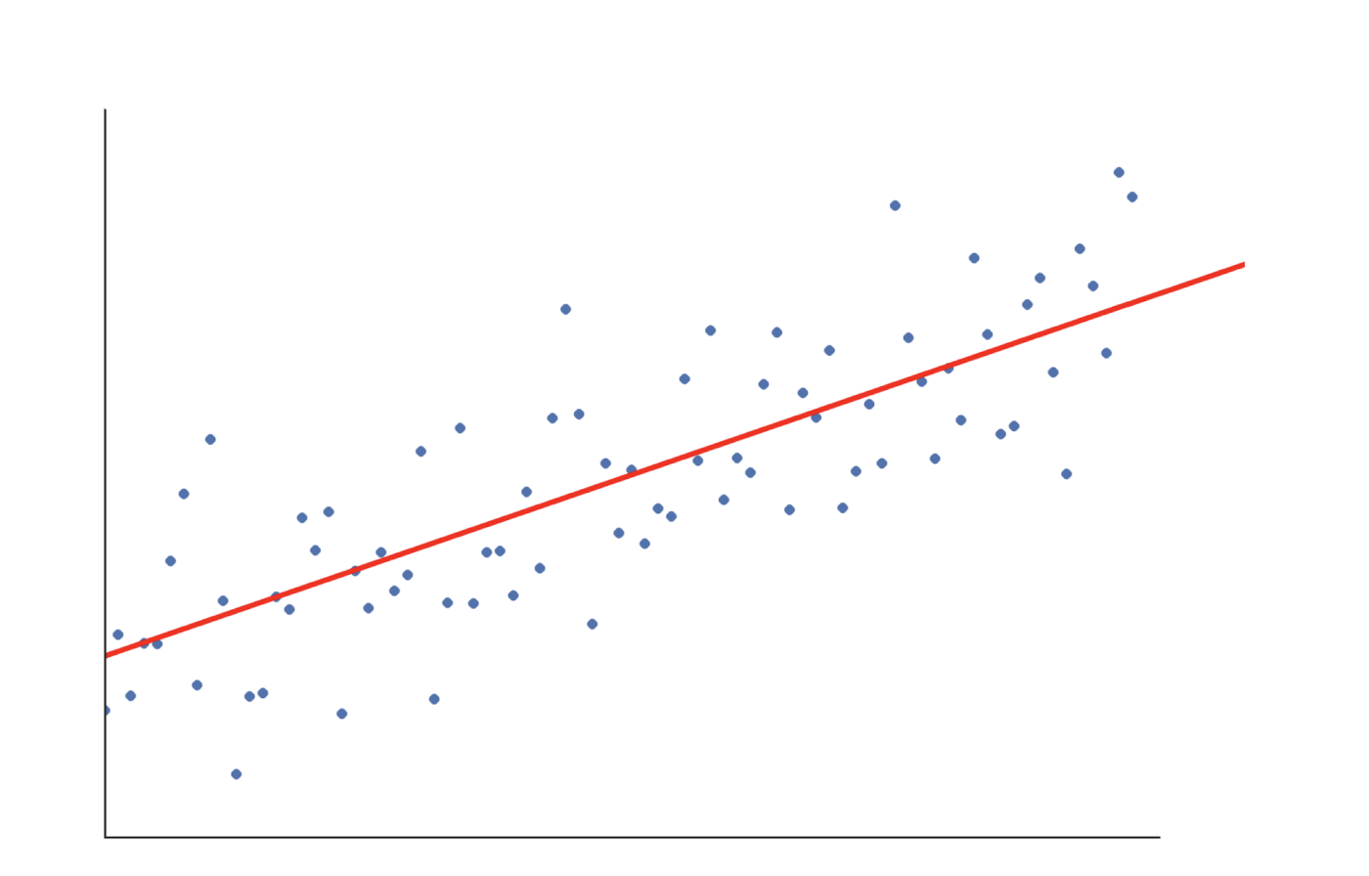
LINEAR REGRESSION
Y
Data ponits
X

Slide 8
LINEAR MODEL
Y = b0 + b1x.
Y = Dependent variable
X = Indpendent variable
b0 = y-intercept
b1 = Slope of the line
SLOPE : The change in Y for increase in X.
INTERCEPT : Where line intercepts the Y-axis.
The relationship between dependent and independent variable is
established by best fitting line.
.

Slide 9
How does it work?
With this equation we can make predictions of our data
Approximating a mapping function from input variables (X) to a continuous output variable (Y).
To determine the values of parameters for a function that cause the function to best fit .
when we use the regression equation to find predicted values of Y for different values of X, we are not calculating the actual value of Y.

Slide 10
REGRESSION LINE
The best fitting line of our data is called regression line
Regression equation allows us to produce the regression line.
How to find a regression line?
The data is displayed as a collection of points
Through these points number of lines may be passes.
The relation between dependent and independent variable established by best fitting line which has minium error.

Slide 11
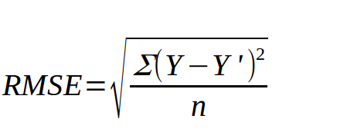
ROOT MEAN SQUARED ERROR
The distance between the data point and the line and then square that distance.for that point.
If you calculated the squared deviation for each data point that did not fall on
the line, and added all of these squared deviations to get sums of squares.

Slide 12
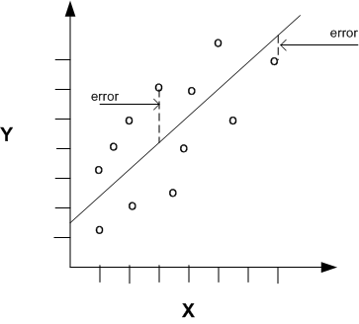
ROOT MEAN SQUARED ERROR
In some cases the amount of error is little whereas in others the amount of error is quite large.
Less than observed values -underpredicted the Y value
More than observed values -overpredicted the Y value
Some amount of error is present in predict

Slide 13
GRADIENT DESCENT
Gradient descent is an optimization algorithm
Used to find the values of parameters (coefficients) of a function(f) that minimizes a cost function (cost)
We want to minimizes the errors by updating a parameters.
Given a function defined by a set of parameters, gradient descent starts with an initial set of parameter values and iteratively moves toward a set of parameter values that minimize the function.

Slide 14
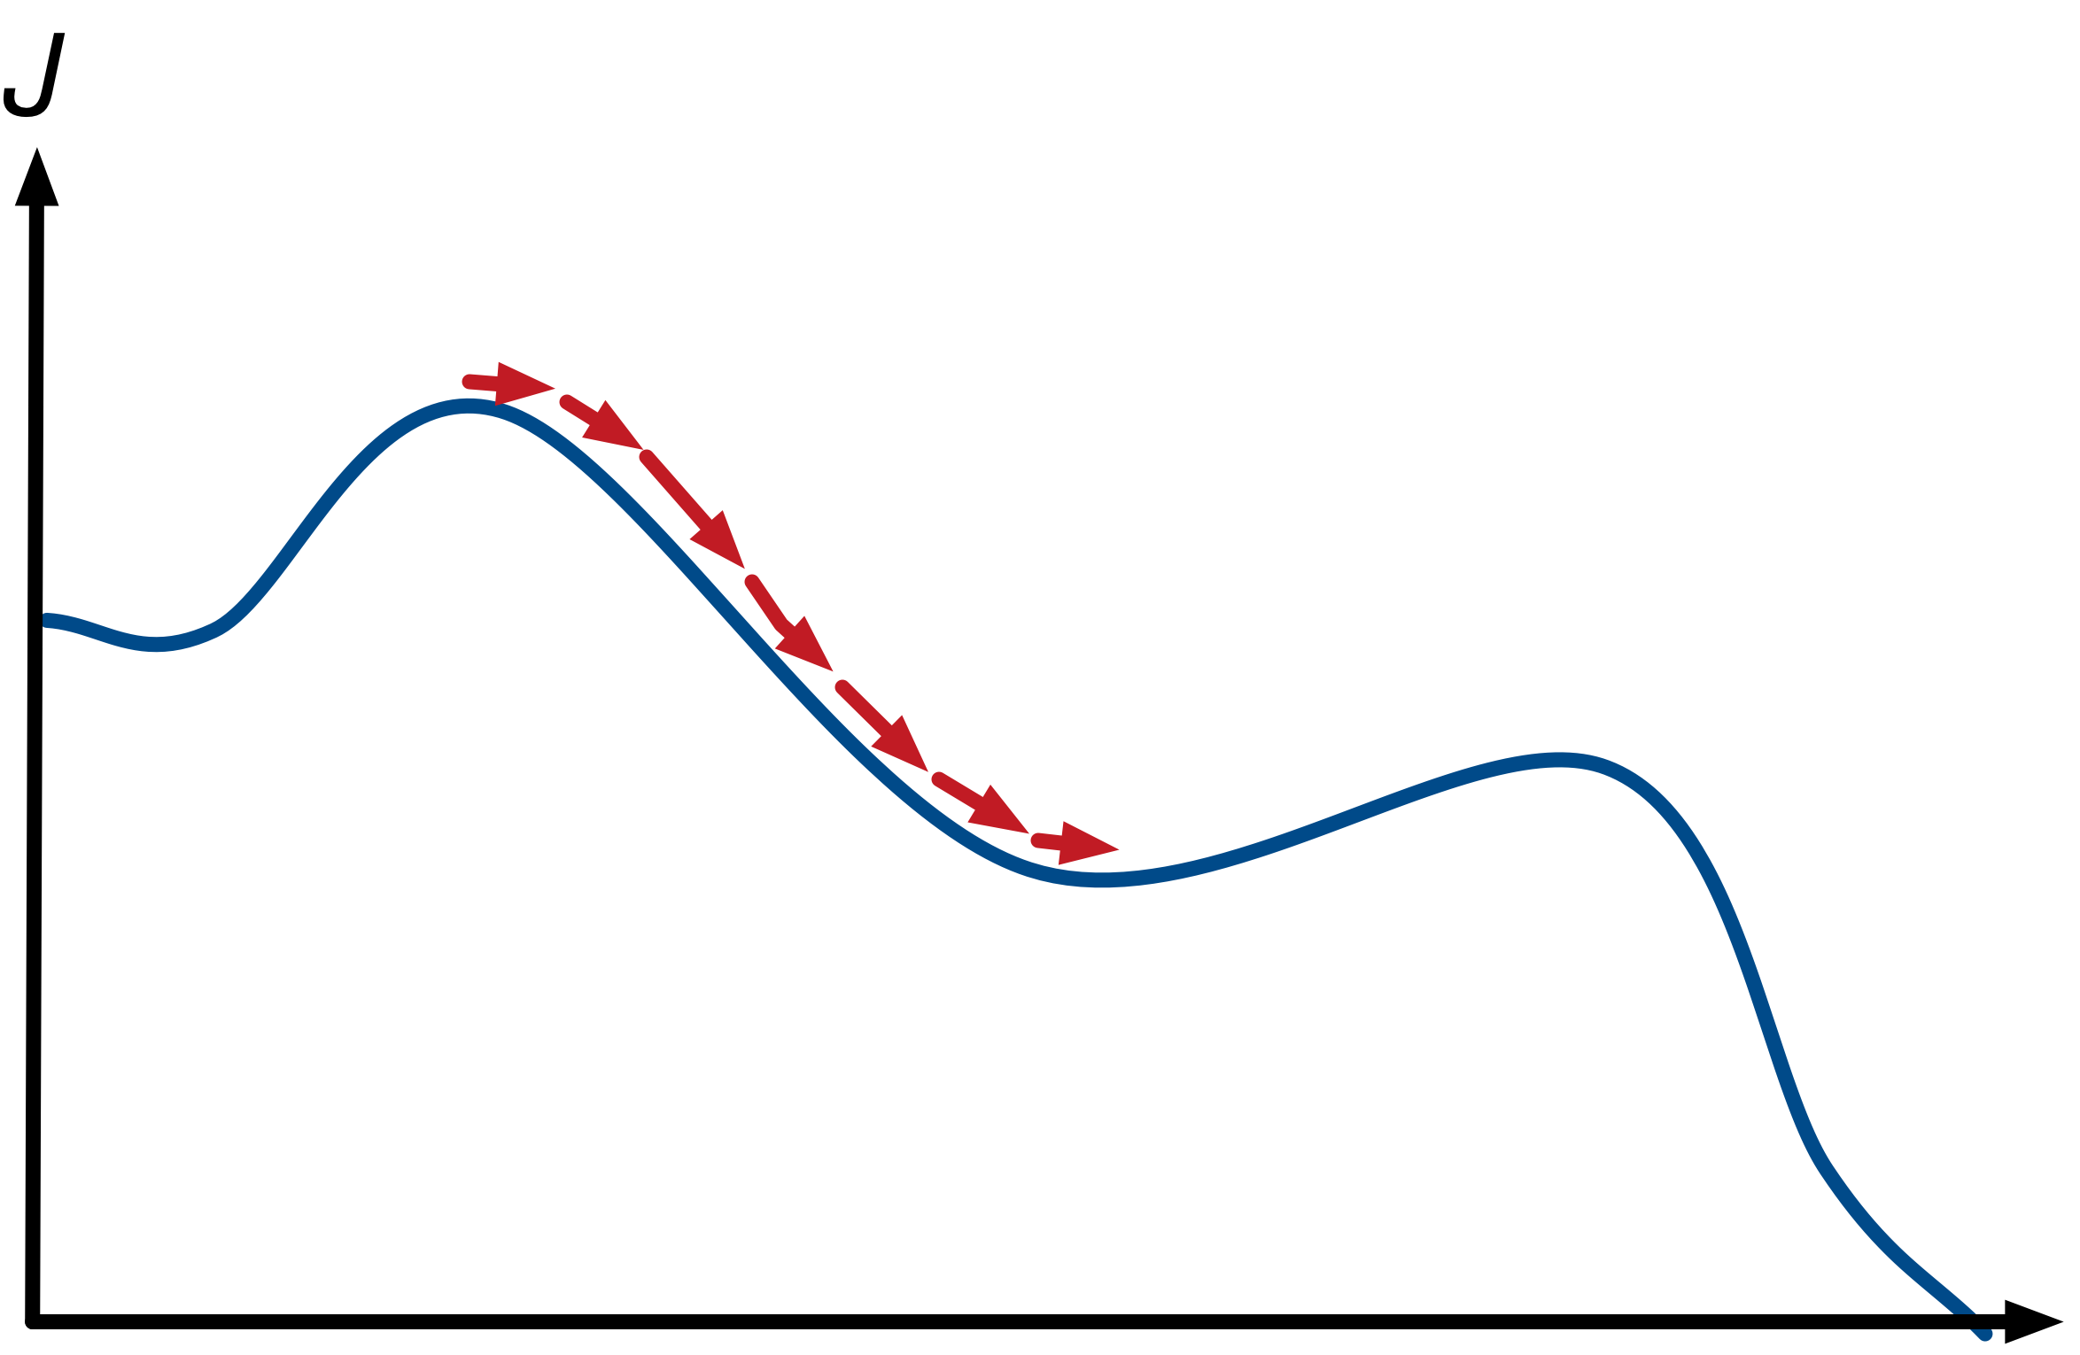
GRADIENT DESCENT
To understand,say we are in top of hill.The high we are larger error is descending means reduce the errors.
The bottom of the hill is the cost of the best set of coefficients, the minimum of the function.
The goal is to continue to try different values for the coefficients, evaluate their cost and select new coefficients that have a slightly better (lower) cost or error
Large error
Small error

Slide 15
MULTIVARIATE-REGRESSION
Relationship among one dependent variable and one or more independent variables.
The term multivariate linear regression refers to linear regression with two or more predictors (x1, x2, …, xn).
Y’ = a + bX 1 + bX 2
where
Y’ is the predicted value of the dependent variable,
X1 is the value of the first predictor variable,and X­2 is the value of the second predictor variable.
for example, different type of sales and profit
x1-type of sale
x2-another type of sale

Slide 16
CLASSIFICATION
Classification is the task of predicting a discrete class label.
The goal of classification is to accurately predict the target class for each case in the data.
For example, a classification model - identify loan applicants as low, medium, or high credit risks.
Classifications are discrete and do not imply order. Continuous, floating
point values would indicate a numerical, rather than a categorical target.

Slide 17
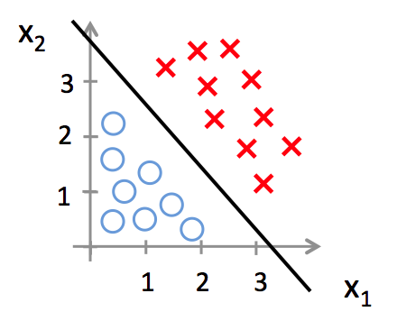
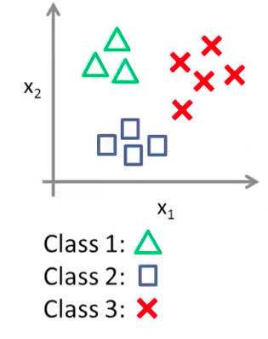
TYPES OF CLASSIFICATION
Binary classification:
The target attribute has only two possible values.
we define our target class Y as a binary
class Y={0,1}
E.g low credit or high credit
Multiclass:
Targets have more than two values.
multi-class Y ={1,2,3,4..}
E.g Low, medium, high,
or unknown credit rating.

Slide 18
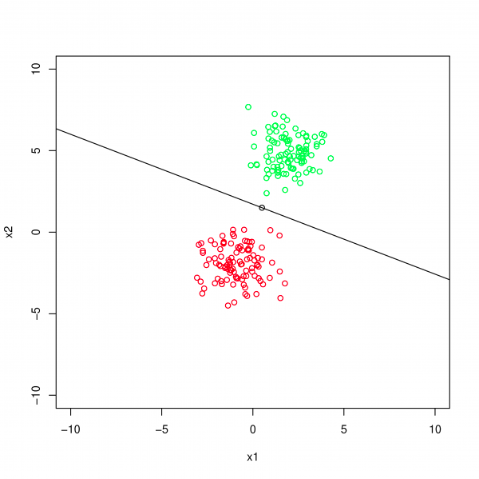
LOGISTIC REGRESSION
Logistic regression is used for a classification problem.
Takes a probablistic approach to learning discriminative functions(i.e,classifiers)
It helps to predict a catagorical dependent variable.
The output value being modeled is a binary values (0 or 1) rather than a numeric value.
It also provides a estimated
probablity of our prediction.
E.g
Email:spam/not spam
Tumor: maignant/benign

Slide 19
Classification based on probability
Instead of just predicting the class,give the probability of the instance being that class.
Estimated probability that y=1 or y=0 on input x.
0<p(event)<1

Slide 20
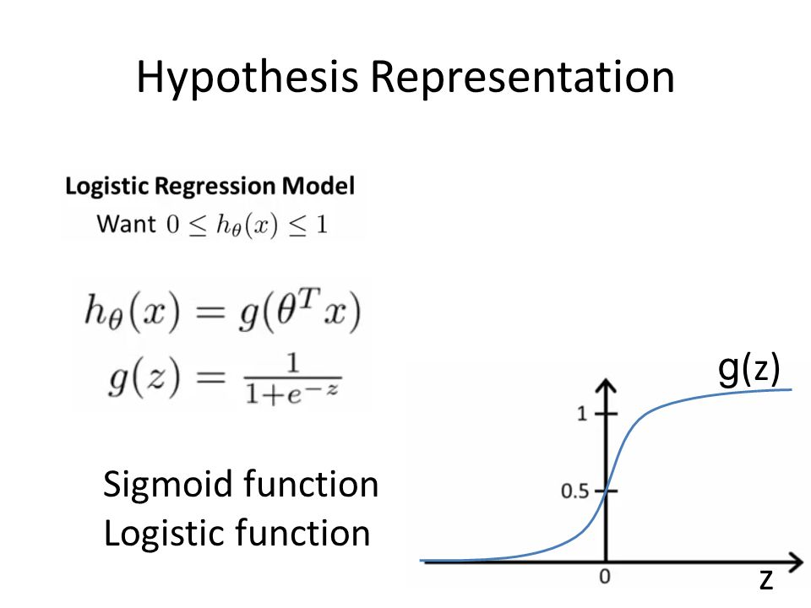
HYPOTHESIS REPRESENTATION

Slide 21
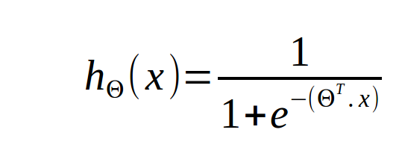
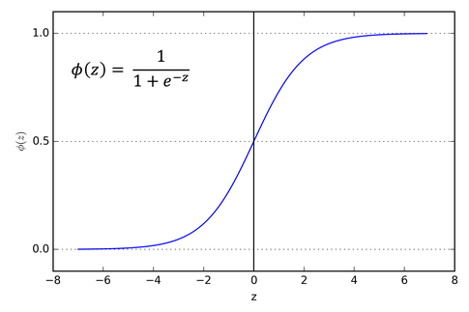
HYPOTHSEIS REPRESENTATION
h(x)=logistic(z) or sigmoid(z)
The logistic regression model is,
If we predict whether y=1 or y=0 depending on estimated probabilty.

Slide 22
HYPOTHSEIS REPRESENTATION
h(x)=logistic(z) or sigmoid(z)
The logistic regression model is,
If we predict whether y=1 or y=0 depending on estimated probabilty.

Slide 23
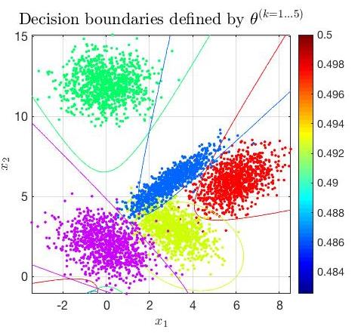
DECISION BOUNDRY
Decision boundry is a boundry which separates the classes.It divides one region from another.
how can we divide ?
we defined a threshold classifier.
if we predict whether Y is equals to one or zero depending on whether the estimated probability is greater than or equal 0.5 (or) it is less than 0.5.

Slide 24
PREDICTIONS
For example, if we are modeling people’s sex as male or female from their height, then the first class could be male and the logistic regression model could be written as the probability of male given a person’s height,
P(sex=male|height)
P(X) = P(Y=1|X)
we can snap the probabilities to a binary class value.
0 if h(x) < 0.5
1 if h(x) >= 0.5

Slide 25
THANK YOU

