Slide 1
Swarm Plot
Graph assignment
By
MuthuKumaranM

Slide 2
Why Swarm Plot is Important in Seaborn (Easy Explanation)
A Swarm Plot in Seaborn is used to visualize the distribution of data points while avoiding overlap. It is very useful in exploratory data analysis (EDA)
What is a Swarm Plot?
A swarm plot displays all individual data points for a variable, spread out along a categorical axis so that no two points overlap.It is an improved version of a strip plot.

Slide 3
1 Shows Actual Data Points
Unlike boxplots or violin plots, swarm plots show every single observation
Helps understand true data distribution
2️ Avoids Overlapping
Automatically adjusts points so they don’t overlap
Makes dense data clearly visible
3️ Best for Small to Medium Datasets
Ideal when you want to see all values
Perfect for academic & project analysis
4. Great for Comparing Categories
Useful in bivariate analysis Example: salary vs specialisation, marks vs placement status
5.Detects Outliers Clearly
Outliers stand out visually easier than boxplots in some cases

Slide 4
Code to make swarmPlot:
import seaborn as sns
import matplotlib.pyplot as plt
sns.swarmplot(x='specialisation', y='salary', data=dataset)
plt.show()

Slide 5
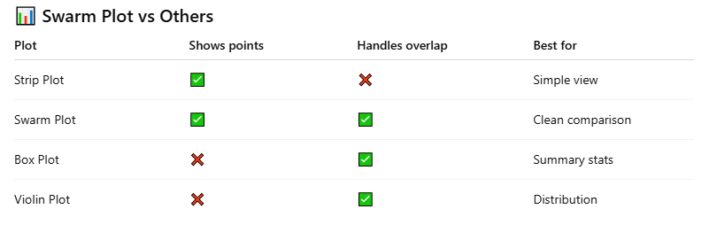

Slide 6
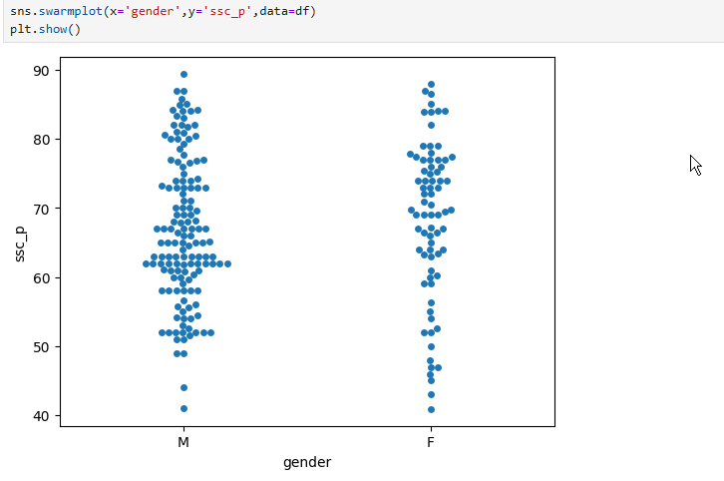

Slide 7
Information In Violin Plot
Most salaries for all groups are concentrated between ₹200,000 and ₹300,000.
Mkt&Fin shows a wider salary spread compared to Mkt&HR.
Mkt&HR salaries are more consistent and compact.
Median salary of Mkt&Fin students is higher than Mkt&HR.
In both specialisations:
Male median salary is slightly higher than female.
Difference is small and overlapping.
Mkt&Fin (Male) has the highest variability in salary.
Female salaries in both specialisations show less variation.
One or two very high salary outliers (around ₹1,000,000) exist in Mkt&Fin (Male).
These outliers stretch the violin upward but do not affect most observations
Wider sections of the violin indicate more students at that salary range.
Narrow ends indicate fewer students.
Mkt&Fin → higher salary potential
Mkt&HR → more stable salaries
Males show slightly higher salary spread
Extreme high salaries are rare

Slide 8
Boxplot
Variables Compared
Y-axis: ssc_p (Secondary School Percentage)
X-axis: ssc_b (Board type)
Others
Central
Grouping: Gender
M (Male)
F (Female)
Spread (Interquartile Range – IQR)
Others board has a wider IQR, meaning more variation in scores.
Central board scores are more tightly clustered, showing consistency.
Male scores show slightly more variability than females.

Slide 9
Maximum ssc_p values for all groups reach around 88–90%.
Minimum values:
Others (Male): around 49%
Others (Female): around 45%
Central (Male): around 41%
Central (Female): around 43%
Central Tendency (Median Line)
Female students consistently have a higher median SSC percentage than males in both board types.
The highest median is observed for Females from “Others” board.
Central board males show the lowest median among all four groups
Performance Distribution (IQR – Box Width)
Others board:
Shows larger IQR, meaning student performance varies more.
Indicates presence of both average and high scorers.
Central board:
Narrower IQR suggests more uniform academic performance.
Females have a slightly tighter IQR than males → more consistent results.
.

Slide 10
Score Extremes:
Upper whiskers:
Reach close to 90% for all groups → top performers exist across boards and genders.
Lower whiskers:
Central board shows lower minimum scores than Others board.
Indicates higher risk of low performance in Central board students.
Outlier Behavior:
A single low-end outlier appears for Others board – Female, indicating:
One female student scored significantly lower than peers.
No extreme high outliers → top scores are stable and not anomalies.
Gender Gap Insights (from Graph Only)
Gender-based gap is more visible in Others board.
In Central board, male and female medians are closer, indicating reduced gender difference.
Overall Visual Pattern:
Board type influences performance more strongly than gender.
Others board dominates in terms of:
Higher medians
Higher maximum scores
Central board emphasizes consistency over peak performance.

Slide 11
Thank you

