Slide 1
Employee Data Analysis using Excel
STUDENT NAME : MUTHULAKSHMI.M
REGISTER NO : D1B90D36127DA699E76444C3A572189E ,
312208721
DEPARTMENT : B.COM ( GENERAL)
COLLEGE : MEENAKSHI COLLEGE FOR WOMEN

Slide 2
PROJECT TITLE
EMPLOYEE PERFORMANCE ANALYSIS

Slide 3


AGENDA
Problem Statement
Project Overview
End Users
Our Solution and Proposition
Dataset Description
Modelling Approach
Results and Discussion
Conclusion
3/21/2024 Annual Review

Slide 4

PROBLEM
STATEMENT
Employee performance analysis serves to:
- Evaluate job performance and progress.Identify areas for improvement and development.Inform compensation and promotion decision.Enhance employee engagement and motivation.

Slide 5

PROJECT OVERVIEW
We need to conduct employee analysis to:
- Improve performance and address weaknesses
- Inform decisions on promotions, raises, and development opportunities
- Boost employee engagement and reduce turnover

Slide 6

WHO ARE THE END USERS?
HUMAN RESOURCE DEPARTMENTS
MANAGEMENT AND LEADERSHIP
TEAM LEADERS AND SUPERVISORS
EMPLOYEES
EXECUTIVE LEADERSHIP
BUSINESS ANALYSTS
RECRUITERS

Slide 7

OUR SOLUTION AND ITS VALUE PROPOSITION
FILTERING- REMOVE VALUES
PIVOT TABLE - SUMMARY OF EMPLOYEE PERFORMANCE
BAR DIAGRAM - FINAL REPORT

Slide 8
DATASET DESCRIPTION:
EMPLOYEE DATA SET - NAAN MUDHALVAN PORTAL
EMPLOYEE ID- ALPHANUMERIC(TEXT)
NAME- ALPHABETICAL(TEXT)
GENDER- ALPHABETICAL(TEXT)
DEPARTMENT - ALPHABETICAL(TEXT)
SALARY - NUMERICAL
START DATE - ALPHANUMERIC(TEXT)
FTE- NUMERICAL
EMPLOYEE TYPE- ALPHABETICAL(TEXT)
EMPLOYEE LOCATION- ALPHABETICAL(TEXT)
current employee rating- NUMERICAL
title-ALPHABETICAL(TEXT)
business unit- ALPHABETICAL(TEXT)
performance rate-numerical
pay zone - ALPHABETICAL(TEXT)
employee type- ALPHABETICAL(TEXT)
employee status- ALPHABETICAL(TEXT)

Slide 9

THE "WOW" IN OUR SOLUTION
Filtering helps in data sets by removing irrelevant data, reducing noise, and improving data quality, allowing for more accurate analysis and informed decision-making. It also saves time and increases efficiency by quickly narrowing down large datasets to relevant subsets, revealing key information and trends.
3/21/2024 Annual Re
view
9

Slide 10
MODELLING
STEP - 1
DOWNLOAD THE EMPLOYEE DATASAET IN NAAN MUDHALVAN PORTAL.
STEP - 2
SELECT THE ENTIRE DATA AND CLICK ON DATA AND CLICK ON FILTER OPTION.
STEP - 3
FILTER FROM A TO Z ORDER.
STEP - 4
SELECT THE ENTIRE DATA AND CLICK ON PIVOT TABLE TO CREATE PIVOT TABLE.
10

Slide 11
STEP -5
DRAG THE NEEDED DATA AND CREATE A PIVOT TABLE.
STEP -6
SELECT THE PIVOT TABLE AND CLICK ON INSERT.
STEP-7
NOW CLICK ON THE CHART THAT YOU WANT.
STEP -8
THE CHART IS CREATED.

Slide 12
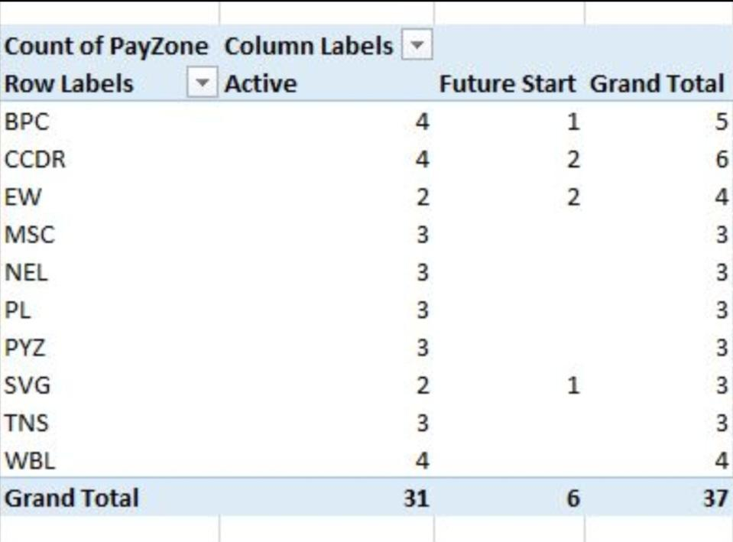
RESULT
TABLES
12

Slide 13
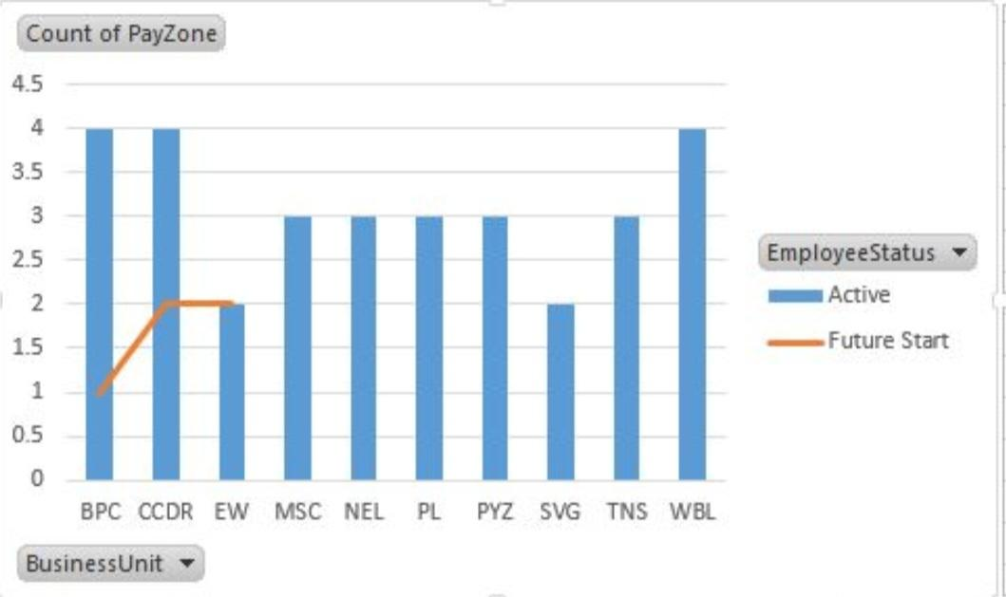
2. BAR DIAGRAM

Slide 14
CONCLUSIONS :
A database is used to store, manage, and retrieve large amounts of organized data, enabling efficient access and analysis for informed decision-making. It also provides a secure and structured repository for data, supporting various applications and business operations.
A database allows for quick data retrieval, updating, and manipulation, making it an essential tool for businesses, organizations, and applications. It also enables data sharing, collaboration, and scalability, supporting growth and innovation in various industries.

