Slide 1
FINAL PROJECT
STUDENT NAME: MUTHUPANDIYAN.R NAAN MUDHALVAN ID: au821721243039 DEPT.: B.TECH ARTIFICIAL INTELLIGENCE AND DATA SCIENCE 3rd YEAR. COLLEGE NAME: SIR ISSAC NEWTON COLLEGE OF ENGINEERING AND TECHNOLOGY.
3/21/2024 Annual Review

Slide 2
BREAST CANCER WISCONSIN DIAGNOSIS USING DIFFERENT ALGORITHM
3/21/2024 Annual Review

Slide 3


AGENDA
PROBLEM STATEMENT.
PROJECT OVERVIEW.
WHO ARE THE END USERS?.
YOUR SOLUTION AND ITS VALUE PROPOSITION.
THE WOW IN YOUR SOLUTION.
DATA VISUALIZATION.
MODELLING.
RESULT.
3/21/2024 Annual Review

Slide 4

PROBLEM STATEMENT
Breast cancer is one of the most prevalent cancers affecting women worldwide. Early detection and accurate classification of breast cancer tumors are crucial for effective treatment and patient prognosis.
Machine learning algorithms can assist in automating the classification process, aiding medical professionals in making informed decisions.
3/21/2024 Annual Review

Slide 5

PROJECT OVERVIEW
This project centers on the development of a robust machine learning model aimed at classifying breast cancer tumors into two categories: malignant and benign.
Leveraging the comprehensive Breast Cancer Wisconsin (Diagnostic) Dataset, which encapsulates diverse features extracted from digitized images of breast masses, this endeavor seeks to harness the predictive capabilities of various classification algorithms.
3/21/2024 Annual Review

Slide 6

WHO ARE THE END USERS?
Oncologists and radiologists for interpreting diagnostic results.
Pathologists for confirming diagnoses based on tissue samples.
General practitioners and specialists for initial assessments and referrals.
Healthcare institutions for integrating the system into diagnostic workflows.
Ultimately, patients benefit from accurate diagnoses and informed treatment decisions facilitated by the system.
3/21/2024 Annual Review

Slide 7

SOLUTION AND ITS VALUE PROPOSITION
Accurate Diagnoses: Provides precise classifications for early detection and treatment planning.
Efficiency: Rapid analysis streamlines diagnostic workflows, reducing time to diagnosis.
Improved Outcomes: Facilitates timely interventions, leading to better patient outcomes.
Resource Optimization: Helps allocate resources effectively by minimizing unnecessary procedures.
Decision Support: Assists healthcare professionals in clinical decision-making.\
Accessibility: User-friendly interface enables integration into existing healthcare systems.
3/21/2024 Annual Review

Slide 8

THE WOW IN THE SOLUTION
Cutting-Edge Accuracy: Our system doesn't just classify breast tumors; it does so with unparalleled accuracy, leveraging the latest advancements in machine learning to provide diagnoses that healthcare professionals can trust implicitly.
Lightning-Fast Speed: With our system, waiting for a diagnosis is a thing of the past. Its lightning-fast analysis capabilities mean patients can receive critical information in record time, allowing for swift treatment decisions.
Life-Saving Precision: Every correct diagnosis our system delivers has the potential to save lives. By catching cancer early and ensuring the right treatment pathways, it's not just a tool—it's a beacon of hope for patients and their families.
Seamless Integration: Unlike other solutions that disrupt existing workflows, our system seamlessly integrates into healthcare practices. Its intuitive design means healthcare professionals can start using it immediately without any hassle.
Empowering Healthcare Heroes: Our solution isn't just about technology; it's about empowering healthcare professionals to do what they do best—save lives. By providing accurate, timely information, it becomes a vital ally in the fight against breast cancer.
8
3/21/2024 Annual Review

Slide 9
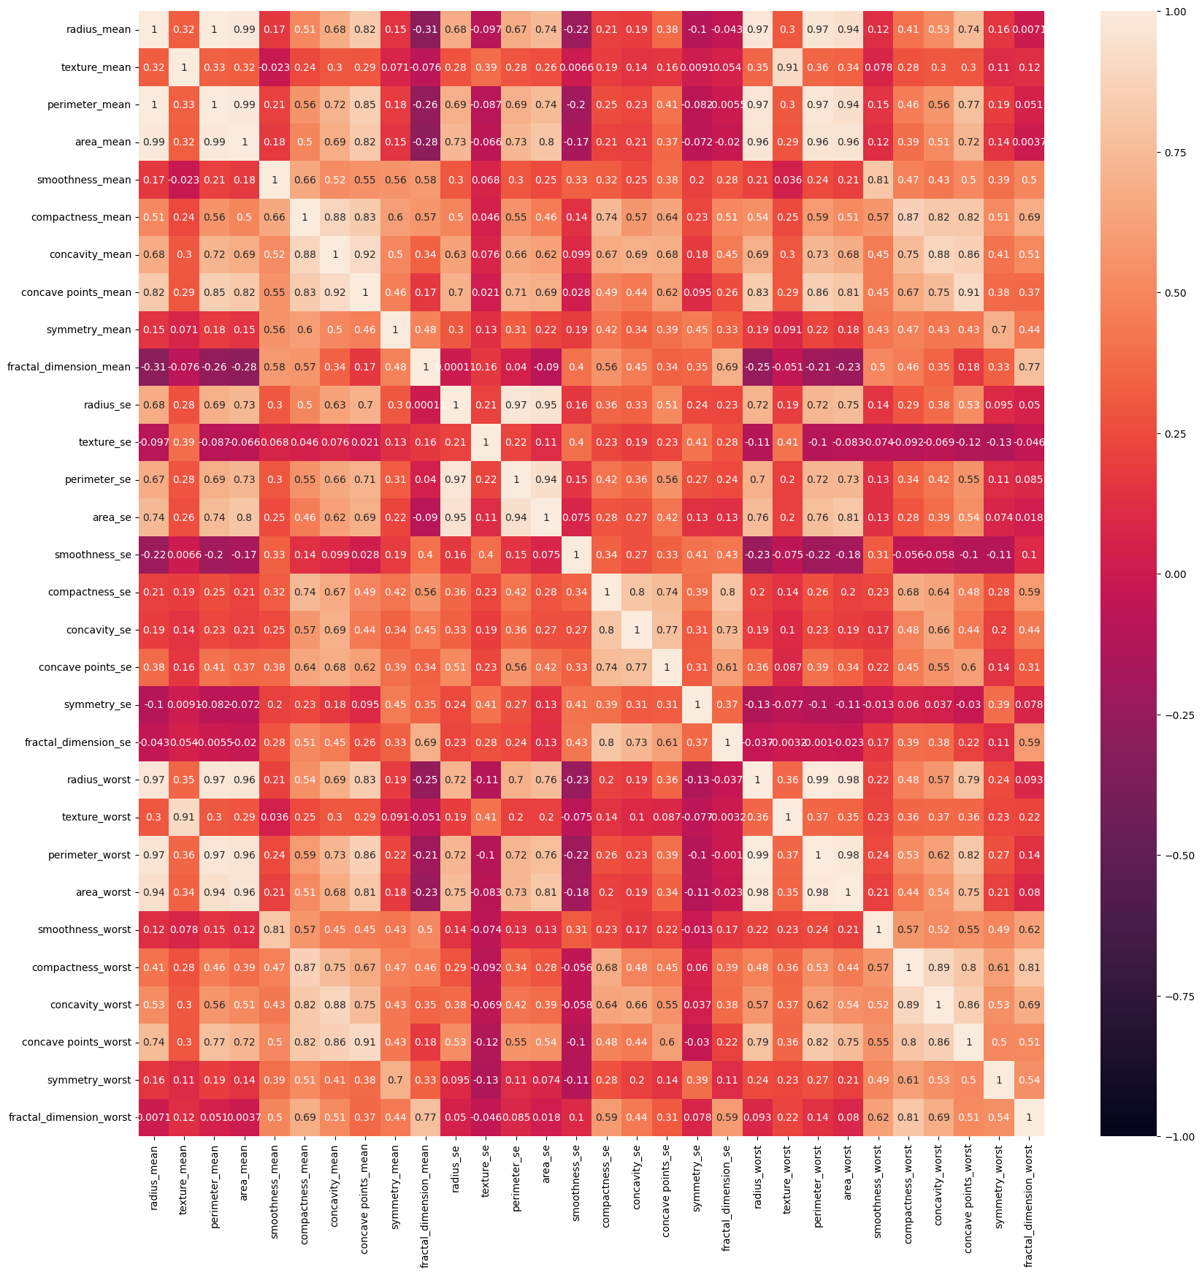
DATA VISUALIZATION
9
3/21/2024 Annual Review

Slide 10
MODELLING
Feature Engineering: Crafting relevant features from diagnostic data for accurate classification.
Algorithm Selection: Choosing the best-performing algorithms like logistic regression, decision trees, and ensemble methods.
Hyperparameter Tuning: Fine-tuning model parameters to optimize performance.
Validation Strategies: Using cross-validation to ensure generalization and prevent overfitting.
Ensemble Techniques: Exploring ensemble methods for improved accuracy and robustness.
Interpretability: Prioritizing model explainability for clinical acceptance.
Continuous Improvement: Iteratively refining models based on feedback and new data.
3/21/2024 Annual Review
10

Slide 11
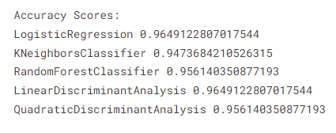
RESULTS
Logistic Regression: Accuracy score of approximately 0.9649.
K-Nearest Neighbors (KNN) Classifier: Accuracy score of approximately 0.9474.
Random Forest Classifier: Accuracy score of approximately 0.9561.
Both Linear Discriminant Analysis (LDA) and Quadratic Discriminant Analysis (QDA) share the same accuracy score as Logistic Regression, which is approximately 0.9649.
These scores represent the performance of each classifier in a specific task. Keep in mind that these results are based on the data and model used, and different datasets or problem domains may yield different outcomes.
11
3/21/2024 Annual Review

