Slide 1
Emergency Panic and Real-Time Location Sharing App for Personal Safety
COURSE FACULTY:
DR 3B ABISHA
PRESENTED BY:
MUTHUPRIYA R (192421002)
T SVETHA (192321155)
ASWATHI K (192421079)

Slide 2


INTRODUCTION
Personal safety is a growing concern.
Quick response is essential during emergencies.
The app automatically detects emergencies.
Shares live location with authorized guardians.
Improves safety through continuous monitoring and instant alerts.

Slide 3
OBJECTIVES
Detect emergencies automatically.
Share real-time location with guardians.
Generate instant alerts.
Continuously monitor user safety.
Provide centralized safety management.

Slide 4
LITERATURE REVIEW
S. No. | Author(s) & Year | Paper Title | Key Features | Limitations | Research Gap / Proposed Improvement
1 | Gowda D.V. et al. (2023) | Development of a Real-Time Location Monitoring App with Emergency Alert Features for Android Devices | GPS tracking, emergency alerts, Android-based monitoring | Relies mainly on user-triggered alerts; limited intelligent monitoring | Introduce automatic emergency detection and continuous background monitoring. (Gnanaganga)
2 | Banerjee S., Maiti P., Biswas S. (2024) | Empowering Personal Safety Through Mobile Apps | Real-time location sharing, safety networks, emergency communication | Privacy concerns and lack of intelligent event detection | Improve privacy while integrating automated emergency detection and guardian monitoring. (ResearchGate)
3 | Bowen-Forbes C. et al. (2024) | Mobile Apps for the Personal Safety of At-Risk Children and Youth: Scoping Review | Reviews personal safety apps, GPS tracking, emergency notifications | Existing apps provide limited continuous monitoring and lack integrated safety management | Develop an intelligent platform with automatic alerts and centralized guardian dashboard. (PubMed)
4 | Fiona Mowbray et al. (2024) | A Systematic Review of Mobile Alerting During Emergencies | Studies effectiveness of mobile emergency alerts and user response | Focuses only on alert dissemination rather than personal monitoring | Combine emergency alerting with real-time tracking and automated emergency recognition. (Wiley Online Library)
5 | Nerkar H. et al. (2024) | Review on Safe Route Recommendation System | Safe navigation, AI-based route recommendation, live location sharing | Primarily focuses on route safety instead of complete personal safety management | Integrate safe routing with emergency monitoring, guardian dashboard, and intelligent alerts. (IJSRD)

Slide 5
EXISTING SYSTEM
Manual SOS required
Limited tracking
No automatic detection
No continuous monitoring

Slide 6
PROPOSED SYSTEM
Automatic emergency detection
Live location tracking
Intelligent alerts Centralized
guardian dashboard

Slide 7
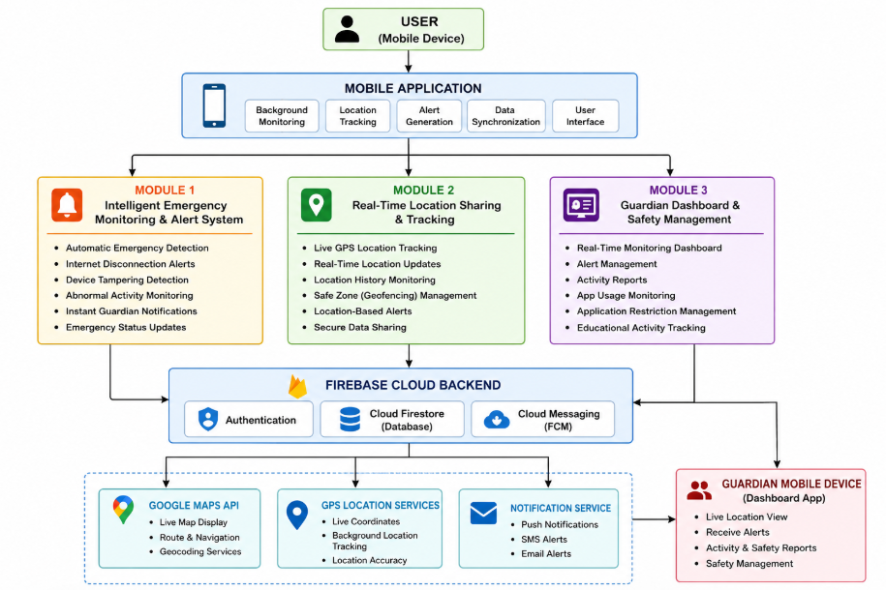
ARCHITECTURE DIAGRAM

Slide 8
MODULE DESCRIPTION
Intelligent Emergency Monitoring
Real-Time Location Sharing
01
02
Guardian Dashboard
03

Slide 9
Module 1-Intelligent Emergency Monitoring
Features:
Automatic Emergency Detection
Internet Disconnection Alerts
Abnormal Activity Monitoring
Instant Guardian Notifications
Emergency Updates
Additional monitoring features

Slide 10
Module 2-Real-Time Location Sharing
Features:
Live GPS Tracking
Real-Time Location Updates
Location History
Geofencing (Safe Zones)
Location-Based Alerts
Secure Location Sharing

Slide 11
Module 3-Guardian Dashboard
Features:
Real-Time Monitoring
Alert Management
Activity Reports
App Usage Monitoring
Application Restriction
Educational Activity Tracking

Slide 12
CONCLUSION
Enhances personal safety through automation.
Detects emergencies without manual action.
Shares live location instantly.
Supports faster response and better safety management.
Reliable solution for modern personal security.

Slide 13
FUTURE SCOPE
AI-Based Emergency Detection: Use machine learning to identify accidents, abnormal movements, or distress situations more accurately.
Wearable Device Integration: Connect with smartwatches and fitness bands to monitor heart rate, fall detection, and health conditions.
Voice-Activated Emergency Assistance: Enable hands-free emergency alerts through voice commands.
Offline Emergency Alerts: Send SOS messages via SMS when internet connectivity is unavailable.

Slide 14
REFERENCES
Gowda, D. V., et al. (2023). Development of a Real-Time Location Monitoring App with Emergency Alert Features for Android Devices. Alliance University.
Banerjee, S., Maiti, P., & Biswas, S. (2024). Empowering Personal Safety Through Mobile Apps. ResearchGate.
Bowen-Forbes, C., et al. (2024). Mobile Apps for the Personal Safety of At-Risk Children and Youth: A Scoping Review. Journal of Medical Internet Research (JMIR).
Mowbray, F., et al. (2024). A Systematic Review of Mobile Alerting During Emergencies. Wiley Online Library.
Nerkar, H., et al. (2024). Review on Safe Route Recommendation System. International Journal of Scientific Research and Development (IJSRD).

Slide 15
THANKYOU

